Slide 1

Assessing The Earth Sustainability Integrative Liberal Education Project: a General Education Model that Promotes Cognitive and Social Development
Barbara Bekken, Director, ES LibEd Program and Geosciences, VT

Slide 2
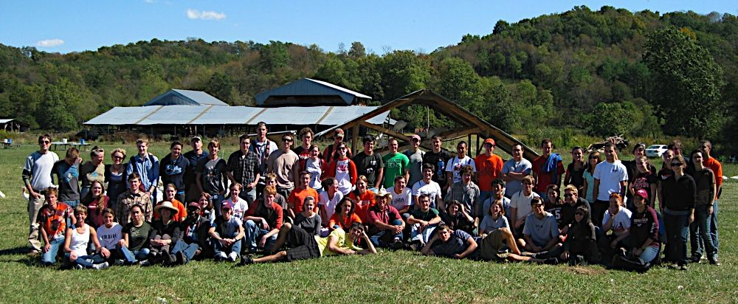
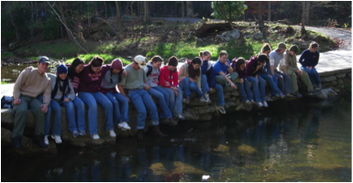
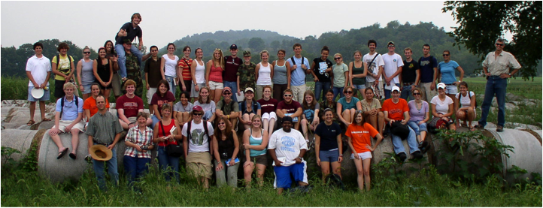
The Earth Sustainability Liberal Education Program at Virginia Tech: 2004-2010
Cohort 3
Cohort 1
Cohort 2

Slide 3
EARth Sustainability Curricular Model

Slide 4
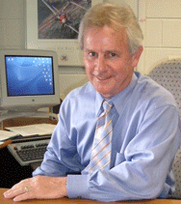

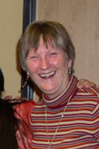
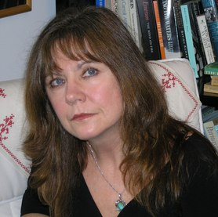


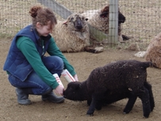
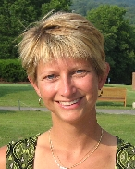

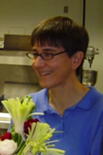
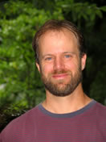
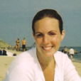
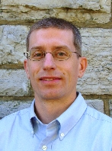
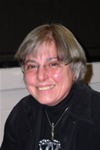

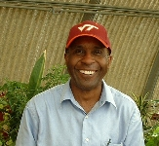
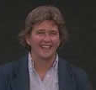
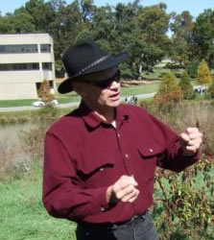


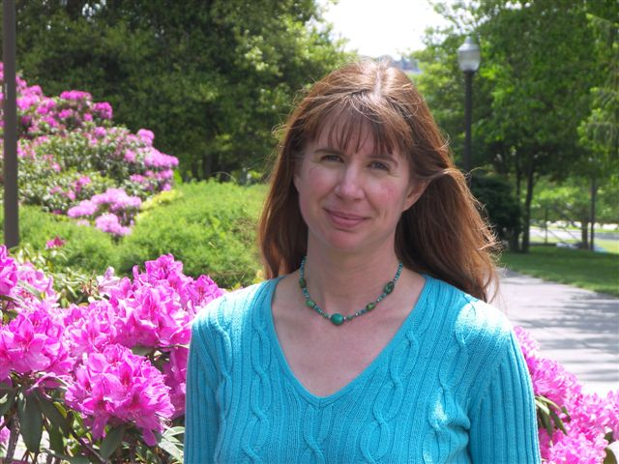
ES: A multi-disciplinary collaboration of faculty
Participation: Over 100 faculty and professional guest lecturers
Pedagogical guidance: Shelli Fowler Terry Wildman Marcia Baxter Magolda
Assessment design: Deborah Olsen Kate Drezek McConnell Chuck Walter
Financial support :
Teaching & Learning Provost’s Office NSF

Slide 5
ES program history and “specs”
Design phase (2003-2004): 14 faculty/4 colleges
Pilot phase /cohort 1 (2004-2006)
  7 faculty/4 colleges (CoS, CLAHS, CNR, CALS, CAUS)
  23 students entered, 19 completed (83% in-series retention rate)
  21 graduated, the remaining 2 will graduate this spring (100%)
  100% graduation rate compared to 78% for this class of graduates at VT
Expansion phase/cohort 2 (2006-2008)
  10 faculty/5 colleges (CoS, CLAHS, CNR, CALS, CAUS, CoE)
  67 students entered, 48 completed (72% in-series retention rate)
  60 of original 67 are still enrolled at VT and on-track to graduate
  90% senior retention rate compared to 83% for VT seniors
Integration phase/cohort 3 (2008-2010)
  10 faculty/5 colleges (all undergraduate colleges represented)
  121 students entered, 84 retained (69% in-series retention rate)
  118 of original 121 are still enrolled at VT
  98% sophomore retention rate compared to 90% for VT sophomores

Slide 6
ES STRUCTURE
By semester
 | Semester 1 | Semester 2 | Semester 3 | Semester 4
Cohort 1 2004-2006 | 3 credits of ES plus 3 credits of ENGL 1105 | 3 credits of ES plus 3 credits of ENGL 1106 | 4 credits of ES | 4 credits of ES
Cohort 2 2006-2008 | 4 credits of ES plus 3 credits of COMM 1015 | 4 credits of ES plus 3 credits of COMM 1016 | 4 credits of ES | 4 credits of ES
Cohort 3 2008-2010 | 5 credits of ES plus 3 credits of writing & discourse | 5 credits of ES plus 3 credits of writing & discourse | 5 credits of ES | 5 credits of ES
By week
 | Monday | Tuesday | Wednesday | Thursday | Friday
12:30 to 1:45 |  | Large-group Lecture |  | Large-group Lecture | Alternate Friday Lab & Workshop
2:00 to 3:15 |  | Discussion |  | Discussion
3:30 to 4:45 |  | Discussion |  | Discussion
5:00 to 6:15 |  | Discussion |  | Discussion

Slide 7
Scaffolding Example: Facilitated discussion
There is always a teacher in the classroom
 | Instructor facilitation of discussion | Student facilitation of discussion
Semester 1 | Prepares reading prompts, incorporates skill-building activities, relates content to reading/current events, guides self-evaluations, creates question pool and quizzes, evaluates participation | Group prepares participation guidelines, student pairs facilitate discussion using lecture note-cards
Semester 2 | Supports student-led facilitation, models information searching during discussion, incorporates skill-building activities, evaluates prompts, participation and question pool | Five student pairs prepare prompts, facilitate discussion of lecture and readings, identify current events, summarize key points, create questions from summary for question pool
Semester 3 | Facilitates discussion synthesis, incorporates skill-building activities, evaluates participation | Student pair facilitates managed discussion using reading prompts, summarizes key points, identifies current events, posts to blog, summarizes discussion and posts questions for pool
Semester 4 | Facilitates synthesis discussion, evaluates participation | Student pair facilitates managed discussion of readings, summarizes key points, identifies current event, posts to blog, summarizes/synthesizes discussion, posts questions for pool, self-evaluates

Slide 8
Use content to teach learning skills
Skill (writing), Learning Skill (Knowing), Content (Topical)
Example: Writing genre | ES1: Worldviews and Water | ES2: Energy and Shelter | ES3: Food and Agriculture | ES4: Waste, Health, Pathways
Genres/Knowing & Knowledge | Complexity of issues | Assumptions & arguments made | Connections between disciplines | Empowerment to action
Personal Essay | x |  | x
Analysis | x
Descriptive Analysis |  | x |  | x
Synthesis |  | x | x | x
Annotated Bibliography | x | x | x | x
STEM Lab or Field Report | x x | x
STEM Research Report/Proposal |  |  | x | x x
Position Paper |  |  | x | x
Editorial |  |  |  | x
Reflection | x | x | x x | x x

Slide 9
Assessing Learning Outcomes
Program assessment is educational research
  Get acquainted with educational researchers
  Learn how they do what they do
  Identify educational researchers interested in your program
  Commit to mutually beneficial outcomes (e.g., publications, grant proposals, etc.)
Find a collaborator who knows what they are doing
  Identify a problem
  Mutually develop clear program goals
  Develop a curricular plan to meet those goals
  Design an assessment to evaluate outcomes relative to goals
    Program/course delivery (e.g., Did the intervention address the goals?)
    Student learning outcomes (e.g., How did the students change?)
    Faculty development (e.g., How did the faculty change?)
Commit human resources to data collection and analysis

Slide 10
Identify A Problem

Slide 11

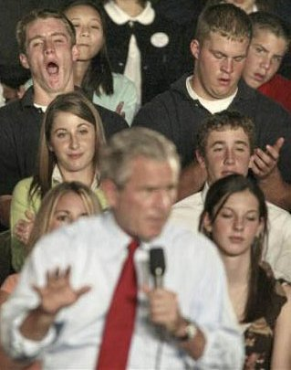


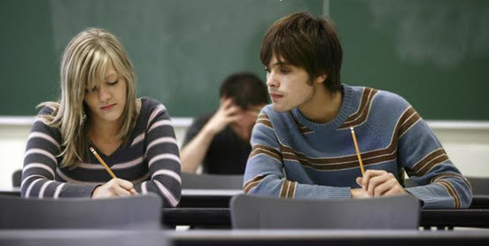
STEM General Education courses, even on “hot Topics,” are not engaging students effectively
Unmotivated
Bored
Disengaged
Distracted
Unoriginal work
What do we want?
Engaged learners who are willing and excited to learn
Motivated learners who take agency for their learning
Confident, self-efficacious learners open to new/novel ideas
Self-regulatory learners who focus on mastery over grades
These attributes are characteristic of developmentally sophisticated learners and knowers

Slide 12
Develop clear Program Goals

Slide 13
Goal: Create a Gen-Ed experience that stimulates Cognitive & Social development While engaging students in STEm
Objective 1: Create a STEM-saturated interdisciplinary and integrative program in general education focused on the challenges of sustaining Earth’s resources
Objective 2: Design the program to advance students’ cognitive and social development (Baxter Magolda LPM model)
Objective 3: Support faculty as they developed more learner-centered instructional approaches
How? Educational researchers involved at all stages
  Marcia Baxter Magolda—Professor of educational leadership
  Deborah Olsen—Co-PI, Past Director of IR, Higher Ed, Ed Psych faculty
  Kathryn Drezek McConnell—Ed psych grad student, LibEd assessment
  Terry Wildman—Director, undergraduate T&L center
  Shelli Fowler—Director, graduate education development program

Slide 14
Develop curricular model to meet Program Goals

Slide 15
Based on LPM, “BEST PRACTICES” Instruction supports more sophisticated Cognitive/social devel. positions
Integration—Opportunities to integrate knowledge/knowing across cultures, communities, ages, professions, disciplines
Interdisciplinary—Investigate the ontological/methodological frameworks of several disciplines
Relevant—Examine of controversial and complex issues
Challenging—Examine authors’ and students’ assumptions and arguments about knowledge and disciplinary knowing
Learning-centered—Instructors and students explore the nature and creation of knowledge
Active Inquiry—Gather and evaluate information/data
Collaborative—Group discussion that includes analysis of ill-structured problems both in and out of classroom settings
Problem-focused/Case-based—Relevant & focused cases as models
Constructive Feedback—Support on both a cognitive and emotional level including respect for students’ assumptions

Slide 16
The Essential Learning Outcomes
AACU Values Rubrics
  Civic Engagement Lifelong Learning
  Creative Thinking Oral Communication
  Critical Thinking Problem-solving
  Ethical Reasoning Quantitative Literacy
  Information Literacy Reading
  Inquiry & Analysis Teamwork
  Integrative Learning Written Communication
  Intercultural Knowledge
We accepted that it is our job to teach to these outcomes

Slide 17
Develop an assessment Plan

Slide 18
Plan for evaluating Program outcomes
  Longitudinally over three cohorts
  Course delivery
    LPM—Baxter Magolda as evaluator
    Constructivist learning environment (CLES)
  Student learning (ES and Control)
    Epistemology (MER)
    Learning beliefs (EQ)
    Motivation (MSLQ)
    Critical thinking (CCT)
    Information literacy (JMU)
    Quantitative reasoning (JMU)
    Communication skills, integrative thinking
    Nature of science interview (Smith and Wenk)
  Faculty development
    Interviews and written reflections
    Classroom observations

Slide 19
Coordinate measures with objectives
Objective | Measures
Deliver a program to promote C&S development according to LPM model | External evaluators, reflections, exit interviews, NSSE (quant), CLES (quant)—3x
Stimulate social/cognitive development in students over time | MER (qual)—3x, EQ (quant)—3x, SAQ (quant-failed)
Stimulate STEM epistemological development over time | NoS survey (qual)—2x, student reflections—4x, exit interviews
Increase student motivation for learning | MSLQ (quant)—3x, exit interviews
Increase critical thinking skills | Cornell CT test—2x, course materials
Increase quantitative reasoning skills | JMU quant reasoning test—2x (failed)
Increase information literacy skills | JMU information literacy test—2x (failed)
Lesson learned: Be strategic when offering or repeating measures
Mixed methods provide fuller picture
Longitudinal studies require three collection periods separated in time
Redundancy is important but students do experience survey burn-out
Measures do get lost; surveys do not always converge when “n” is small

Slide 20
Commit human resources to assessment and evaluation

Slide 21
Educational researchers and social scientists involved at all stages of assessment
Collaborators
  Marcia Baxter Magolda—Professor of educational leadership
  Deborah Olsen—IR, Higher Ed, Ed Psych, consultant
  Kathryn Drezek McConnell—Center for Assessment
  Terry Wildman—Director, undergraduate teaching center
  Shelli Fowler—Director, graduate teaching program
  Chuck Walter—Sociologist

Slide 22
A few Outcomes described (2004-2010)

Slide 23
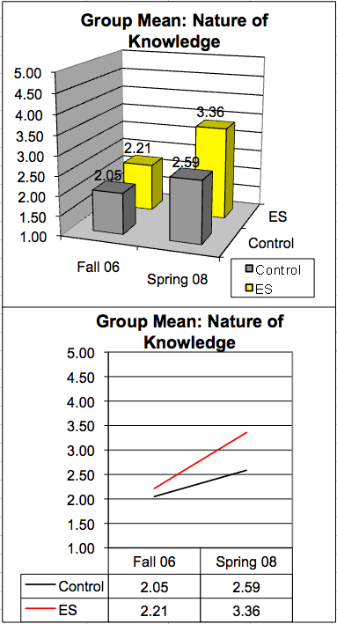
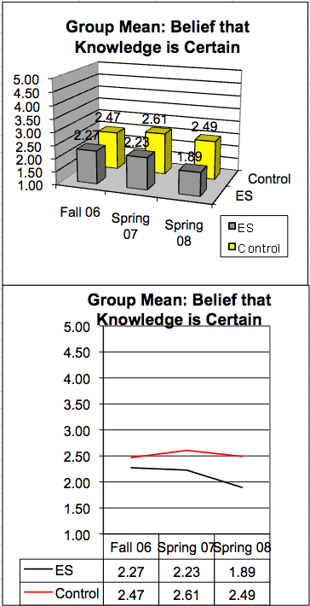
Epistemological beliefs (EQ and MER)
EQ: ES students were less likely to be confused by unstructured knowledge or to hold naïve beliefs about the certainty of knowledge.
MER: After two years, ES students held more sophisticated conceptions of the nature of knowledge than non-ES students.

Slide 24
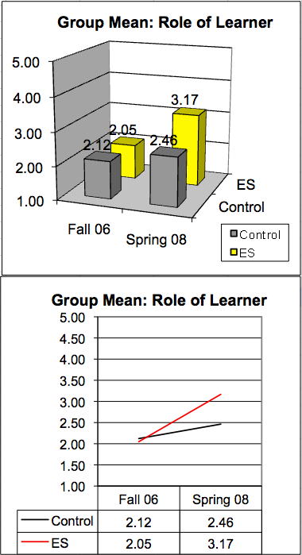
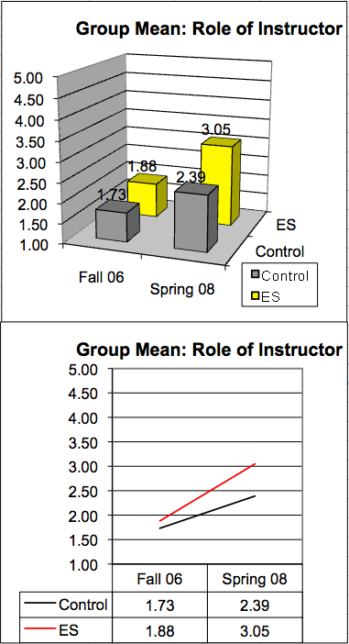
Learning Beliefs (EQ And MER)
ES students:
  Were more likely believe that they could produce a desired learning result
  Held more mature beliefs about learning with peers
  Relied less on the instructor to make their learning “happen”
  Were less likely to believe that “learning is quick” than non-ES students

Slide 25
Student Epistemological Development measured using Baxter Magolda’s (1992) open-ended MER
Cohort 1
ES (n=19) and CLE (n=12)
Cohort 2
ES (n=48) and CLE (n=34)

Slide 26
Intrinsic Motivation (MSLQ)
Although students in the ES group entered the program with higher intrinsic goal orientation on average, over time intrinsic goal orientation grew in comparison to non-ES students, even while holding constant students' epistemic beliefs.
Participating in the ES program had a positive and direct effect on students' intrinsic motivation to learn.

Slide 27
Learning Strategies (MSLQ): Elaboration, rehearsal, critical thinking, Peer learning
ES students in blue; control students in pink

Slide 28
Effect of Epistemology and Motivation on Learning strategies
Students who perceive knowledge as certain (an epistemic belief) are less likely to engage in effort regulation/metacognitive self-regulation.
Finding: Epistemological beliefs directly affect learning strategies.
Students who are more intrinsically motivated are more likely to use learning strategies for elaboration, critical thinking and meta-cognitive self-regulation.
Finding: Intrinsic motivation also directly affects learning strategies.
At the outset of the program, ES students were less likely than comparison students to use the learning strategy rehearsal; however, over the two-year program of study, they became more likely to use rehearsal as a learning strategy.

Slide 29
HLM of longitudinal data from cohort 2 suggests this preliminary learning model
The ES intervention affects epistemic beliefs and motivation.
Epistemic beliefs positively affect learning beliefs and intrinsic motivation.
Motivation and learning beliefs positively affect learning strategies such as rehearsal, elaboration, effort regulation, critical thinking, and metacognitive self-regulation.
Intrinsic Motivation
Earth
Sustainability
Program
Epistemic Beliefs
Learning Strategies
Learning Beliefs

Slide 30
If Integrative learning stimulates Epistemological development;
What Activities are
Integrative?

Slide 31
Prompt: Which course materials were most effective in your learning? (n=48)
 | Cohort 2--most effective | Cohort 2--least effective
Readings | 14 | 18
Projects | 18 | 5
Action Project | 9 | 1
SLV Project | 5 | 1
Lecture/Disc | 4 | 1
Papers | 15 | 3
Labs | 8 | 3
Yogurt Lab | 0 | 5
Exams | 9 | 4
Nothing listed | 0 | 7

Slide 32
Unsolicited explanations for why a particular pedagogy “worked”
 | Cohort 2
Sense of autonomy, agency, or motivation to undertake an academic task | 8
Encouraged creativity | 3
Actively engaged (discover, hands-on, apply, analyze, problem-solve) | 15
Made connections (synthesize, think critically, think deeply, reflect) | 9
Skill development or concept transfer | 4
Content relevance | 7
Opportunity to collaborate on an academic task | 2
Have fun/be entertained | 2
No outcome described | 6

Slide 33
Using “Higher order” thinking was evident in more than 75% of the responses
I think the most effective materials were the projects because they truly allowed you to apply your knowledge from class to a real issue.
The papers and essay tests are what stand out because I was able to synthesize the information in the lectures and readings and make my own connections on the issue.
The Action Projects were outstanding and proved to me that I could really make a difference in the world within my community.
Claim: INTERDISCIPLINARY PROJECTS THAT REQUIRE HIGHER ORDER THINKING SKILLS CHALLENGE STUDENTS TO ADDRESS NAÏVE OR SIMPLISTIC BELIEFS ABOUT KNOWLEDGE AND KNOWING

Slide 34
Bottom line FROM THE ES PROJECT
Teaching to support greater epistemological sophistication is important
Epistemological growth complements intrinsic motivation and supports learning strategy development (rehearsal, elaboration, effort regulation, critical thinking, and metacognitive self-regulation)
“Best practices” combined with an interdisciplinary, integrative learning environment support epistemological growth
Learning community support and self-reflection are crucial to growth
These findings are significant because they underscore the value of instructional pedagogies that advance epistemic beliefs, learning beliefs, and intrinsic motivation.
LEARNING IS MUCH MORE THAN STEM CONTENT OR PROCESS
Claim: Without attending to the antecedent intellectual and social development of undergraduates, higher order STEM learning and literacy will likely not be achieved.

Slide 35
Interdisciplinary experiences are key to Engaging students in their learning
  “Answers start jumping off the page that wouldn't have even normally been conceived, problems stop looking so daunting because you have already solved half of it in some other area. Interdisciplinary studies are one of the most powerful tools a person could have to ensure a comprehensive, close to absolutely true, learning experience.”

Slide 36
Building integrative thinking:
Addressing complexity
ES1—Worldviews and Water: The world is complex
  What is Sustainability (Personal Essay)? Define the concept of “sustainability.” Q. What does it mean to “be sustainable.” What is it that should be sustained? Who should do the sustaining? Who is responsible for making these decisions about what should be sustained and who should do it? Who or what should benefit from this process? Who or what will lose in this process?
  Changes in Consumption and Affluence in Two Generations (Social Science Investigation and Report). Q. How have consumptive habits changed over the past two generations for the families and friends of students enrolled in Earth Sustainability? Find out by collecting, pooling, evaluating, and reporting on changes in consumptive patterns. Compare these findings to those of another group.

Slide 37
Building integrative thinking:
Addressing complexity
ES1—Worldviews and Water: The world is complex
  Envisioning the Future (Analysis Paper). Q. What kind of future do you want? What kind of future do you think is most likely? What assumptions do you make about the role of technology in achieving these futures?
  Evaluating Stormwater Management (Field Study and Scientific Report). Q. How effective are the ponds on campus in protecting Stroubles Creek from further degradation? How do you know?
  Taking an Informed Position: Should I drink tap or bottled water? (Annotated Bibliography and Oral Presentation). Q. How do we find information about something so basic to our lives? What kinds of evidence would we look for? Can you find the evidence and assess its reliability?

Slide 38
Building integrative thinking:
Recognizing Assumptions & arguments
ES2—Energy and Shelter: Everything has a bias
  Residential Carbon Footprint (Life Cycle Analysis and Report). Q. How “green” is your residence? Using a life cycle approach, how much CO2 does your family’s residence add to the atmosphere in a calendar year? What recommendations can you make to lower your footprint?
  The Climate Change Debate (Annotated Bibliography and Debate). Q. What are the assumptions and arguments made by groups who adhere to different worldviews about climate change? How valid are these assumptions and arguments? Can you debate an assertion by supporting it with compelling evidence from multiple perspectives?

Slide 39
Building integrative thinking:
Recognizing Assumptions & Arguments
ES2—Energy and Shelter: Everything has a bias
  The Most Beautiful House in the World (Poster Presentation and Descriptive Analysis Paper). Q. What would the most beautiful house in the world be? Who would live there? Where would it be located? Would it be aesthetically pleasing, environmentally sensitive, designed and constructed with local or sustainable materials? Would it be energy efficient?
  When Will Oil Production Peak? (Synthesis Paper) Q. When will oil production peak? Analysts vary from “it has already peaked” to “not until 2050.” Why is there such a range in numbers? Do the various authors’ assumptions and arguments differ? Do they use different sources of evidence? Based on the authors’ assumptions, evidence, and arguments, when do you think oil peaked or will peak?

Slide 40
Building integrative thinking:
Making Connections
ES3—Agriculture and Food: Everything is connected
  Don’t Treat Soil Like Dirt (Synthesis Report). Q. Why be concerned about soil? Who, other than farmers, benefits from a healthy soil? How important is it to adopt sustainable land management practices if all you own is a half acre lot in a suburb?
  From Farm Gate to Plate: Life Cycle Analysis of a Modern Meal (Life-cycle Concept Map and PowerPoint Presentation). Q. What are the material and energy inputs and outputs of foods in a typical modern meal? How can you calculate embodied energy? How can you use this information to make more energy and materials efficient choices?

Slide 41
Building integrative thinking:
Making Connections
ES3—Agriculture and Food: Everything is connected
  I Am What I Eat (Essay and Poetry). Q. Using food preparation and consumption as the conceptual vehicle, what are your family’s traditions, history, stories, and sense of place? Using a family recipe and a photo, what imagery and emotions about food and family can you capture through poetry?
  Culinary Showcase (Food Narrative, Prepared Food, and Peer Evaluation). Q. Why is the food you chose to prepare personally and culturally significant? What are its environmental impacts?
  ESers In Action (Project Description, Pre-Proposal). Q. What can you do to take action on what you have learned? What kind of action will contribute to making your community more sustainable?

Slide 42
Building integrative thinking:
Empowering responsible Action
ES4—Waste, Health, and Pathways: Walking the Walk
  ESers In Action (Project Proposal, Action, PSA Podcast, Drillfield Poster, Self-published Report).
  Living Downstream (Annotated Bibliography and Literature Review Report). Q. What chemical contaminant worries you? How can you find up-to-date and reliable information on the hazards of this contaminant? How can you make sense of what you find?
  Art, Science, and Creativity (Synthesis Essay). Q. What are the traits of the creative thinking process? How can you apply these toward solving an environmental issue?
  Personal Pathways (Oral Presentation and Reflection Essay). Q. How has your worldview evolved over the past two years? How have your actions changed? How will you continue to use what you have learned in ES to contribute to a more sustainable future?

Slide 43
Integrative Reflection Prompts following First Semester
Task (4x): After rereading the guidelines, reread your paper. Imagine that you received this assignment today. Would you produce the same general product? If so, how would you augment and improve it? If not, how has your thinking changed from how you thought when you wrote it?
Journal: Describe at least two events that occurred this semester (they may or may not be associated with this class) that have significantly shaped, guided, or influenced your first-term learning experience at Virginia Tech.

Slide 44
Integrative Reflection Prompts following Second Semester
Task (3x): After rereading the guidelines, reread your paper. Imagine that you received this assignment today. Would you produce the same general product? If so, how would you augment and improve it? If not, how has your thinking changed from how you thought when you wrote it?
Task: After rereading the guidelines, think about your participation as a facilitator. How could you more effectively engage your peers in discussions that critically evaluate and expand upon the assumptions, evidence, and arguments presented by guest speakers or in selected readings?
Journal: Describe at least two events that occurred this semester (they may or may not be associated with this class) that shaped, guided, or influenced your first semester at Virginia Tech significantly.

Slide 45
Integrative Reflection Prompts following Third Semester
Task: Based on at least two lines of evidence taken directly from your projects this term, describe in 500 words or fewer how you are an influential member of a food and agricultural system.
Task: Using your responses to the three in-class surveys, describe in 500 words or fewer any changes in growing, buying, cooking, or eating foods that you have made over the course of the term.
Task: Using information and ideas you have learned this semester, write a ‘Letter to the Editor’ that is appropriate for the Collegiate Times or Roanoke Times. Pick a topic that interests you and construct a persuasive, evidence-based argument to folks in the Blacksburg and/or VT community.
Journal: Describe at least two events that occurred this semester (they may or may not be associated with this class) that shaped, guided, or influenced your first year at Virginia Tech significantly.

Slide 46
Integrative Reflection Prompts following Fourth Semester
Task: Thinking Quantitatively. Choose three of the “Ten Habits of Thinking Quantitatively” that you have experienced as important tools for either understanding concepts of sustainability or for addressing complex problems in sustainability. For each tool, upload an example of how you have used it to address a complex problem or shape your worldview.
Task: Communicating Effectively. List and describe three ways that ES has helped you develop as a communicator.
Task: Using information responsibly. Using examples, describe how ES has supported you in learning how to: 1) search for, locate, and access information, 2) evaluate the perspective and relevancy of the information to your project, and 3) use information effectively, ethically, and legally.
Journal: Describe how ES has helped you integrate learning not only across disciplinary boundaries, but across your life.
  Applied your academic knowledge gained in ES to some other experience
  Made connections between or across disciplines
  Transferred and applied skills, abilities, theories, or methods learned in ES to a new and novel situation separate from ES.

Slide 47
What is Personal Epistemology and why care about it?

Slide 48
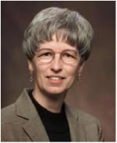




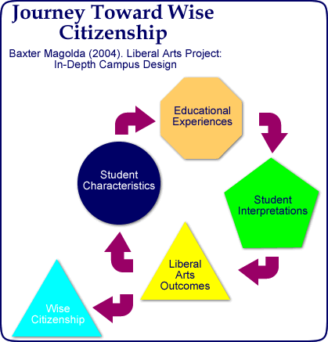
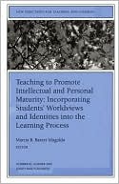

Marcia Baxter Magolda’s Self-authorship theory & Learning Partnerships Model for Cognitive/social development
Distinguished Professor of Educational Leadership at Miami of Ohio

Slide 49
What is personal epistemology?
See: Hofer and Pintrich, 2002, Personal Epistemology
Epistemology (philosophy)—origin, nature, limits, methods, and justification of human knowledge
  What is knowledge?
  How is knowledge acquired?
  To what extent is it possible for a given subject or entity to be known?
  How do we know what we know?
Personal epistemology—individual beliefs about epistemology
  What are the beliefs I hold about knowledge and knowing?
  How do I judge new information?
  How do I evaluate new information sources?
  “The adequacy of our epistemological theories will in some way determine what and how we make meaning of the information we encounter…..we need a better understanding of personal epistemology and its relation to learning.” (Hofer, 2002, p. 3)

Slide 50
What is epistemological development?
The change/shift in an individual’s personal epistemology
Several conceptual models (Piaget, 1950)
  Developmental models (Perry, 1970)—systematic progression, more stable across disciplines
  Belief model (Schommer, 1990)—system of quasi-independent beliefs, trait-like
  Personal theory model (Hofer and Pintrich, 1997)—epistemology as a dimension within a broader conception of personal theories
  Epistemological resource model (Hammer and Elby, 2002)— different epistemological positions based on discipline or context
Empirical evidence suggests that epistemological views:
  Are “coherently organized”; consistent patterns emerge
  Vary over lifespan
  Vary depending on context/discipline

Slide 51
Why care about students’ personal epistemologies?
Beliefs about knowledge and knowing:
  affect knowledge acquisition and construction process
  are critical component to understanding how students learn
“Our “educated citizenry” may in fact be largely composed of individuals who view the world from a position of absolutism, or who simply accept a multiplicity of opinions about complex issues, seeing no need to support positions with evidence. Such individuals might not only lack the skills to solve ill-structured problems.., but may also lack the motivation to do so. Education that focuses on the progression of epistemological thinking has the potential for addressing this critical need.” (Hofer, 2001)
For an excellent review, see Hofer, B. K. (2001). Personal epistemology research: Implications for learning and teaching. Journal of Educational Psychology Review, 13(4), 353-383.

Slide 52
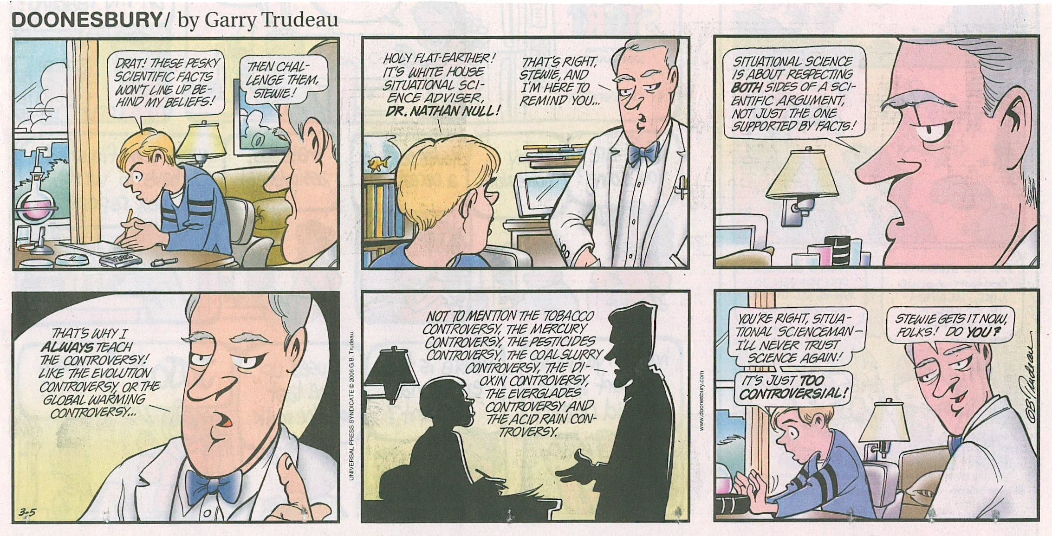
Why care about students’ personal epistemologies?
Kegan (1996) estimates that up to 60% of the adult US population is relativistic in their thinking

Slide 53
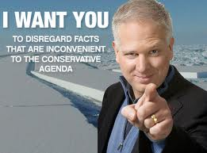
Why teach to epistemological change?
Our classrooms are the best place for students to practice articulating, defending, re-examining, and claiming a point of view
Our classrooms can provide a supportive community in which students can model expertise using sound disciplinary thinking
Modeling sound thinking over several disciplines, students develop more sophisticated epistemological beliefs about the nature of knowledge and knowing
Even if a student forgets specific course content, they will likely not “forget” more sophisticated ways of making sense of the world

Slide 54
If developing or adopting more sophisticated epistemological beliefs or positions is important, why aren’t we already teaching to support it?
“Although there is increasing attention to both theory building and empirical investigations in the realm of personal epistemology, this work has not reached as wide an audience as it may deserve, has yet to be acknowledged as a component of either educational psychology or cognitive development, and is not typically part of a teacher preparation curriculum in spite of growing evidence of its importance.”
(Hofer, 2001)

Slide 55
Assessing Epistemology is tough!
Quantitative instruments do not converge well
Qualitative measures are time-consuming to code
Success with embedding prompts into journal or reflection assignments
Need to familiarize instructional faculty with
  The importance of developing epistemic awareness
  The characteristics of each position (through rubrics)
  Provide examples of student responses
Activity: Prompts, Rubric, & Examples

Slide 56
Modified from Baxter Magolda’s (1992) Epistemological Reflection Model
Absolute—Knowledge is objective, certain, and knowable. It is “out there”, written in books. Authorities create new knowledge; this replaces old knowledge. I go to an authority to find out what I need to know.
Transitional to Independent—In some subjects, knowledge is certain but in others, it is more subjective. There seem to be multiple truths. Authorities don’t always agree. It is hard to know how to make sense of some of them.
Independent—Knowledge is subjective. There are multiple truths. I am the author of my opinions; all opinions are valid. Authorities select the opinion that makes most sense to them, as do I. I seek evidence that supports my position.
Transitional to Contextual—Knowledge is subjective but some truths are more compelling than others. Sound evidence trumps skillful but empty rhetoric.
Contextual—Knowledge is subjective and chronicles a changing landscape of human activity. As a knower, I have the tools to weigh arguments, to appreciate and value multiples lines of evidence, and to shift my position as new lines of evidence emerge. Because my position is evidence-based, I am motivated to seek information. As author of what I know, information is fuel for my mind.

Slide 57
What is my role as a learner?
I learn best in classes that focus on factual information. There is a clear line between right and wrong in these classes.
Everything is biased. The way you take bias is what forms you as an individual. It's impossible not to be influenced, so you must let yourself be influenced by the right people.
I use my own judgment, what I have learned from my classes, and the opinions of both sides to determine what I believe.
I am active in discussion, which requires that I read. It keeps me informed about global issues providing a wider context.
I would deconstruct their argument. Find out what their assumptions are and how they differ… find outside information to supplement my decision of who, if either, I agree with. I can be more sure, but never absolutely sure.

Slide 58
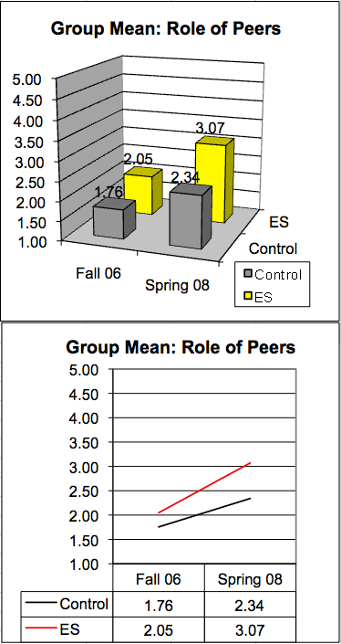
What is the role of my peers in my learning?
I don't actually like it when students talk very much, because usually their questions don't really add anything to the lecture.
I prefer to ask questions and benefit from other students asking questions. Hearing different opinions and viewpoints is certainly an advantage.
Everyone understands things differently; sometimes you learn more from other students than professors.
My peers help(ed) me with my German, constantly teaching me and learning from me. I played the student and the teacher. … we were encouraged to help our peers with their learning of the German language.
I found myself talking with friends about concepts in the text. I had conversations about the meaning of economy, self-sufficiency, and perceived vs. real needs. Talking helped me formulate my ideas.

Slide 59
What is my instructor’s role?
I like to be taught by the professor for he knows the material best and makes the exams. You are always told to listen to your elders because they are wiser;, who am I to question the professor?
I work well with professors that know my name and are willing to chat. I learn well one-on-one because I can ask as many questions as I like.
It's all relative. We learn things in different ways and have different beliefs. Obviously in some subjects, there is a fair amount of certainty, while in others there's much room for debate. The professor might not even necessarily believe what he or she is teaching, but rather is giving a different perspective.
The instructor should play devil's advocate and the students could defend the opposite view. This forces students to think analytically so they can gain a bigger view on the situation.
His teaching method does not challenge me which is unfortunate because theory is very complex. These methods motivate me to teach myself; luckily the textbooks are adequate and fairly in-depth so I do a lot of independent reading.

Slide 60
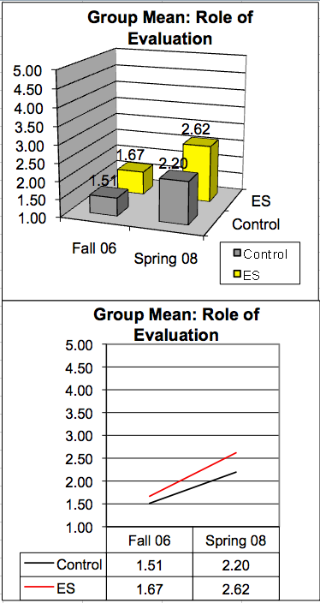
What is the role of evaluation in learning?
Ideally I wish I had a camera that followed me to show the professor how hard I try because I am not the best test taker so if I get a bad grade I don't want people to think I just didn't study.
I think that ideally you should be graded on your effort because … if you're working really hard and just have a hard time understanding the subject, that isn't really your fault.
I appreciate when teachers allow for student-graded assignments. I don't see this as a reason to lie, but instead I see it as a relationship with my professor representing mutual trust.
Grades should be a measure of progress. It would be great if every student could be interviewed so that they could demonstrate their knowledge and application beyond the classroom.
The student and the teacher should jointly evaluate the work/performance together. Evaluation should focus on mastery and the student should self-evaluate his/her work.

Slide 61
What is the nature of knowledge?
…if all evidence supports one point of view, then one can be sure that their belief is correct.
When I came here I loved learning about factual information but the courses I took this semester dove into very thought-provoking concepts and ideas that greatly appealed to me.
There are many theories or explanations that satisfy different people. Find the one that satisfies you.
If enough peer-reviewed articles and respected scholars say something is so, its probably safe to agree. However, I understand that sometimes even the really, really, really smart people of the world can be wrong - and lots of them can be wrong together. It's important to question everything, but it is necessary to believe in something once in a while.
… with historical events or scientific phenomena…I would not discount either account but rather would embrace both, weigh the explanations, and decide for myself while remaining open to revision by new evidence.

Slide 62
Is knowledge fixed and certain?
Likert scale: disagree (1) to agree (5)
Questions posed so that more develop-mentally advanced score lower
Being a good student generally involves memorizing facts
Most words have one clear meaning
When I study, I look for the specific facts
If professors would stick more to the facts and do less theorizing, one could get more out of college
It's a waste of time to work on problems which have no possibility of coming out with a clear-cut and unambiguous answer

Slide 63
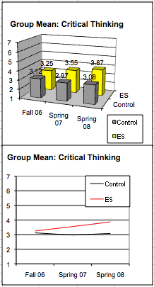
Critical thinking
Evaluates students’ ability to:
1) apply previous knowledge to new and novel situations or
2) make critical evaluations of ideas

