Slide 1

An Outsider Looks at Geoscience: Methods, Content, Pedagogy, and Partnerships
Pinky Nelson
Western Washington University
June 27, 2012

Slide 2
Disclaimer:
Important topics that I am ignoring
Recruiting and preparing geoscience majors
What to do with/about large classes
Cool Geoscience activities: field vs. classroom
The siren song of Integrated Curriculum
Taking astrophysics out of the K-12 core curriculum to make room for geoscience

Slide 3
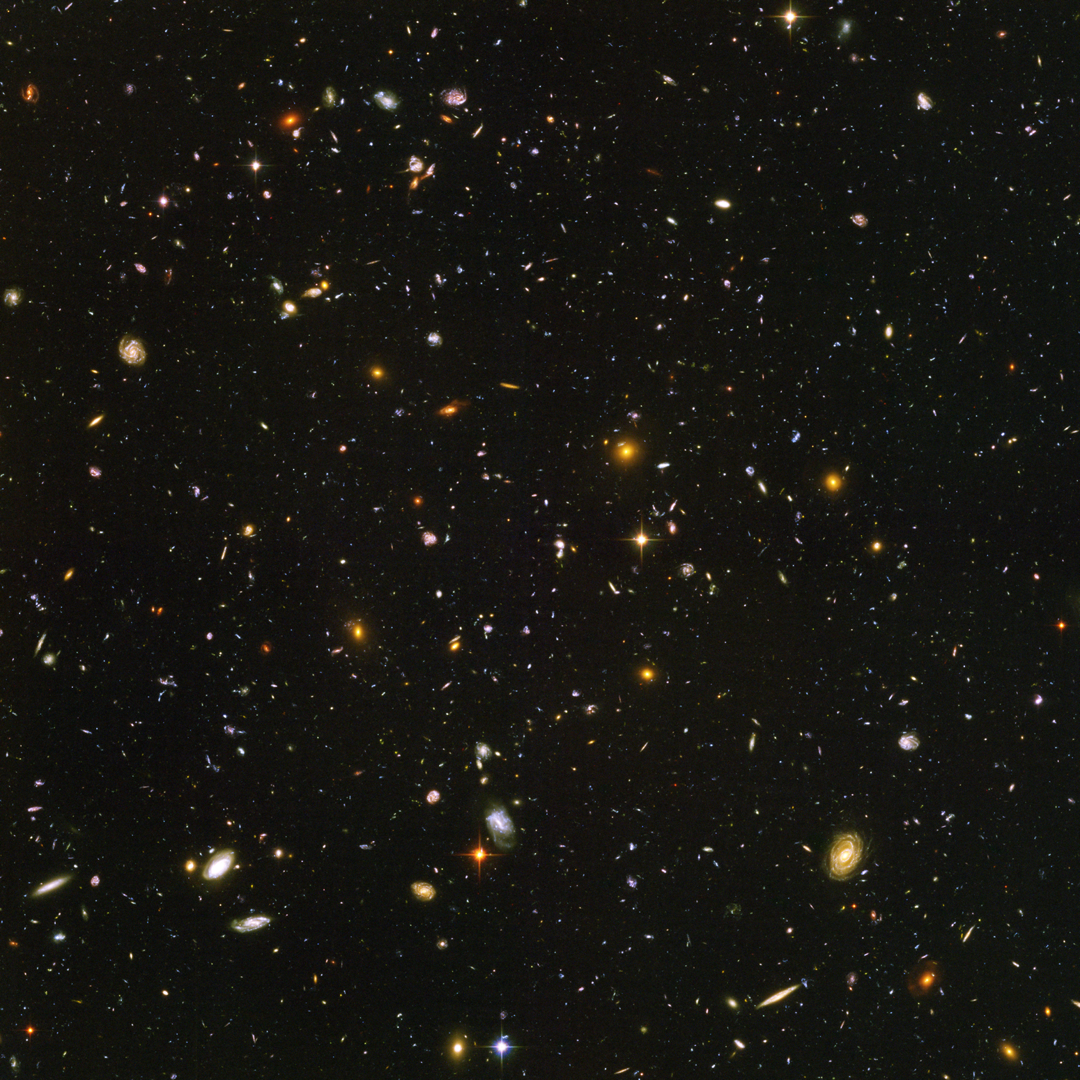

Slide 4

Methods

Slide 5
School Scientific Method (Prentice Hall Exploring Earth Science)
1. Stating the problem
2. Gathering information on the problem
3. Forming a hypothesis
4. Performing experiments to test the hypothesis
5. Recording and analyzing data
6. Stating a conclusion
7. Repeating the work

Slide 8
Scientific Methods
(Order of steps is not absolute)
Quadrant 1 (Explaining natural phenomena)
1. Pose an interesting question
2. Plan observations to gather information to answer question
3. Collect data/observations/phenomena
4. Look for Patterns
5. Invent theory that fits data/observations/phenomena
6. Communicate

Slide 9
Scientific Methods
(Order of steps is not absolute)
Quadrant 2 (Finding and explaining new phenomena)
1. Pose an interesting question
2. Plan experiment to answer question (controlling variables)
3. Do experiment (controlling variables)
4. Look for patterns in the results
5. Invent theory that fits data
6. Communicate

Slide 10
Scientific Methods
(Order of steps is not absolute)
Quadrant 3 (Testing through model building or experimentation)
1. Pose an interesting question
2. Understand theory
3. Predict outcome of model or experiment based on theory
4. Build model or do experiment (controlling variables)
5. Compare results of model or experiment to prediction
6. Communicate

Slide 11
Scientific Methods
(Order of steps is not absolute)
Quadrant 4 (Testing through model building or observation)
1. Pose an interesting question
2. Understand theory
3. Predict outcome of model or observation based on theory
4. Build model or make observation
5. Compare results of model or observations to prediction
6. Communicate

Slide 12
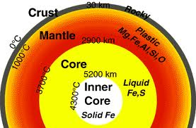
K-12 Geoscience Standards

Slide 13
NGSS Science and Engineering Practices (Methods)
Asking questions and defining problems
Developing and using models
Planning and carrying out investigations
Analyzing and interpreting data
Using mathematics and computational thinking
Obtaining, Evaluating, and Communicating Information

Slide 14

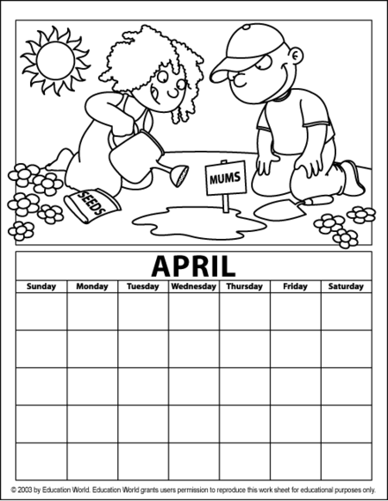
How much time is available for learning geoscience in school?
Class time for geoscience is limited
  ~ 10 hours/year K-5
  ~ 60 hours in MS
  ~ 80 hours in HS

Slide 15
What’s in the new K-12 Draft Science Standards? Elementary
Grade K: Weather (Has to be read to be believed!)
Grade 1: Patterns and Cycles
Grade 2: Earth’s Changing Surface (See K!)
Grade 3: Weather, Climate, and Impacts
Grade 4: Processes that Shape the Earth
Grade 5: Earth Systems and Their Interactions

Slide 16
What’s in the new K-12 Draft Science Standards? Middle School
The History of Earth (2X)
Earth’s Interior Processes
Earth’s Surface Processes
Weather and Climate Systems
Human Impacts

Slide 17
What’s in the new K-12 Draft Science Standards? High School
Earth’s Systems
Climate Change
Human Sustainability

Slide 18
What do you assume that your students know when they show up in your Geology 101 class?
What if you assumed this?
Middle School: ESS-HE a.
Students who demonstrate understanding can construct explanations for patterns in geologic evidence to determine the relative ages of a sequence of events that have occurred in Earth’s past [Clarification Statement: Evidence can be field evidence or representations (e.g. model of geologic cross-sections). Events may include sedimentary layering, fossilization, folding, faulting, igneous intrusion, and/or erosion.]

Slide 19
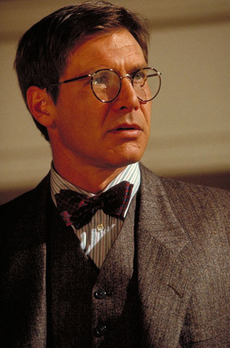
Pedagogy

Slide 20
An Integration of Proven Practices Into Good Content Experiences
How People Learn
Formative Assessment Processes (Assessment for Learning)
Collaboration (teacher-teacher [PLCs], teacher-student, student-student)
Mindset (Effort vs. Talent)
Change (individuals, groups, organizations)

Slide 21
Formative Assessment as Example of Transparent Teaching Techniques
Clear Learning Targets—What, Why, How, How Well?
Initial Ideas—What do you think?, What can you do?, What do you know?
Discourse—What are you thinking? What are your learning strategies? What do you need to find out/do?
Feedback—Moves thinking forward. How can you take the next step?
Peer Assessment—What are you thinking? How does that compare to the learning target?
Self Assessment—What am I thinking? What are my learning strategies? How am I doing? What do I need to do now?

Slide 22
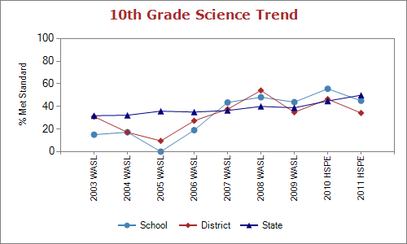
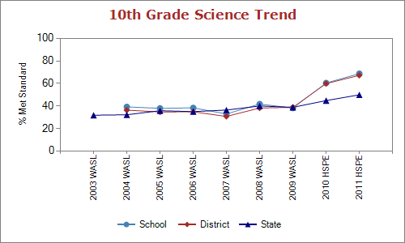
Neah Bay High School
Blaine
High School

Slide 23
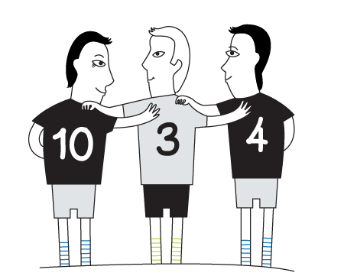
Partnerships

Slide 24

Higher Ed Science Education Collaborators
Physics: Jim Stewart¹, Andrew Boudreaux^{1,}, George Nelson¹, Sara Julin², Ann Zukoski³, Linda Zuvich⁴, Ted Williams⁵
Biology: Deb Donovan¹, Carolyn Landel¹, Alejandro Acevedo¹, John Rousseau², Val Mullen³, Rene Kratz⁴, Pam Pape-Lindstrom⁴, Adib Jamshedi⁵
Geology: Scott Linneman¹, Sue DeBari¹, Bob Mitchell¹, Bernie Dugan², Brad Smith³, Ben Fackler-Adams³, Steve Grupp⁴, Terri Plake⁵
Chemistry: Steve Gammon¹, Emily Borda¹, Paul Frazey^{2,3}
Science Education: Chris Ohana¹, Jacob Blickenstaff¹(Physics), Liesl Hohenshell¹(Biology), Don Burgess¹(Biology), Molly Lawrence¹
Evaluation:, Dan Hanley¹, Jim Minstrell⁶, Ruth Anderson⁶, Phil Buly¹, Many Graduate Students¹
¹ Western Washington U^{, 2} Whatcom CC, ³ Skagit Valley C, ⁴ Everett CC, ⁵ Northwest Indian College, ⁶ FacetInnovations Inc.
Notes:
Need PhD mathematics (especially) and science educators. This is a major role for UW and WSU. Please make this your highest priority!

Slide 25
Teacher Leaders: Content Knowledge

Slide 26
Two Issues (at least!)
1. Field experiences for pre-service teachers are just as, or more, important than university education classes so it is critical to partner with K-12 schools to improve teaching to provide excellent mentors (who should be trained and compensated).

Slide 27
Two Issues (at least!)
2. Science (much less Geoscience) is not a big enough lever to move schools or universities to reform. Partnerships that include all teachers in a building, and partnerships across departments, colleges, and administrative units are necessary to impact all students.

Slide 28

Summary
We all need to address how science works
The K-12 standards are ambitious
Improving learning requires expanding our teaching tools
Sustainable change requires partnerships

