Slide 1
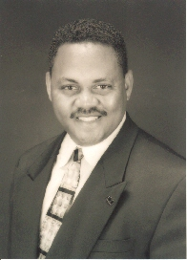

presenter
Next presenter
Environmental Scientist
J. Kyle Bryant
Be The Change You Wish To See…
EPA-Region 4, Superfund/OSPAO
Notes:
1

Slide 2
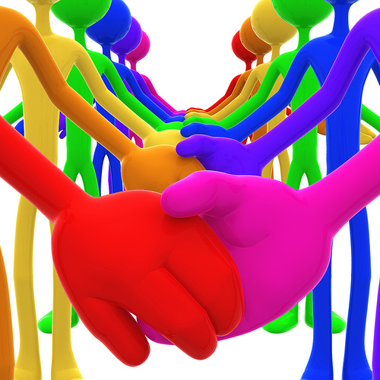
Understanding “Community”,
An Introduction To Capacity-Building
Presented by:
J. Kyle Bryant, Environmental Scientist
Superfund Division/OSPAO
U.S. EPA – Region 4

Slide 3
Objectives
Look At Environmental Justice Through A Different Lens
Define Several Dimensions Of Capacity-Building
Provide Some Simple, Yet Effective Tools To Help Communities Build Capacity

Slide 4
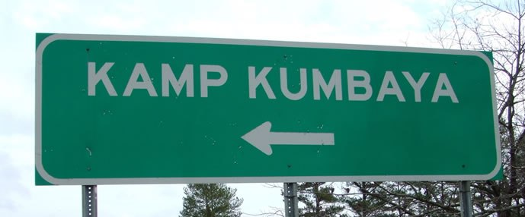

Slide 5
That is not where we’re going today.
Nope.

Slide 6
What looks like resistance is often a lack of clarity.

Slide 7
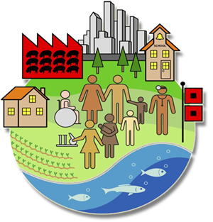
WHAT IS ENVIRONMENTAL JUSTICE? (EPA)
Environmental Justice is the fair treatment and meaningful involvement of all people regardless of race, color, national origin, or income with respect to the development, implementation, and enforcement of environmental laws, regulations, and policies.
This will be achieved when everyone enjoys the same degree of protection from environmental and health hazards and equal access to the decision-making process to have a healthy environment in which to live, learn, and work.

Slide 8

Region 4 Priorities
Successfully Resolve/Advance Regional Issues
Focus on Underserved or Under-represented Populations
      Environmental Justice
      Children’s Health
Expand the Conversation on Environmentalism and Build New Partnerships

Slide 9
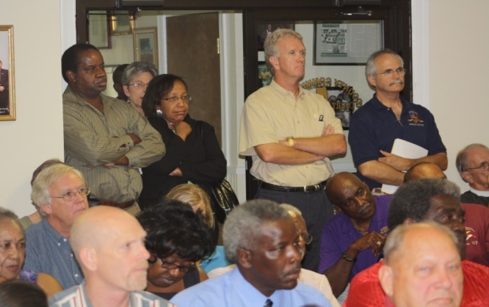
Why Prioritize Environmental Justice?
Morally Right Thing To Do!
Constitutional Right to Equal Protection Under the Laws
  Clean Water, Air, and Land are not parochial
Clean Air Act, Clean Water Act, and CERCLA have inherent inclusion message:
  No one should bear undue burden

Slide 10
Economic Implications of EJ
Only as Strong as our Weakest Link
Pockets of Poverty Negatively Impact Ability to Compete Globally
Strong and Healthy Communities Attract Business
  Economically Advantageous

Slide 11
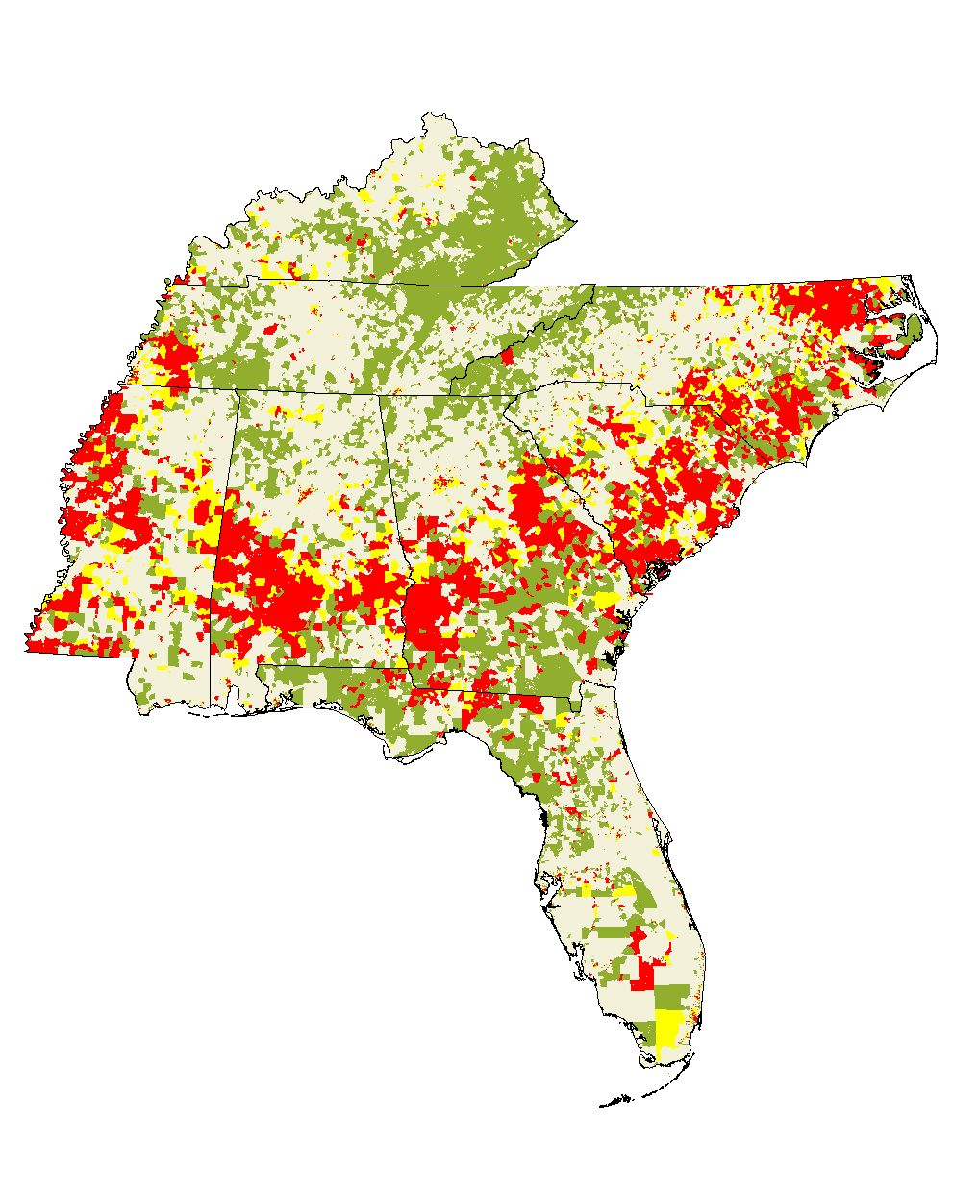
Environmental Justice in the South
Minority & Low Income*
Low Income*
Minority
*Low Income < $15,000/year

Slide 12
What Images Come To Mind When You Think Of
“Environmental Justice Communities”?
(Be Honest…)

Slide 13
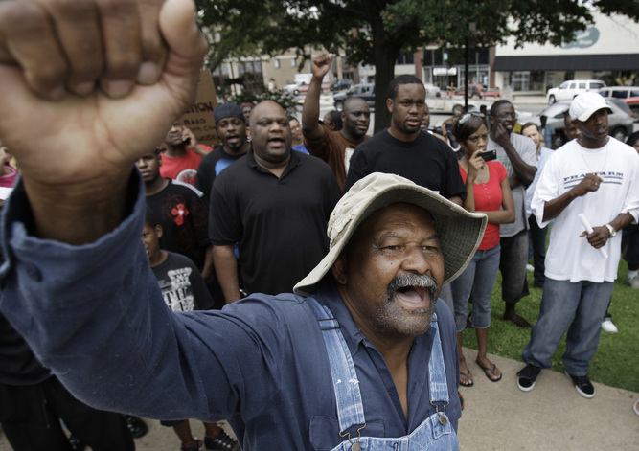
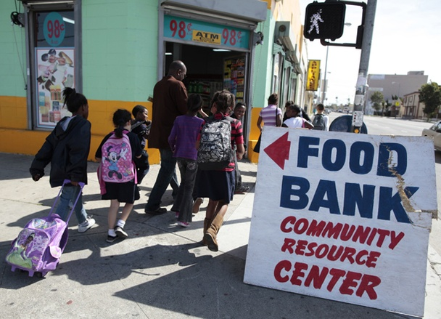
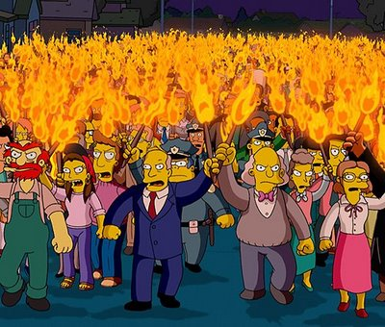

Slide 14
Now… What Images Come To Mind When You Think Of
“Environmental Regulatory Agencies”?
(Again, Be Honest…)

Slide 15
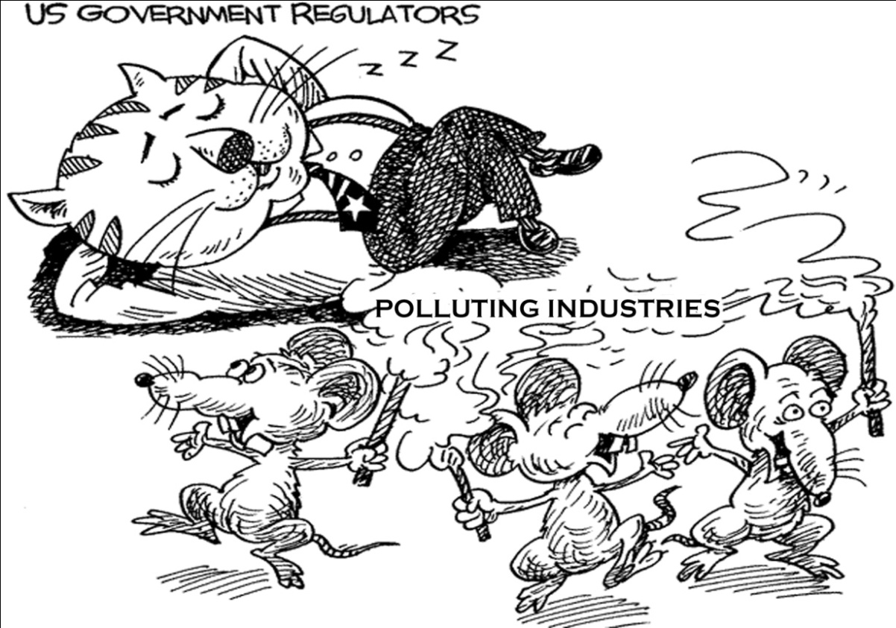
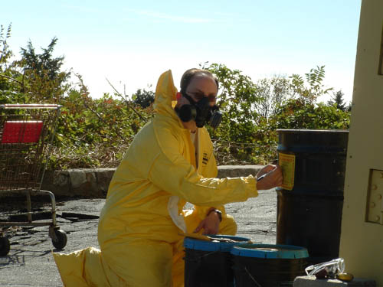
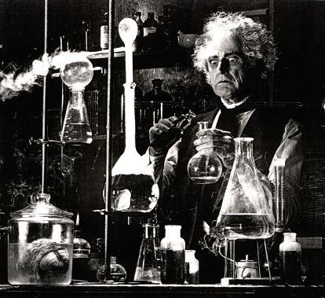

Slide 16
It’s All A Matter Of Perception!

Slide 17
di-ver-si-ty
[dih-vur-si-tee]
Noun, plural -ties
The state or fact of being diverse; difference; unlikeness.
Variety; multiformity.
A point of difference.

Slide 18
Ethnicity
Religion
“Blue-Collar”
“White-Collar”
Coke
Pepsi
Culture
Values
Inner City
Suburban
Liberal
Conservative
Difference is Relational

Slide 19
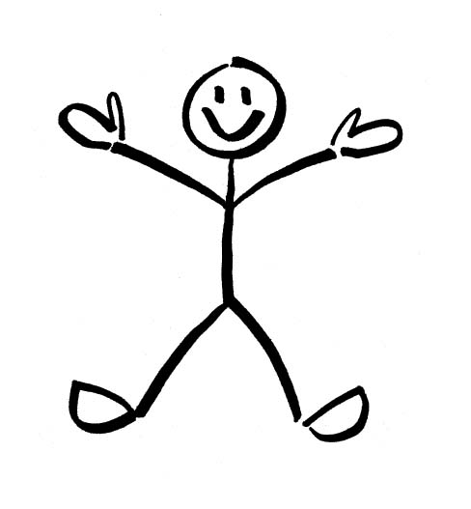
Difference lives here
Notes:
It is said that where two, or more, people are gathered, “difference” exists. The smaller this “space”, the more people have things in common. The bigger the space, the more challenging it will be to communicate.

Slide 20

tension
Difference brings this
Notes:
“Difference”, of course, brings about tension – individual or collective fear of being unfairly judged, or having your fate tied to someone else’s negative perception of you or your community. (“You People” statements; noticeable discomfort with other cultures.)

Slide 21
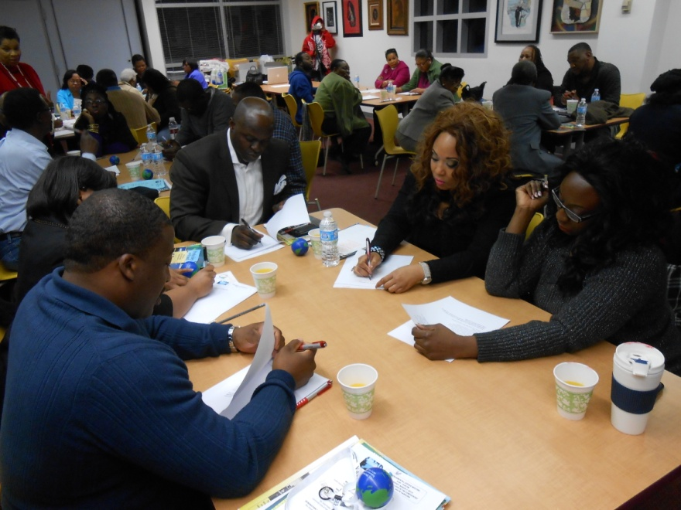
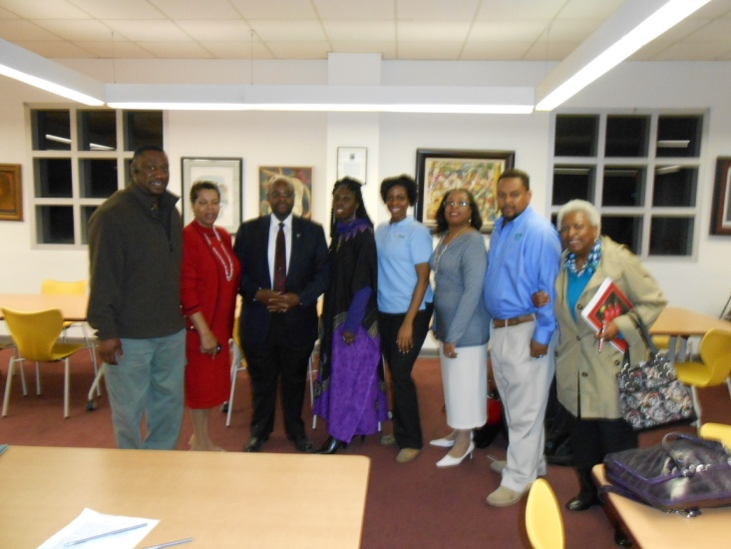
The Value of “Community”
Fosters a desire to Lead and to Participate
Can reinforce connections among groups in conflict
Facilitates Power sharing among groups
Enhances values toward caring and sharing

Slide 22
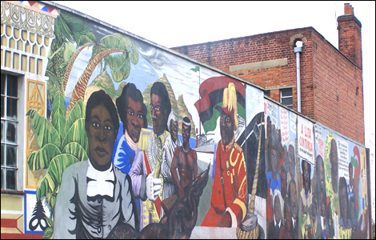
Develop A Sense Of Community
Characterized by high level of concern for community issues, respect, generosity, and service to others
Sense of connection with the place and people
Fulfillment of needs through membership

Slide 23
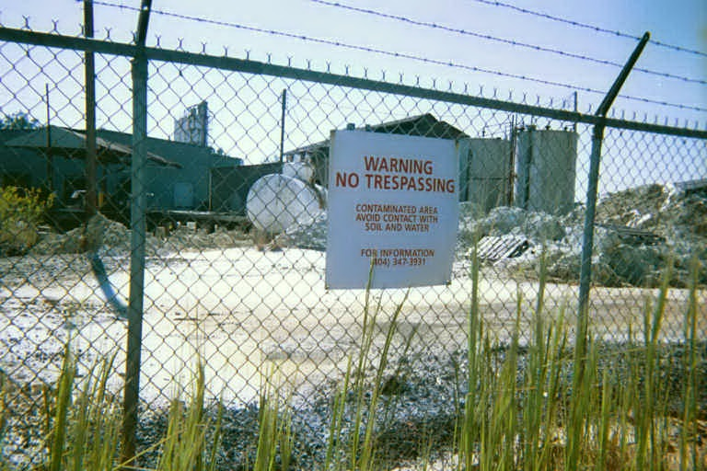
Things You Need To Know About Your Community
It’s Resources
It’s History
It’s Power
It’s Values
It’s Institutional Assets
Notes:
Resources - Social capital, or the ability to generate trust, confidence, and cooperation
History - awareness of important social, political, and economic changes that have occurred both recently or more in the past
Power - by the ability to create or resist change regarding community turf, interests, or experiences
^{Values -} Know what the ethical norms are in your community. What are “acceptable” behaviors and/or practices and what aren’t
Institutional Assets - Churches with large congregations, High number of home owners, respected stakeholders that know the history of the community

Slide 24
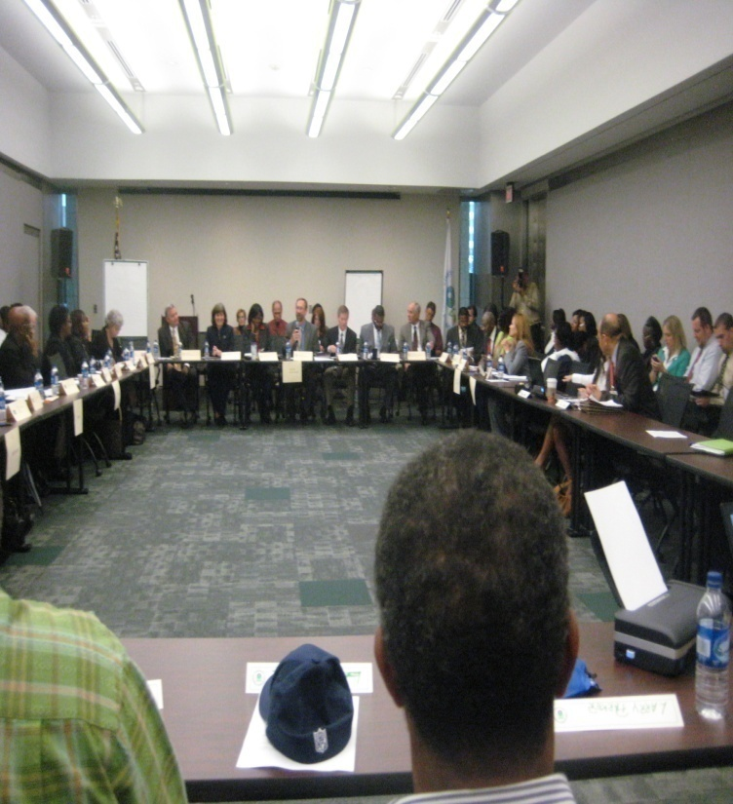
Participation and Leadership
Participation and Leadership are two important and related dimensions of community capacity.
These two factors are connected in that a community lacks capacity when its leadership does not have a strong base of actively involved ^{residents.} Conversely, participation without the direction and structure that leadership provides often results in disorganization.

Slide 25
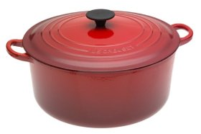
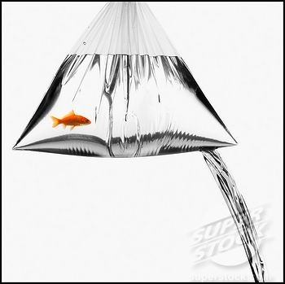
What Kind of Containers Are You Building With Your Relationships, Conversations, & Groups?
Notes:
Is your organization sturdy enough to withstand a little pressure, or “tension”, without losing its structure? Or is it just propped-up to give the appearance of being “organized” – caving in at the first signs of resistance and disharmony?

Slide 26
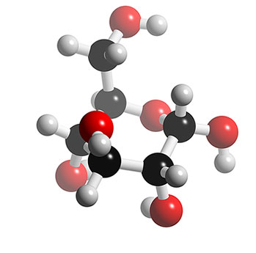
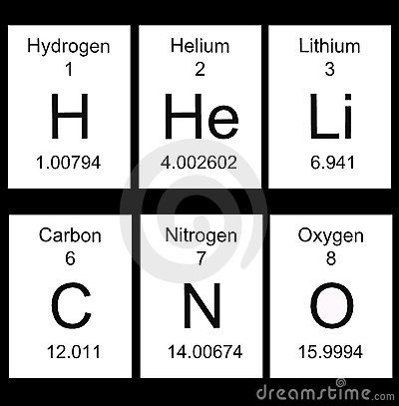

Slide 27
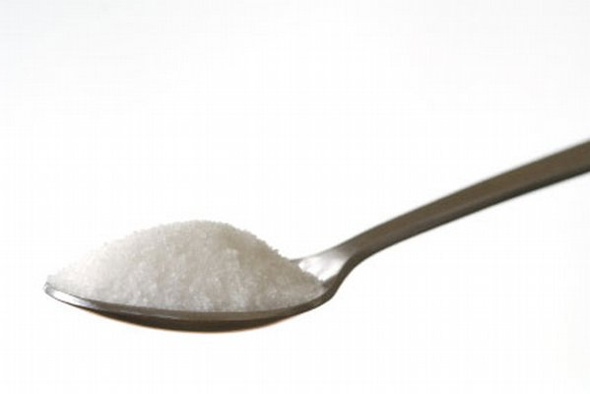

Slide 28
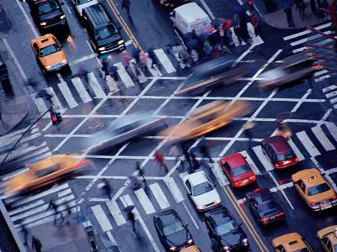

Slide 29
A Thought for the Future
“In every community, there is work to be done. In every nation, there are wounds to heal. In every heart, there is the power to do it..”
- Marianne Williamson.
Notes:
I’d like to say a word about power dynamics. It’s simple physics, people. POWER is finite! Whenever you, or your cause, gains power, understand that you are taking power from someone else! The revelation of that notion to the masses, makes those who currently control it, very uncomfortable. Therefore it is necessary to keep you in fear – guessing about your uncertain, yet prescribed future.

