Slide 1
Trans-disciplinary Teaching and Environmental Justice: A Relational Path
Richard Kujawa, Saint Michael’s College, Vermont

Slide 2
A note on geography
Pedagogical entrepreneurialism
Scale and the Arc of the Story
Sacrifice Zones and other books
Awards and Partnerships – Cooptation and Therapy or Entry Point for critical pedagogy?
Comedy and Environmental Ethics

Slide 3
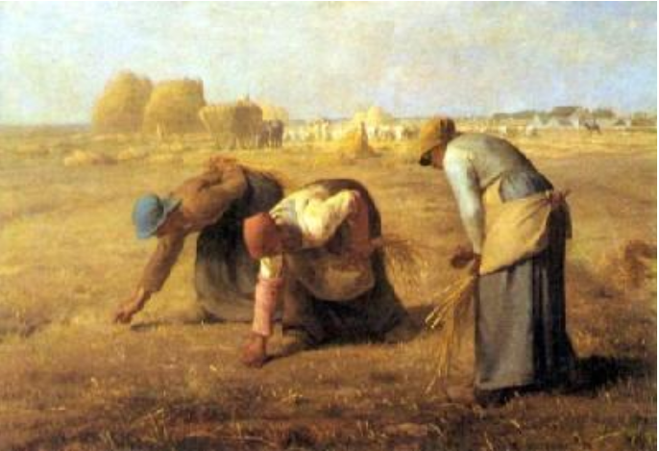

Slide 4
NIMBY, LULU, NIMFYE, CAVEMEN, BANANA and more....
Garbage Dictionary from Garbage Magazine 4(1) 1993 p.68

Slide 5
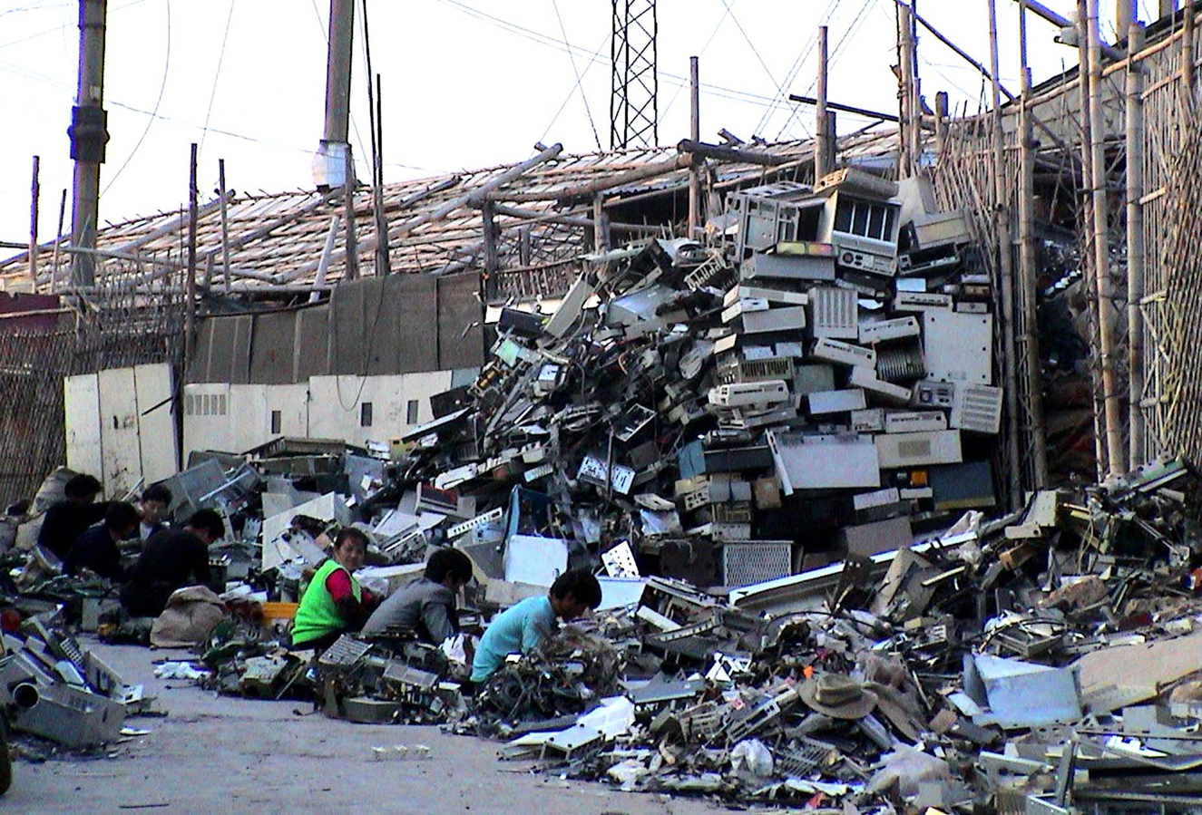
Source: Exporting Harm, ban.org
Notes:
Typical E-scrapping dismantling operation. 100,000 such migrant workers labor in Guiyu breaking down imported computers in hundreds of small operations like this one in a 4 village area surrounding the Lianjiang River. Guiyu, China. December 2001. Copyright Basel Action Network.

Slide 6
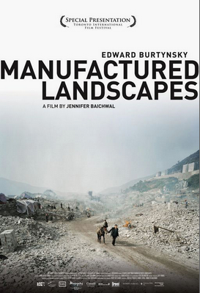

Slide 7
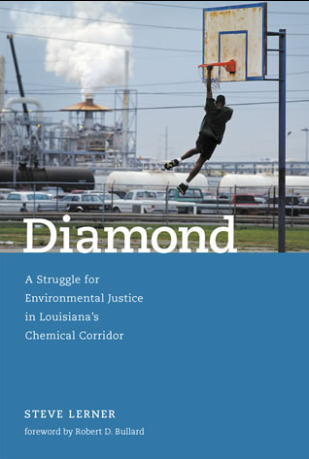

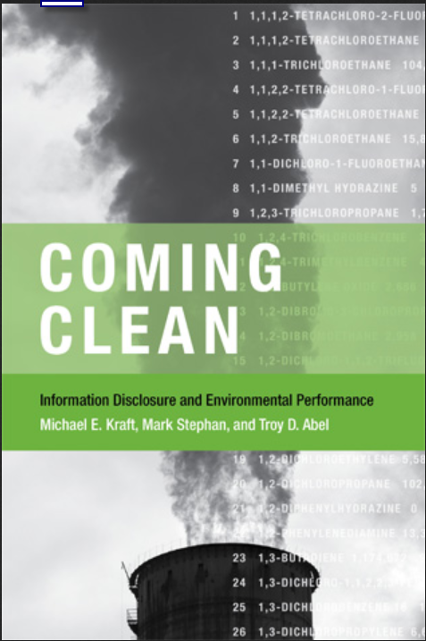


Slide 8
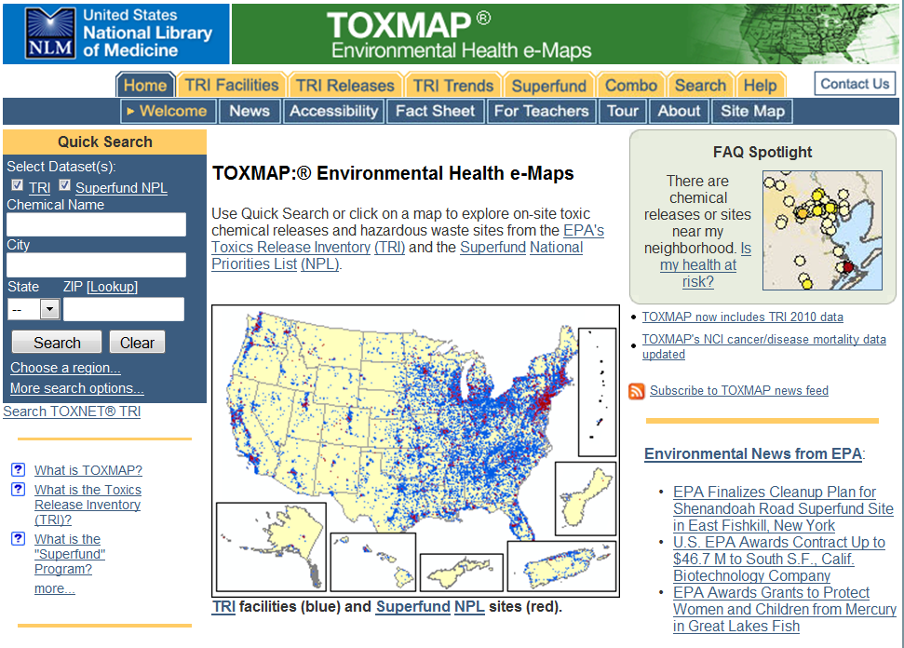

Slide 9

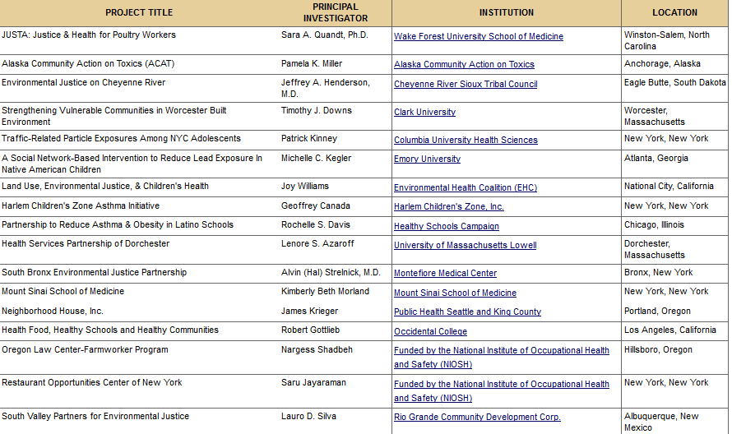
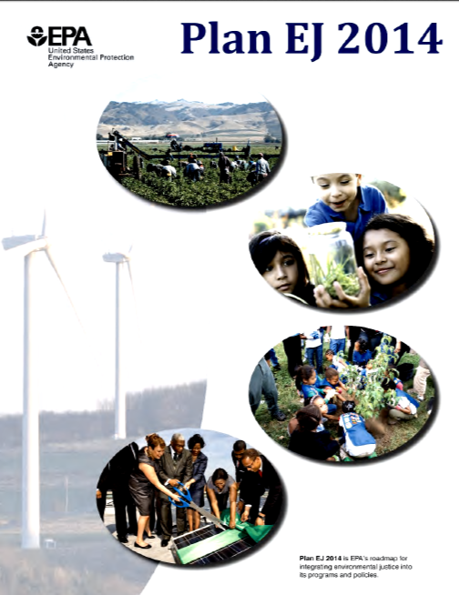
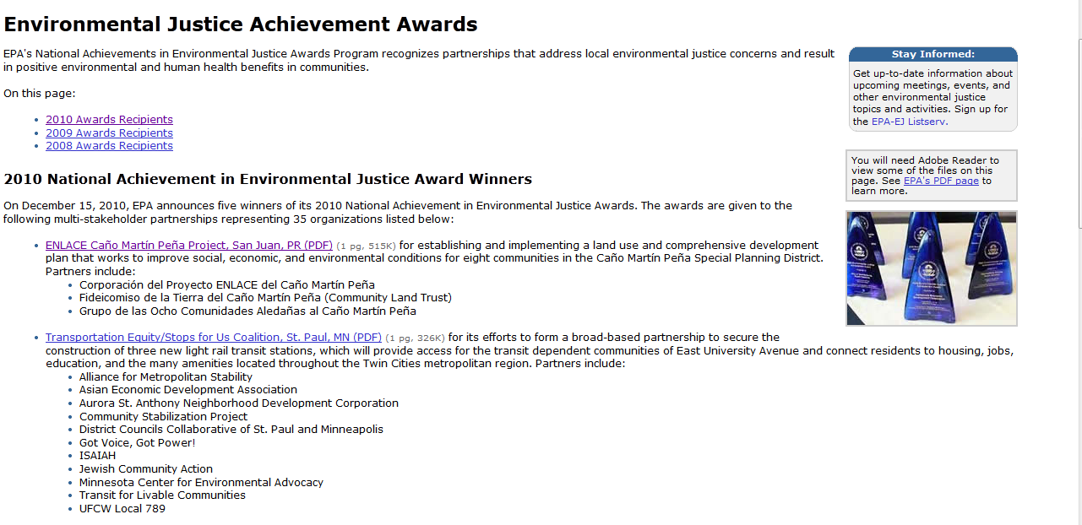

Slide 10
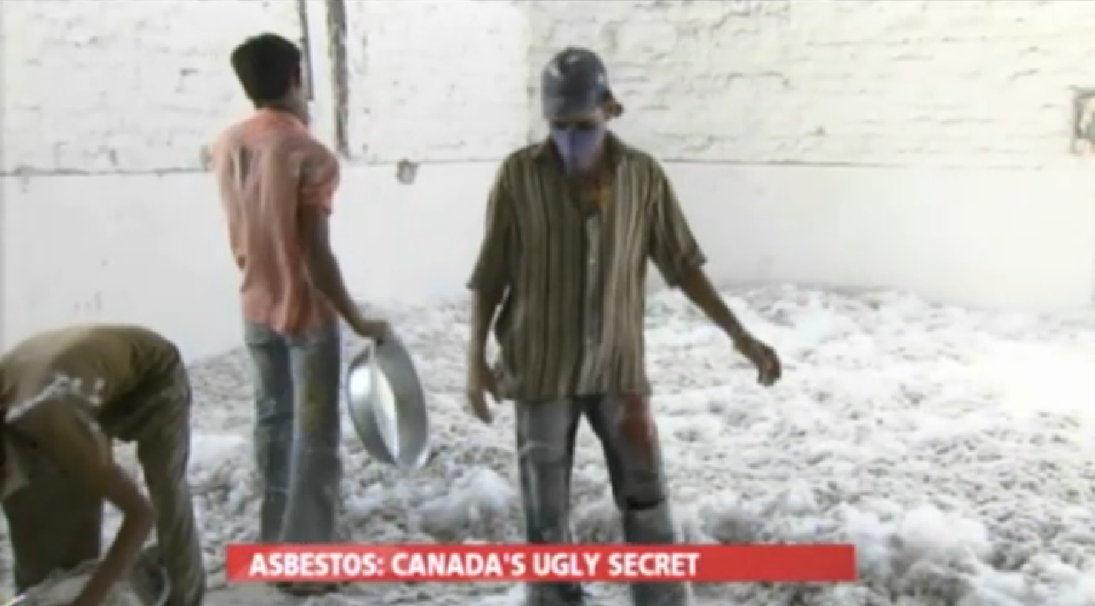
Comedy and Environmental Ethics:
Kree-zoh-teele…
Source: Ored to Death, The Daily Show http://www.thedailyshow.com/watch/thu-may-12-2011/ored-to-death

