Slide 1
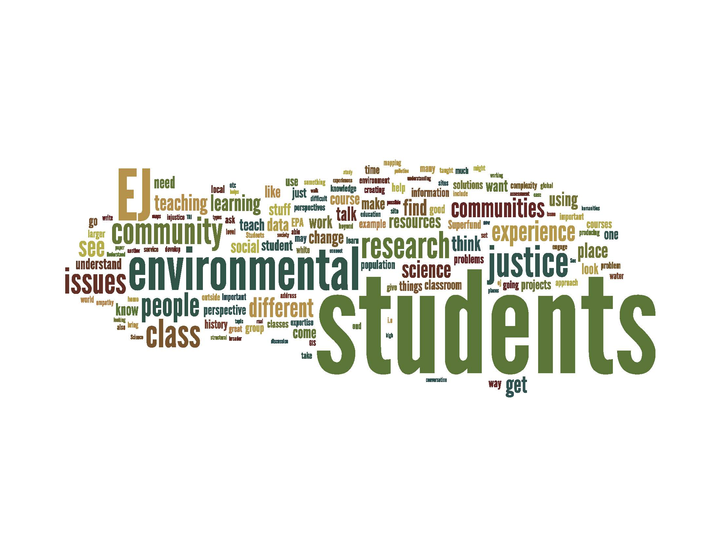

Slide 2
Reciprocation of justice: Inclusion of marginalized populations in environmental awareness
Chris Atchison
Georgia State University

Slide 3
“Environmental Justice is the fair treatment and meaningful involvement of all people regardless of race, color, national origin, or income with respect to the development, implementation, and enforcement of environmental laws, regulations, and policies.”
- EPA: Environmental Justice

Slide 4
“No person in the United States shall, on the ground or race, color, or national origin, be excluded from participation in, be denied the benefits of, or be subjected to discrimination under any program or activity receiving federal financial assistance.”
- Civil Rights Act, Title VI

Slide 5
Americans with Disabilities Act of 1990: Disability is defined as "...a physical or mental impairment that substantially limits a major life activity."

Slide 6
Is EJ for everyone? Should it be? | Bias
Equity is racism and classism/ gender, ethnicity | Personal agendas
Community knowledge | Discrimination
Interdisciplinary of people and environment | Activism
Mainstream education | Disproportion
Unacceptable bias | Marginalization
Boundary between awareness and activism | Subjectivity versus objectivity
Distribution of pollution | Transparency
Community engagement | Sustainability
Critical thinking | Local versus global implications
EJ is complexity | Segregation
Progressive thinking versus reaction | Empowerment
Gaps in knowledge | Corruption

Slide 7
Historical perspective | Advocacy
Corporate gain regardless of environmental impact | Oppression and environmental violence
Power dynamic | Sensory extinction
Policy failures | Hazards, resource extraction, risk, burden
Aligning science and community | Capacity building
Lack of informed consent | Underserved, underrepresented populations
Think globally, act locally | Environmentalism
Exploitation | Perception
Betrayal | Deceit
Blissfully ignorant decision-making | Diversity
Risk taking versus the inability to understand implications of decisions | Common voice, common vision, diverse outcomes

Slide 8
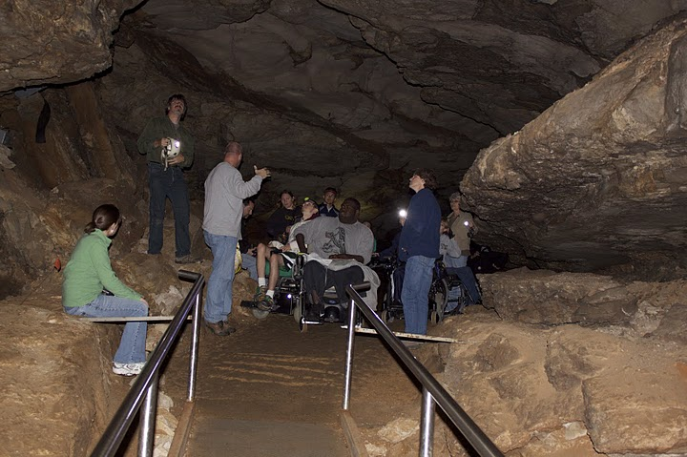

Slide 9


