Slide 1
Environmental Justice as A New Cultural Education
An Understanding of Its Structure and Evolutionary Tendencies
--- Josefina Li

Slide 2
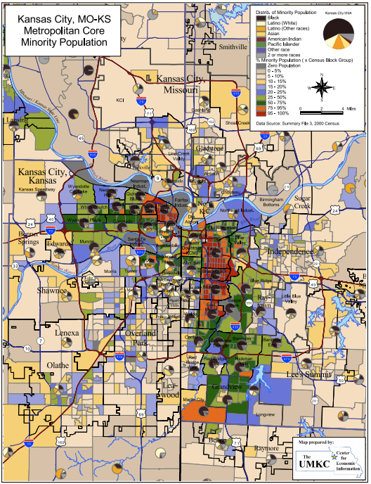
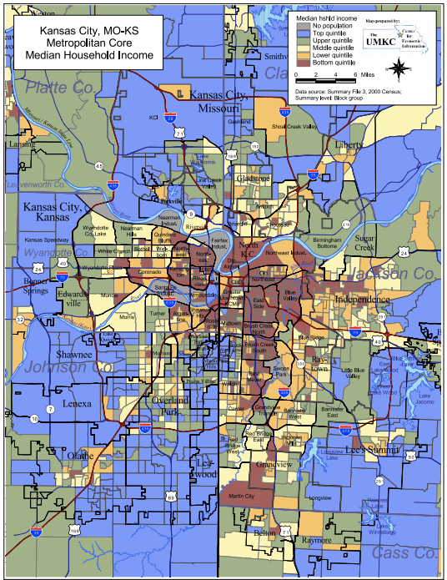
State of Black Kansas City
Notes:
The university campus is in fact, bordered by Troost Avenue. It wasn’t hard to talk about injustice, because it is happening right across the campus, just east of Troost, the community is systematically targeted by harmful practices in housing, land use, industrial pollution, and infrastructure.

Slide 3
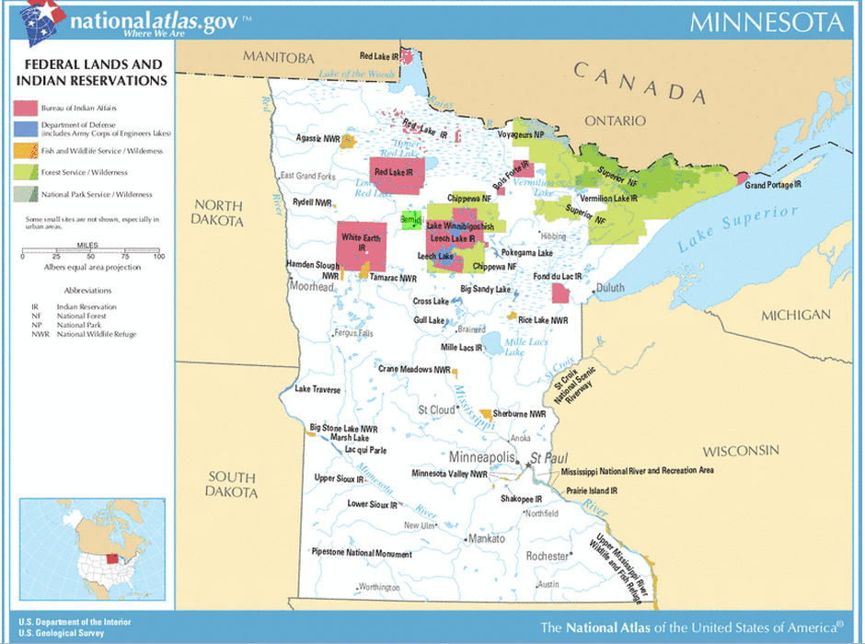
The Geographic Environmental We Work In
Red Lake IR
White Earth IR
Leech Lake IR
Notes:
Then I moved to Bemidji, Minnesota, and our campus is in proximity to three American Indian Reservations, and American Indian studies is one of our signatures. You would think that they are aware of the environmental injustice towards indigenous people, I realize that I was teaching to a drastically different audience. Most of my students are predominately white, working class, and rural. Without a methodical understanding of how racism, classism and sexism manifest themselves as systems of oppression within a capitalist patriarchal power hierarchy, many responds to injustice to the indigenous people with conflict and anger. Not only their denial to an institutionalized discrimination has long formed, their working class background makes them disinterested in knowledge and skills that are not so practical as to land them a job after graduation.

Slide 4
Tasks of Education
Culture Education
Vocational Education
Moral education
Notes:
1, promoting the rational and institutional understanding of Nature and Society (making sense/interpreting the meaning of the world, structure and evolution);
2, technique, specialist profession, he says to make him intellectually fit for a society based on division of labor
3, dealing with volitional attitudes of the student, with the aim of forming him according to the “true” standards of society in question

Slide 5
Tying It Back to My Experience
Change in Environment and Student Population
Notes:
When we have a social background similar to the principles that dominate universities, that is family life, the Church, social/public media all stood for the same values, the tasks can be relatively easy to achieve, because the university is simply developing attitudes which had already been formed by tradition and daily life in the stages proceeding university education. But the background has changed, and we have an increasing trend towards specialization, objectivity/scientific, and even the social stratification of the student body. So we have this rising lower middle classes, and upper working classes attending universities, for training for remunerative professions. So now we experience frustration of Cultural and moral education, the universities more and more retreat from their position as interpreters of the meaning of culture.

Slide 6
Implications
Implication for teaching EJ
Action at the departmental and institutional level
Notes:
As a consequence of the chaos of value, we have broken up the unanimity of public opinion. Thus, a new cultural education is needed both to balance and underpin vocational education. We can’t simply emphasize the technical problems, but to supplement the big culture outlines to reflect the totality of social life,(ie EJ) in its various aspects. This “synthetic” courses becomes include political and economic history and the social structure of the country, the structure and evolutionary tendencies or like the people and the environment course offered at BSU. The reverse is also important, natural sciences, like biology, geology or mathematics, can offer students a detached point of view outside of the social field where personal standpoints constantly color interpretation.
What can be done at the institutional level is in developing the curriculum, we need to keep that in mind. In developing a course, we also need to keep the importance of cultural education in mind.

Slide 8
How I Approach it
Notes:
My specific way of teaching the synthetic course of environmental justice is to explore with my students where their viewpoints come from. Thus, I begin the course by guiding my students through the different frameworks that are used to identify, analyze and resolve environmental issues. Readings are presented from contending arguments on these frameworks, so to leave the final call to the students. By examining mainstream environmental economics, ecofeminism, deep ecology, and Buddhist economics, students begin to the see that redlining, economic disinvestment, discriminatory dumping, male dominance in today’s society, and slavery, genocide in human history are all interconnected issues rooted in the same oppressive conceptual framework. Environmental injustices are not simple environmental issues, but complex legal, political, geological, social and economic problems. With that in mind, we then proceed to read the case studies in Bullard’s edited volume The Quest for Environmental Justice, and through group discussion, to demonstrate the existence of an inequitable distribution of environmental risks based on race and socioeconomic status.
To those students who could care less the injustice because they are white privileged believe that they will never be the victim of injustice, I read to them this quote by Pastor Martin Neimoeller: “They came first for the communists and I didn't speak up because I wasn't a communist. Then they came for the Jews and I didn't speak up because I wasn't a Jew…Then they came for me and by that time there was no one left to speak up”.

