Slide 1
Sustainability to a geoscientist
Easy to be flippant about sustainability
  We think on deep time
  Humans can’t destroy or save Earth
  Humans are a geologic force
Yet many geoscientists are “green”
If many resources are non-renewable, then sustainability has to be about taking from one system to invest in another
Geoscientists are good about interdisciplinary systems thinking

Slide 2
Some of my teaching philosophy
David Orr
  All teaching is environmental
  Must consider impact on communities
David Foster Wallace (1996) Infinite Jest
“Like most North Americans of his generation, Hal tends to know way less about why he feels certain ways about the objects and pursuits he's devoted to than he does about the objects and pursuits themselves. It's hard to say for sure whether this is even exceptionally bad, this tendency.”
Terry and Renny Russell (2001) On the Loose
“Crazy kids on the loose, but on the loose in the wilderness, and that made all the difference.”

Slide 3
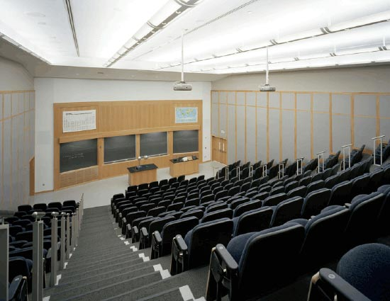
Integrating sustainability into EES 101
130 students
Huge range of backgrounds
Only college science class for most students
Huge interest in sustainability

Slide 4
Some of my course goals
Think over multiple timescales and perspectives
Think about the role of humans in earth systems
Consider the effects on real communities

Slide 5
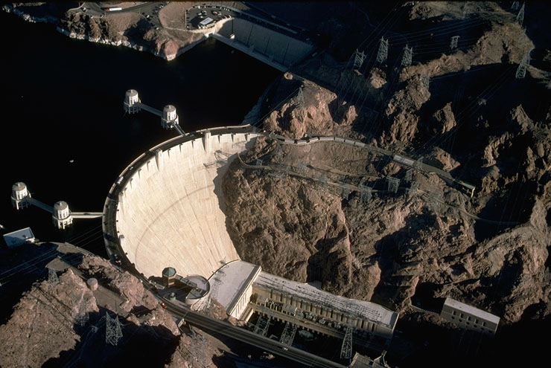
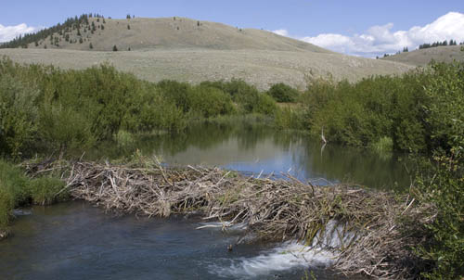
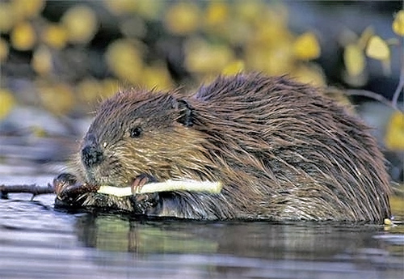
Participation
What’s the difference between a dam built by a beaver for beaver purposes and a dam built by humans for human purposes?
- Robert Heinlein

Slide 6
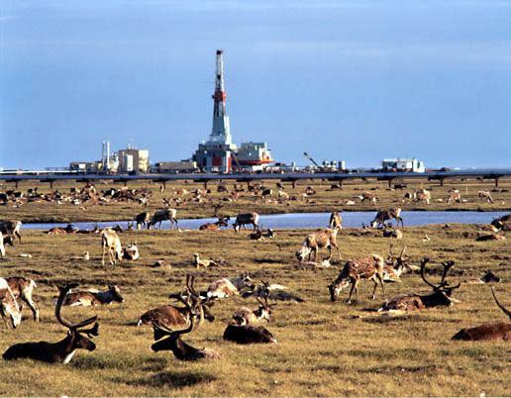
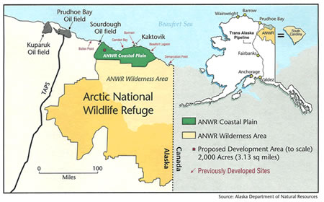
Should we open the Arctic National Wildlife Refuge for petroleum development?
We’ve gone through geology of petroleum, energy use in US
How much oil is in ANWR? What are ecological values?
Stakeholders from multiple perspectives – local to global

Slide 7
Challenges and Opportunities
Hard to create new course material, new assessments
Not experts outside of our fields
Easy to get distracted , need to prepare students for upper level courses
Don’t want to mislead students about major
Motivate students
Engage students with other skills
Real examples and applications
Science in context

