Slide 1
Reinventing the Introductory Geology Course at Princeton University
Motivations
  Declining enrollment in traditional Physical Geology course
    Students fulfilling lab requirement drawn to more focused intro courses (hazards, weather and climate, oceanography)
    Not getting majors from those courses
    Were getting majors from other sources

Slide 2
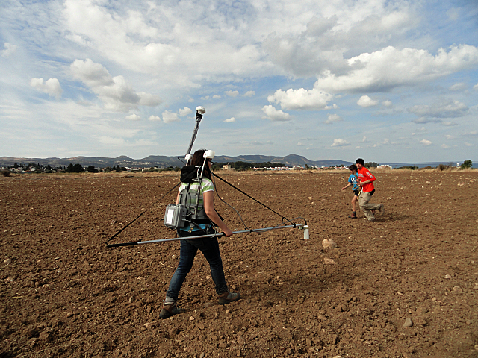
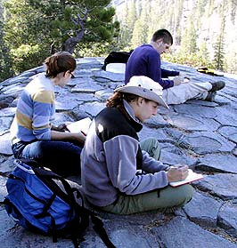
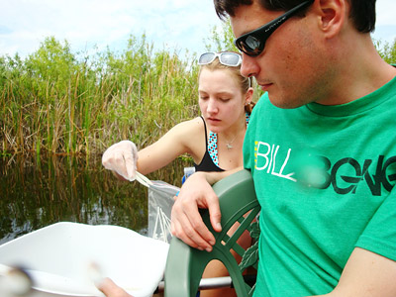
Majors: from Freshmen Seminars
Active Geologic Processes (field trip to central CA)
The Everglades Today and Tomorrow: Global Change and the Impact of Human Activities on the Biosphere
(field trip to FL)
Controversies in Science: Past and Present
Earth's Environments & Ancient Civilizations
(field trip to Cyprus)

Slide 3
Majors, etc. : right into upper-level classes
Prerequisites in math, chemistry, and/or physics
Not necessarily geoscience
Also “instructor permission”
Earth Materials (petrology)
Structural Geology
Earth Chemistry: The Major Realms of the Planet
Physics of the Oceans and Atmosphere
Environmental Geochemistry
Introduction to Seismology
Dynamic Meteorology
Physical Oceanography

Slide 4
Reinventing the Introductory Geology Course
Motivations
  Declining enrollment in traditional Physical Geology course
    Students fulfilling lab requirement drawn to more focused intro courses (hazards, weather and climate, oceanography)
    Not getting majors from those courses
    Were getting majors from other sources
  Course should reflect the department and the science as it is practiced
    modern, quantitative, rigorous

Slide 5
Reinventing the Introductory Geology Course
Motivations
  Declining enrollment in traditional Physical Geology course
    Students fulfilling lab requirement drawn to more focused intro courses (hazards, weather and climate, oceanography)
    Not getting majors from those courses
    Were getting majors from other sources
  Course should reflect the science as it is practiced, the faculty
    modern, quantitative, rigorous
  Attract science/math-oriented students unfamiliar with geoscience (or with misconceptions about it). Those coming to college to major in science or engineering.

Slide 6
Reinventing the Introductory Geology Course
Motivations
  Declining enrollment in traditional Physical Geology course
    Students fulfilling lab requirement drawn to more focused intro courses (hazards, weather and climate, oceanography)
    Not getting majors from those courses
    Were getting majors from other sources
  Course should reflect the department and the science as it is practiced
    modern, quantitative, rigorous
  Attract science/math-oriented students unfamiliar with geoscience (or with misconceptions about it). Those coming to college to major in science or engineering.
  Modeled on experience of Astrophysics (and indeed other sciences)

Slide 7
AST203: The Universe
This specially designed course targets the frontier of modern astrophysics. Subjects include the planets of our solar system, the birth, life, and death of stars; the search for extrasolar planets and extraterrestrial life; the zoo of galaxies from dwarfs to giants, from starbursts to quasars; dark matter and the large-scale structure of the universe; Einstein's special and general theory of relativity, black holes, neutron stars, and big bang cosmology. This course is designed for the non-science major and has no prerequisites past high school algebra and geometry. High school physics would be useful.
AST204 Topics in Modern Astronomy
This course will provide a broad overview to modern astronomy and astrophysics for students in the sciences. Topics include historical developments; the birth, life, and death of stars; supernovae, neutron stars and black holes; the formation, structure, and evolution of galaxies; the large-scale structure of the universe; dark-matter and dark-energy; the expanding universe; cosmology; and the evolution of the universe from the Big-Bang 13.7 billion years ago to today.

Slide 8
Reinventing the Introductory Geology Course
Motivations
  Declining enrollment in traditional Physical Geology course
    Students fulfilling lab requirement drawn to more focused intro courses (hazards, weather and climate, oceanography)
    Not getting majors from those courses
    Were getting majors from other sources
  Course should reflect the department and the science as it is practiced
    modern, quantitative, rigorous
  Attract science/math-oriented students unfamiliar with geoscience (or with misconceptions about it). Those coming to college to major in science or engineering.
  Modeled on experience of Astrophysics
  Much closer connection between Geoscience and Engineering
    Supported by the Engineering dean
    Option for fulfilling a CE requirement, promoted by CE

Slide 9
GEO203:
Fundamentals of Solid Earth Science
Reinventing the Introductory Geology Course
“A quantitative introduction to Solid Earth System Science, focusing on the underlying physical processes and their geological and geophysical expression. Topics include basic physical conservation laws, examples of constitutive relationships, waves, transport phenomena, geopotential fields, geologic time, basic thermodynamics and mineralogy. Single variable calculus is a prerequisite.”
First offered Fall 2012

Slide 10
GEO203:
Fundamentals of Solid Earth Science
Reinventing the Introductory Geology Course
Course personnel
Prof. Jeroen Tromp (theoretical and computational seismology)
Prof. John Higgins (geochemistry of Earth’s climate, atmosphere and oceans on geologic timescales)
Tech Staff Laurel Goodell (geologist)
Grad student Jon Husson (field geologist, geochronology, Earth history)
Prof. Jessica Irving, Fall 2013 (seismology, esp. of the inner core)

Slide 11
GEO203:
Fundamentals of Solid Earth Science
Reinventing the Introductory Geology Course
Two 80-minute lectures/week
One 50-minute precept/week
Weekly problem sets (calculus, basic linear algebra, using MatLab)
Two day-long field trips
Geology of the Princeton area
Pennsylvania Valley and Ridge

Slide 12
Reinventing the Introductory Geology Course
Why did you take this course?
New CEE Requirement.
Departmental…I chose it out of three options for departmental, and I chose it because it looked the most interesting.
I took this course as an introduction to Geo-science, since I was not quite sure what the department was and wanted to learn more about it as a potential major. Fulfilled CEE requirement, and wanted to check out GEO.
I took it because I'm a GEO major.
Engineering
It sounded interesting, but mostly was a required departmental.

Slide 13
GEO203 syllabus
Reinventing the Introductory Geology Course
Overview and philosophical approach
Kinematics
Conservation of mass
Conservation of momentum
Constituative relationships
Waves and structure of the Earth
Gravity and magnetism
Heat and Convection
Synthesis of elements, stellar and solar system evolution
Thermodynamics, minerals, and planetary formation
Mantle melting and igneous petrology
Geologic time
Continental drift and seafloor spreading
Plate motions
Growth of the continental crust
Sediments and the geologic record
The faint young sun and Earth’s thermostat
The coevolution of Earth and life
Earth resources

Slide 14
Reinventing the Introductory Geology Course
Texts on Reserve:
Davies – Dynamic Earth
Davies – Mantle Convection for Geologists
Stacey and Davis – Physics of the Earth (4th edition)
Moores and Twiss – Tectonics
Lliboutry – Quantitative Geophysics and Geology
Langmuir & Broecker – How to Build a Habitable Planet
Lowrie – Fundamentals of Geophysics

Slide 15
Structure of a problem set (and precept):
Introductory material:
“With the exception of the outer core and some volcanic chambers, Earth is a solid. We have conclusive evidence of this characteristic because Earth transmits shear waves…However, we also have several lines of evidence suggesting that Earth is a fluid. Earth's oblate shape (and) Earth's response to the addition or removal of large masses in the form of mountains or ice sheets.. (These) observations suggest that Earth's interior is fluid, despite the fact that Earth behaves as an elastic solid with respect to seismic waves and solid Earth tides. In this problem set, you will explore the nature of fluids, Earth's behavior as a fluid, and how motion in Earth's deep interior drives deformation on Earth's surface….
Review of relevant math, MatLab code, supplementary readings
Working through problems or parts of problems in precept

Slide 16
Results from 1st run, fall 2012
Reinventing the Introductory Geology Course
Mixed course reviews overall
“Great, interesting course”
“I would have liked to learn more geology”
“The excitement is tangible and I love that”
“…the course is also a bit scattered in terms of what I was expecting to learn”
“The course was misleading. The prerequisite was single variable calculus but we used multivariable as well as linear algebra.
Field trips were particularly well-received
1/3 of the class either in upper-level GEO classes this spring, planning on others, or working in research labs

Slide 17
Challenges
Reinventing the Introductory Geology Course
Too ambitious
Lack of appropriate textbook – suggested readings were not taken advantage of, need more explicit assignments & accountability
Better integration of process-oriented and quantitative, of lectures and problem sets
Too quantitatively front-loaded
Promoting the course, awareness
Revisions before next fall

