Slide 1
Bringing Real World Experiences and Examples to the Classroom
Anne Dudek Ronan
Industry Professor
Civil and Urban Engineering

Slide 2
Why?
Make theory more relevant
Engage students in discussion
Broaden students’ horizons
Introduce non-technical issues: environmental, economic, political, social justice

Slide 3

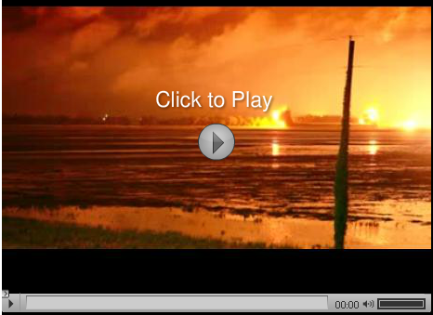

Slide 4
Bringing in Real-World Examples
Videos
Newspaper clippings – yes, torn directly out of a paper newspaper for visual effect
Online media sources
Photos from past field trips
Discussion of previous experiences in consulting and research

Slide 5
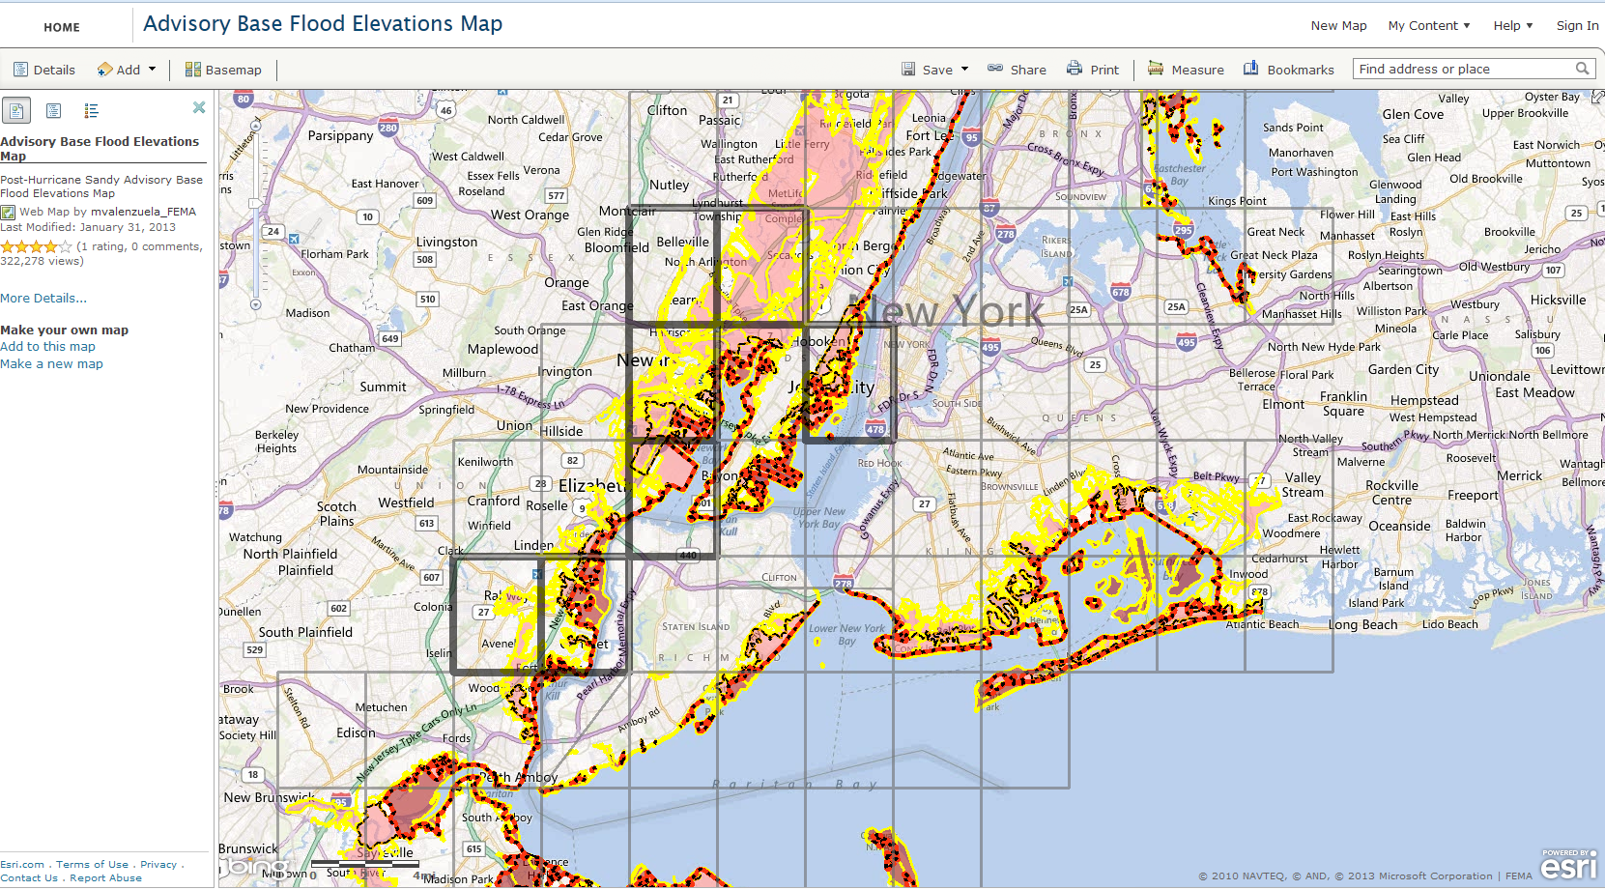
FEMA ABFE Maps
(Advisory Based Flood Elevations)

Slide 6
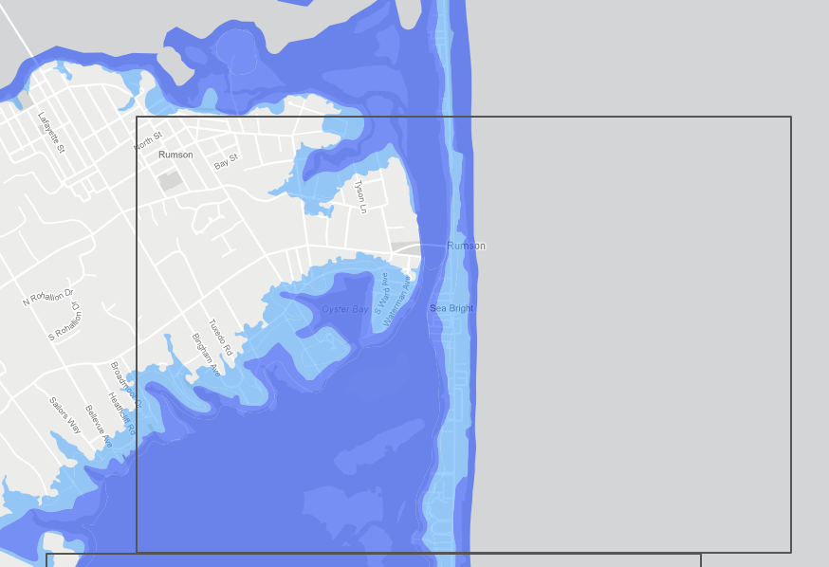
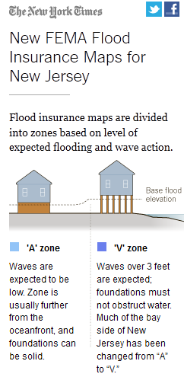

Slide 7
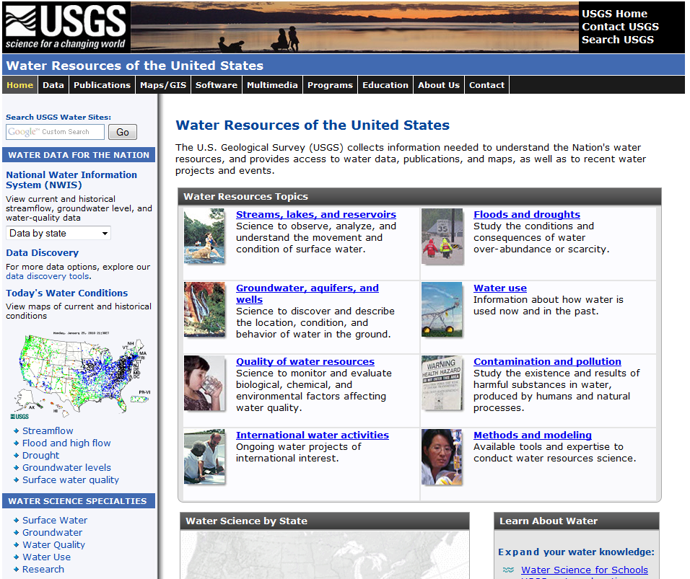
http://water.usgs.gov/

Slide 8
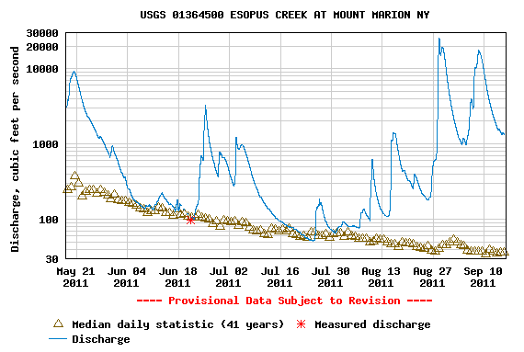
This graph shows May to September 2011 at the same station.
Look at the effect of Hurricane Irene.
Discussion: what do these triangles represent?

Slide 9
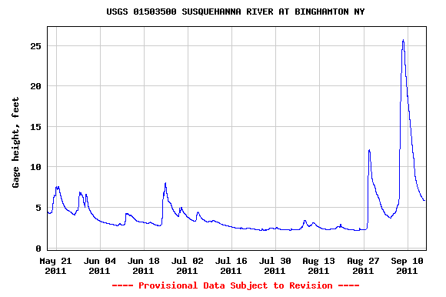
The river stage at Binghamton, NY, from May to September 2011

Slide 10
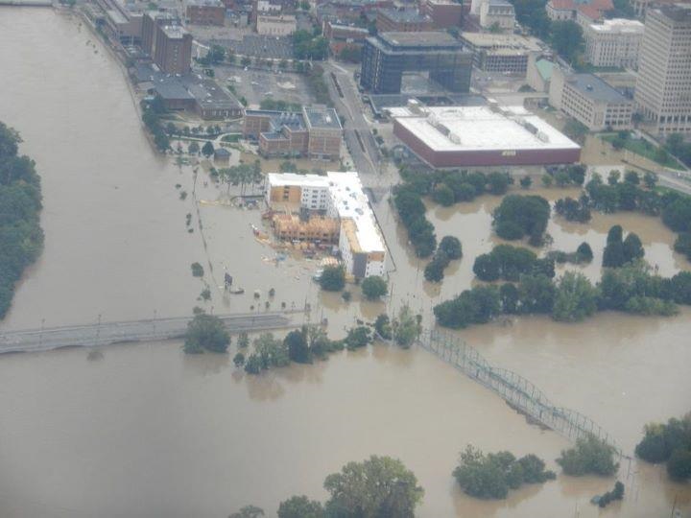
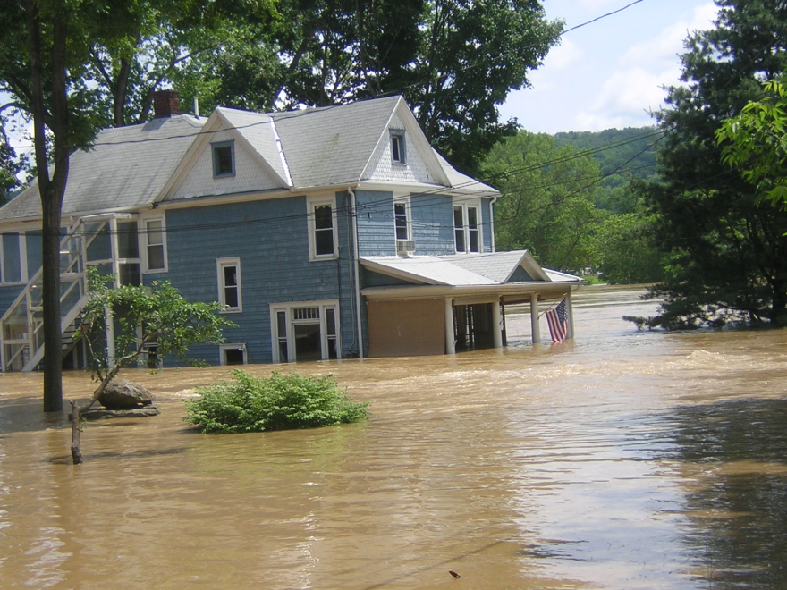
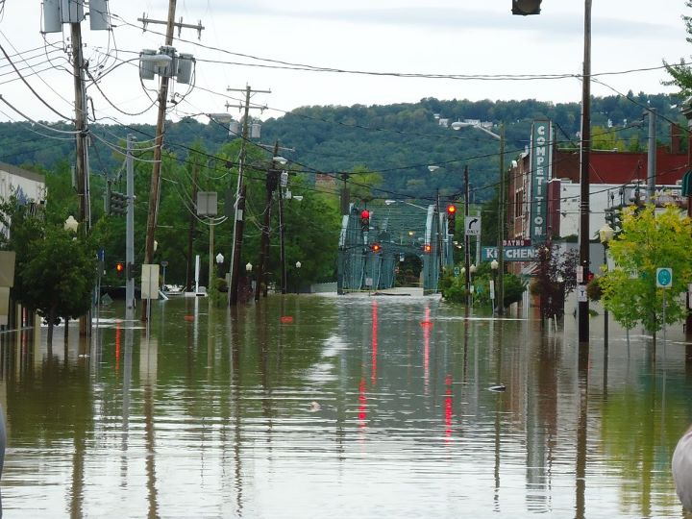
Binghamton, NY in early September 2011

Slide 11
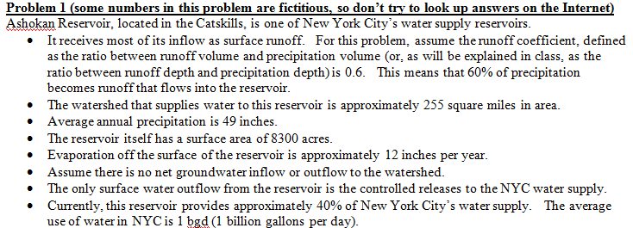
Pseudo-“Real-World”
Homework Problems
No textbook problems
Base problems on real data, include more information than is needed, take some liberty to simplify the real world

Slide 12
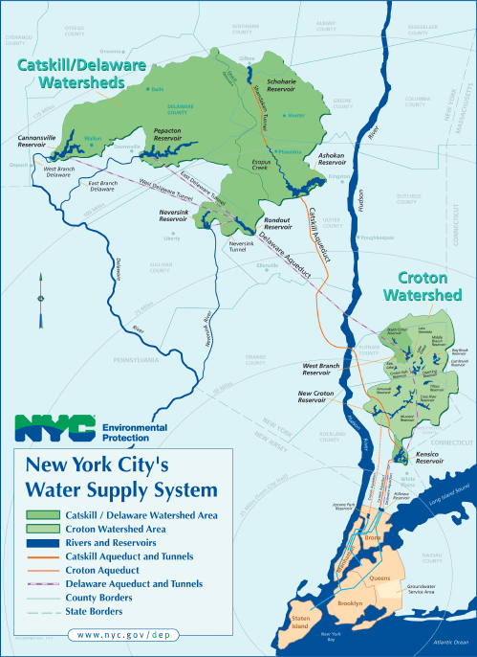

Slide 13
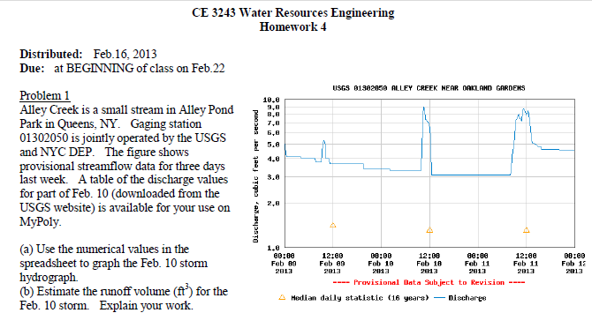

Slide 14
Benefits
Make theory more relevant
Engage students in discussion
Broaden students’ horizons
Introduce non-technical issues: environmental, economic, political, social justice
I learn a lot too!!

Slide 15
Challenges
Providing an appropriate balance between theory and discussion
Keeping up with current events is time consuming – finding enough background facts to make it a teaching point rather than just a wow point
Formalizing presentation within a Powerpoint lesson, then keeping it up to date, is very time consuming

Slide 16
Opportunities
Invert the process – provide incentives for students to bring the news to class
  I tried (but didn’t succeed) post-Sandy
  The idea: use discussion board to share photos and experiences
  The limitations: power outages, general disruption of day-to-day activities, lack of experience with the technology
NYC sustainability initiatives are happening right now – get involved

Slide 17
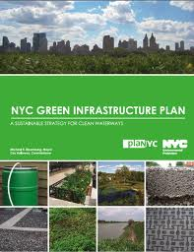
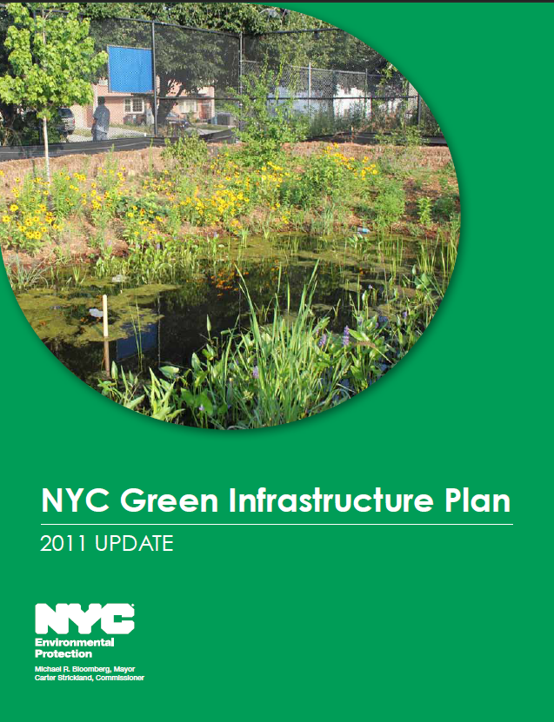
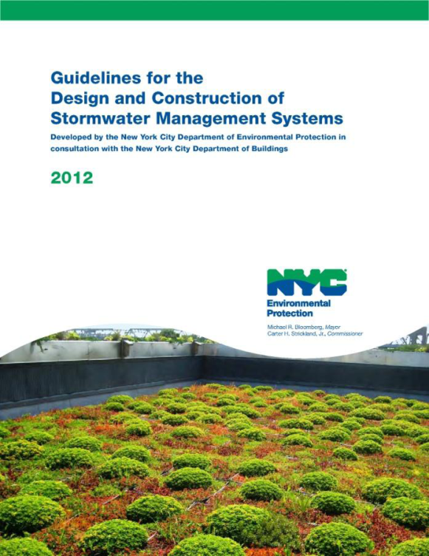
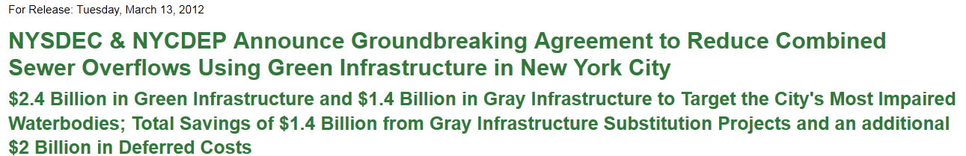
NYC Green Infrastructure Plan

