Slide 1




Integrated Activities and Challenges of Assessing
“Higher level” Thinking Skills
~
Dep’t Earth, Ocean & Atmospheric Sciences
Francis Jones

Slide 2
Outline:
Define higher level thinking
Assessment
Deconstructing expert thinking
Challenges solved and challenges NOT yet solved.
Context for this example:
The one course about applied geophysics methods for 3rd yr geological engineering AND geology majors.
Scaling up is a key objective for me.

Slide 3
1. Define higher level thinking:
Learning = deliberate practice.
Teaching = providing tasks to practice AND by guiding with feedback .
“Lower level” (Bloom’s) = recall, explain, solve, etc…
  Geoscience ~ processes…
  Engineering ~ design or analysis …
Higher level thinking = synthesis, evaluation, judgment etc.
  Eg. Choose and justify optimal procedure to achieve xyz
  Eg. Incorporate cost/benefit considerations when making choices
Experiential settings all enable higher level thinking, but (like tutoring) are tough to scale up.

Slide 4
2. Assessment: two parts …
Feedback: needs to be timely and ideally “Socratic” (like 1-on-1 tutoring BUT scaled for large classes).
Measuring competence.
Assessing higher level thinking:
Essays or labs (reports), with rubrics and criteria.
  Compromised by “cost” of reading, variable writing skills, varied abilities of TAs, etc.
  Feedback may be slow & poorly connected to difficulties.
  Students can get mixed messages about important goals:
  are communication or thinking skills being assessed?

Slide 5
3. Enable & assess higher level skills by deconstructing expert thinking → decision trees.
Goal: Have students make decisions and judgments – not “answer questions”.
Thinking pathways have feedback – but NOT ‘answers’.
Deliverables ?
  Some activities include a deliverable for assessment.
  One is a scenario-based synthesis exercise for groups.
Decision tree exercises are ...
  Challenging to design.
  Logically tricky.
  But technically easy (Quandary software).

Slide 6
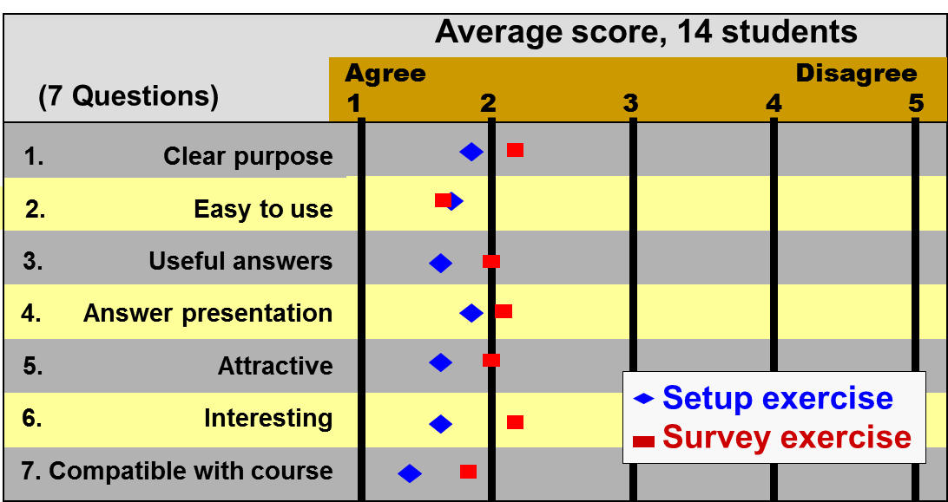
4a. Challenges “solved”:
Students can fail “safely” during a decision sequence that depends on prior technical knowledge.
Some activities have solo &/or group deliverables suitable for grading.
Students “like” it and recognize it’s relevance.

Slide 7
4b. Challenges not yet “solved” :
Efficiently designing decision tree exercises.
Incorporating them into instruction.
Assessing competence (“grading”).
Possibilities / Needs:
  Track student clicks or choices in a new setting (needs I.T. help).
  Ask single questions based on a tree PLUS “why or how did you make this decision”.
  Group (team-based) exercises and exams
  Test experimentally the impact of decision tree assignments.
  Other ideas?

Slide 8
Physical properties
Activity objectives: demonstrate the steps involved in matching
geophysical properties to geoscience tasks.
Testable learning objectives: after the demo, translate to another setting.
The 4 requirements are:
a. Path and depth of pipeline
b. Volume of calcine
c. Bedrock topography
d. Presence of plume
properties crsswrd
relative materials
1. What geologic materials
are expected at this field site?
12
materials
2. What are expected relative
values of these materials?
Explain why we need this.
3. for each requirement what
exactly should be imaged?
object, zone or horizontal
or vertical boundary.
keyword
pipeline
bedrock
plume
if all four are
completed
calcine
4. pipeline: image
object, zone or boundary?
5. calcine: image
object, zone or boundaries?
bndy is harder here
6. bedrock topo: image
object, zone or boundary?
7. plume: image
object, zone or boundary?
bndy likely not distinct
wrong
wrong
8. why (loose time)
wrong
wrong
right
9. why
right
10. why
right
11. why
right
12. object’s
detectable property
lo res’y
13. zone’s
detectable property
lo res’y, hi den’y
14. H bound’y’s
detectable property
low res‘y, NOT den
15. zone’s
detectable property
low res‘y, NOT den
wrong; do nothing
loose time
right; return to 3.
16. Summarize materials & relative values, imaging needs for each of task,
and corresponding detectable property contrast.
ASSETS
nonproductive time
generate RFP
design surveys
Assessment: how to test whether learning objectives were met?

Slide 9
Set up
Activity objectives: demonstration how to identify the ways that geophysics can contribute.
Testable learning objectives:
True needs are as follows (false needs could be added)
- Map bedrock topography along most likely groundwater flow path downstream of the dam.
- Identify a possible high conductivity plume.
- Find location, and estimate volume, of calcine dumps.
- Find location and depth of the buried steel pipe.
Introduction:
on the home page
1. Outline of objectives
and situation.
first
subsequent
only if 4,5
anytime
only if 4.
only if 3,4,5.
2. Review 7-step
framework (ref)
3. Call the mine
site manager
4. Research a summary
of the site history
5. Organize a
field site visit
8. Establish clear
needs of the project
4 choices;
wrong ones
add u-p-t
if 4 done
if not 4
direct
direct
change first link
to subseqent
return
to 1.
bkgnd-quiz
6. Carry out a
site visit (ref)
9. identify needs
seven button click.
optional
return to 1.
keyword
7. Learn about
the site. (ref)
keyword
NEXT appears
only if correct
3 buttons were
removed.
12. Research the
literature for precedent
prior info
10. subsurface aspcts
that are needed.
What key words would you use?
What references can you find?
- Without reading references in detail, what kinds of methods are people using to address the types of questions you have identified.
infotype
keyword
ASSETS
nonproductive time
11. Summary page
Done or Next
Assessment: how to test whether learning objectives were met?

Slide 10
pointers
http://www.halfbakedsoftware.com/quandary.php
http://www.jiscdigitalmedia.ac.uk/guide/using-quandary-to-add-interactive-learning-objects
http://urls.bccampus.ca/h6

Slide 11
Context for here and now
The one course in applied geophysics methods for geological engineering AND geology majors.
Traditional tasks:
give a setting, analyze survey data, fine answer (depth to target, conductivity of volume, etc …)
Ideas here might transfer to other settings.

