Slide 1
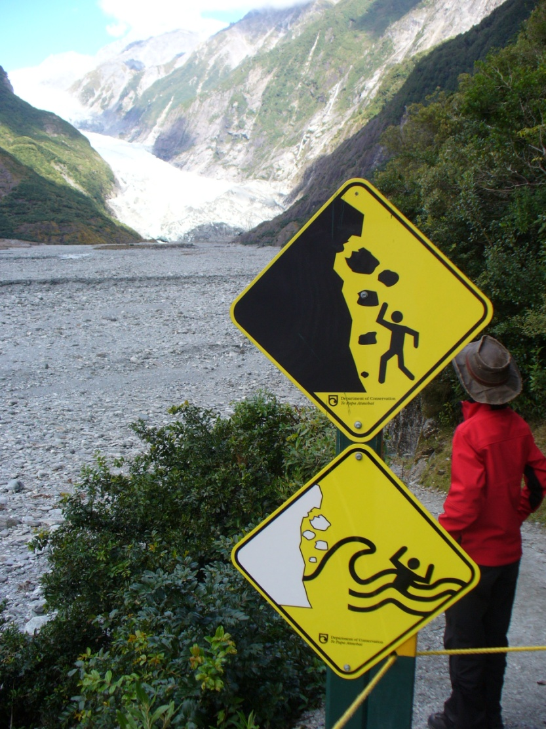

Challenges InTeGrating Engineering and Geoscience Cultures
Paul M. Santi
Colorado School of Mines

Slide 2
Contrasting Interests
Scientist vs. Engineer
Why? So what?
Descriptive Importance
Understanding Significance
Geologic maps Derivative maps
Bedrock Surficial deposits
Where are outcrops? How deep is bedrock?
What process created? Is it still active?
Past-oriented model: present is key to the past
Future-oriented model: recent past is key to near future

Slide 3
5 words to describe…
Engineering to geologists:
Practical (multiple constraints)
Quantitative (need values to work with)
Resourceful (how can we do this?)
Linear
Solution-driven (have to pull the trigger sometime)
Geology to engineers:
Vast (ancient, large)
Ambiguous
Cyclical (dynamic processes)
Observational (forensic)
Hypothesis-driven (hold competing thoughts in balance)

Slide 4
What students want out of courses
Geologists:
Gee whiz
Scenery, landscape, nature
Impressive, vast, old, powerful
Planetary scale
Appreciation
“I understand this”
Engineers:
Sophisticated skill
Problem-solving tools
Elegant, clever solutions
Know-how
“I can do this”

Slide 5
The continuum
Geologist
Origin of land mass
Building Construction
Engineering Geologist
Process that created this site
Geological Engineer
Rates of processes, extent and properties of materials
Significant overlap
Geotechnical Engineer
Foundation design
Civil Engineer
Structural Engineer
Building design

Slide 6
The continuum
Geologist
Environment of deposition, stratigraphic packages
Hazardous Waste Site Cleanup
Engineering Geologist / Geomorphologist
Water-bearing units, extent and trend and variability
Significant overlap
Hydrologist
Aquifer flow parameters, contaminant transport
Environmental Engineer
Clean-up technology, pumps and piping, chemistry

Slide 7
The continuum
Geologist
Mineral suite, origin, extent
Mine Design
Geological Engineer
Pit slope design, water control
Minimal overlap
Mining Engineer
Extraction plan, mine layout
Metallurgical Engineer
Processing system

Slide 8
Challenges communicating between cultures
Areas of overlap reduce appreciation of need for other fields
Value different parts of the problem-solving process (hypothesis – front end vs. solution – back end)
Want different things out of classes
Embraces ambiguity vs. driven towards practicality

