Slide 1
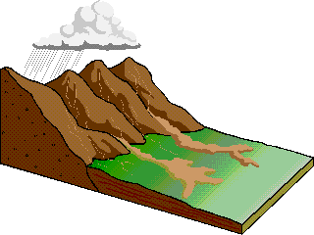
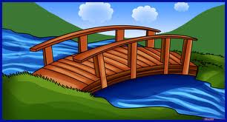
Bridging the “Disciplinary Divide”
Steve Burian
Department of Civil & Environmental Engineering
Assoc. Director, Global Change and Sustainability Center
Co-Director Sustainability Curriculum Development
University of Utah

Slide 2
Bridging the “Disciplinary Divide”
Steve Burian
Department of Civil & Environmental Engineering
Assoc. Director, Global Change and Sustainability Center
Co-Director Sustainability Curriculum Development
University of Utah

Slide 3
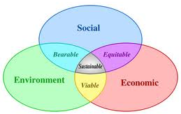
Bridging the “Disciplinary Divide”
Steve Burian
Department of Civil & Environmental Engineering
Assoc. Director, Global Change and Sustainability Center
Co-Director Sustainability Curriculum Development
University of Utah

Slide 4

My History
Teach Sustainability + CE courses
Teach 3 upper division massively multidisciplinary courses
    Sustainability Practicum
    Sustainable Infrastructure
    Hydrotopia
Team taught with instructors from:
    Geology and Geophysics
    Urban Planning
    Atmospheric Sciences
    Engineering
    Philosophy
Many failures, but learned
A few successes to share…

Slide 5
Classroom Strategies
Team Teaching
Establish Disciplinary Respect and Awareness
Develop Common Language
Use Differential Teaching Tactics

Slide 6
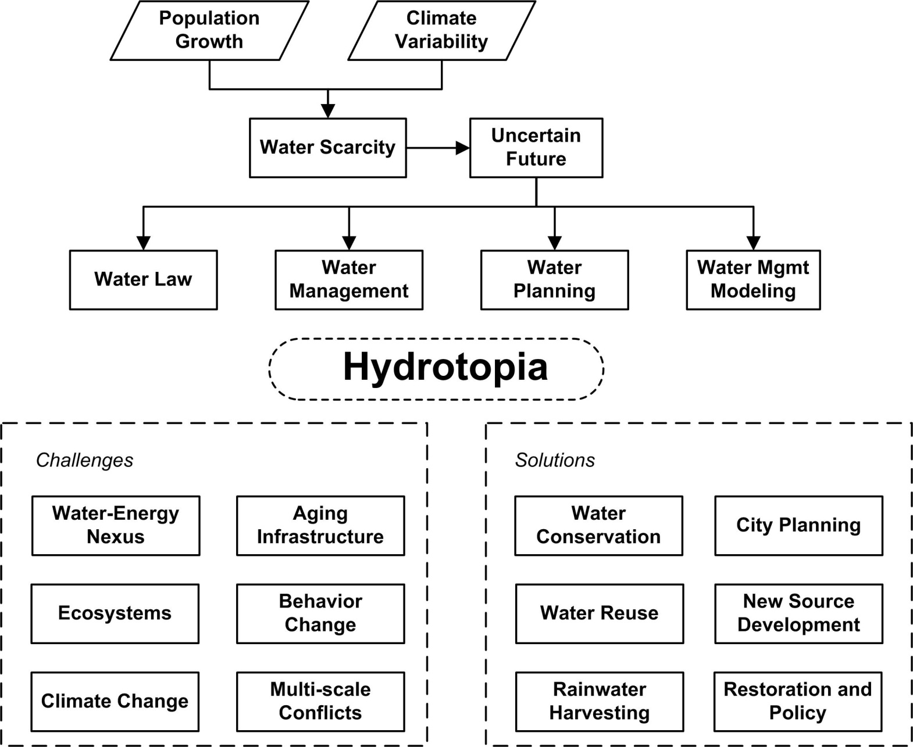
Hydrotopia
Course Goal: develop professionals responsible for planning, designing, managing, and operating water resources systems and facilitating the interaction of those systems with society in the western U.S.

Slide 7
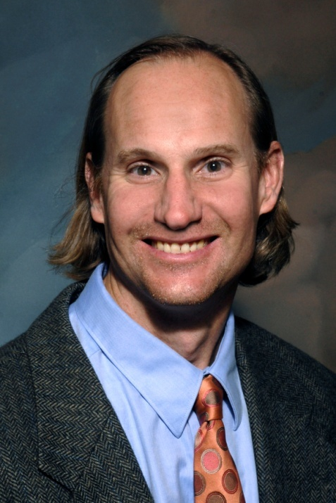
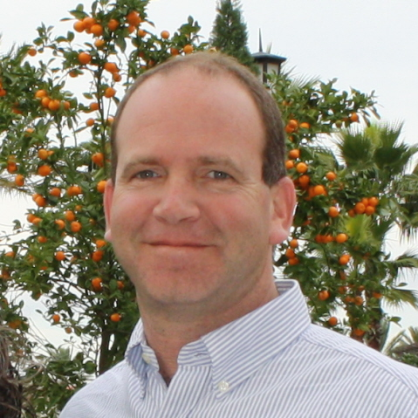
Team Teaching

Slide 8
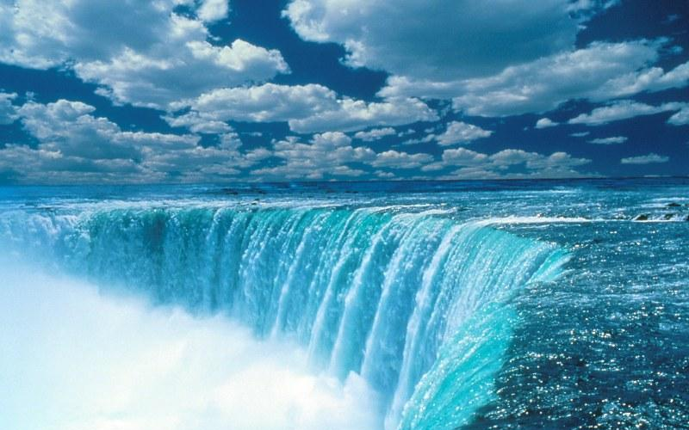
Team Teaching

Slide 9
Team Teaching
Relationship

Slide 10
Team Teaching
Relationship
Together

Slide 11
Team Teaching
Relationship
Together
Effective Teachers

Slide 12
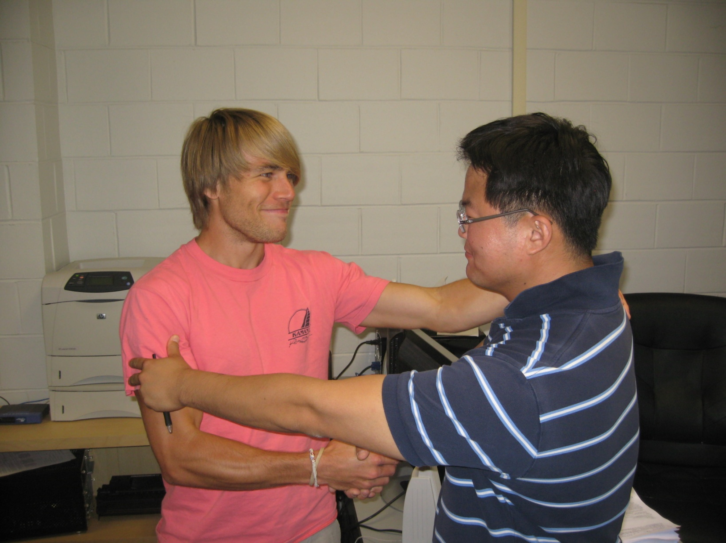
Establish Respect

Slide 13
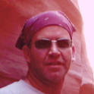
Common Language
Sustainable Development: A set of environmental, economic and social conditions in which all of society has the capacity and opportunity to maintain and improve its quality of life indefinitely without degrading the quantity, quality or availability of natural resources and ecosystems.
Design requires *&X>!D)+]
Processes and &*&X>!D)+]
Sustainable Development: Meeting the needs of the present without compromising the ability of future generations to meet their own needs.
Sustainable Development: achieving prosperity of the present without compromising the ability of future generations to be prosperous.
Sustainability: ability to sustain
Sustainability: capacity to endure
Sustainability: ability to be supported

Slide 14
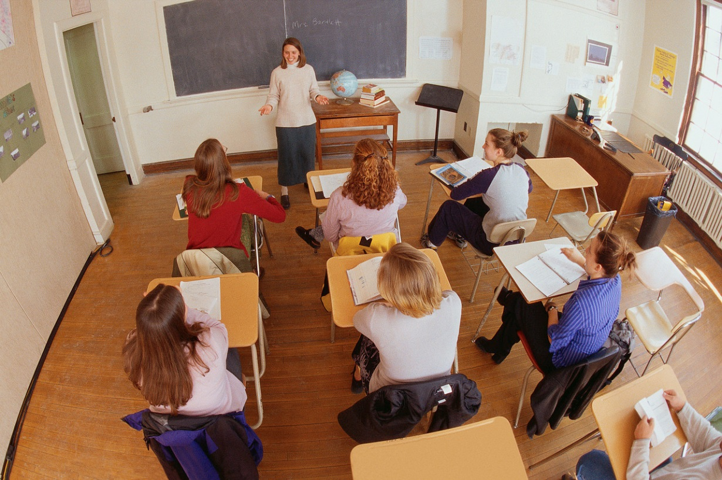
Differential Teaching
Learning Objectives
In-Class Team Activities
Small Group Discussions
Project-Based Learning
Linked Learning

Slide 15
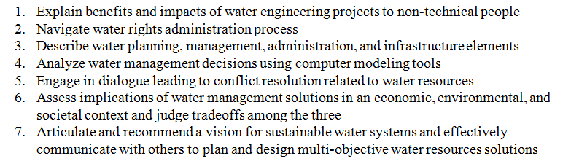
Differential Teaching
Learning Objectives
In-Class Team Activities
Small Group Discussions
Project-Based Learning
Linked Learning

Slide 16
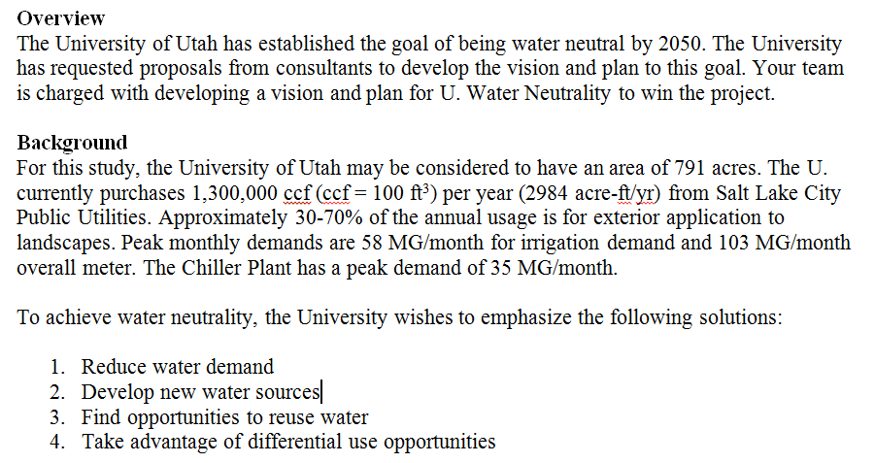
Differential Teaching
Learning Objectives
In-Class Team Activities
Small Group Discussions
Project-Based Learning
Linked Learning

Slide 17
Differential Teaching
Learning Objectives
In-Class Team Activities
Small Group Discussions
Project-Based Learning
Linked Learning
The design requires…
We achieved social equity!

Slide 18
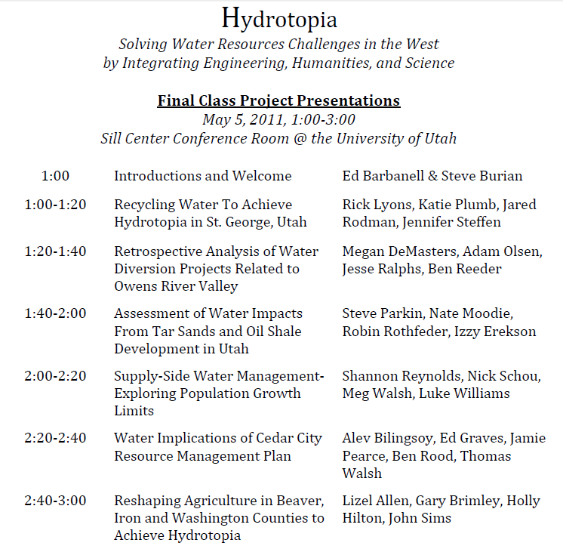
Differential Teaching
Project-Based Learning

Slide 19
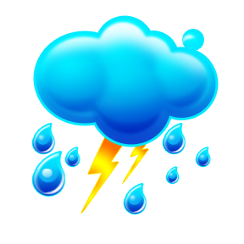
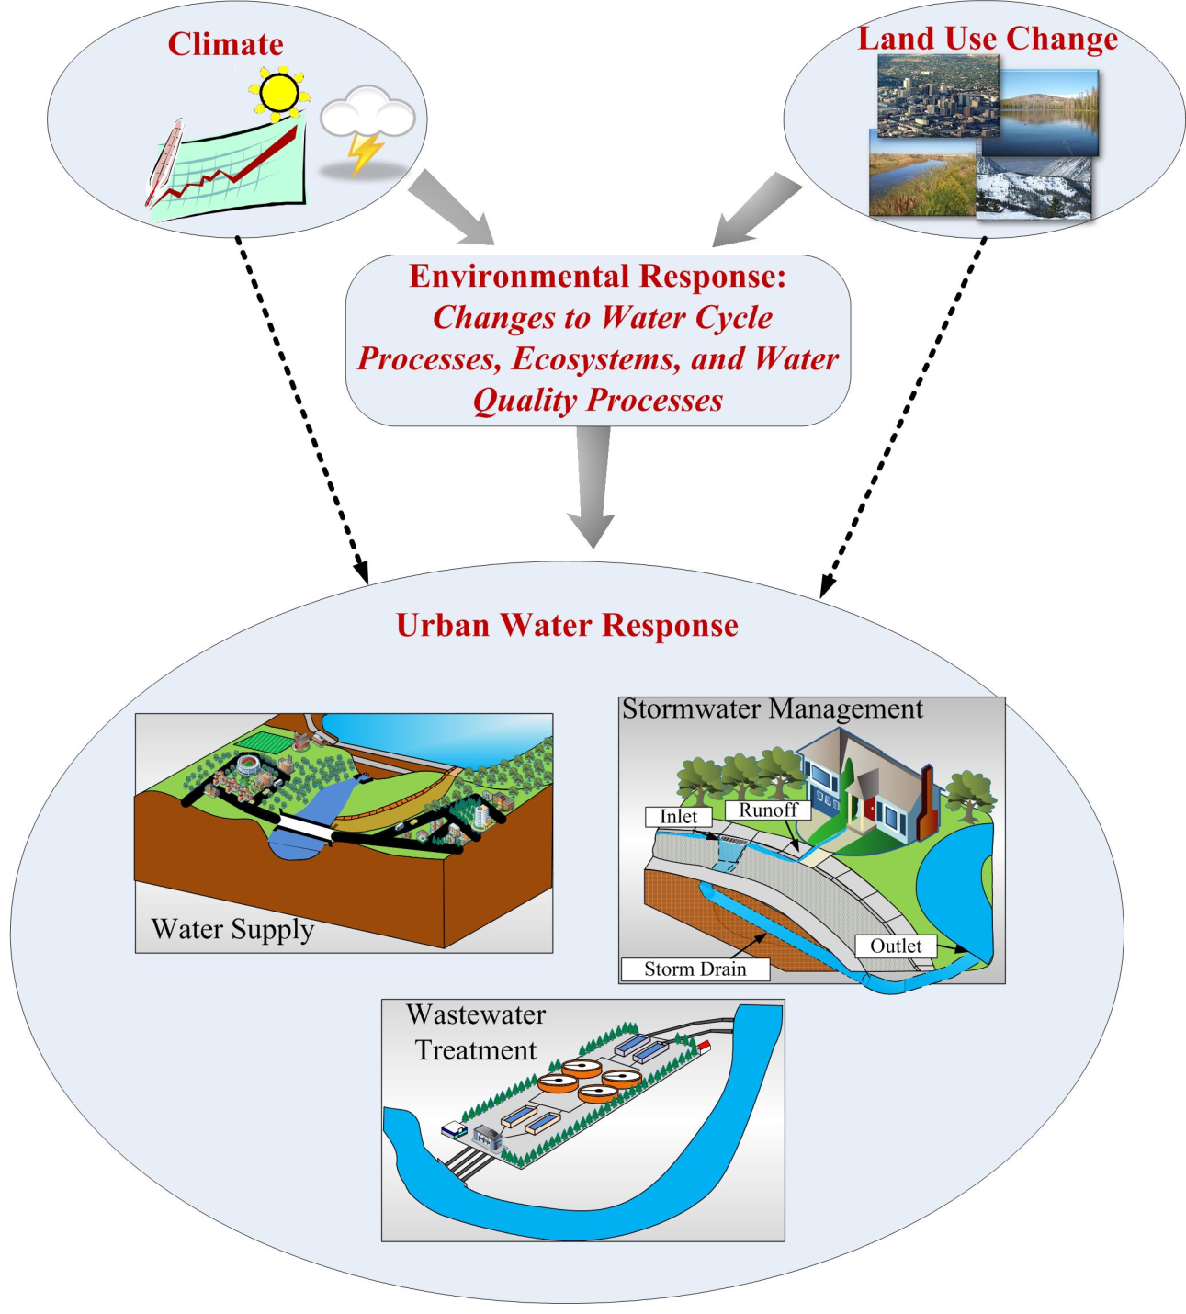
Differential Teaching
Learning Objectives
In-Class Team Activities
Small Group Discussions
Project-Based Learning
Linked Learning

Slide 20
Thank You
Steve Burian
burian@eng.utah.edu

