Slide 1
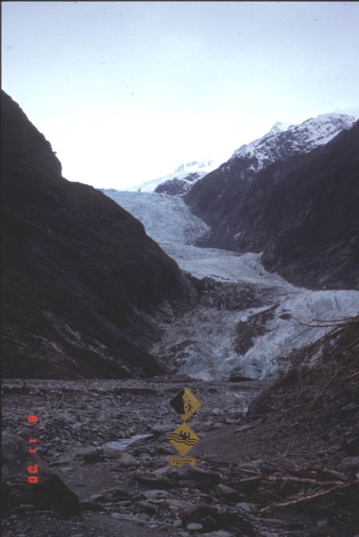

Accidentally teaching engineering to science majors
Gigi Richard, Ph.D.
Associate Professor of Geology
Colorado Mesa University
(formerly Mesa State College)

Slide 2
My background
1989 – BS Civil Engineering, MIT
1997 – MS Civil Engineering, CSU
2001 – Ph.D. Civil Engineering, CSU
2002 – present Associate Prof of Geology
2008-2011 – Coordinator CMU/UC-Boulder Mechanical Engineering Partnership Program

Slide 3
Courses taught at CMU
CHEM 100 – Chemistry and Society
ENVS 101 – Intro to Environmental Science
GEOL 111L – Physical Geology Lab
GEOL 107 – Natural Hazards & Env Geology
GEOL 305 – Cartography for GIS
GEOL 332 – Intro to GIS
GEOL 375 – GPS for GIS
GEOL 250 – Environmental Geology
GEOL 325 – Engineering Geology
GEOL 355 – Basic Hydrology
GEOL 415 – Intro to Ground Water
GEOL 455 – River Dynamics
Gen-Ed Classes
Emphasis on sustainability
GIS/GPS Technology
Map design
Semester projects
“Anthropocentric Geology”
Problem-solving and Sustainability
Upper-division
Problem-solving emphasis
Real data

Slide 4
Goals
Make the material relevant
  “what does this mean to me?” “why do I need to know this?”
Develop problem-solving skills
Make sustainability relevant- “how can I be part of a solution?”
How?
  Use real-world data and problems
  Apply course material to solve environmental problems

Slide 5
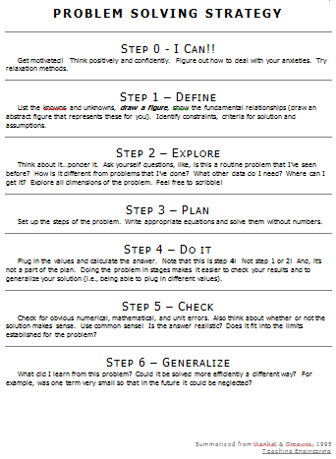
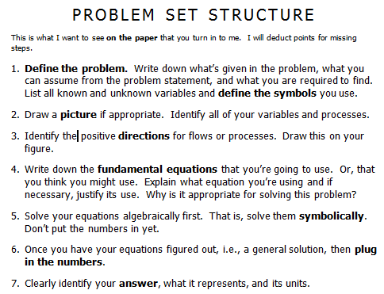
Building problem-solving skills

Slide 6
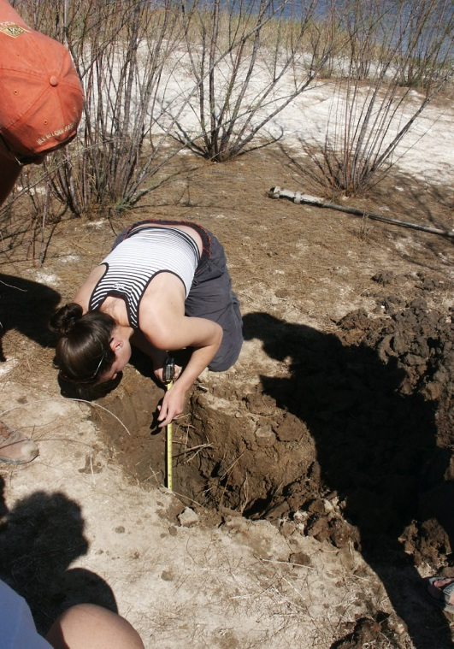
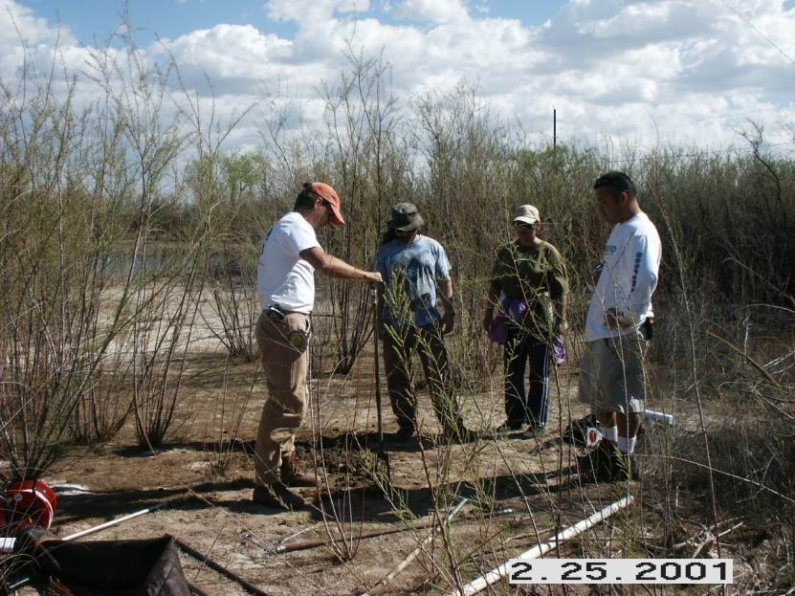
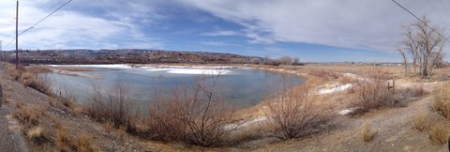
Example – Intro to Ground Water
Mesa County Gravel Pit
Wetlands restoration & mitigation banking site
2004 – CMU students installed piezometers
Continued monitoring in Intro to Ground Water lab
Value of collaboration with local gov’t and continued monitoring
“real” problem – understand what is driving water level fluctuation – irrigation water? Colorado River? Precipitation?
  Potentiometric surface mapping
  Field skills
  Exposure to complex interactions in natural systems where there is not a clear perfect solution

Slide 7
Example – Basic Hydrology
Evaporation and Evapotranspiration
  Physical process
    Factors that affect rate of process
    Spatial and temporal variability
  Measurement methods
  Estimation methods
    Physically-based methods
    “Cookbook” methods
Reservoir evaporation in the west. Lakes Mead and Powell vs. Blue Mesa.
Are two reservoirs better than one?
Evaporation from proposed new reservoir in Grand Valley?
Blaney-Criddle method used to estimate consumptive use of crops for Colorado agricultural water rights
Notes:
Use same method for each hydrologic process – cover the basics of how the physical process works, what factors influence the rate of each process, spatial and temporal variability of the process
Measuring the process – shift from point measurement to areal average

Slide 8
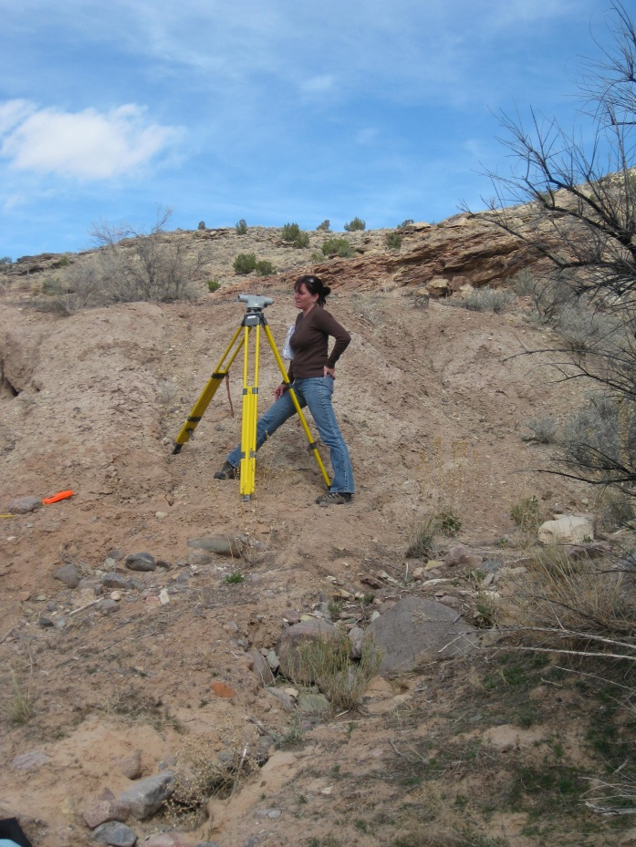
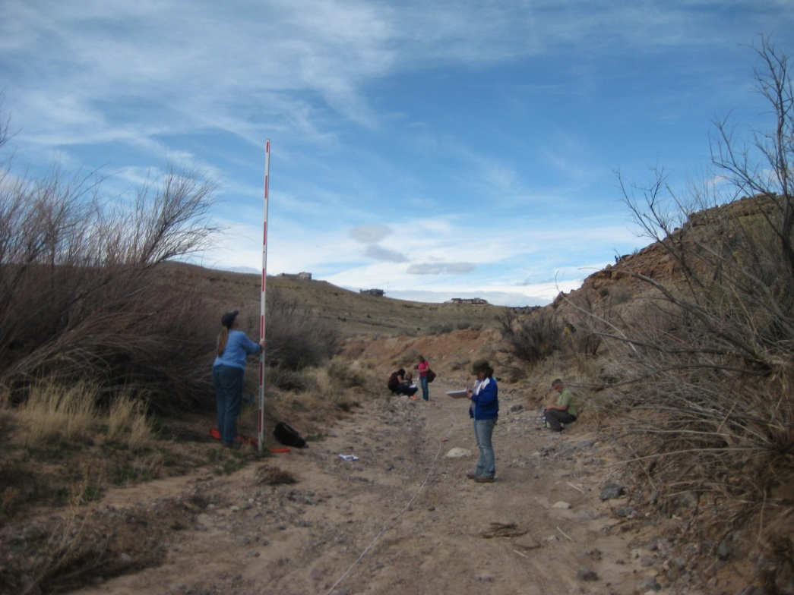
Example – River Dynamics
Flash Flooding – indirect discharge measurements & HEC-RAS modeling
  Discharge necessary to entrain bed material
  Challenge - No calibration data
Notes:
400-level class
Mixture of envs and geology majors with different backgrounds
Some have taken water quality and aquatic restoration, others have lots of geology and no water
Have had physics majors also
Challenges – streams nearby with water. Colorado River is too big for wading. So use ephemeral washes. Makes surveying easy and safe!
Flood frequency curves and flow duration curves – Excel lab sessions
Suspended sediment load and annual yield – sediment rating curves
Use same gaging station on Colorado River – visit with USGS hydro tech

Slide 9
Challenges
Lack of math skills
How to teach problem-solving skills
Varying levels of preparation
  Engineering vs. science majors
How to teach technical writing skills
Uncertainty and complexity of natural systems

