Slide 1
Grand Challenges
Energy resource availability - balance between energy security and development of less environment-friendly sources in North America
Mineral resource development - population, wealth distribution, technology, limited supplies, recycling, waste management
Land use - ecosystem changes (e.g., deforestation) and implications for biological diversity and biogeochemical cycles
Biogeochemical cycles - movement of key elements (e.g., C, N)
Hydrologic cycles – supply and demand, contamination, landscape change
Hazard awareness - preparation for future natural disasters, predictions, cost/benefits
Infectious diseases - environmental factors may affect distribution, transmission, severity of diseases
Climate patterns - short-term time scales (seasonal, decadal), implications for severe weather events, ocean/atmosphere
Biological diversity - biomes, geological past, implications for future
Jones Kershaw, P., 2005, Creating a disaster resilient America: Grand challenges in science and technology. Summary of a workshop. National Research Council, http://www.nap.edu/catalog.php?record_id=11274.
National Research Council, 2001, Grand Challenges in Environmental Sciences. Washington, D.C., National Academy Press, 106 p.
Zoback, M, 2001, Grand challenges in Earth and Environmental Sciences: Science, stewardship, and service for the Twenty-First Century. GSA Today, December, p.41-47.
Global climate system - link together many of the topics on the basis of the most recent modeling for future trends

Slide 2

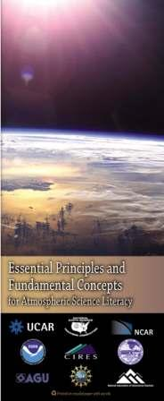
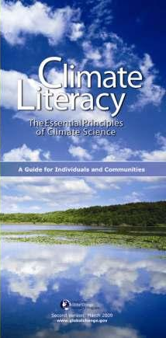
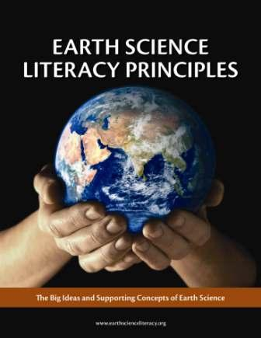
The Geoscience Literacy Documents

Slide 3
Geoscience Literacy Connections
Theme | Earth Science | Atmospheric Science | Climate Science | Ocean Science
Nature, methods, processes of science | 1. Earth scientists use repeatable observations and testable ideas to understand and explain our planet | 6. We seek to understand the past, present, and future behavior of Earth's atmosphere through scientific observation and reasoning. | 5. Our understanding of the climate system is improved through observation, theoretical studies and modeling. | 1. The Earth has one big ocean with many features. 7. The ocean is largely unexplored.
Earth is composed of four interacting systems | 3. Earth is a complex system of interacting rock, water, air, and life. (3.2 All Earth processes are the result of energy flowing and mass cycling within and between Earth’s systems. 3.3 Earth exchanges mass and energy with the rest of the Solar System) | 5. Earth's atmosphere continuously interacts with the other components of the Earth System. | 2. Climate is regulated by complex interactions among components of the Earth system. | 3. The ocean is a major influence on weather and climate. (3A. The ocean controls weather and climate by dominating the Earth’s energy, water and carbon systems.)
External and internal energy sources drive Earth processes |  | 2. Energy from the sun drives atmospheric processes. 3. Atmospheric circulations transport matter and energy. | 1. The sun is the primary source of energy for Earth's climate system
Earth system components undergo changes at a range of temporal and spatial scales | 2. Earth is 4.6 Byrs old. 4. Earth is continually changing. 5. Earth is the water planet. | 4. Earth's atmosphere changes over time and space, giving rise to weather and climate. | 4. Climate varies over space and time through both natural and man-made processes. | 2. The ocean and life in the ocean shape the features of the Earth.
The history of life has influenced and, has been influenced by, the natural environment | 6. Life evolves on a dynamic Earth and continuously modifies Earth. | 1. Earth has a thin atmosphere that sustains life. | 3. Life on Earth depends on, has been shaped by, and affects climate.
 |  |  |  | 4. The ocean makes Earth habitable. 5. The ocean supports a great diversity of life and ecosystems.
Modern societies have adapted to, and continue to change, the environment | 7. Humans depend on Earth for resources. 8. Natural hazards pose risks to humans. 9. Humans significantly alter Earth. | 7. Earth's atmosphere and humans are inextricably linked. | 6. Human activities are impacting the climate system. 7. Climate change will have consequences for the Earth system and human lives. | 6. The ocean and humans are inextricably interconnected.
after Duggan-Haas & Miller, 2009
http://virtualfieldwork.org/downloadabledocs/Earth_Science_Ideas_Rainbow_Charts.pdf

Slide 4
Constructive Alignment
Literacy Big Ideas
Assessments
Course/Module Goals
Learning Objectives

