Slide 1
Geoscience Literacy Connections
Theme | Earth Science | Atmospheric Science | Climate Science | Ocean Science
Nature, methods, processes of science | 1. Earth scientists use repeatable observations and testable ideas to understand and explain our planet | 6. We seek to understand the past, present, and future behaviour of Earth's atmosphere through scientific observation and reasoning. | 5. Our understanding of the climate system is improved through observation, theoretical studies and modeling. | 1. The Earth has one big ocean with many features. 7. The ocean is largely unexplored.
Earth is composed of four interacting systems | 3. Earth is a complex system of interacting rock, water, air, and life. (3.2 All Earth processes are the result of energy flowing and mass cycling within and between Earth’s systems. 3.3 Earth exchanges mass and energy with the rest of the Solar System) | 5. Earth's atmosphere continuously interacts with the other components of the Earth System. | 2. Climate is regulated by complex interactaions among components of the Earth system. | 3. The ocean is a major influence on weather and climate. (3A. The ocean controls weather and climate by dominating the Earth’s energy, water and carbon systems.)
External and internal energy sources drive Earth processes |  | 2. Energy from the sun drives atmospheric processes. 3. Atmospheric circulations transport matter and energy. | 1. The sun is the primary source of energy for Earth's climate system
Earth system components undergo changes at a range of temporal and spatial scales | 2. Earth is 4.6 Byrs old. 4. Earth is continually changing. 5. Earth is the water planet. | 4. Earth's atmosphere changes over time and space, giving rise to weather and climate. | 4. Climate varies over space and time through both natural and man-made processes. | 2. The ocean and life in the ocean shape the features of the Earth.
The history of life has influenced and, has been influenced by, the natural environment | 6. Life evolves on a dynamic Earth and coninuously modifies Earth. | 1. Earth has a thin atmosphere that sustains life. | 3. Life on Earth depends on, has been shaped by, and affects climate.
 |  |  |  | 4. The ocean makes Earth habitable. 5. The ocean supports a great diversity of life and ecosystems.
Modern societies have adapted to, and continue to change, the environment | 7. Humans depend on Earth for resources. 8. Natural hazards pose risks to humans. 9. Humans significantly alter Earth. | 7. Earth's atmosphere and humans are inextricably linked. | 6. Human activities are impacting the climate system. 7. Climate change will have consequences for the Earth system and human lives. | 6. The ocean and humans are inextricably interconnected.
after Duggan-Haas & Miller, 2009
http://virtualfieldwork.org/downloadabledocs/Earth_Science_Ideas_Rainbow_Charts.pdf

Slide 2
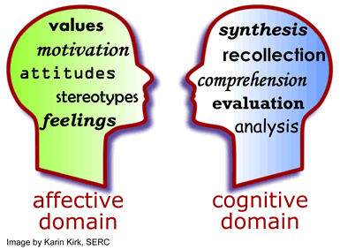
Affective Domain
The feelings, emotions, and general moods a learner brings to a task or that are generated in response to a task¹.
Cognitive Domain
Student conceptions and understanding of content.
Addressed through a variety of pedagogical interventions.
Educational psychology research reveals that student adoption of cognitive strategies may be influenced by affective factors such as motivation, attitudes, feelings and emotions.
Students leaving STEM fields often cite affective factors such as loss of motivation or interest in topic or development of interest in another field².
¹ Ormond, J., 2006, Essentials of Educational Psychology; ² Seymour & Hewitt, 1997, Talking about leaving: Why undergraduates leave the sciences.

Slide 3
Why should a student care about this stuff?
The affective domain involves attitudes, motivations, feelings and emotions that may hinder or promote learning. The cognitive and affective domains have fundamental significance for student learning. This morning we will consider the affective domain, which some researchers argue has perhaps the largest, influence on student learning.
Watch the 10-minute You-Tube video clip at the link below. The author, Daniel Pink, is describing how different aspects of the work environment can enhance motivation.
http://www.youtube.com/watch?v=u6XAPnuFjJc&feature=player_embedded
In your teams, suggest at ways in which an instructor could introduce
autonomy,
mastery, and
purpose
to enhance aspects of student learning when teaching your module.

Slide 4
Factors that influence learning
Student motivations
(things that drive learning, e.g., task value, self-efficacy)
Personal Characteristics of Student
(age, gender, academic rank, experience)
Course Outcomes
(effort, interest, performance)
Course Context
(tasks, grading policy, pedagogy, instructional resources)
Student self-regulation of learning
(studying and/or learning behaviors, e.g., planning, monitoring, reflection)
Instructional Design
Learning Process
Mastery
adapted from Pintrich and Zusho (2007)

Slide 5
Student Expectancy and Value
Expectancy of Success
Goal-directed behavior
Motivation
Learning & performance
Value of Task
After Fig. 3.1, Ambrose et al., 2010

Slide 6
Student Expectancy and Value
Align objectives, assessments, activities
Identify appropriate level of challenge
Provide early success opportunities
Articulate your expectations
Provide rubrics, targeted feedback
Discuss effective learning strategies
Expectancy of Success
Provide flexibility, control
Schedule opportunities for reflection
Goal-directed behavior
Motivation
Learning & performance
Value of Task
Link skills to professional lives
Identify, reward what you value
Show your passion, enthusiasm
Connect material to student interests
Provide real world tasks
Show relevance to academic future

Slide 7
Learning Environment, Student Expectancy and Value
Non-supportive Learning Environment
Supportive Learning Environment
Don’t see value
See value
Don’t see value
See value
Disengaged
Helpless
Disengaged
Fragile
Student’s expectancy of success is . . .
HIGH LOW
Evading
Defiant
Evading
Motivated
After Fig. 3.2, Ambrose et al., 2010

Slide 8
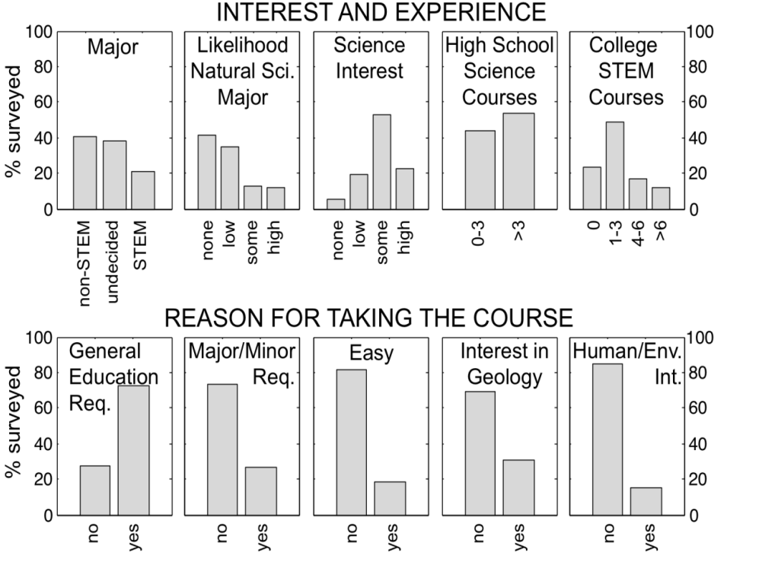
Most students report that they are taking a physical geology course to fulfill a requirement . . .
. . . and indicate at least some interest in science (about 30% declare an interest in geology).
Significantly lower scores on 6 MSLQ subscales
Significantly higher scores on 10 MSLQ subscales

Slide 9
Interest
Triggered situational interest –short term, the result of tasks that are surprising, novel, emotional, have personal relevance, or intensity. Provides an opportunity for students to form a connection to content. Questions at this stage provided by instructor.
Maintained situational interest – focused attention/persistence, involves successful completion of meaningful tasks (and understanding of content). Positive feelings developed in a supportive learning environment designed to motivate students to ask “curiosity” questions and may present students with choice of tasks.
Emerging individual interest – beginning of predisposition to reengage with content in future (when given choice), students have positive feelings, value topic, generate questions unprompted, and/or seek out resources independent of class. Instructors/peers model behavior, communicate well, demonstrate enthusiasm..
Well-developed individual interest – students internally driven to reengage with material for which they have a personal interest. Student can sustain long-term creative tasks and generates successful self-regulated learning strategies.
(Hidi, S., and Renninger, K. A., 2006, The four-phase model of interest development. Educational Psychologist, v. 41, no. 2, 111-127.)

