Slide 1
InTeGrate Assessment
David Steer, University of Akron
Ellen Iverson, Carleton College
May 2012

Slide 2
Materials Development Timeline
Materials Team Application Accepted
Checkpoint 1: Goals and Objectives
Checkpoint 2: Half of Module complete
Checkpoint 3: Confirm final review date
Materials Review (first payment upon passing materials review)
Materials Tested in Classroom
Materials Revised
Final Review
Materials published on InTeGrate site and become freely available for use (second payment upon completion)

Slide 3
Materials Development Timeline
Materials Team Application Accepted
Checkpoint 1: Goals and Objectives

Slide 4
Materials Development Timeline
Checkpoint 2: Half of Module complete
Materials Team Responsibilities: 50% complete with module/course. Significant description of goals, objectives, instructional strategies, and materials are available for review (on the team CMS workspace)
Assessment Team: consultant reviews and provides constructive feedback

Slide 5
Materials Development Timeline
Checkpoint 3: Confirm final review date
Materials Team Responsibilities: Nearly complete (75-90%) and available on the team CMS workspace. Confirm the final review date
Assessment Team: consultant reviews what is complete and verifies final review date

Slide 6
Materials Development Timeline
Materials Review (first payment upon passing materials review)
Materials Team Responsibilities: submits module/course for review on the team CMS workspace
Assessment Team: consultant and 2 other assessment team members review based on rubric. Within 2 weeks of submission, consultant provides team with review. ***If significant revision is required, return to Checkpoint 1***

Slide 7
Materials Development Timeline
Materials Tested in Classroom
Materials Revised
Final Review
Materials published on InTeGrate site and become freely available for use (second payment upon completion)

Slide 8
Assessment Elements
Design Rubric – to ensure we are testing strong materials that meet project goals
Geoscience Literacy Exam (GLE) – to measure geoscience literacy, understanding of process of geoscience, and systems thinking
Plus – to measure motivation to address societal issues
Embedded Assessments – to measure ability of materials to address stated learning objectives

Slide 9
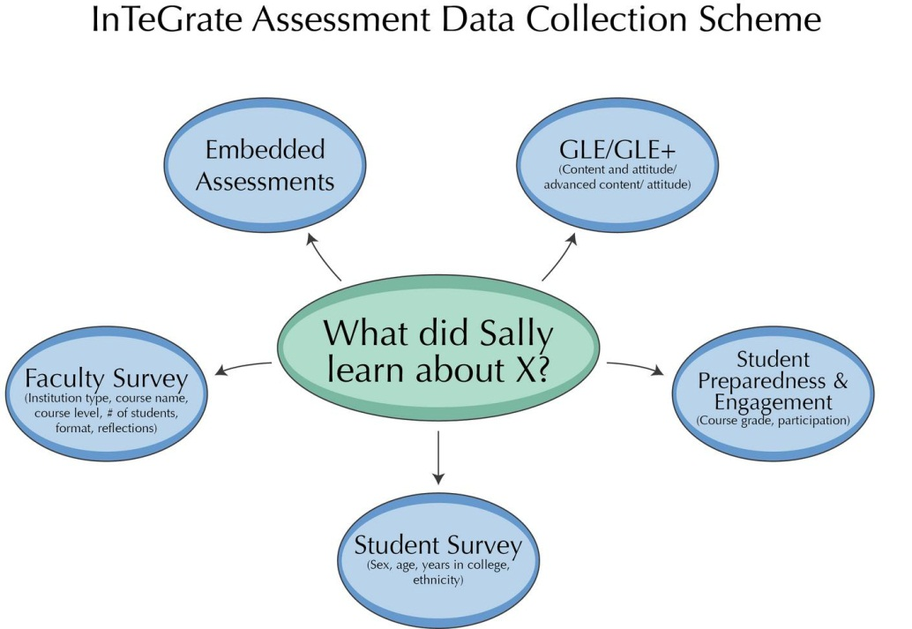

Slide 10
Assessment Procedure
9 total assessment team members (holding one spot open)
One member per development team
  Works with developers
  Collaborative relationship
Modules externally scored by 3-person team
  Majority rules on rubric scores
  Leader reports to development assessment member and development leader
Detailed Feedback provided

Slide 11
Feedback
Constructive: Offer solutions
Specific: Link directly to course components
Measureable: You will know when the recommendation has been implemented
Sensitive: Positive
Balanced: Strengths and weaknesses

Slide 12
Operations and Procedures
Collaborative relationship with Assessment Team member
  Materials Development
    Teams will manage their schedules and schedule dependencies with assessment member
    Teams will communicate with assessment member
Classroom Pilot Testing
    Requirements for collecting student assessment responses
    Collection procedures will be defined

Slide 13
Overview
May meeting
Finalize Materials Rubric
Review and develop items for Geoscience Literacy Exam (GLE)
May to August
Working with assigned module authors
Embedded assessments
Score materials
Participating on working groups (GLE, motivation and career questions)
Our next meeting
Analysis of collected student work (GLE and what embedded assessments data is available)

Slide 14
Proposed Rubric for course/module design
Six main components
  Overarching goals
  Learning objectives
  Assessment and measurement
  Resources and Materials
  Instructional Strategies
  Alignment
See scoring handout

Slide 15
Embedded Assessments
Play a critical role in evaluating if instructional materials and strategies are meeting the stated learning objectives. These assessments must be:
Part of the flow of class,
Graded by the faculty of the pilot testing classroom,
Summative, measuring the level of understanding when learning related to that objective is completed
Used in all materials pilot testing classrooms.
Format will vary depending on what aligns best with the given module.
Could include quizzes, a subset of exam questions, or homework.
Complete courses (both lab or field components), the embedded assessments could be collected as part of the lab or field experience.
All pilot testing classrooms, copies of all the student work for the embedded assessments must be sent to the InTeGrate project.

Slide 16
Geoscience Literacy Exam (GLE) and Plus
External Assessment
Assesses progress at meeting literacies and overarching goals
Probes multiple cognitive levels
PLUS Includes attitude and career interest measures

