Slide 1
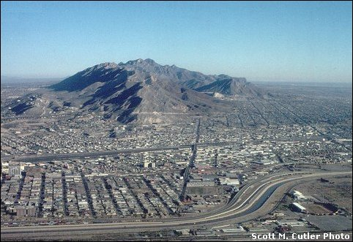
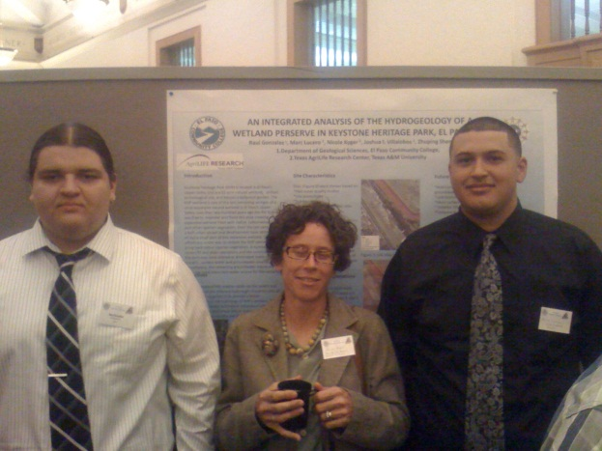

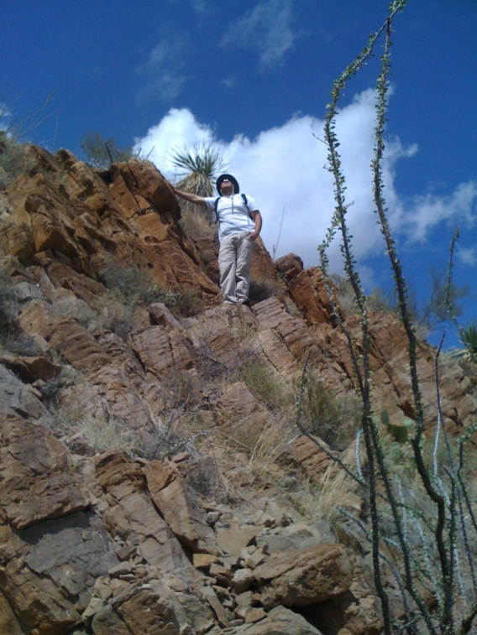
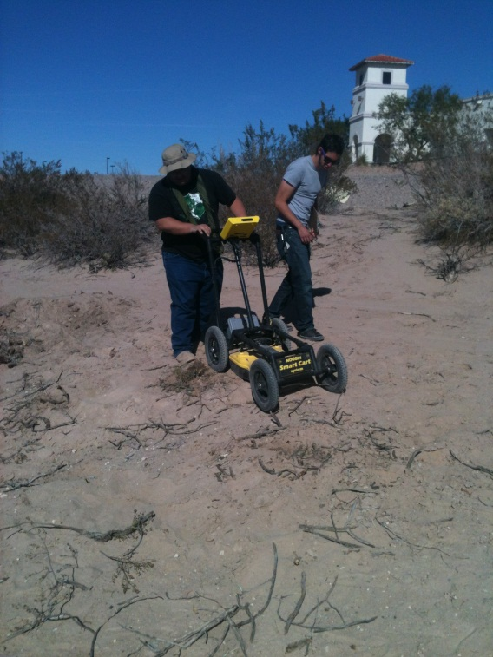
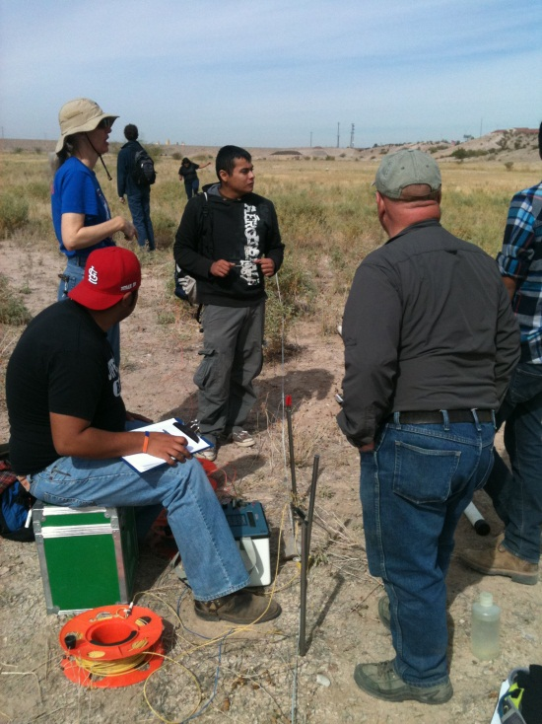
Increasing Participation and Matriculation in the Geosciences at El Paso Community College

Slide 2
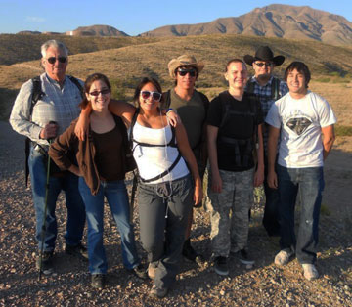
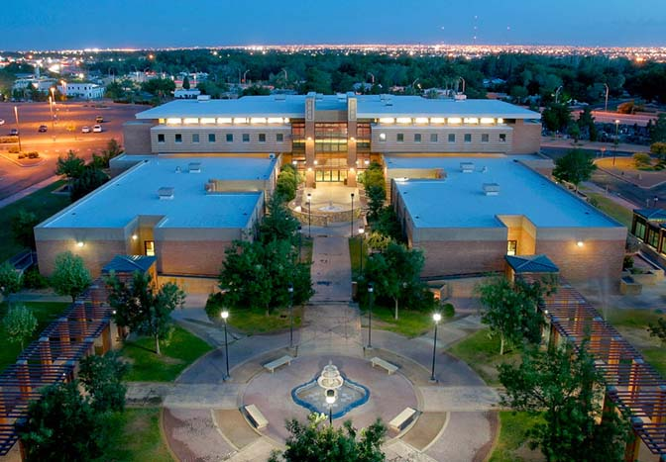
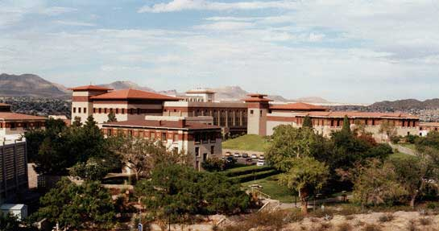
Background
EL Paso Community College
  30,000+ enrolled students (2011)
    ~ 90% Hispanic
    5 campuses (6th by 2013)
    5 Early College High Schools
  Over 130 programs of study
    Geological Sciences A.S.
  University of Texas at El Paso
    Geological Sciences B.S, M.S., Ph.D.

Slide 3
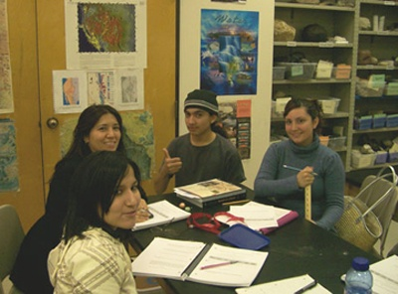
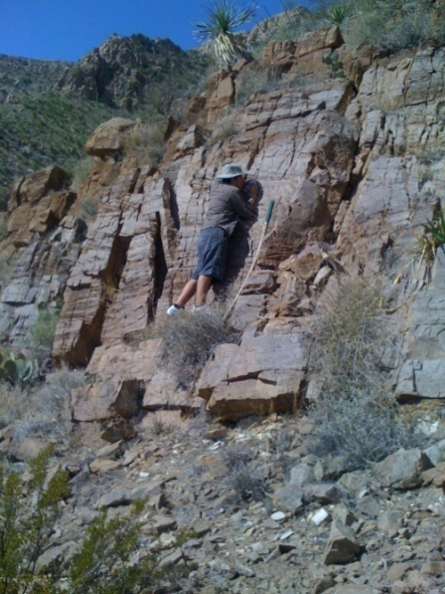
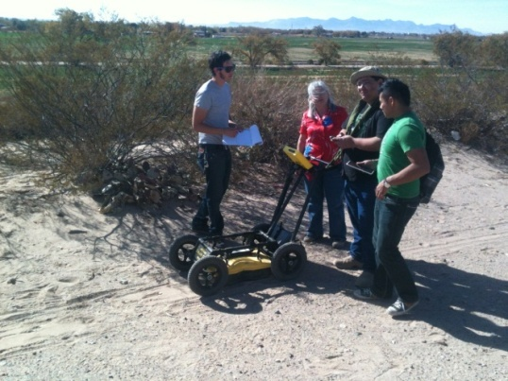
Increasing Participation
2004-2006 courses enrollment rose 26% to 2,984 students
2008 Geological Sciences A.S. created
  Designed as a 2+2 degree plan with UTEP
    60 credit hrs. at EPCC last 60 credit hrs. at UTEP
  Developed new EPCC geology courses
    GEOL 1305-Environmental Geology
    GEOL 2389- Research Topics in Geology
    GEOL 2407- Geological Field Methods (capstone course)
  Interactive online course catalog
2009-2010 24 Geology Majors at EPCC
As of Fall 2011 48 Geology Majors

Slide 4

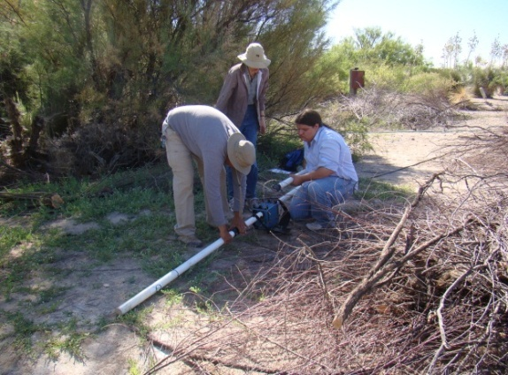
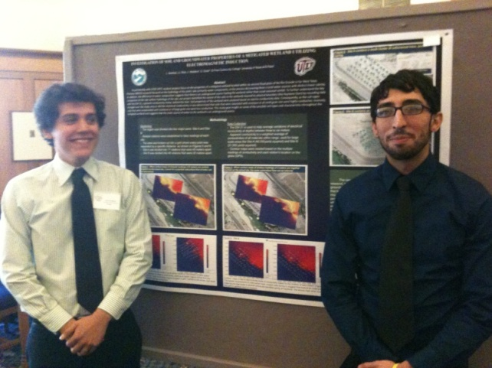
Increasing Matriculation
Spring 2010 research began at EPCC
  Funded by WAESO (Western Alliance to Expand Student Opportunities)
  8 students have since been funded:
    Integrated study of the hydrogeology of a wetland preserve
    Delineation of groundwater flow within the Rio Grande Flood Plain
    An Integrated Study Investigating Groundwater Flow in Keystone Park
    Investigations of Potential Archaeological sites horizons using Ground Penetrating Radar

Slide 5

SOLARIS
Track-1 project design:
  Component 1- educational outreach
    2-day workshop involving high school and Dual Credit Earth Science Instructors
      Day 1 –
        hands on earth science activities
        Speakers from local industries
        Counselors from EPCC and UTEP
        Educational kits
      Day 2-
        Field trip to local geology sites suitable for class field trips

Slide 6
SOLARIS
Component 2- student research (Spring-Fall 2012)
    $600 mini-grants for 5 EPCC faculty
    Support 10 geology majors at EPCC
      Stipend of $1000/semester
      $500 for supplies/rentals
      Travels for students to present research
    $5000 Sub-award to partnering 4-YC
        faculty co-mentoring
        Training on equipment
        Facilities (computer labs and software)

Slide 7
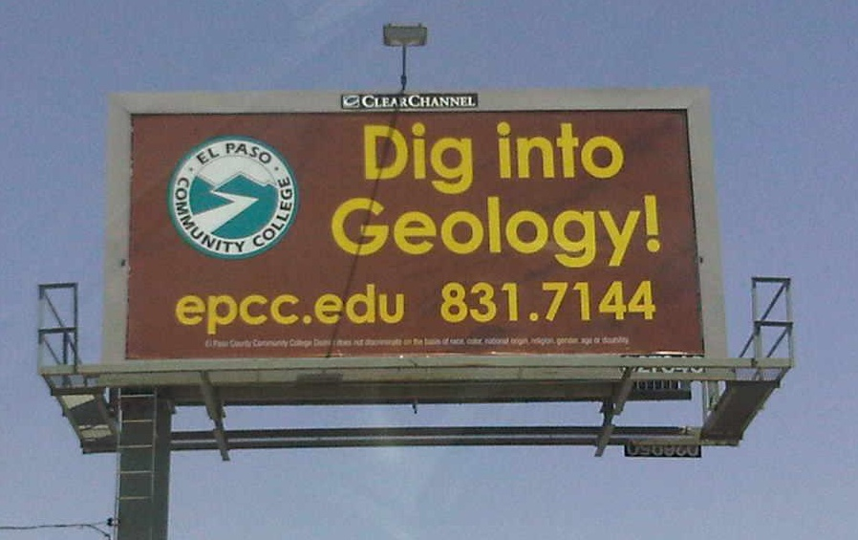
“EPCC the best place to start!”

