Slide 1
Mystery of the Back Yard Holes
Using the Scientific Method to Solve a Real-Life Problem
Allison Beauregard
Mattie Kelly Environmental Institute
Northwest Florida State College
Notes:
Let’s use the scientific method to solve a real-life problem.

Slide 2
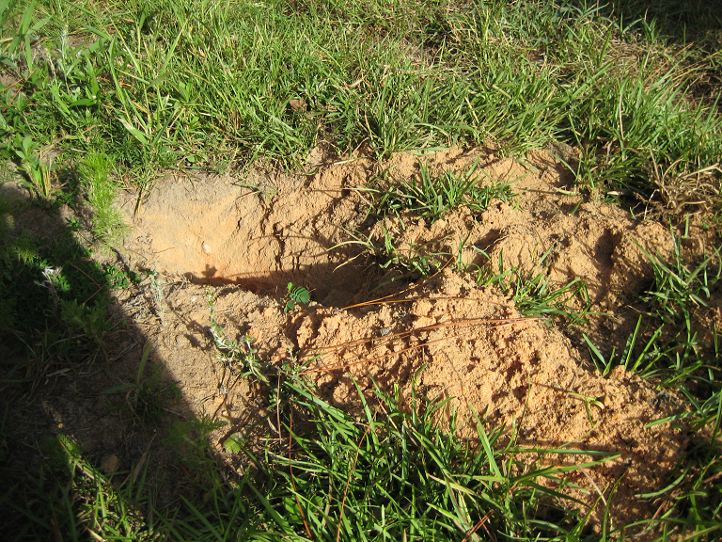
The Mystery ….
Notes:
I keep finding holes in my backyard. I am frustrated by this problem, because not only is it destroying the grass, but I am waiting for someone to trip in one of these holes and break a leg!

Slide 3
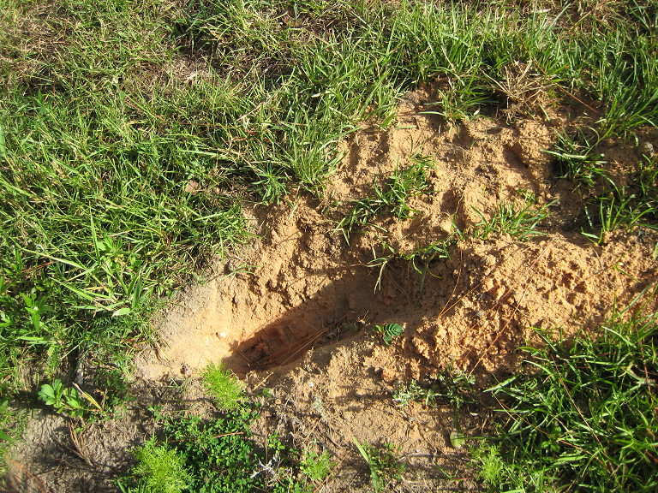
The Mystery ….
Notes:
The holes keep popping up, as if out of no where!

Slide 4
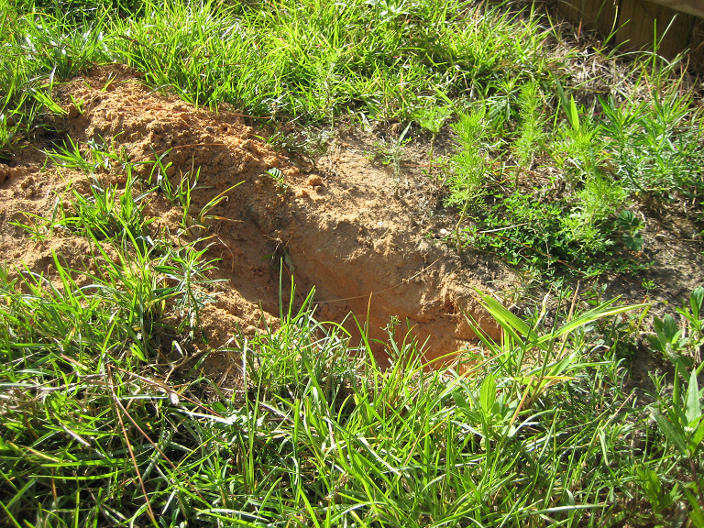
The Mystery ….

Slide 5
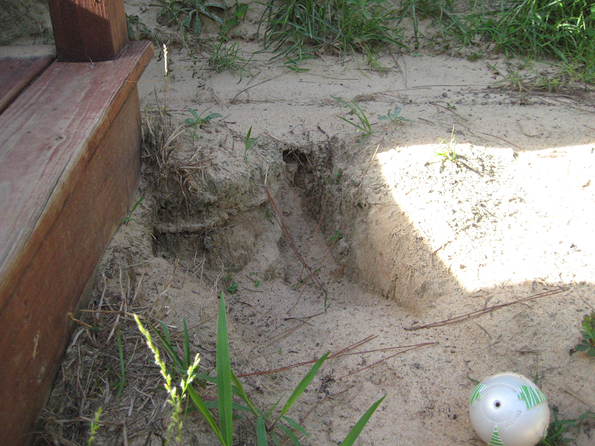
The Mystery ….
Notes:
This photo shows not only one of these holes, but also the toll they are taking on the lawn.

Slide 6
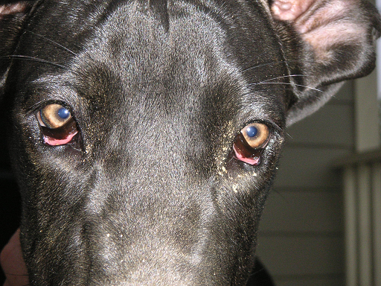
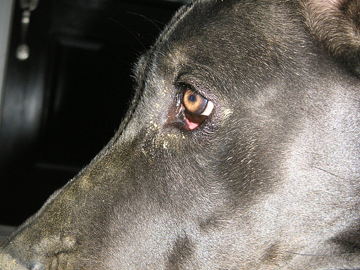
The suspect (hypothesis)…
Inmate # K-9
Front View
Left-Side View
Notes:
Meet Maggie. She’s a year-old Great Dane. And she is my prime suspect in this case.

Slide 7
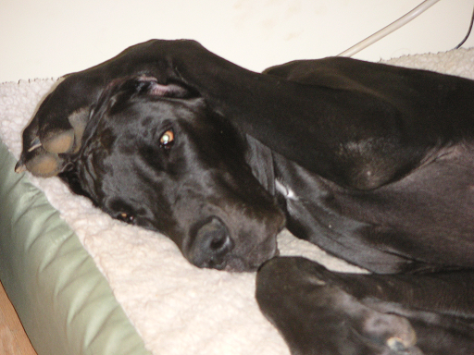
Notes:
Despite mounting evidence against her…. The suspect is unwilling to talk….

Slide 8
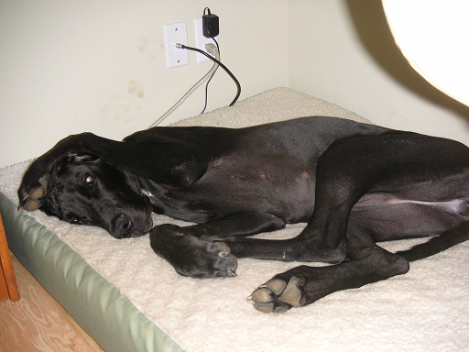
Notes:
She blatantly defies investigators and refuses to listen to questions asked about the origin of the holes….

Slide 9
finger prints
Notes:
Even when the evidence is glaring….

Slide 10
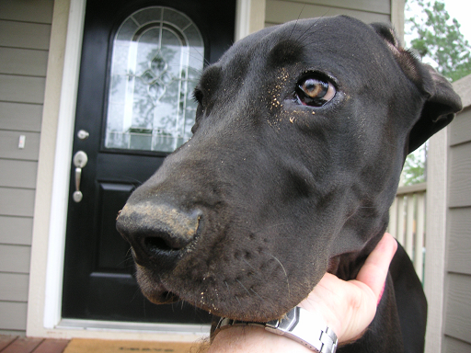
The Evidence (Observations)…..
Photo #1
Notes:
Following the appearance of one such hole, several photos were taken of the suspect. These photos suggest Maggie knows more about the origin of the backyard holes than she is letting on.
Several of these photos will now be presented as evidence….
Photo #1 shows dirt around Maggie’s eye and on her nose.

Slide 11
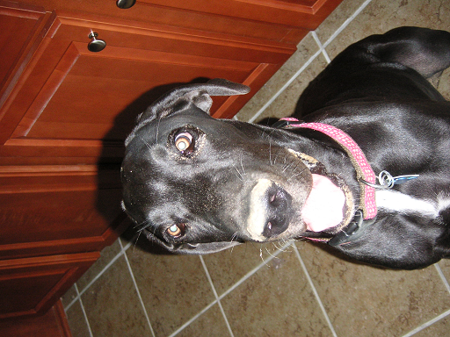
The Evidence (Observations)…..
Photo #2
Notes:
Don’t let her pleasant demeanor fool you, look closely to notice the “dirt smile”

Slide 12
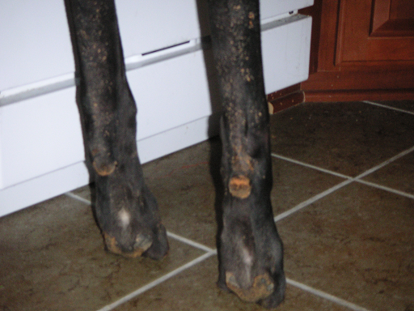
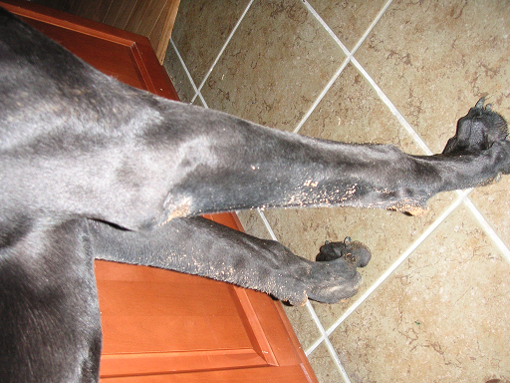
The Evidence (Observations)…..
Photos #3 and 4
Notes:
These photos show her front legs and paws covered with dirt!
Similar photos have been taken following the appearance of backyard holes on at least 5 separate occasions.

Slide 13
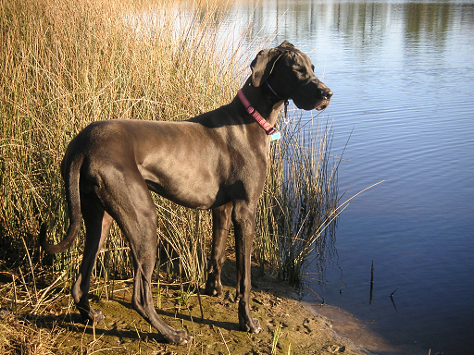
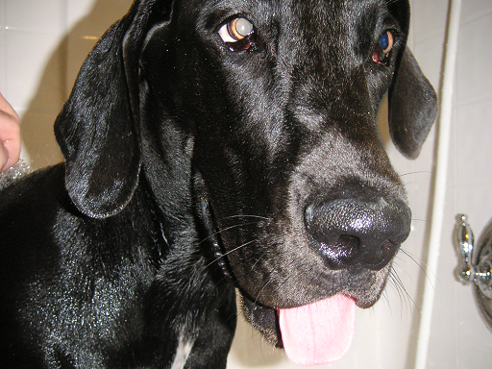
The Evidence (Observations)…..
Notes:
The dirt is not a constant feature of the suspect – sometimes she is clean. These clean periods tend to coordinate with periods in which the backyard holes are not present.
Further, I did not observe any backyard holes during the year that I lived in my house prior to Maggie’s arrival.

Slide 14
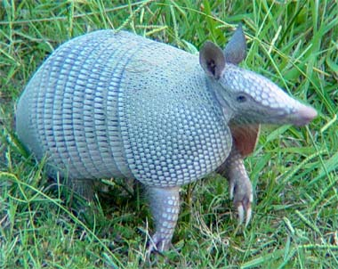
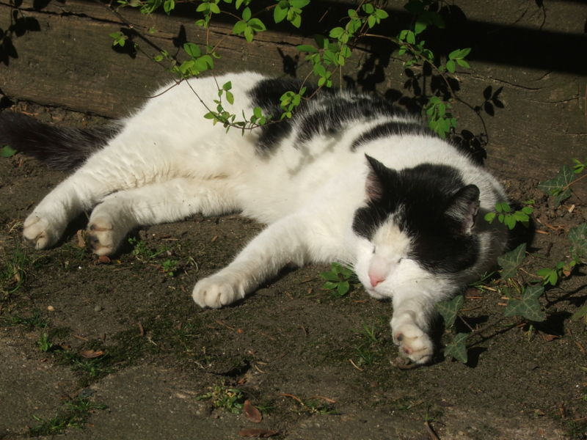
Other possible suspects….
neighbor’s cat
armadillos
Notes:
Before we fully formulate our hypothesis, we must also consider other reasonable alternatives. Is it reasonable to think that someone else might be responsible for the holes? Could Maggie have been “set up”?!
We considered some other local inhabitants….
The neighbor’s cat is unlikely – based on observations of her behavior, she seems far too lazy to bother digging a hole for fun.
The local armadillo population was also considered…..

Slide 15
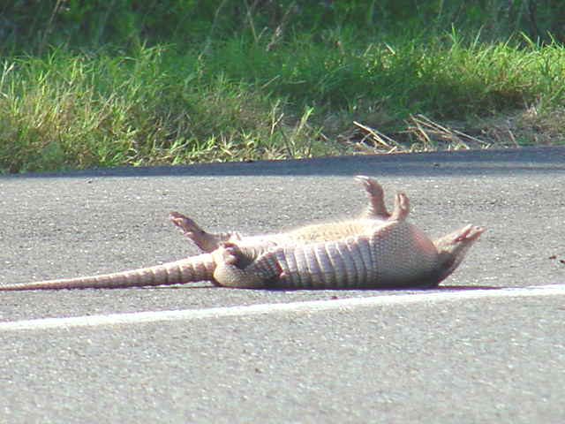
Other possible suspects….
Notes:
We believe this also an unlikely scenario, since armadillos are too busy dodging cars…..

Slide 16
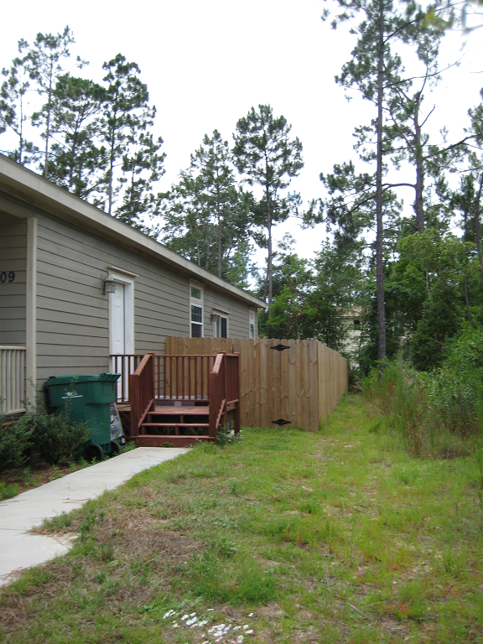
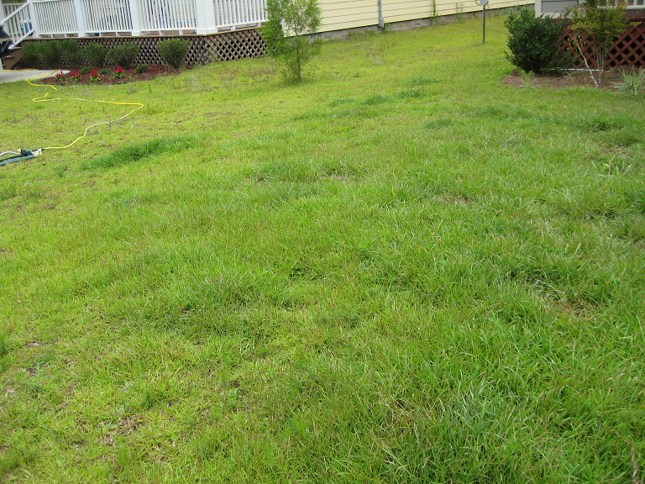
Other possible suspects….
Notes:
Also, these individuals do not appear to directly inhabit the area in question. All of the observed holes have been located inside a fenced in area. For comparison, the photograph on the left was taken of the lawn outside of the fenced in area. As you can see, this area is free of holes.
We investigated the possibility of other creatures living inside the fence that could be responsible for the holes.

Slide 17
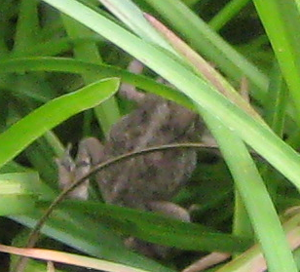
Other possible suspects….
2cm
20 cm
Notes:
The only thing observed was a toad…
However, a comparison of the size of the toad and hole suggest he is not the culprit.

Slide 18
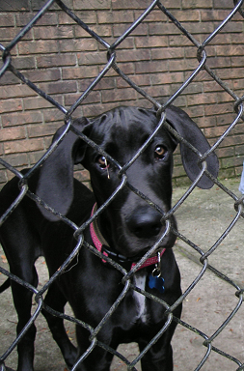
The hypothesis….
Guilty!
Notes:
Based on all of the observations – my hypothesis is that Maggie is digging the holes! All of the data I have acquired suggests that Maggie is digging the holes. None of the evidence suggests anyone other than Maggie is digging the holes.
However, as a scientist, I am not willing to say with 100% certainty that Maggie is digging the holes. I cannot make this statement, as a scientist, unless I actually witness Maggie digging one of the backyard holes.
Let’s suppose that all of my neighbors got in on the investigation as well. All of my neighbors begin watching Maggie and looking for other “diggers” in the neighborhood. Let’s further suppose that all of their observations also support my hypothesis that Maggie is digging the holes – yet still no one actually observes Maggie digging the holes. After many, many investigations, if all observations point to Maggie, we might be able to move this explanation from a hypothesis to a theory. But unless anyone actually observes Maggie digging a backyard hole, we can NEVER say with 100% certainty that she is the guilty party.

Slide 19
The hypothesis….
Guilty!
Notes:
Alternatively, other people monitoring this story may not use the scientific method --- for example, the court system or a newspaper reporter. For these groups, it is only necessary to say that Maggie is the culprit “beyond a reasonable doubt” or in some cases, not even that! But these groups of people will/do tell you that yes, she is guilty because they do not follow the same process as scientists do.

