Slide 1

Exploring Whole Transcriptomes with Genetics Students
Susan R. Singer, Benjamin J. Taylor, Cathy Manduca, Sean Fox, Ellen Iverson, Jodi Schwarz, Jeff J. Doyle, Dan Ilut, Andrew Farmer, and Gregory D. May
Department of Biology, Carleton College, Northfield, MN
Science Education Resource Center, Carleton College, Northfield, MN
Department of Entomology, University of Wisconsin, Madison, WI
Vassar College, Poughkeepsie, NY
Department of Plant Biology, Cornell University, Ithaca, NY
National Center for Genome Resources, Santa Fe, NM
Notes:
A current challenge for biology undergraduate education is integrating genomics into the curriculum in a way that keeps the biology at the center and fosters the development of cognitive and affective domain skills students need to deal with biology at a very different scale. I’ll briefly describe the efforts that have led to our current efforts to integrate research and education in our genetics course using WTS from a prairie plant.

Slide 2
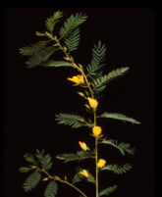
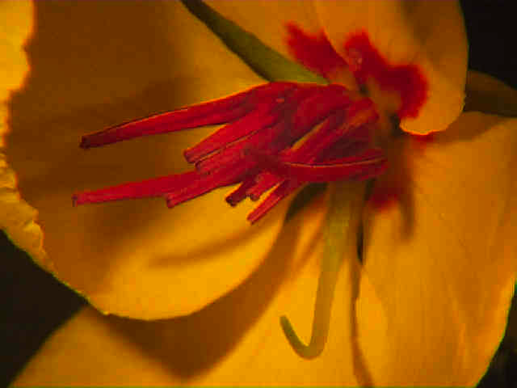
Why Chamaecrista
(Partridge Pea)?
Phylogenetic position
Not a tree
Legume genome duplication events
Origin(s) of nodulation
Flowering and floral development evolution
Different flowering ecotypes likely to become extinct with global change (Etterson and Shaw 2001)
Biofuel potential – mixed prairies
Model for integrating research and education
Notes:
Dave Tilman has included Chamaecrista in all his prairie plots except Cedar Creek where it overruns everything. We’d like to eventually include field studies in the project.

Slide 3
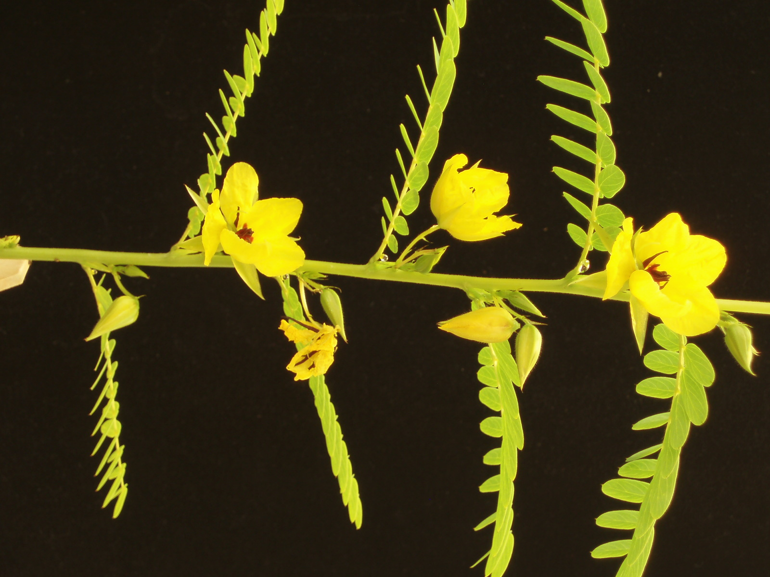
Illumina Results
Total passing reads (46 bp): 143,442,505
Total Mbp: 6,598
157,350 SNPs among 3 ecotypes
454 Titanium Results
Total reads (370 bp): ~1,000,000
Total Mbp: 370
ESTs in NCBI as of 11/28/08
Medicago truncatula 260,238
Glycine max 1,386,618
Lotus japonicus 157,951
Notes:
As W09 genetics started, we had preliminary assembled WTS from Chamaecrista shoots, roots, and nodules at different developmental stages, expression data (Solexa) and SNP data MN, OK, KS shoots. Our group organized a Chamaecrista research workshop at the International Conference on Legume Genomics and Genetics in Mexico in December which gave us the impetus to get things together in time for the January class start date. Main point – tons of data. Just about settled on final assemblies, expression and SNP data now. Not clear that students could pull off the assembly work with the type of quality needed for research community.

Slide 4
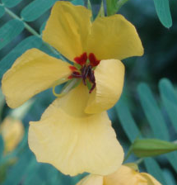
Goal: Authentic research experience in genetics lab
Challenges Winter ‘08
Embedding work in a biological context
Strategizing
Getting lost while navigating through numerous tools
Not understanding or considering data quality
Feeling overwhelmed
Coping with scale of data
Notes:
SERC lab observations and interviews helped us identify some major challenges for students. To help with the sense of overwhelm we applied for a CCLI grant to create a web interface to scaffold learning and free up the instructor to have higher order discussion with student groups.

Slide 5
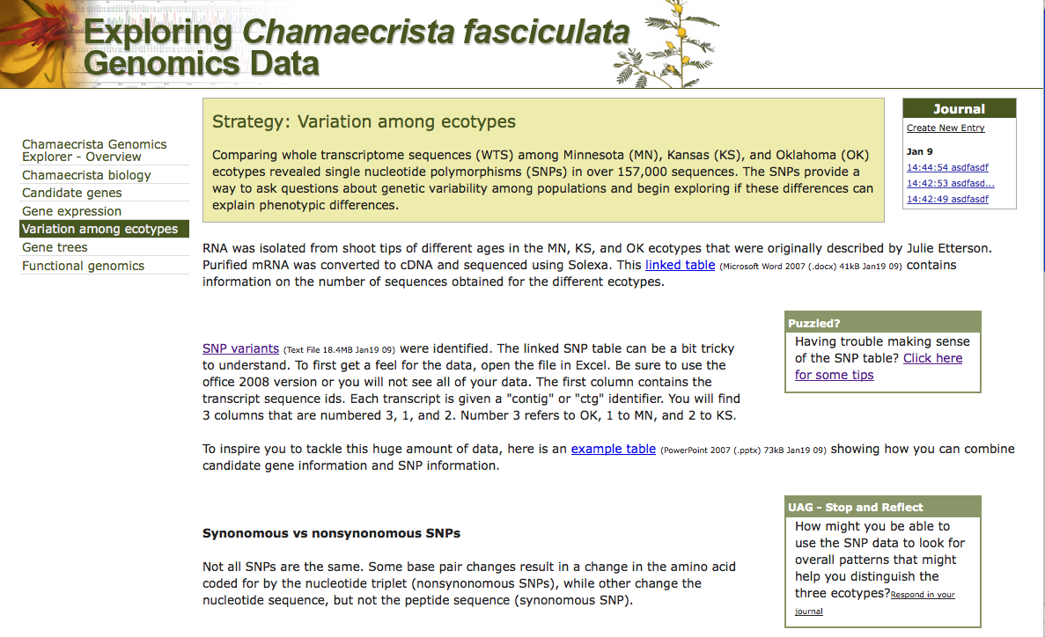
Emphasizing the Biology & Scaffolding Learning
Online journaling
Strategy choice
Stop and Reflects
Concept guidance

Slide 6
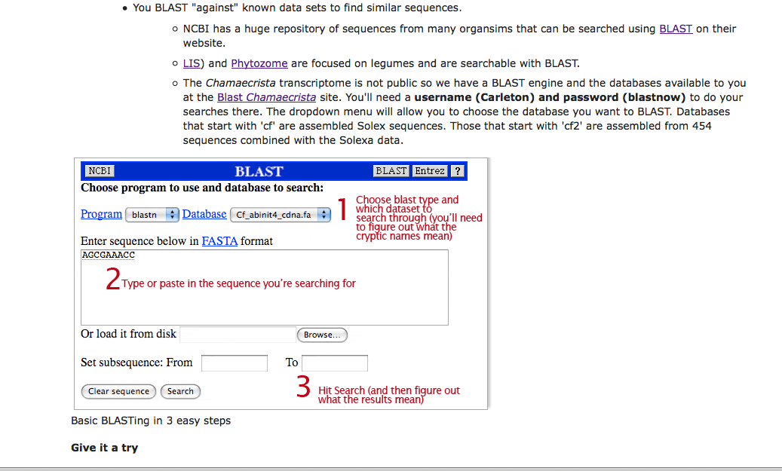
Guided access to tools

Slide 7
Chamaecrista WTS Learning Goals
Genetics Class Winter 2009
Frame a meaningful question that can be addressed using transcriptome data.
Propose a testable hypothesis based on reading several journal articles that can be evaluated using transcriptome data.
Modify a hypothesis based on data analysis.
Use multiple bioinformatics resources without losing focus on a biological question.
Distinguish what type of information can be extracted from a transcriptome sequence vs. a genome sequence.
Notes:
Learning goals drove curriculum development and assessment.

Slide 8
Chamaecrista WTS Learning Goals
Genetics Class Winter 2009
Understand that SNPs are mutations.
Use mutant analysis in a related species (e.g. garden pea or Arabidopsis) to formulate hypotheses based on SNP variation in ecotypes.
Demonstrate ability to leverage investigation by using the whole transcriptome for analysis (i.e. pattern search).
Design an experiment that can be tested using PCR based on a working hypothesis derived from transcriptome analysis.
Notes:
Learning goals drove curriculum development and assessment.

Slide 9
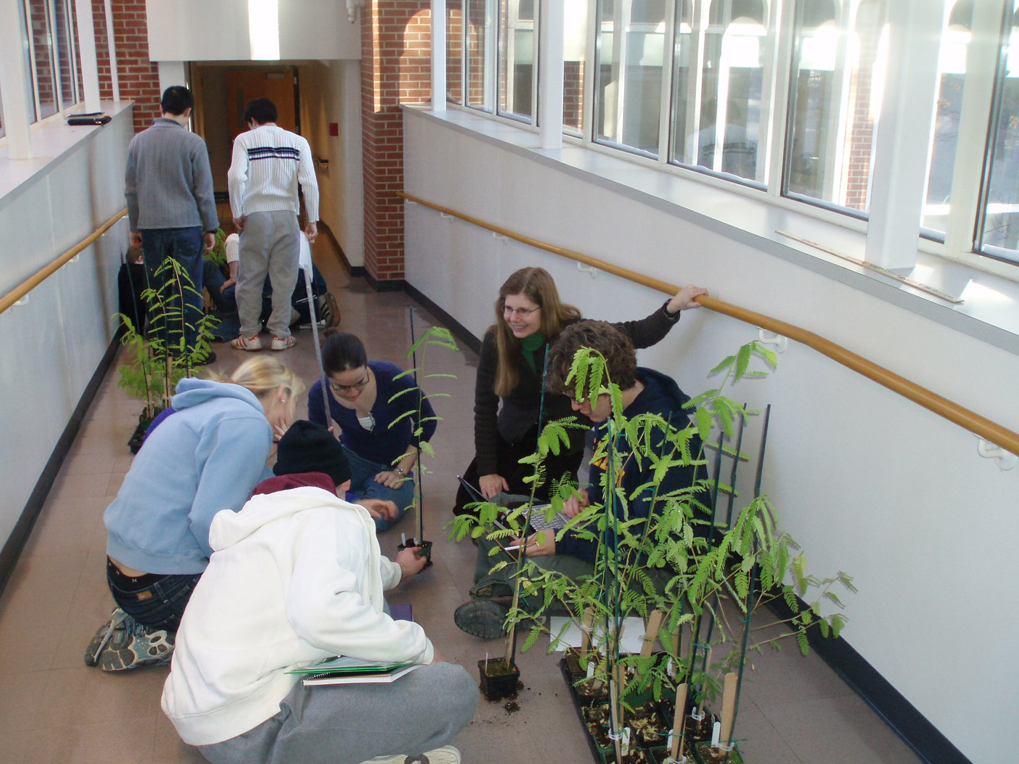
Chamaecrista WTS
Genetics Class Winter 2009
Whole plant labs
One organism all term
Start with whole plants
Whole plant labs drive in silico questions
In silico work drive wetlab questions
Opportunties for iteration
In silico labs
Molecular labs
Presentation
Final paper
Notes:
One organism all term, more intentional integration of lab throughout term and also classroom. Still 2 in silico labs. While keeping the focus on the biology was a huge challenge in W08, the restructuring of the lab and having our own transcriptome date alleviated this challenge in W09, not that there weren’t others.

Slide 10
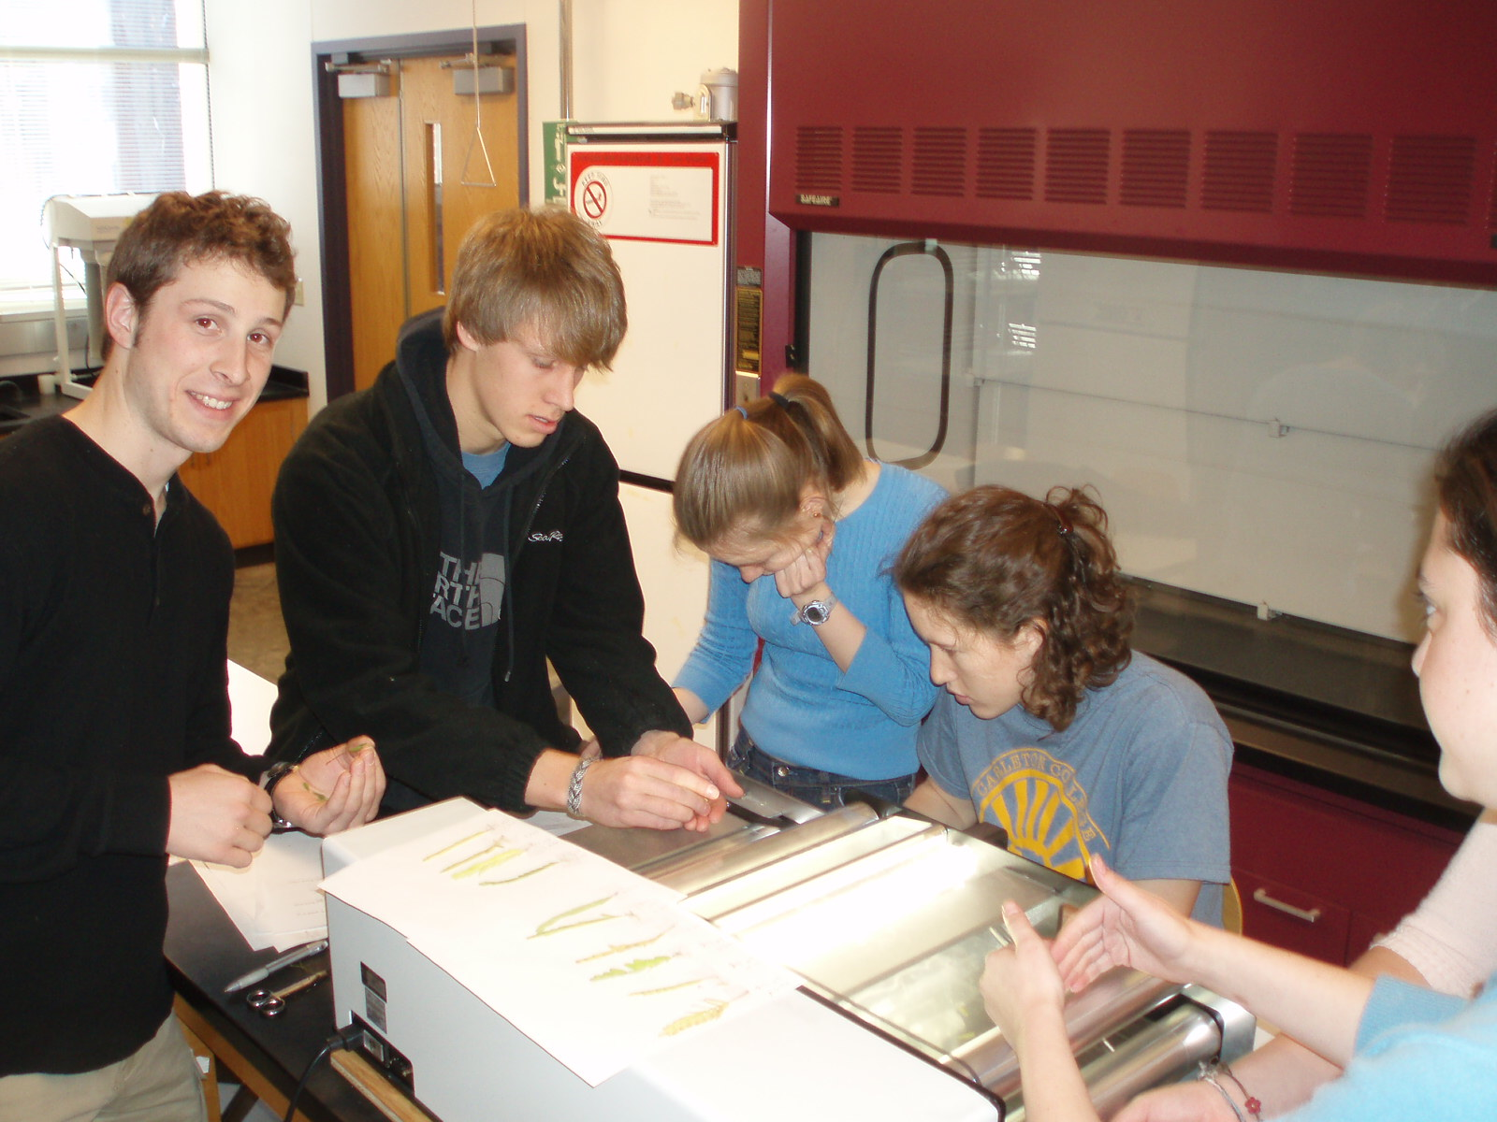
Whole plant lab
(30 ecotypes, same growth conditions)
Strategies
Link lilac phenology/latitude with Chamaecrista latitude/flowering node
Literature analysis
Links to in silico lab
Flowering time genes
Leaf size differences to expansin genes
Notes:
Examples of how some students moved through the term conceptually.

Slide 11
In silico labs:
Gene expression analysis
Candidate gene approach
Focus on overall patterns

Slide 12
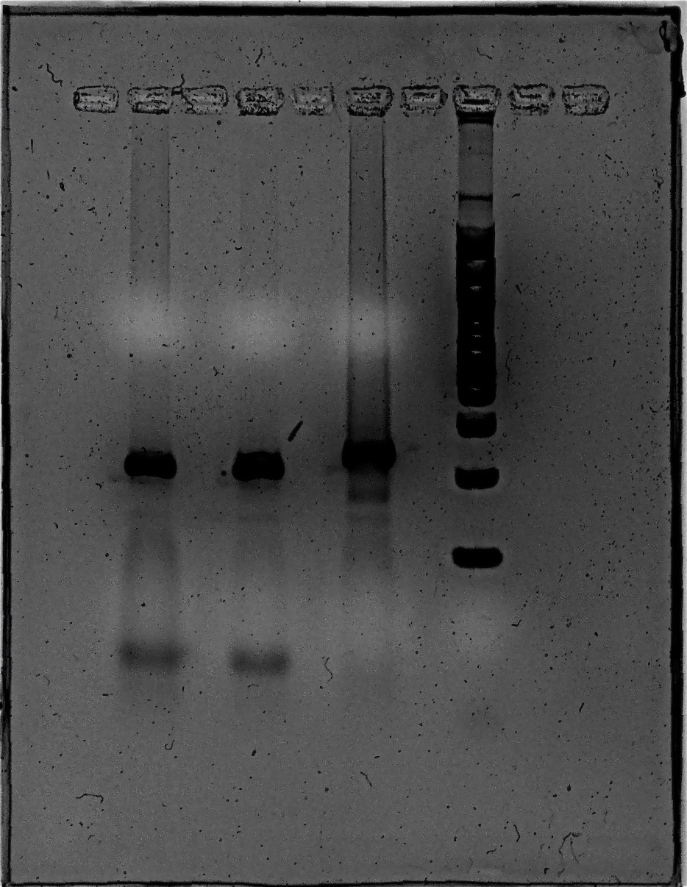
Linking in silico to wet lab:
SNP analysis
MN MN OK
ladder
239 bp
210 bp
29 bp
Strategy
Identified SNP variant among ecotypes
Identified restriction enzyme that cuts only one variant
Designed primers
PCR
Digest
Gel
Challenges
No known gene function
Synonymous SNP
Resolution of size differences

Slide 13
Mixed methods assessment*
ACT CAAP Science Reasoning (pre)
ACT Science Reasoning
Genetics Concepts Inventory (pre/post)
Motivated Strategies for Learning Questionnaire(MSLQ, pre)
Critical Thinking Rubric (2 papers, powerpoint presentation)
Journal entries
Web click throughs
Classroom observers
* 40 students, 11 groups

Slide 14
What counts as success?
Final paper evaluated with critical thinking rubric as proxy for success
  First paper 69.4% (SD 10.9, Range 42.8 – 78.6)
  Final paper 83.3% (SD 14, Range 52 – 100)
  Assesses ability to frame a tractable problem, understand context and assumptions, develop own perspective, make case with evidence, integrate other perspectives, form conclusions, communicate effectively
Pathway analysis – what did it take to move towards success?

Slide 15
Pre-course barriers to success?
Range of prior knowledge and experience was not a limiting factor
Cognitive preferences were not a barrier
Affective preferences generally not barriers
  Possible exception: extrinsic vs. intrinsic motivation and beliefs regarding control over learning

Slide 16
Assessment | Final Paper (Individual) | Final Paper Group)
CAAP | p=0.94 | p=0.84
SAT-Math | p=0.99 | p=0.99
ACT-Math | p=0.28 | p=0.35
ACT-Science Reasoning | p=0.88 | p=0.84
GCI Pre-Test (full) | p=0.14 | p=0.35
Total Science Classes | p=0.91 | p=0.75
MSLQ-Intrinsic Goals | p=0.72 | p=0.67
MSLQ-Extrinsic Goals | p=0.05 | p=0.04
MSLQ-Task Value | p=0.39 | p=0.16
MSLQ-Control of Learning | p=0.05 | p=0.03

Slide 17
Assessment | Final Paper (Individual) | Final Paper Group)
MSLQ-Self-Efficacy | p=0.83 | p=0.81
MSLQ-Elaboration | p=0.20 | p=0.06
MSLQ-Organization | p=0.05 | p=0.18
MSLQ-Critical Thinking | p=0.51 | p=0.41
MSLQ-Self-Regulation | p=0.85 | p=0.70
MSLQ-Instructor Help-Seeking Strategies | p=0.61 | p=0.69
MSLQ-Peer Help-Seeking Strategies | p=0.69 | p=0.73
GCI Post-Test (full) | p=0.02 | p=0.01
Comfort With Ambiguity | p=0.68 | p=0.75
Linear Thinking | p=0.99 | p=0.96

Slide 18
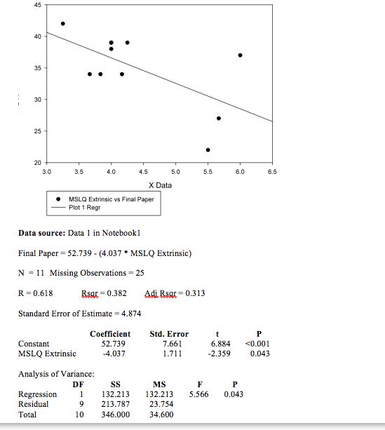
Extrinsically motivated groups were less successful
Critical Thinking on Final Paper
R=0.62
Extrinsic Motivation

Slide 19

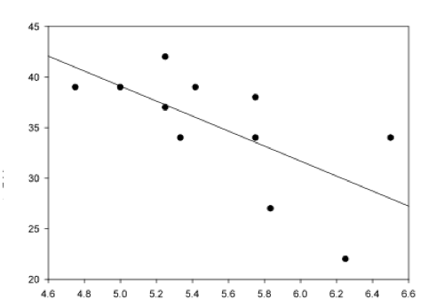
Groups that believed they were in control of their learning were less successful
Critical Thinking on Final Paper
R = 0.66
Control of Learning

Slide 20
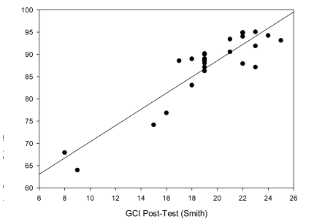
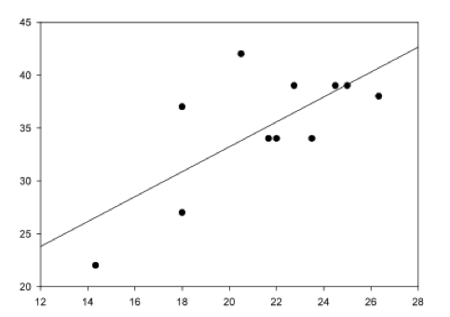
Results: Good alignment with success on GCI post but not pre and both final course grade and success in lab.
Conclusion: Understanding core genetics concepts is important for success with the transcriptome lab. Interplay between course and lab learning.
Critical Thinking on Final Paper
Course grade (%)
R=0.91
R=0.72
GCI Post-test (Smith)
GCI Post-test (Smith)

Slide 21
Pathway Analysis Example
Literature
Expression
1
5
2
Variation (SNP)
6
Student generated strategy
3
4
7
8
Candidate Gene
Gene trees

Slide 22
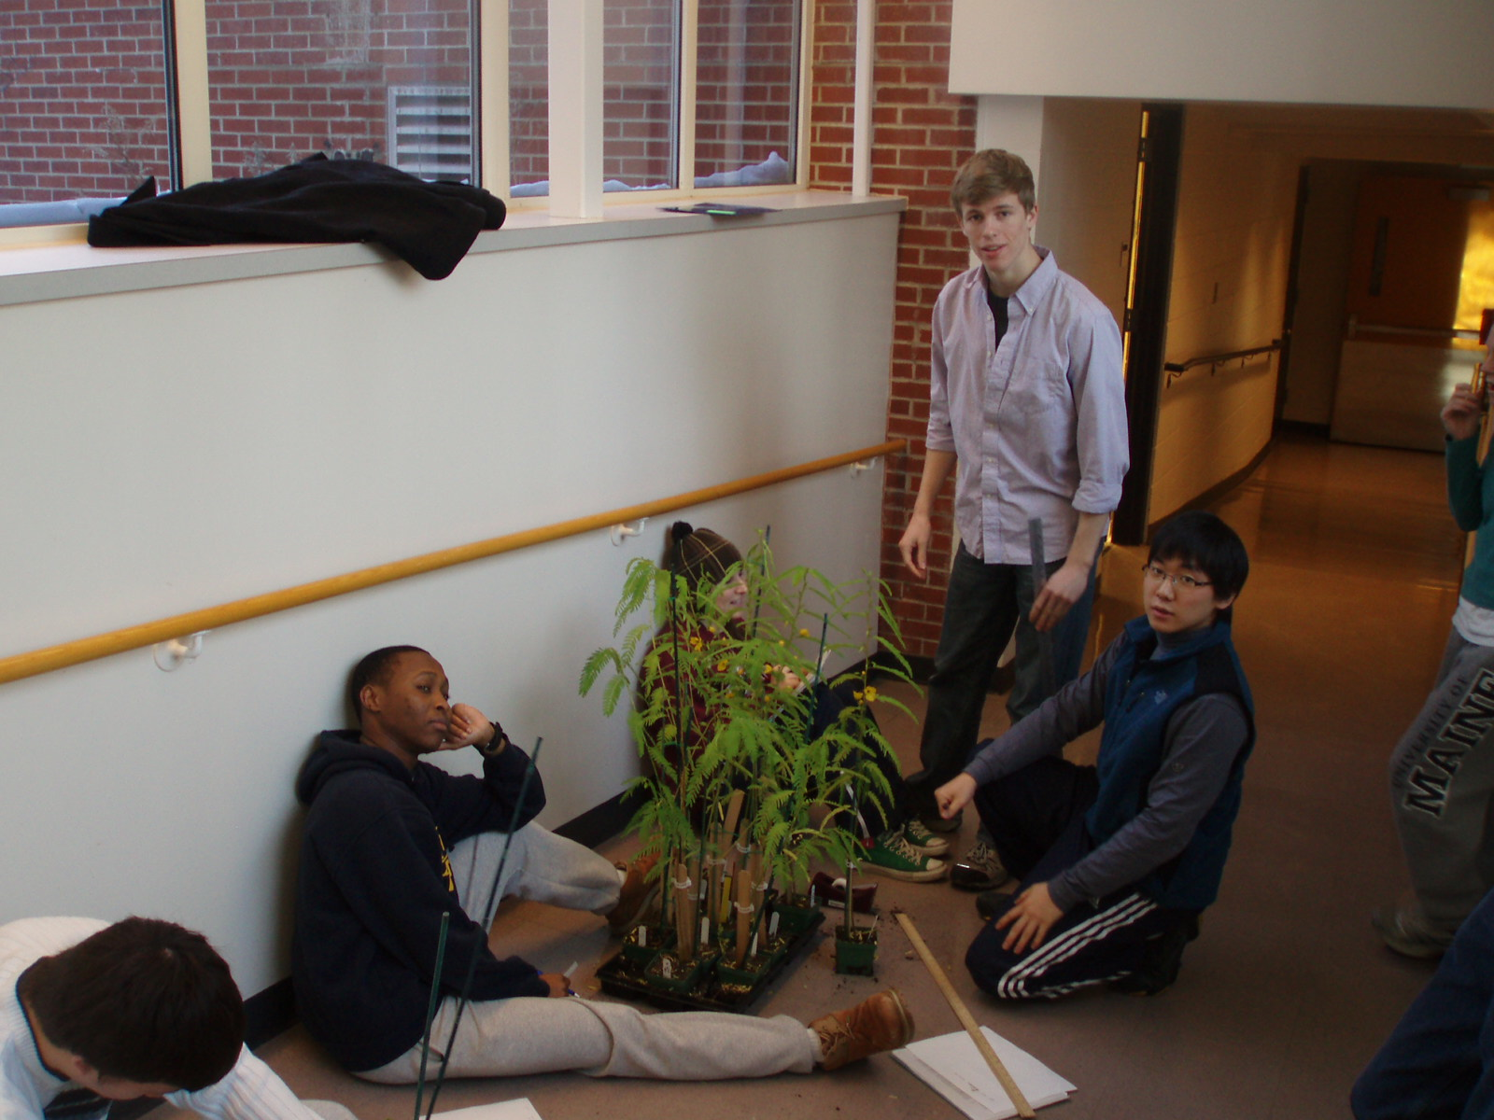
Factors corresponding with success
Iterative approach over entire term
Integrated multiple strategies
Think aloud
Engaged each other
Metacognitive use of journal
Focused, clarification questions for instructor
Incorporated presentation feedback to improve paper

Slide 23
Think Aloud
A metacogintive strategy
“I am also interested in finding those genes that are have differential expression in one or two specific regions … a gene that is a spike on the graph of all gene expression.”
“If they [SNPs] do affect protein sequence, does this cause a functional difference that allows plants to be better adapted to their ecotype?”
“Change of plan. We are going to work on the LFY gene instead, because we returned no hits on our SNP data for the FT gene. LFY is apparently crucially important for floral meristem specification. “
Th4 Journal

Slide 24
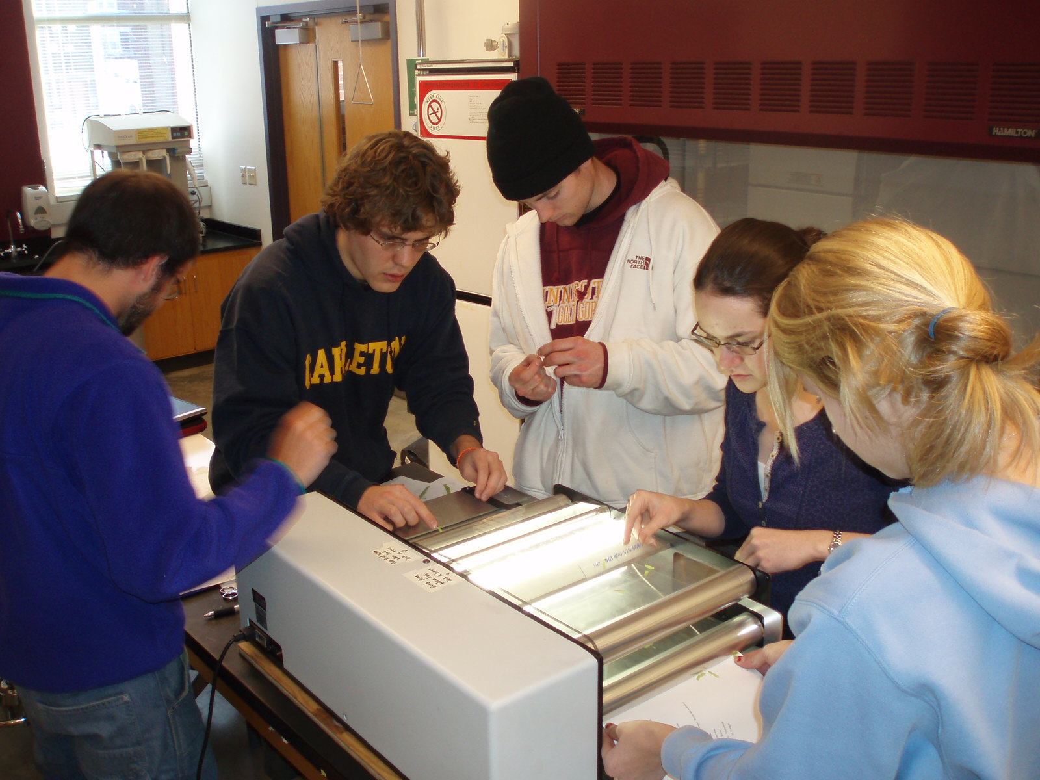
Innovators
Can both design problems and extend conclusions
Can make independent progress
Use a metacognitive approach where they identify what they don't understand, find a specific way to probe, draw conclusions and iterate
Frame specific well posed questions based on their experience for Susan - appropriately ask for help
  critical to forward movement
  they have investigated solutions from other sources
  confirming their hypotheses/plans
.

Slide 25
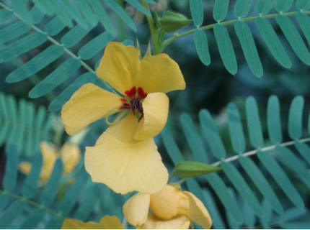
Mimics
Make progress by finding an analogous situation in the literature and mimicking it
Ask relational questions - how does what we are interested in relate to something doable; needed help with experimental design

Slide 26
Carleton Genetics
Preliminary data gathering and analysis
Vassar Genomics
Transfer and improve what we’ve learned
Carleton Genetics
Improvements based on Carleton and Vassar experience
Vassar Bioinformatics
Extending from biology to computer science students

Slide 27

Acknowledgements
Big Science at Small Schools Genomics project (Teagle funded)
NSF SGER grant – curriculum development to involve undergraduates in genomics research in the context of a course
NSF CCLI grant – Scaffold genomics exploration with a web interface
Teagle Foundation, NSF DEB-0746571 and NSF DUE-0837375
Notes:
A current challenge for biology undergraduate education is integrating genomics into the curriculum in a way that keeps the biology at the center and fosters the development of cognitive and affective domain skills students need to deal with biology at a very different scale. I’ll briefly describe the efforts that have led to our current efforts to integrate research and education in our genetics course using WTS from a prairie plant.

Slide 29

Integrate workshop and web approaches over 3 years to:
  Support faculty development of genomics curriculum (Integrated Instructional Units)
  Built in assessment of activities and overall faculty development effort
  Disseminate coherent, vetted curricular activities
http://serc.carleton.edu/genomics/
Notes:
Complements focus of HHMI phage genomics and Drosophila annotation projects by providing a broad range of activities that keep the focus on organisms as well as DNA and exploring a range of assessment.

Slide 30
Unpacking I³Us
Inquiry-based – actively engages students in asking and answering questions
Integrated - flow of lab experience, lecture, discussion, and reading are designed to optimize learning
Instructional units – comprehensive package that can range from a short activity to course or larger-scale curricular effort.

Slide 31

Why I³Us ?
Evidence-based curriculum development
I³Us follow the instructional design principles recommended in the NRC's "America's Lab Report" (National Academies Press, 2005)
Notes:
Goal was to build evidence-based practices.

Slide 32
Design Principles:
The How of I³Us
Clear learning outcomes in mind.
Thoughtfully sequenced into the flow of classroom science instruction.
Integrate learning of science content with learning about the processes of science.
Incorporate ongoing student reflection and discussion.
Notes:
Importance of integrating the overall learning experience was also clear in our comparison of two years of building transcriptomics into genetics lab.

Slide 33
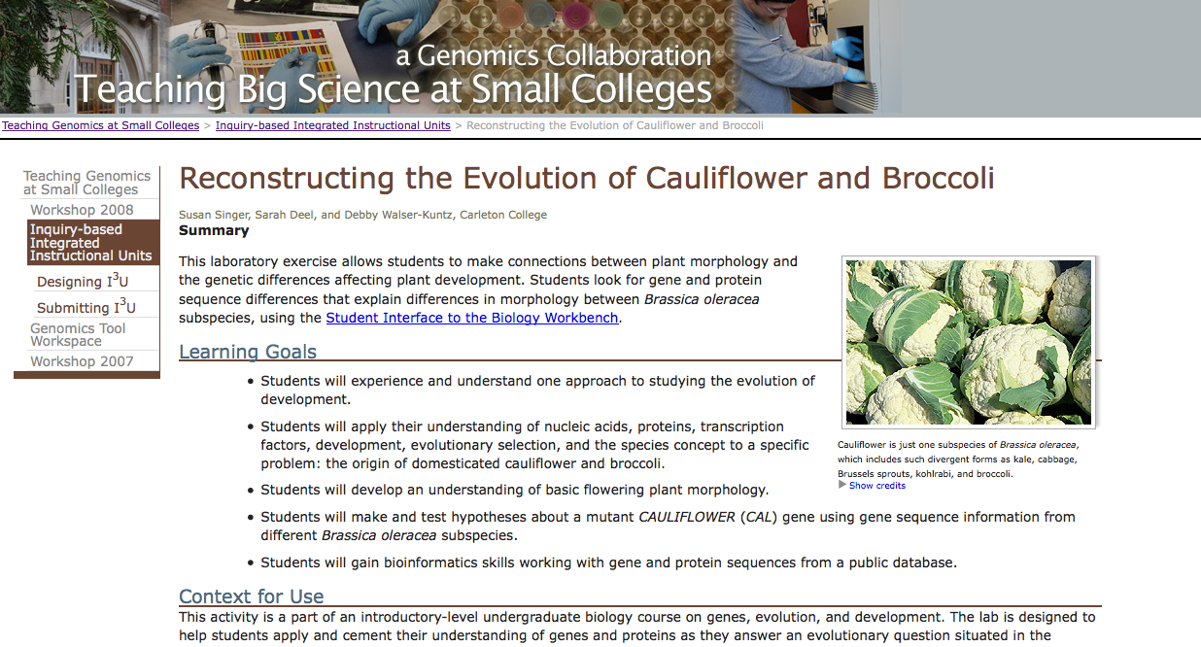
Example of a starting point activity
Single gene vs. genome
Notes:
Example I3Us are up on the TBSSC website and this project will finish up this summer with a paper in the works. This particular example is one we use in our introductory biology lab. Students use informatics tools but the focus is on a single gene.

Slide 34

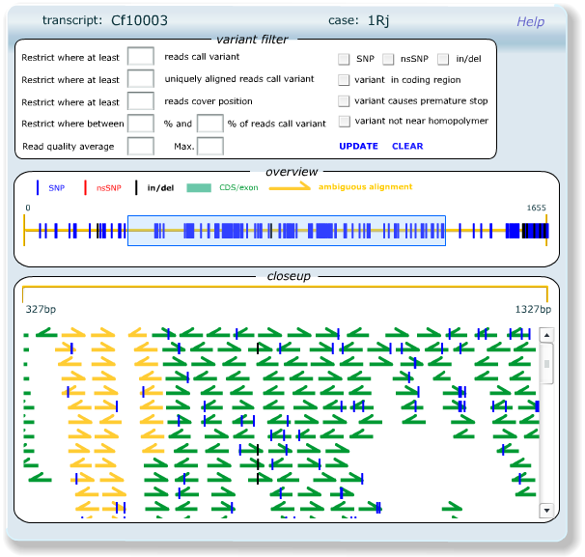
Moving on to Illumina/Solexa generated WTS
Genetics class winter 2008
Students worked with WTS data
  schizophrenia patients
  2n and 4n soybeans
Notes:
For genetics, a 200 level course we wanted students to gain comfort and skill in working with the large data sets generated by WTS to move forward from more single gene approaches. This is our second grant, with Cornell and NCGR that fully integrates research and learning. While we were working on sequence generation, our collaborators shared WTS data for W08 genetics students to explore using the NCGR interface.

Slide 35
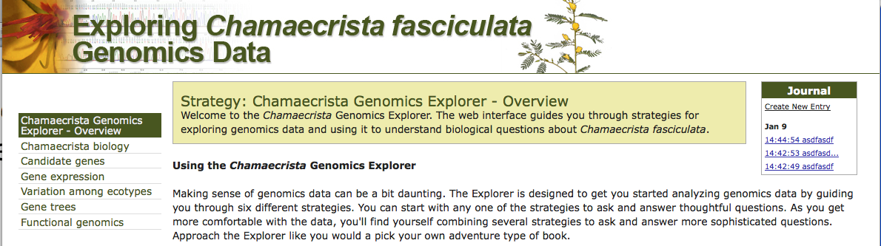
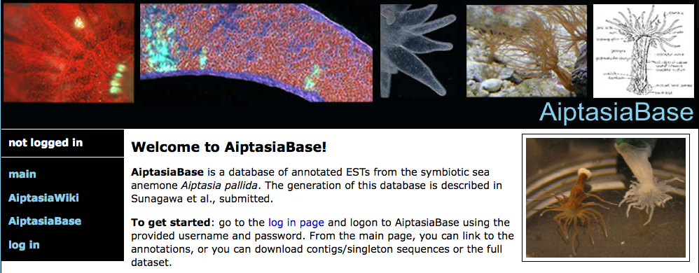
Emphasizing the Biology and
Scaffolding Learning
Chamaecrista – Carleton
Aiptasia – Vassar, Jodi Schwarz and Marc Smith
Notes:
We are working with one of our Teagle partner schools, Vassar, to focus on eukaryotic transcriptomes and questions that relate to climate change.

Slide 36
Metacognition
“…we had a hard time deciding on a specific gene to examine because our transcriptome project does not translate easily to examination of specific genes.”
“We specifically chose this gene because it has three such point mutations, which might result in a more different gene product that might be reflected by the PCR and gel electrophoresis. “
Th2 Journal

Slide 37
Next Steps
Develop ill-structured problem for pre/post assessment of critical thinking and problem solving ability
Build more robust scaffold
  Specific examples to support mimics
  Incorporate more detail on common problems
  ‘Forced’ journaling and ‘stop and reflects’
  More support for presentation & paper preparation
  Local whole lab “Twitter”

