Slide 1
Teaching Students HOW to Learn:
Metacognition is the Key
Saundra Yancy McGuire, Ph.D.
Assistant Vice Chancellor for Learning and Teaching
Professor, Dept. of Chemistry
Former Director, Center for Academic Success
Louisiana State University
Washington University, St. Louis

Slide 2


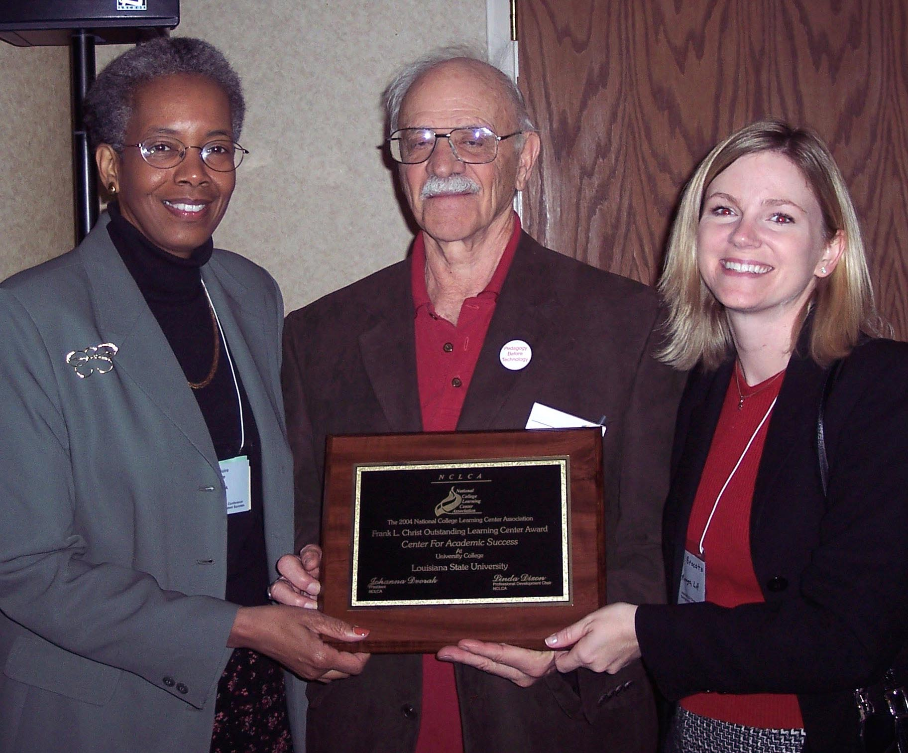
2004 National College Learning Center Association
Frank L. Christ Outstanding Learning Center Award

Slide 3
The Story of Three Students
Robert, freshman chemistry student
42, 100, 100, 100
Michael, senior organic student
30, 28, 80, 91
Ifeanyi, sophomore ME student
67, 54, 68, 95

Slide 4
LSU Chemistry Graduate Student’s Cumulative Exam Record
2004 – 2005
9/04 Failed
10/04 Failed
11/04 Failed
12/04 Failed
1/05 Passed
2/05 Failed
3/05 Failed
4/05 Failed
2005 – 2006
10/05 Passed
11/05 Failed
12/05 Passed best in group
1/06 Passed
2/06 Passed
3/06 Failed
4/06 Passed last one!
5/06 N/A
Began work with CAS in October 2005

Slide 5

Dr. Algernon Kelley, December 2009

Slide 6
How’d They Do It?
Metacognition was the key!
They learned HOW to Learn
and renewed their self-confidence!

Slide 7
Why don’t students know how to learn?
It wasn’t necessary in high school
- 66% of 2003 entering first year students spent less than six hours per week doing homework in 12th grade.
- More than 46% of these students said they graduated from high school with an “A” average.
Students’ confidence level is high
- 70% believe their academic ability is above average or in the highest 10 percent among people their age
Higher Education Research Institute Study
http://www.gseis.ucla.edu/heri/03_press_release.pdf

Slide 8
Reflection Questions
What’s the difference, if any, between
studying and learning?
Which, if either, is more enjoyable?

Slide 9
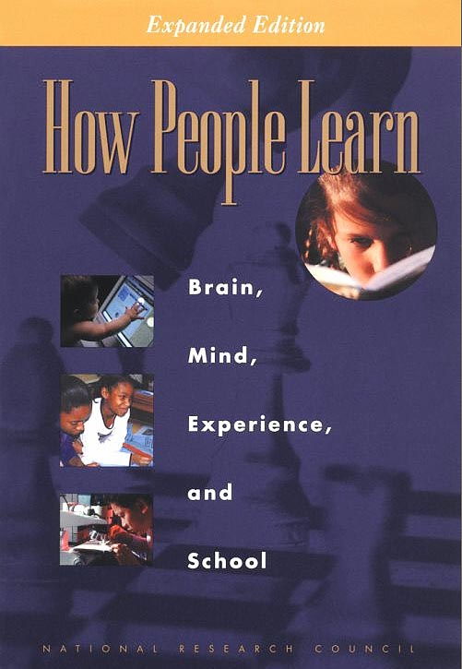
Bransford, J.D., Brown, A.L., Cocking, R.R. (Eds.), 2000. How people learn: Brain, Mind, Experience, and School. Washington, DC: National Academy Press.

Slide 10
Learning How to Learn
Learning is a process
There are different levels of learning
Expert learners can be developed by providing the proper tools for learning
Self-directed, independent learners are made, not born; it’s never too late!
Metacognition is the key to lasting, meaningful learning

Slide 11

Metacognition*
The ability to:
think about thinking
be consciously aware of oneself as a problem solver
monitor and control one’s mental processing
accurately assess what one
understands and does not understand
*term coined by J. H. Flavell

Slide 12
Counting Vowels in 30 seconds
How accurate are you?

Slide 13
What We Know About Learning
Learning is a complex process involving the development of conceptual understanding
Individual learners must actively construct their own learning (constructivism)
New learning is based on prior knowledge
Active learning is more lasting than passive learning
Thinking about thinking is important
  Metacognition
The level at which learning occurs is important for effective transfer

Slide 14
This pyramid depicts the different levels of thinking we use when learning. Notice how each level builds on the foundation that precedes it. It is required that we learn the lower levels before we can effectively use the skills above.
Bloom’s Taxonomy
Creating
Putting elements together to form a coherent or functional whole; reorganizing elements into a new pattern or structure through generating,
planning, or producing.
Graduate School
Making judgments based on criteria and standards through checking and critiquing.
Evaluating
Breaking material into constituent parts, determining how the parts relate to one another and to an overall structure .
Analyzing
Undergraduate
Carrying out or using a procedure through executing, or implementing.
Applying
Constructing meaning from oral, written, and graphic messages through interpreting, exemplifying, classifying, summarizing, inferring, comparing, and explaining.
Understanding
High School
Retrieving, recognizing, and recalling relevant knowledge from
long-term memory.
Remembering
http://www.odu.edu/educ/llschult/blooms_taxonomy.htm

Slide 15
At what level of Bloom’s did you have to operate to make A’s or B’s in high school?
Knowledge
Comprehension
Application
Analysis
Synthesis
Evaluation

Slide 16
At what level of Bloom’s do you think you’ll need to be to make an A in Chem 1201?
Knowledge
Comprehension
Application
Analysis
Synthesis
Evaluation

Slide 17
Learning Strategies Gold Nugget
The Study Cycle with Intense Study Sessions

Slide 18
The Study Cycle
Phase 1: Preview material to be covered in class… before class.
Phase 2: GO TO CLASS! Listen actively, take notes, participate in class.
Phase 3: Review and process class notes as soon after class as possible.
Phase 4: Implement Intense Study Sessions.
Repeat

Slide 19

Intense Study Sessions
2-5 minutes: Set Goals
20-50 minutes: STUDY with FOCUS and ACTION (Read your text, create flash cards, create maps and/or outlines, work problems -without peeking at the answers, quiz yourself…) Achieve your goal!
5 - 10 minutes: Take a break
5 - 10 minutes: Review what you have just studied
Repeat

Slide 20
Concept maps facilitate development of higher order thinking skills

Slide 21
Chapter, Research Paper, or Disease Treatment Map
Title of Chapter or Paper, or Name of Disease
Primary Headings
Subheadings
Secondary Subheadings

Slide 22
Compare and Contrast
Concept #1
Concept #2
How are they similar?
How are they different?

Slide 23
Effective Metacognitive Strategies
Always ask why, how, and what if
Use SQ5R for reading assignments
(survey, question, read, recite, review, wRite, reflect)
Test understanding by giving “mini lectures” on concepts
Move higher on Bloom’s taxonomy
Always solve problems without looking at an example or the solution
Use the Study Cycle with Intense Study Sessions

Slide 24
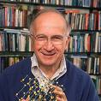

Teaching and Learning Strategies That Work
SCIENCE , VOL 325
4 SEPTEMBER 2009 www.sciencemag.org
Published by AAAS
ROALD HOFFMANN¹* AND SAUNDRA Y. MCGUIRE²
¹Department of Chemistry and Chemical Biology, Cornell
University, Baker Laboratory, Ithaca, NY 14853, USA.
²Center for Academic Success and Department of Chemistry,
Louisiana State University, Baton Rouge, LA 70803, USA.

Slide 25
Mindset
Another Key Factor
in Increasing Student Learning

Slide 26
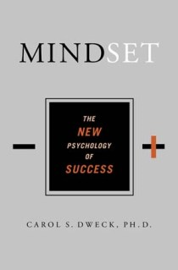
Dweck, Carol, 2006. Mindset: The New Psychology of Success. New York: Random House Publishing

Slide 27
Two Types of Mindsets
Fixed Intelligence Mindset
Intelligence is a static
You have a certain amount of it
Growth Intelligence Mindset
Intelligence can be developed
You can grow it with actions

Slide 28
Mindset determines responses to
Challenges
Obstacles
Tasks requiring effort
Criticism
Success of Others

Slide 29
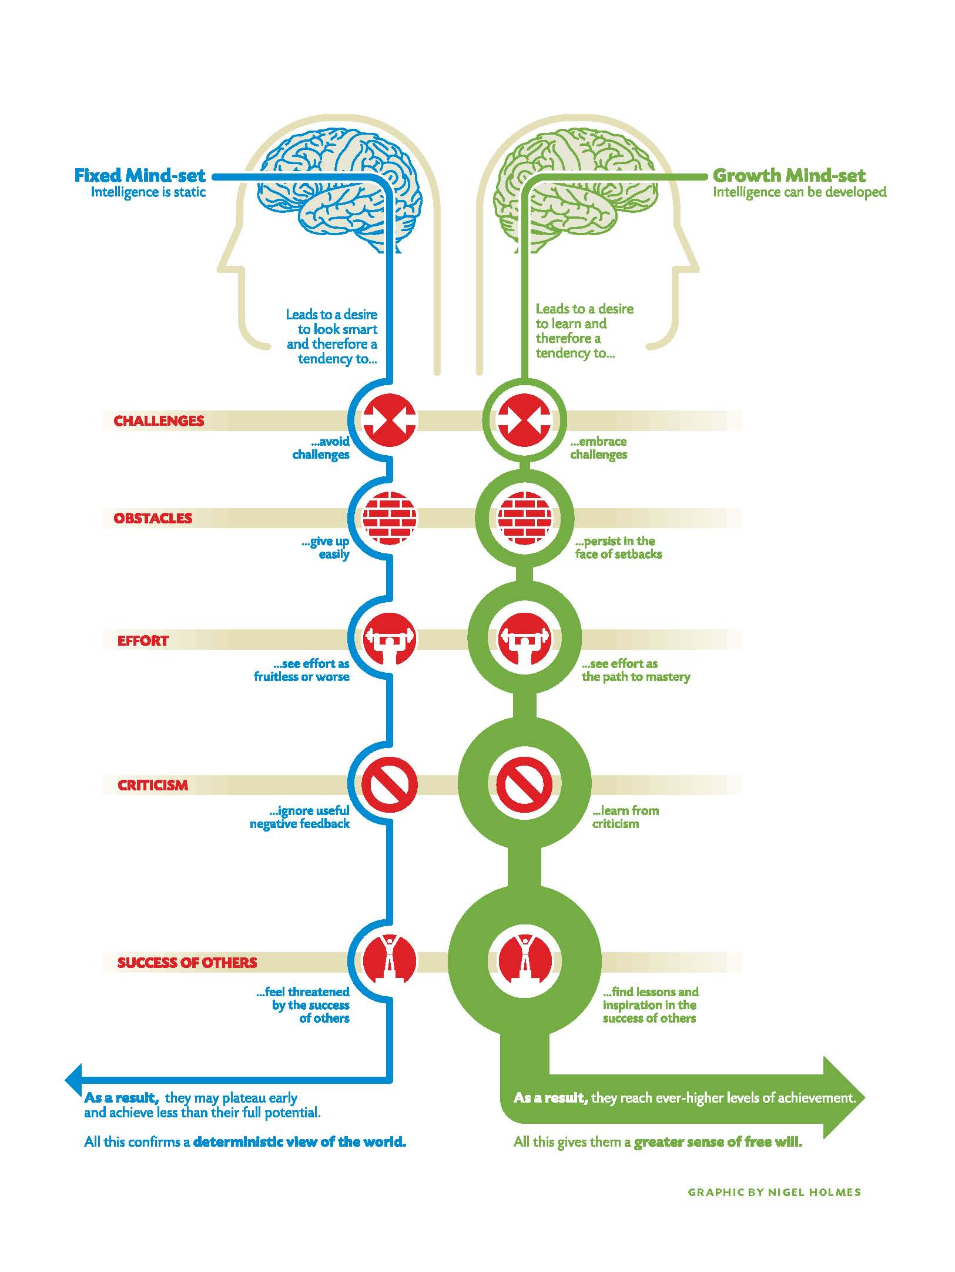
Dweck, Carol, 2006. Mindset: The New Psychology of Success.

Slide 30
Documented strategies that improve student learning and success
Integrating learning and study strategy techniques into class structure.
Teaching and requiring concept mapping
Setting up collaborative working groups in class
Frequent pop quizzes and different approaches to testing and homework
Supplemental Instruction
Service-Learning for community involvement

Slide 31
Knowledge of Research on Metacognition
and Mindset Greatly Increases
Minority and Urban Student Success
They are less likely to have been cognitively challenged in high school
They are less likely to be encouraged to persist in their pursuit of a degree
They are more likely to fall victim to stereotype threat
They are more likely to experience the
impact of a paradigm shift
Meaningful Learning Rote Learning

Slide 32

We CAN Increase Student Learning!
Teach students the learning process and strategies
Resist the temptation to judge students’ potential on their initial performance
Encourage students to use metacognitive strategies
Persuade students to persist
in the face of initial failure
Build student confidence in their
ability to excel!

Slide 33
The LSU Dental School First Year Class:
An Amazing Success Story!
Metacognition Discussion – August 13, 2004
First Histology Exam – August 23, 2004
Previous class averages: 74 – 77
Challenge to class on August 13: 84 average
Reported average on August 24: 85!

Slide 34
Chem 1001 Results Spring 2007
Test 1 Test 2 Final Total points
Attended SYM 156 109 214 801 Lecture on 3/2
Did not attend 154 93 153 563
Class average 153 100 176 662
*app. 80 attendees out of 200 students because session was on a Friday afternoon. Exam 1 was Wednesday, March 7.

Slide 35
Useful Websites
www.cas.lsu.edu learning strategies
www.ccell.lsu.edu service-learning
www.howtostudy.org learning strategies
www.vark-learn.com learning styles
www.drearlbloch.com learning strategies
http://www.umkc.edu/cad/SI/ supplemental
instruction

Slide 36
Additional References
Aronson, J., Fried, C.B., & Good, C. (2002). Reducing the Effects of Stereotype Threat on African American College Students by Shaping Theories of Intelligence. Retrieved August 5, 2007 from http://www.atkinson.yorku.ca/~jsteele/files/04082317412924405.pdf
Bloom, Benjamin S. 1984. Taxonomy of Educational Objectives. Boston, MA: Allyn and Bacon, Pearson Education.
Bruer, John T. , 2000. Schools For Thought: A Science of Learning in the Classroom. Cambridge, MA: MIT Press.
Bransford, J.D., Brown, A.L., Cocking, R.R. (Eds.), 2000. How people learn: Brain, Mind, Experience, and School. Washington, DC: National Academy Press.
Flavell, J. H. (1979). Metacognition and cognitive monitoring: A new area of cognitive-developmental inquiry. American Psychologist, 34, 906-911.
Halpern, D.F and Hakel, M.D. (Eds.), 2002. Applying the Science of Learning to University Teaching and Beyond. New York, NY: John Wiley and Sons, Inc.

Slide 37
References Continued
Kameenui and Carnine, 1998. Effective Teaching Strategies That Accommodate Diverse Learners. Upper Saddle River, NJ: Merrill Publishing
Murray, M. and Owen, M. (1991). Beyond the Myths of Mentoring. San Francisco, CA: Josey-Bass.
Peddy, S. (2001). The Art of Mentoring: Lead, Follow, and Get Out of the Way. Houston, TX: Bullion Books.
Peirce, W. (2003). Metacognition: Study Strategies, Monitoring, and Motivation. Retrieved August 4, 2007 from
http://academic.pg.cc.md.us/~wpeirce/MCCCTR/metacognition.htm
Taylor, S. (1999). Better learning through better thinking: Developing students’ metacognitive abilities. Journal of College Reading and Learning, 30(1), 34ff. Retrieved November 9, 2002, from Expanded Academic Index ASAP.
Zull, James (2004). The Art of Changing the Brain. Sterling, VA: Stylus Publishing.
http://academic.pg.cc.md.us/~wpeirce/MCCCTR/metacognition.htm

