Slide 1
Patents and More ….
NSF Minority Faculty DevelopMent Workshop
17 March 2012

Slide 2
Types of Intellectual Property
Patent
Trademarks
Copyright
Trade Secrets

Slide 3
What Is Protected?
Patents protect processes or methods
Trademarks and Service Marks protect identity
Copyrights protect expression
Trade Secrets protect secret information

Slide 4
Basis for the
U.S. Patent System
Congress shall have the power to promote the progress of science and useful arts, by securing for limited times to authors and inventors the exclusive right to their respective writings and discoveries.
U.S. Constitution, Article I, Sec. 8

Slide 5
What Is A Patent?
A grant by the Government of the right to exclude others from making, using, offering to sell, or selling the patented invention within the United States or importing it into the United States.

Slide 6
What Is a Patent?
The legal right to exclude others from
  making,
  using,
  selling,
  offering to sell, or
  importing, or offering to import, a patented item
A patent does not grant an affirmative right

Slide 7
What is a patent?
Contract between the U.S. government and an inventor – NOT A MONOPOLY
A patent secures for a limited time, the right to EXCLUDE others from making, using, selling, offering for sale the invention in the United States
A patent DOES NOT give the inventor the right to make and sell his invention
Term: 20 years from filing date (provisional year does not count)
Public policy to protect and to encourage inventions
Requires FULL disclosure of invention

Slide 8
Non-Affirmative Rights Example
Company 1 patents: A + B + C
Company 2 patents: A + B + C + D
Company 2 can exclude others from using A+B+C+D
Company 2 must license A+B+C from Company 1 to use A+B+C+D
Notes:
It is possible to obtain a patent that you cannot practice without infringing another’s patent
Value of subservient patent lies in its value for possible cross-licensing to the owner of the dominant patent or for its unexpired term at the end of the dominant patent

Slide 9
What Can Be Patented?
Any new and useful:
Process
Machine
Manufacture
Composition of matter
Any new and useful improvement of the above

Slide 10
Three Types of Patents
Utility patents
  Protects function, method, or composition
  Provisional and Conventional (Non-Provisional)
Design patents
  Protects only the ornamental appearance
  Example: the case design of a pager
Plant patents
  Example: new rose varieties

Slide 11
Patent Terms
Utility patent: 20 years from effective filing date (up to 21 years if based upon Provisional). Note - different rule if pending/patented on 8 June 1995 - 17 years from the date of issue.
Design patents - 14 years from the date of issue
Plant patents - 20 years from the date of issue
Extensions due to Patent Office delays

Slide 12
Conditions of Patentability
Utility Patent
Utility
Novelty
Non-obviousness
Disclosure

Slide 13
Novelty
Invention cannot be:
Publicly known or used by others in U.S. before the invention date
Patented or described in printed publication anywhere before the invention date
Patented or described in printed publication anywhere more than one year prior to U.S. application date
In public use in U.S. more than one year prior to U.S. application date

Slide 14
Novelty (continued)
Invention cannot be:
On sale in U.S. more than one year prior to U.S. application date
Abandoned
Described in a later issued patent whose application date was filed before the invention date
Invented by another but claimed by the applicant
Made by another in the U.S. before the invention date

Slide 15
Non-Obviousness
The subject matter of the invention as a whole must not be obvious at the time the invention was made to a person having ordinary skill in the art to which the subject matter of the invention pertains.

Slide 16
Non-Obviousness
KSR Int'l Co. v. Teleflex, Inc., 550 U.S. 398 (2007)
The "teaching-suggestion-motivation" (TSM) test not explicitly denounced, but ….

Slide 17
Conditions of Patentability
Design Patent
Novelty
Originality
Non-obviousness
Ornamental

Slide 18
Who May Apply
For A Patent?
With very few exceptions, an application must be made by, or authorized to be made, by the inventor(s) and signed by the inventor(s)
inventor(s)
registered patent attorney
registered patent agent

Slide 19
The Patent Application Process
Preliminary Patentability Search
Patent Application

Slide 20
Invention Disclosure
Determine the “essence” of the invention
Provide as much information as possible that would be helpful in describing the invention, including a brief background of the technology, problems that exist, how the invention solves the problems
The information provided must enable one skilled in the art to make the invention and the information must provide the “best mode” of doing so
Inventors should be available to answer questions, provide additional information when necessary, and execute declarations and assignment forms

Slide 21
The Patent Application
A complete application includes:
  A specification
  An oath or declaration
    identifying each inventor
    signed by each inventor
  Drawings, when necessary
  Government filing fee

Slide 22
Inventorship
Inventorship is a key component of a patent application, and if the listed inventors are deceptively and intentionally in error, can cause an ultimately issued patent to be held invalid and unenforceable.
Inventors are those individuals that share in the ideas forming an invention, as claimed (often referred to as those that conceived of the invention)

Slide 23
Prosecution Procedure
For Application
Issuance of filing receipt
Examination of application by PTO Examiner
Issuance of Official Action
  allowed
  rejected
  objected

Slide 24
Prosecution Procedure (cont)
Opportunity to Amend/Interview
Reconsideration by Examiner
If allowed, issuance of Notice of Allowance/Issue Fee Due Patents can take five+ years from initial filing to issue.
If remains rejected,
  abandon
  appeal
  file continuation or continuation-in-part application
Maintenance Fees

Slide 25
Patent Family
What is meant by the term patent family?
    Provisional
    Utility
    Continuation
    Continuation-in-part
    Divisional

Slide 26
Foreign Patent Protection
PCT
Paris Convention
Other foreign jurisdictions

Slide 27
Foreign Patent Protection (cont)
U.S. Patent provides rights in U.S. and Territories only
Most foreign patent laws do not allow 1 year grace period

Slide 28
Foreign Patent Protection (cont)
PCT - an international patent law treaty providing a unified procedure for filing patent applications to protect inventions in each of its contracting states (142 as of April 2010)
Paris Convention – 1 year to file foreign application in member country

Slide 29
Specific Patent Considerations in the University Setting:
Entity Status
Inventorship and/or Ownership
Federal Rights

Slide 30
Dangers to Avoid in a University Setting
Who is and who is not the client
Accuracy of Assignment
Budgetary restraints

Slide 31
What is a Trademark?
Word, name, symbol, or device that identifies the source of goods or services
  Single source
  Quality assurance function
Protects against likelihood of confusion
Rights are based on use or registration
State or federal registrations

Slide 32
Trademark Tips
Before using a word, name, or slogan, ask for a trademark search
  Identify the risk associated with using the word, name, or slogan
Before adopting a new mark for a product or service, get protection
  Make sure you are not infringing another entity’s mark
  Protect your mark before publicizing it by filing an intent-to-use federal trademark application

Slide 33
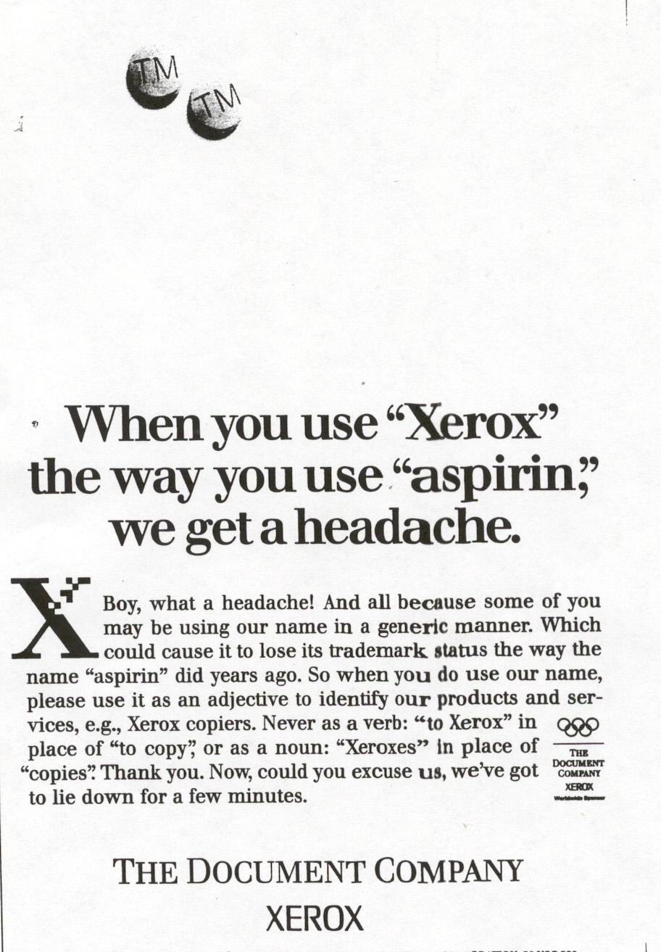
Trademarks
Must Be Defended

Slide 34

Copyright
Protects the expression of an idea, not the idea itself
Protects against copying, not against independent development of an identical work
Copyright protection occurs automatically once the original work is fixed in a tangible medium
Registration of the copyright is NOT required for protection (but it may be required to sue for infringement).

Slide 35

Copyright
Under the “Work Made for Hire Doctrine”:
The employer AUTOMATICALLY owns the copyright for work product created by an employee within the scope of his or her employment
The employer does NOT own the copyright for work product created by an independent contractor . . .
unless the contractor assigns the copyright in writing

Slide 36
Trade Secrets Definition
“Information, without regard to form (any formula, pattern, physical device, idea, process, compilation of information or virtually any other information that), that:
1. is not commonly known or available to the public;
2. derives economic value from not being generally known; and
3. is the subject of reasonable efforts to maintain its secrecy.”

Slide 37
Limitations of Trade Secrets
Does not protect against reverse engineering
Does not apply to independent creation
Public disclosure ends trade secret protection
Not suitable where the distinctive technology or idea is disclosed when the product/system is sold/public
Trade secrets must be maintained as a secret.

Slide 38
Contact Information
Ryan Schneider, Esq.
Intellectual Property Group
Patents, Trademarks, Copyrights and Related Matters
Troutman Sanders LLP
Bank of America Plaza
600 Peachtree St Ne Ste 5200
Atlanta Ga 30308-2231
Direct: 404.885.2773 │ Fax: 404.962.6849
E-Mail: ryan.schneider@troutmansanders.com
Web: www.troutmansanders.com
Atlanta • Chicago • Hong Kong • London • Newark • Norfolk • Orange County • Portland • Richmond • San Diego • Shanghai • Tysons Corner • Virginia Beach • Raleigh • Washington, D.C. • New York

