Slide 1


NON-DILUTIVE FUNDING
Julie Turner Collins
ATDC/SBIR GA
SBIR – Small Business Innovation Research
STTR – SBIR Technology Transfer

Slide 2
NON-DILUTIVE FUNDING
FREE $$$?
NOTHING IS FREE

Slide 3
PRICE TO PAY
Grantor’s Objectives vs. Company Objectives
Meeting RFP Criteria
Time is $$$
Notes:
Objectives:
Department of Defense - technology tooled to their specs
Bill & Melinda Gates - social improvement
RFP:
What are your next technological challenges? Is this requested in the RFP or are you re-tooling your device to fit their criteria
Timing:
Application to Award - 1 month to 10 months. What should you have accomplished in that time frame?

Slide 4
$$ SOURCES
Small Business Innovation Research (SBIR/STTR)
$2.3 Billion/Year
Foundations/Societies
(Bill & Melinda Gates, Susan G. Komen, etc)
Federal: Non-SBIR
(CDC, FDA, DARPA, BARDA, etc)

Slide 5
RESOURCES
SBIR/STTR Grants and Contracts:
www.zyn.com/sbir
www.sbir.gov
Community of Science
Foundations Directory Online

Slide 6
SBIR/STTR RULES
SET-ASIDE:
3.2% SBIR, 0.45% STTR
R&D FUNDING:
PHASE I SUBCONTRACTS:
SBIR: 33% Max
STTR: 60% Max
PRINCIPLE INVESTIGATOR:
Company Employee †
FACILITIES:
Company Operated
PATENTS/IP:
Company Controlled ††

Slide 7
PHASES
 | AWARD AMOUNT | DURATION | OBJECTIVE
PHASE I | $150,000 | 6 TO 12 MOS. | Feasibility
PHASE II | $1,000,000 | 2 TO 3 YEARS | Product Development
Phase I Phase II
Note: some agencies allow Phase II applications by request only

Slide 8
ELIGIBILITY*
1. For-profit small business concern
2. Less than 500 employees including affiliates
3. Independently owned and operated primarily in USA
4. 51% owned and controlled by one or more individuals who are U.S. citizens or permanent residents
5. Research must be performed in the U.S.
*at the time of award; not required at time of application

Slide 9
AGENCIES
SBIR and STTR Participants
SBIR Participants
Department of Defense*
National Institutes of Health*
National Aeronautics and Space Administration
Department of Energy
National Science Foundation*
Department of Homeland Security
Department of Agriculture
Environmental Protection Agency
Department of Transportation
Department of Commerce
* FUND MEDICALLY RELATED PRODUCTS

Slide 10
SOLICITATIONS
 | Open | Submit | Close
NIH SBIR Contracts | Aug-12 | Aug-12 | Nov-12
NSF SBIR | Mar-12 | May-12 | Jun-12
DoD SBIR 2012.2 | 24-Apr-12 | 24-May-12 | 27-Jun-12
DoD STTR 2011.A | 26-Jan-12 | 27-Feb-12 | 28-Mar-12
NSF STTR | Jul-12 | Oct-12 | Nov-12
NIH SBIR/STTR | Jan-12 | Mar-12 | 5-Apr-12 5-Aug-12 5-Dec-12
www.zyn.com/sbir

Slide 11
NOT JUST A FUNDING MECHANISM
PART OF YOUR FUNDING STRATEGY
SBIR Angel VC

Slide 12
FASTTRACK
PROS
No Phase II application
Farther along in development
CONS
Few awarded
Previous grant awardee
Phase I still evaluated
WHAT IS FASTTRACK?
PHASE I & II combined
Not all agencies allow

Slide 13
WHEN
  In the product life-cycle?
  Proof of Concept to Alpha Prototype
  Product 2.0 to Product 3.0
To apply?
Application to Award = 10 mos.

Slide 14
TEAM
Who should be the PI?
Faculty, Post-doc, recent Ph.D. graduate
Consultants?
Faculty, Industry Representative
Letters of Support
Potential Investor or Customer or Partner

Slide 15
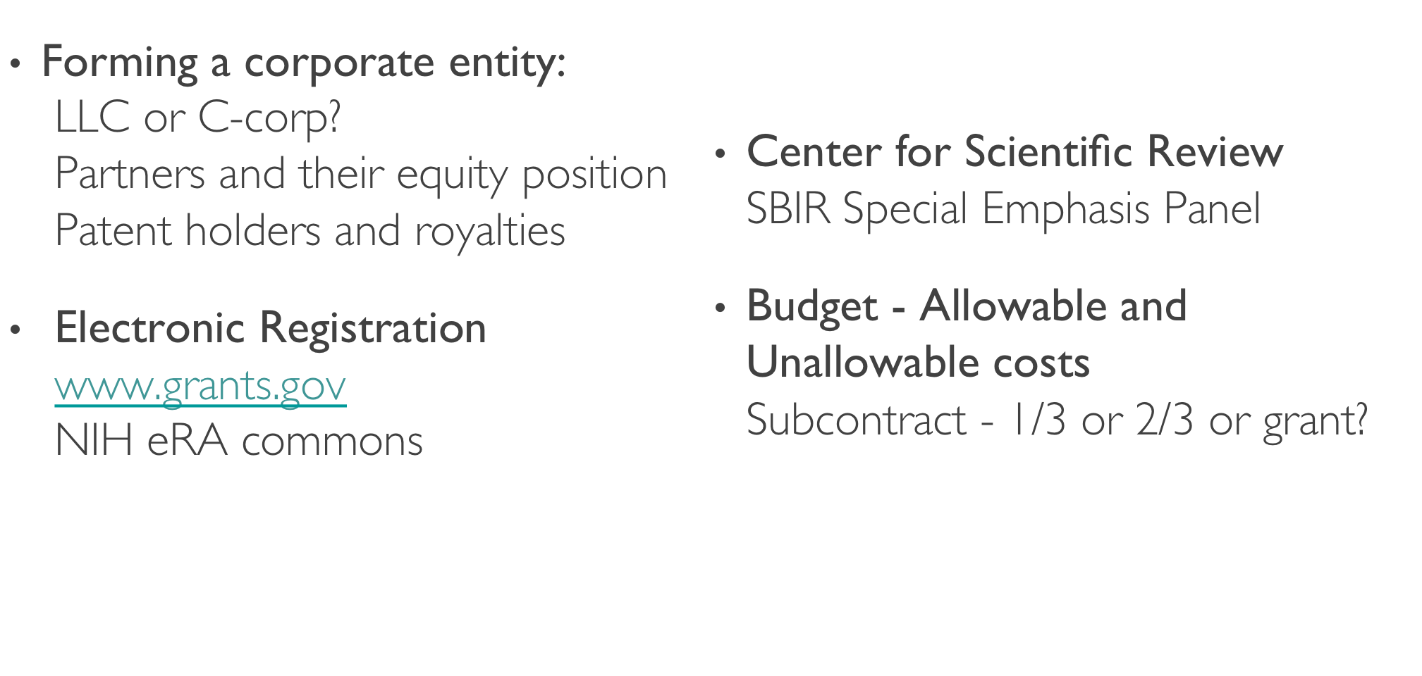
ADMINISTRATIVE DETAILS

Slide 16
GRANT PREPARATION
Not just an academic grant
Not just a business plan
Who is your audience?
Did you define?
Market
Potential Customers
Commercial Significance of Solution

Slide 17
REFERENCES
Grants.gov http://www.grants.gov
SBIR Gateway http://www.zyn.com/sbir/
SBIR GA http://www.sbirga.com

Slide 18
JULIE TURNER COLLINS
Director, SBIR GA and the Georgia FAST Program
www.sbirga.com www.atdc.org
julie@atdc.org
404-385-6646

