Slide 1


Funding Opportunities: Views from a former AAAS Science & Technology Policy Fellow at NSF/ENG/IIP
Malathi Srivatsan, Ph.D.
Associate Professor, Arkansas State University

Slide 2
AAAS Science &Technology Policy Fellowship
The science and engineering challenges that society faces today-locally, nationally and internationally-are far more complex
To address these challenges, AAAS manages and administers Science & Technology Policy Fellowships to provide the opportunity for accomplished scientists and engineers to participate in and contribute to the federal policymaking process while learning firsthand about the intersection of science and policy
For more information and to apply, go to: http://fellowships.aaas.org/01_About/01_index.shtml

Slide 3
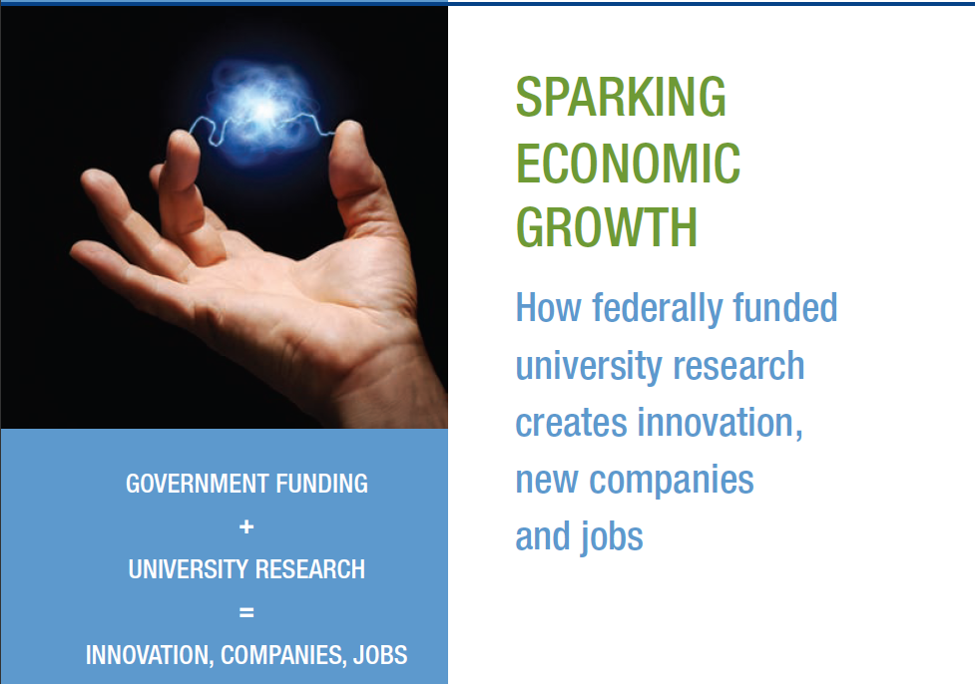
Economic Growth & Human Capital
Science and technology have been responsible for half of the growth of the American economy since WWII. However currently U.S. annually imports $53 billion more in advanced technology products than we export .
In addition, participation of minorities in science and technology based entrepreneurship is very minimal.
What do we gain by Broadening Participation?
Diverse Talents and Skills
Unique experiences
Invaluable approaches
Creativity and innovation
2010 Task Force on American Innovation http://www.innovationtaskforce.org/index.php?p=1_8
Notes:
3

Slide 4
Current Needs & Priorities
US will need one million additional graduates in STEM fields over the next decade to maintain its upper hand in science and technology (President’s Council of Advisors on Science and Technology: http://www.whitehouse.gov/sites/default/files/microsites/ostp/pcast-engage-to-excel-v11.pdf
Their education and research training need to be interdisciplinary to meet the current and future challenges in innovation and economic growth

Slide 5

Why Interdisciplinary, Translational Research?
http://web.mit.edu/dc/Policy/MIT%20White%20Paper%20on%20Convergence.pdf
Interdisciplinary approach is critical for finding innovative solutions for current and future societal needs

Slide 6
From Bench Research to Market Place
“From inventing the traffic light to developing the artificial heart, our Nation's doers, makers, and entrepreneurs have proven time and again that, in America, it takes only a single good idea and the courage to pursue it to change history. In fulfilling this simple promise, these visionaries play a critical role in sparking new industries, expanding our economy, and generating new job growth across our country”
http://www.whitehouse.gov/the-press-office/2011/11/01/presidential-proclamation-national-entrepreneurship-month-2011
On 09/16/2011, President Obama Signed America Invents Act, Overhauling the Patent System to Stimulate Economic Growth, and Announced New Steps to Help Entrepreneurs Create Jobs
Engineers have what it takes to be successful entrepreneurs! “The most common educational background of CEOs in the S&P 500 companies … the nation’s most successful, most powerful corporations … is not business, it’s not finance, it’s not economics—it’s actually engineering” http://www.whitehouse.gov/the-press-office/2010/10/18/remarks-president-white-house-science-fair
Participation by underrepresented minorities and women in science and technology based entrepreneurship is significantly less

Slide 7
NSF SBIR Phase I Applications Submitted (in %)
Self-reported Data
Year | Men | Women | Black or African Americans | Hispanics or Latinos | American Indian & Alaskans | Hawaiian & Pacific Islanders | Persons with Disability
2001 | 85.57 | 9.42 | 1.38 | 1.47 | 0.52 | 0.09 | 1.21
2002 | 82.69 | 10.47 | 1.78 | 1.92 | 0.57 | 0.14 | 1.35
2003 | 79.83 | 9.77 | 1.58 | 1.62 | 0.12 | 0.00 | 1.16
2004 | 78.72 | 8.41 | 1.88 | 2.06 | 0.35 | 0.12 | 2.18
2005 | 74.62 | 10.13 | 2.37 | 2.27 | 0.47 | 0.00 | 1.70
2006 | 71.73 | 10.51 | 1.84 | 1.84 | 0.37 | 0.00 | 0.92
2007 | 72.59 | 9.48 | 1.56 | 1.93 | 0.22 | 0.00 | 1.48
2008 | 72.02 | 10.49 | 1.67 | 3.02 | 0.4 | 0.00 | 0.72
2009 | 68.47 | 9.77 | 1.16 | 2.32 | 0 | 0.19 | 1.55
2010 | 64.44 | 10.08 | 2.47 | 2.85 | 0.72 | 0.04 | 1.32
Notes:
While applications submitted by women are around 10% of the total application, those from the other underrepresented groups are much lower. Applications from Hispanics appear to be increasing while applications from those who identify themselves as men show a decline.

Slide 8
Interventions
Based on research findings and discussions, the following intervention measures have been identified by IIP Diversity Focus Group in 2010-2011 to encourage participation by minorities ……….
Providing opportunities for
- Understanding how to be a successful entrepreneur
- Training by working in a funded, successful small business
- Learning about available funding and other resources
- Developing grant writing skills
- Becoming a reviewer
- Mentoring
- Networking
Inspiring through examples of success stories
Learning ‘Best Practices’ from other divisions and agencies for implementation
Notes:
These are some of the interventions identified from research, through discussions and learning about best practices

Slide 9
Opportunity for Training: Small Business Postdoctoral Research Diversity Fellowship
50 Fellowships, One year duration
Fellow works in companies of current NSF SBIR Phase II grantees
Fellow receives $65,000 from NSF funds and $10,000 from the small business
ASEE matches applications with businesses and manages the program
Website for details: http://nsfsbir.asee.org/

Slide 10
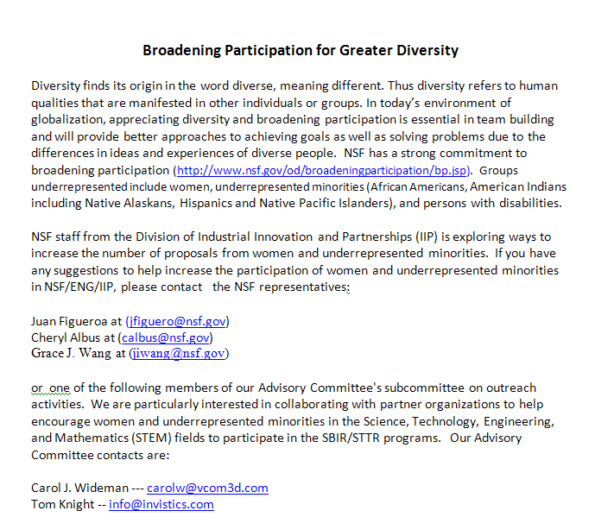
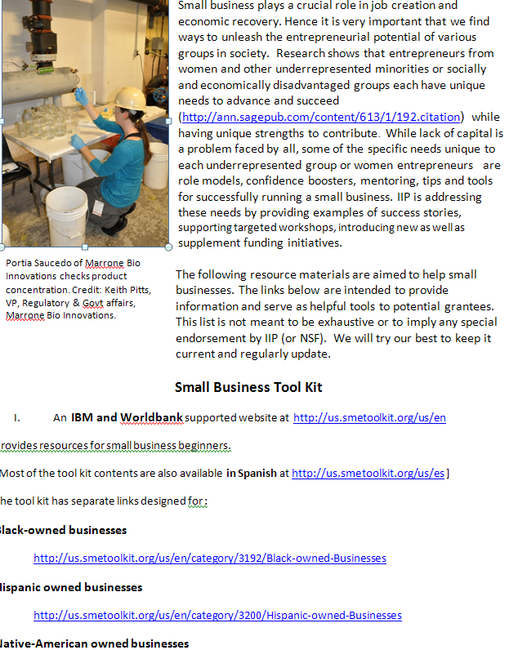
Webpage providing Resources, Tips & Tools
Connecting through Facebook and Blog to follow…….
Notes:
This webpage will be linked to IIP website. As we videotape conferences and workshops, they too will be posted/linked here

Slide 11
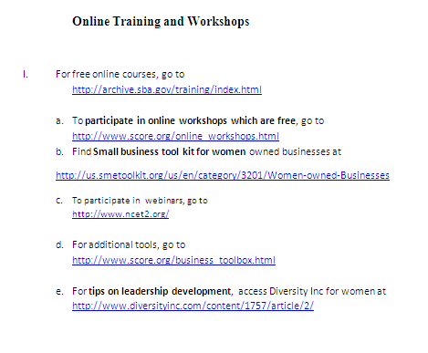
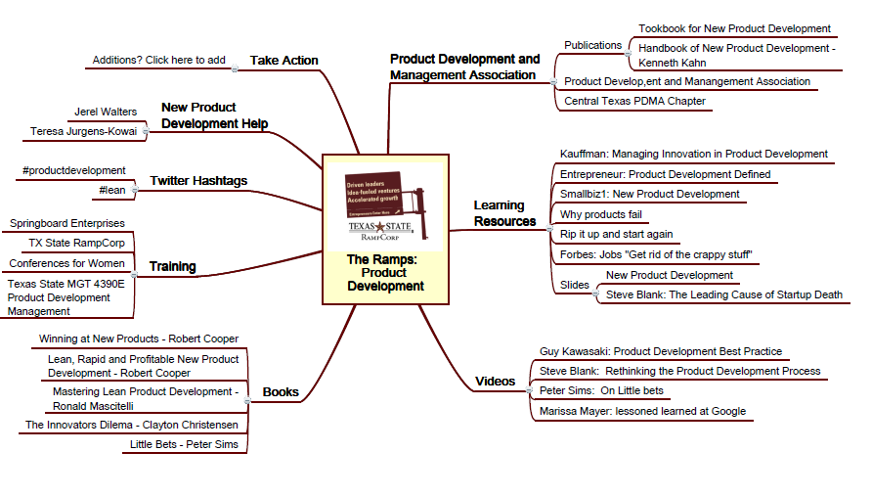
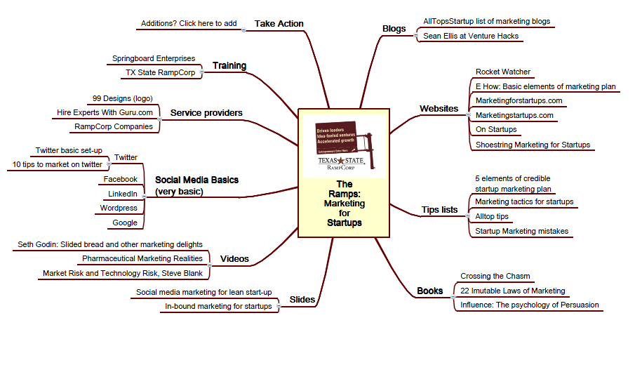
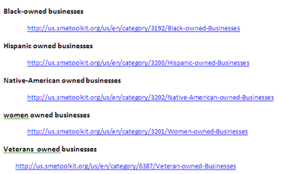

Slide 12
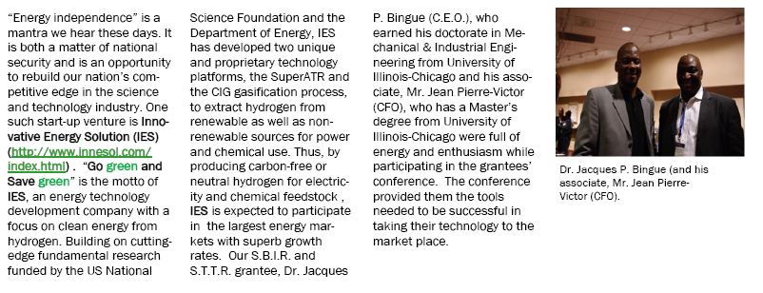
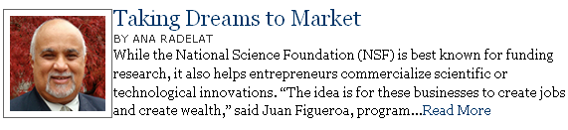
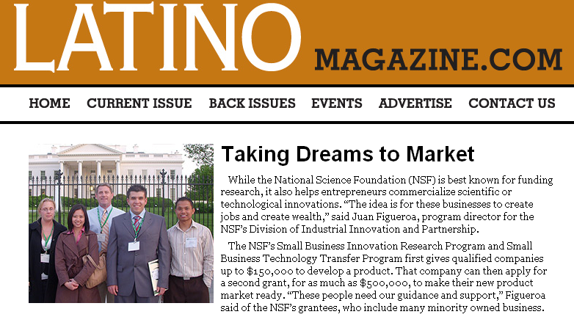
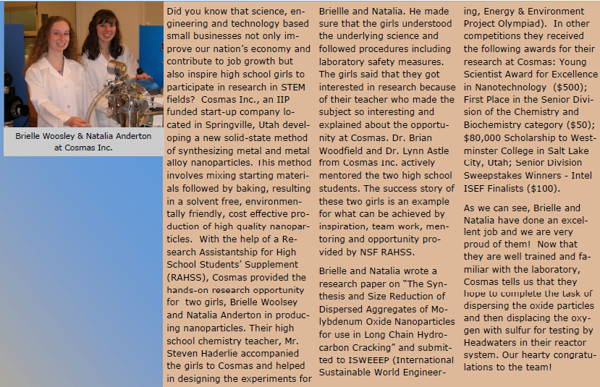
Inspiring through Examples
Notes:
Success stories are published via NSF Current news letter and will also be linked to IIP Webpage

Slide 13
Facilitating Exchange of Ideas through Networking
In May of 2011, during NSF/SBIR Phase II Grantees Conference, a get together for women grantees was held
The participants expressed a strong interest in having an internet forum for discussion
To serve this purpose, an external wiki site has been established and will be launched soon

Slide 14
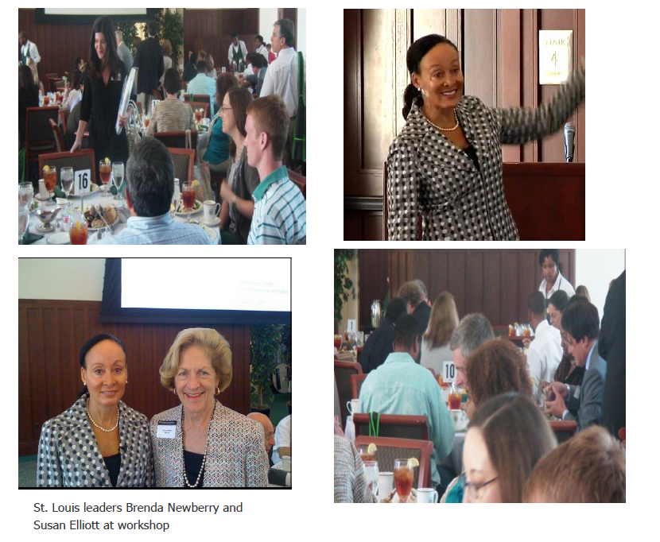
Opportunities for Learning & Networking (workshops & conferences)
130 participants, four tracks
At St. Louis on 07/25/2011
workshop on "Diversity as a Catalyst for Innovation in the Sciences: Connecting Women and Under-Represented Innovators to Regional Resources “ was held
(i) the presence of good research institutions with appropriate R&D facilities
(ii) availability of educated workforce
(iii) engaged public sector
(iv) quality of life attractive to creative minds and more importantly
(v) the region recognizing the strength in diversity
All of these necessary features make a region thrive economically
Notes:
St. Louis workshop is planned for July end. Georgia Tech workshop proposal is in review

Slide 15
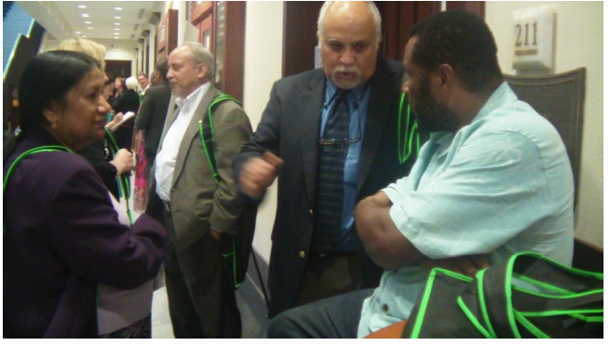
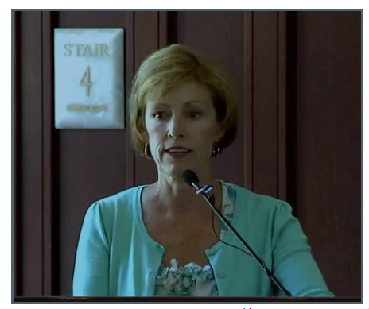
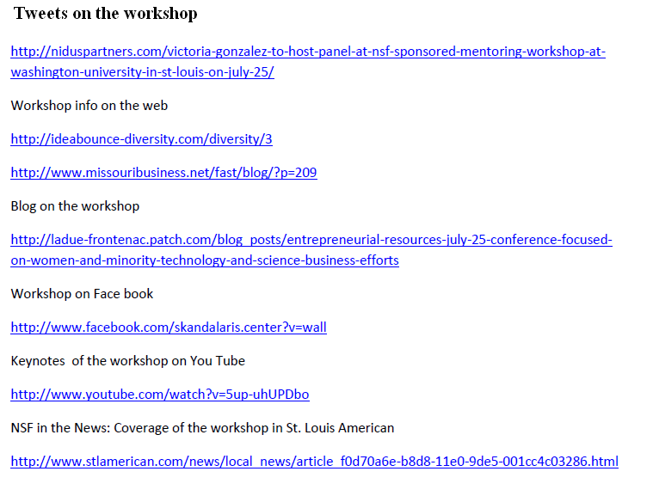
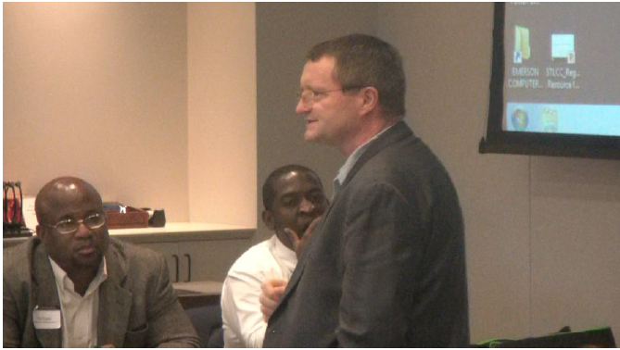

Slide 16
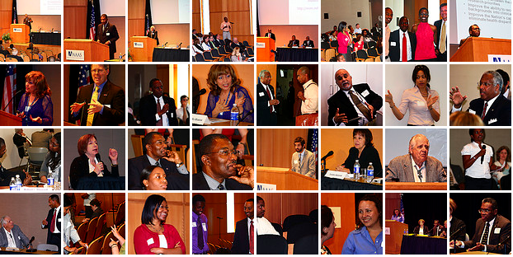

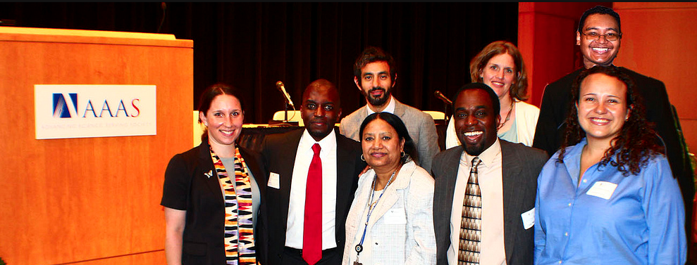
What works and what doesn’t?
Broadening Participation in Economic Growth through Industrial Innovation and Partnerships, ¹Malathi Srivatsan and ²Kesh S. Narayanan
4th Annual Conference on Understanding Interventions that Broaden Participation in Research Careers,
May 26-28, 2011, Nashville, TN 37240

Slide 17

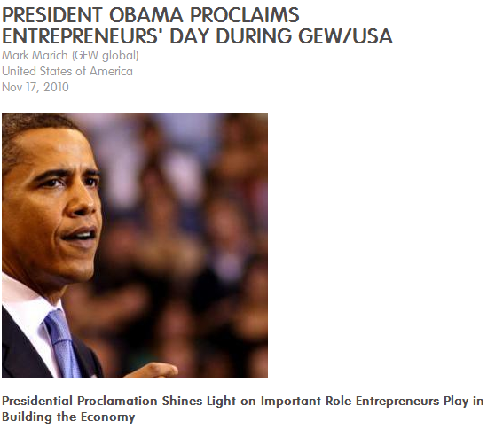
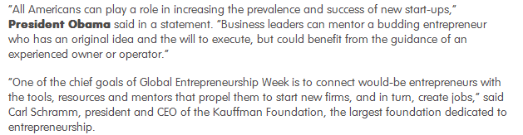

We can no longer afford not to tap a much larger and diverse set of minds in pursuit of taking valuable ideas based on scientific discovery and technological innovation to the market place for the benefit of society!!
Thank you

