Slide 1
Creating Your Own Innovation
Micro Eco-System
Pamela McCauley Bush, Ph.D., CPE
Associate Professor & Director Ergonomics Laboratory
University of Central Florida &
Chief Technology Officer
Bush Enterprises

Slide 2
Topics
Determine IF you want to be in this game of innovation
Career innovation
Developing your innovation micro-ecosystem

Slide 3
IF you want to be in this game…

Slide 4
Entrepreneur vs. Innovator
They are very different
Don’t believe the hype
Requires a paradigm shift from the “academic only” mindset

Slide 5
The “If”
Do you want to participate in innovation and/or entrepreneurial activities?
  Is it YOUR vision?
  Impact today?
  Long term impact?

Slide 6
How
Will you do it through the university?
Will you seek external collaborators?
Will you do it as a small business?
Is a hybrid possible?

Slide 7
When
Timing is critical
Compatibility with current goals
Building toward long term goals

Slide 8
Outcome of your IF evaluation
Define your career innovation mission statement
  Vision: big picture idea
  Mission: general statement of how
  Core Values

Slide 9
Career Innovation

Slide 10
What is Career Innovation?
Tailoring our career focus, personal capabilities, skills and relationships areas to meet current and emerging needs in a given area of opportunity
Can be done at any point in your career

Slide 11
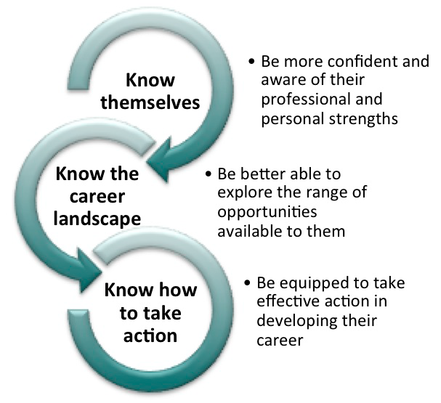
Personal Innovation
Source: http://www.careerinnovation.com/

Slide 12
Career Innovation
A Great time to be a STEM faculty member!
However… for the academic only types:
  Requires a paradigm shift from the academic only mindset

Slide 13
What is our paradigm?
How are we thinking?
What are we thinking?
Where are we thinking?

Slide 14
Take off the Limits…
What is limiting our thinking?
It’s not about the “pie”

Slide 15
Developing YOUR innovation micro-ecosystem

Slide 16
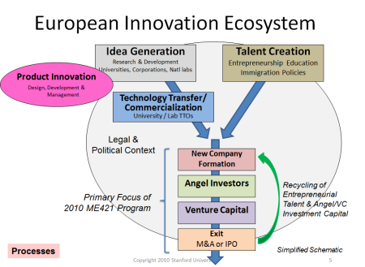
Innovation Ecosystem

Slide 17
Create Your Team
Identify a trusted person that can be your “Innovation soundboard”
Develop a core team of (3 to 5) supporters/advocates with key areas of knowledge that you can trust
  Business, legal, strategic and financial guidance

Slide 18
Create Your Micro-Innovation Eco-system
Idea generation plan
Product innovation strategy
Talent and expertise resources
Technology transfer strategy
Funding options and strategies

Slide 19
Will it be easy?
Maybe but probably not
What it takes
  Faith
  Resilience
  Consistency
  Optimism

Slide 20
Innovation Initiation
Find a need
Know what you know – know what you don’t know
Don’t be afraid to think differently.
Know the market/customer

Slide 21
Innovation Instantiation
Determine who wants this innovation
Protect your idea/innovation
Create a brief but clear explanation of the innovation
Identify potential collaborators

Slide 22
Innovation Introspection
Decide if/how you want to take the innovation to the finish line
  Will you hand it off?
  Partner with others?
  Will you lead it?

Slide 23
Innovation Implementation
Draft a plan to develop the idea to at least a “proof of concept”
Plan toward an “end result”
  University relationship
  Funding for proof of concept and product development
  SBIR/STTR funding
  Venture capital funding

Slide 24
Plan Your Exit Strategy
Yes, you will want to exit…
Get professional advice

Slide 25
It’ a great time to be YOU!

