Slide 1
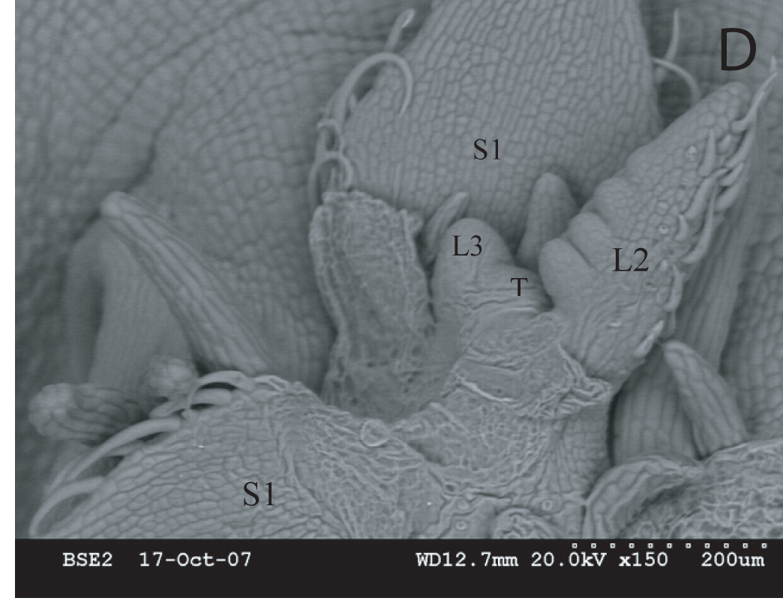
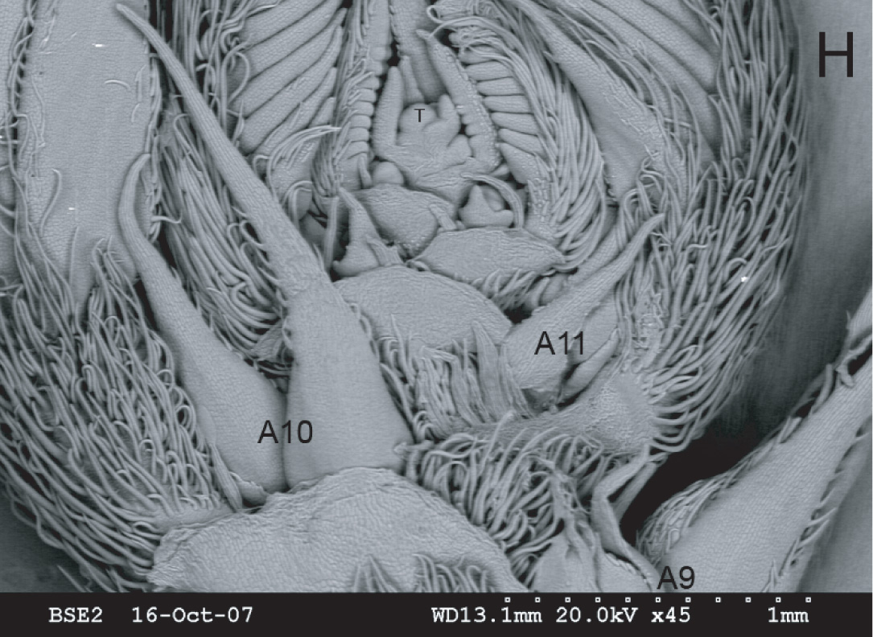
Chamaecrista Solexa data for Shoot Development
4 days post-imbibition
Flowering (18-21 nodes)

Slide 2
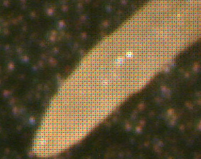
Chamaecrista nodule and root Solexa data

