Slide 1
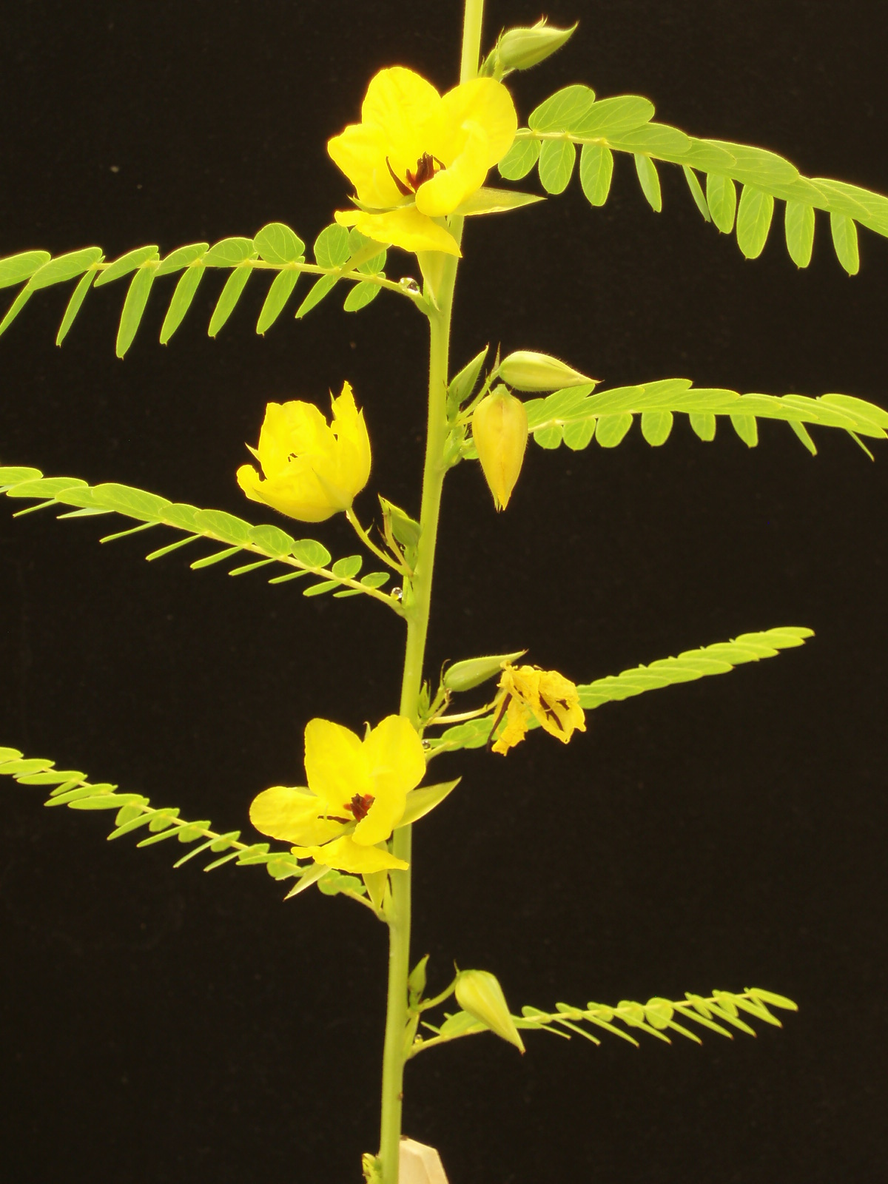
Illumina/Solexa Results
Total passing reads (46 bp): 143,442,505
Total Mbp: 6,598
157,350 SNPs among 3 ecotypes
454 Titanium Results
Total reads (370 bp): ~1,000,000
Total Mbp: 370
ESTs in NCBI as of 11/28/08
Medicago truncatula 260,238
Glycine max 1,386,618
Lotus japonicus 157,951

