Slide 1
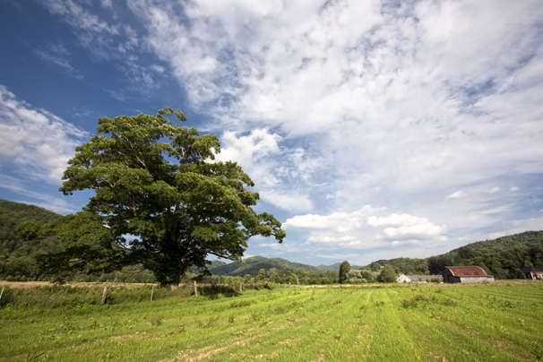
VERMONT SEASONS

Slide 2
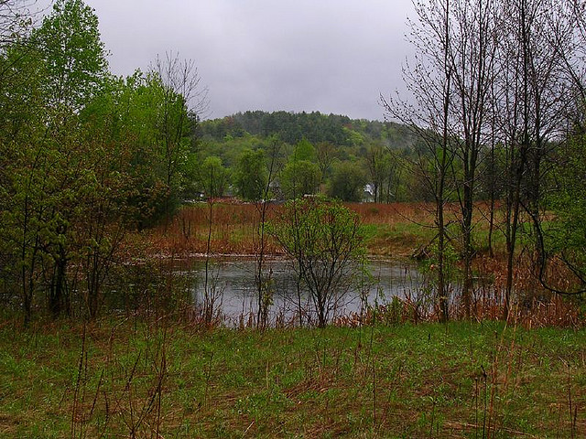

Slide 3
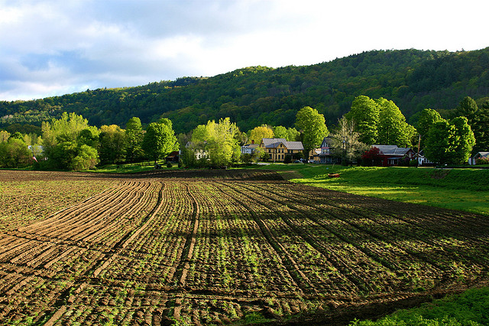

Slide 4
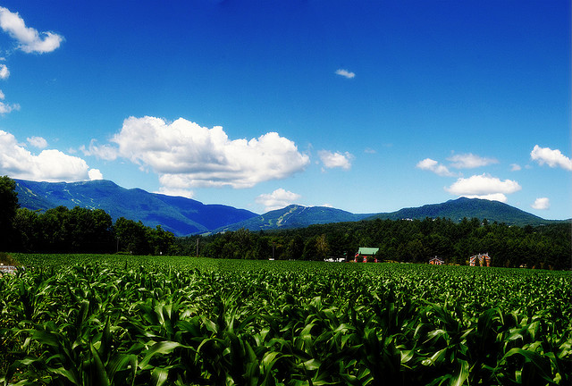

Slide 5
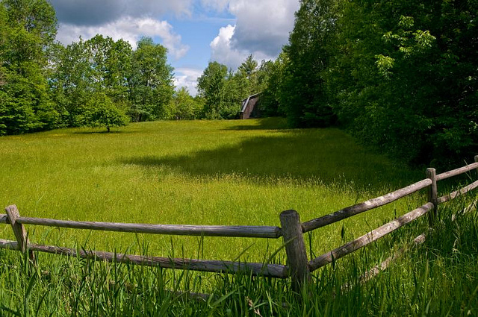
Notes:
Source: http://www.flickr.com/photos/melrick/4715374606/sizes/z/in/photostream/

Slide 6
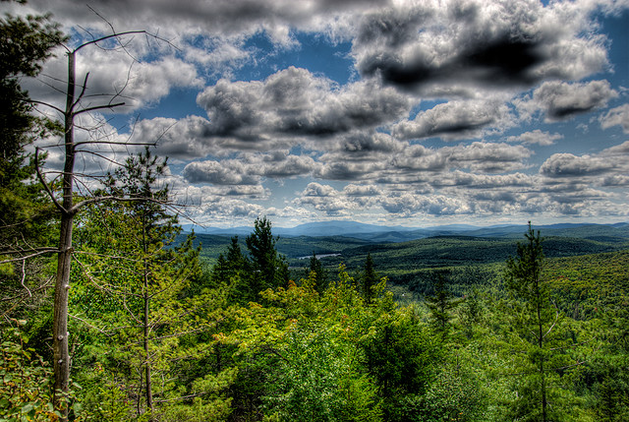
Notes:
Source: http://www.flickr.com/photos/emedia/2825621193/in/set-72157606484515499

Slide 7
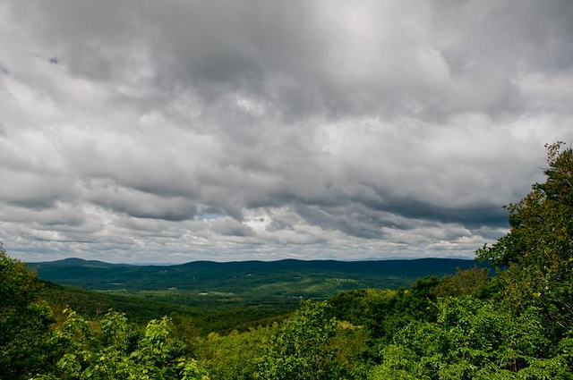

Slide 8
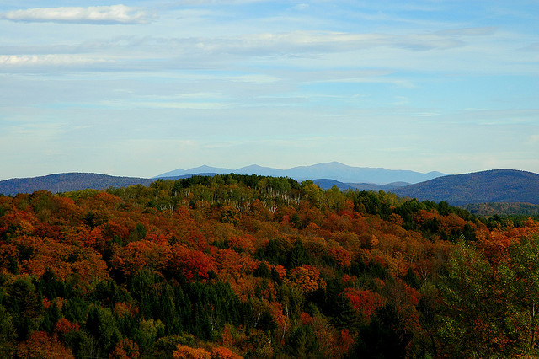
Notes:
Source: http://www.flickr.com/photos/bloggle/52303912/

Slide 9
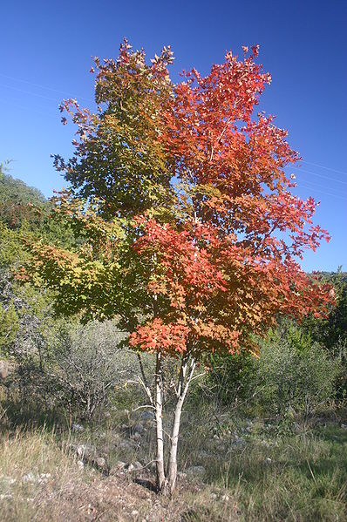
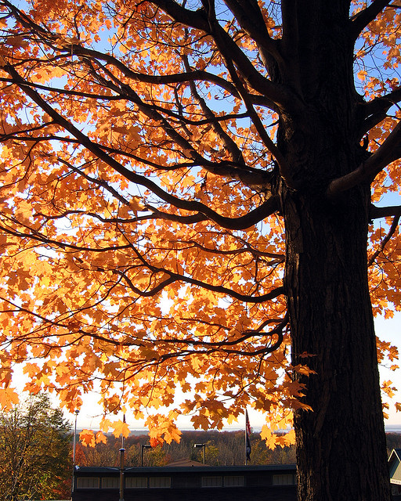

Slide 10
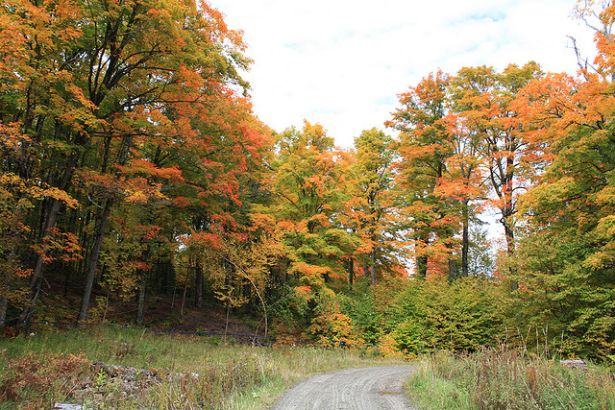

Slide 11
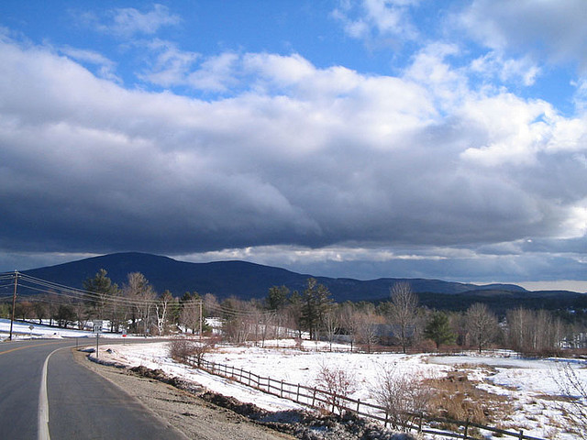

Slide 12
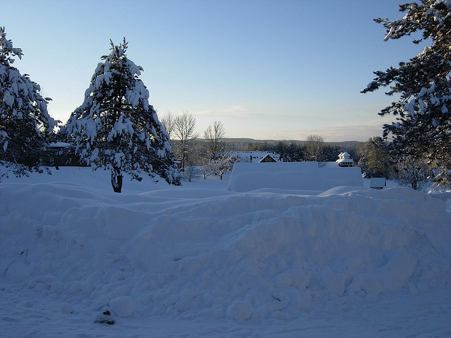
Notes:
Source: http://www.flickr.com/photos/lisa_yarost/2257863480/sizes/z/in/photostream/

Slide 13
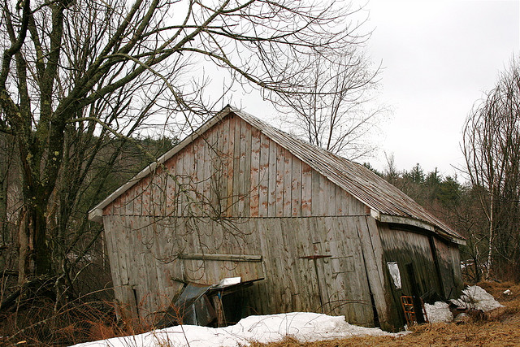

Slide 14
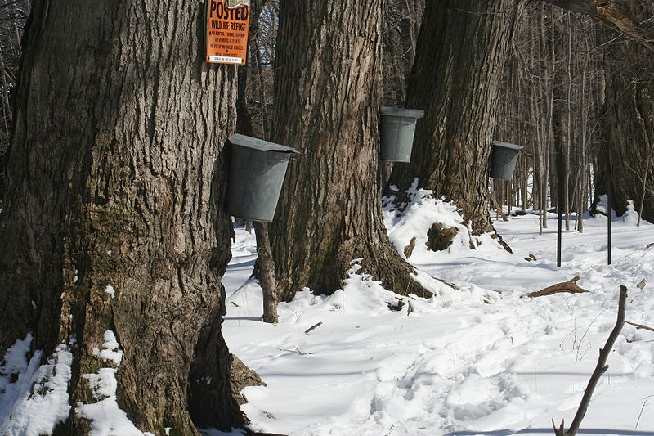

Slide 15
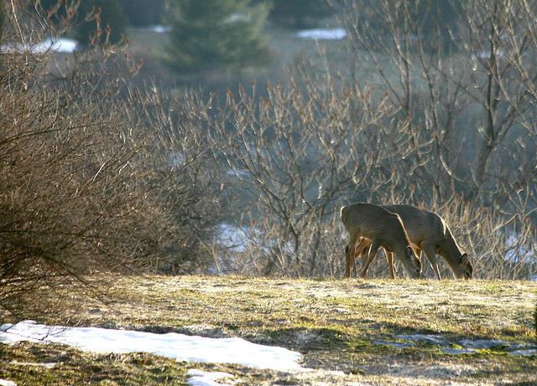

Slide 16
