Slide 1



Global Climate Models
How scientists simulate the climate system
and project future climate scenarios
Notes:
Slide set courtesy Keith Dixon and Marian Westley, NOAA Geophysical Fluid Dynamics Laboratory. Earth image above by Reto Stockli, SSAI / NASA’s Earth Observatory

Slide 2
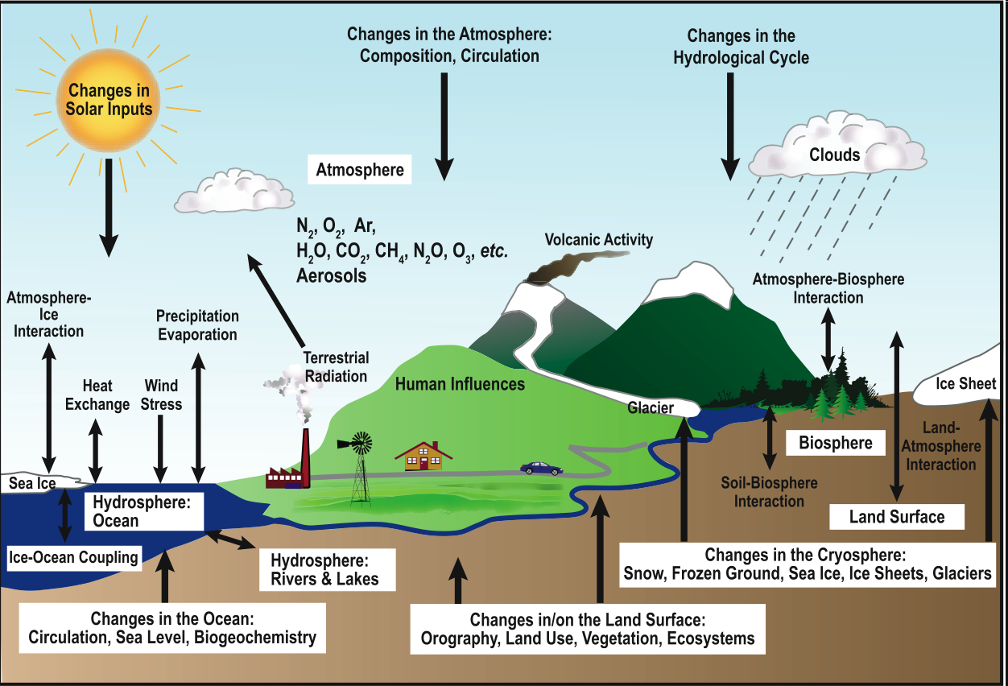
Scientists observe & measure all the factors that are known to influence Earth’s climate
2

Slide 3
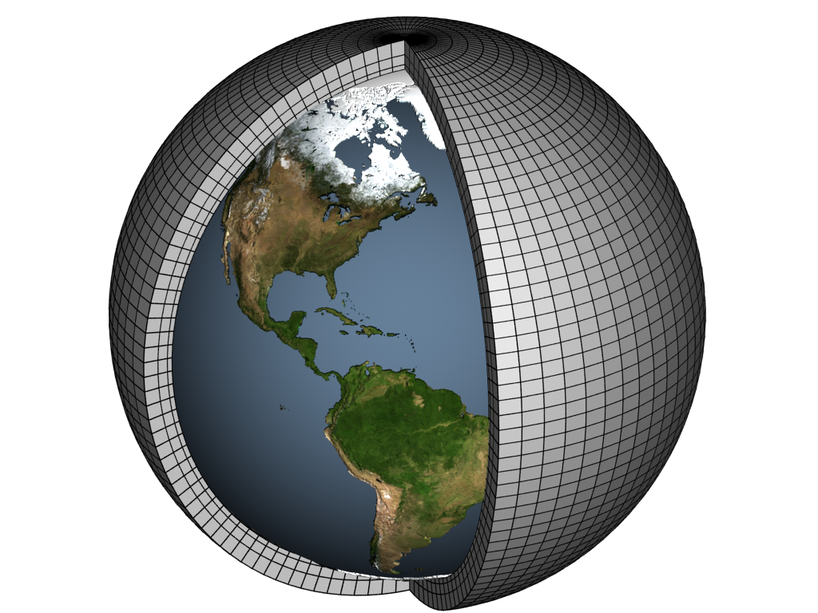
Scientists apply that knowledge to a scaled-down, computer simulation of the planet: a global climate model
Modelers represent Earth’s surface and atmosphere as a virtual world made up of interacting, three-dimensional boxes.

Slide 4

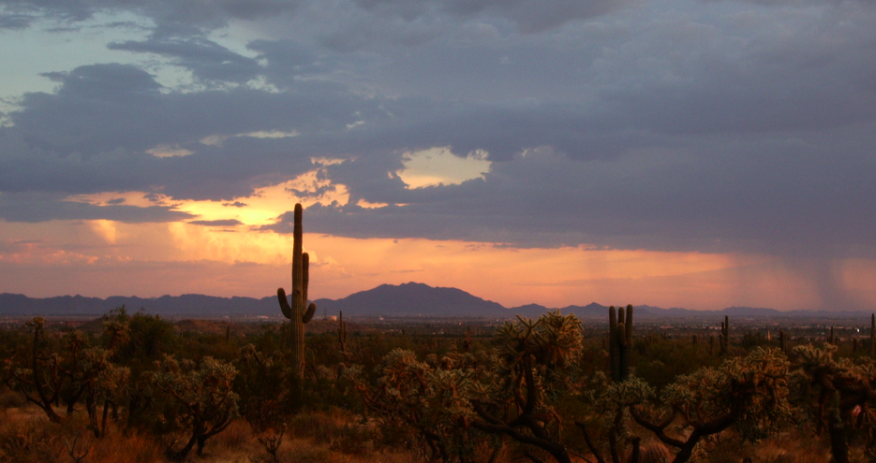
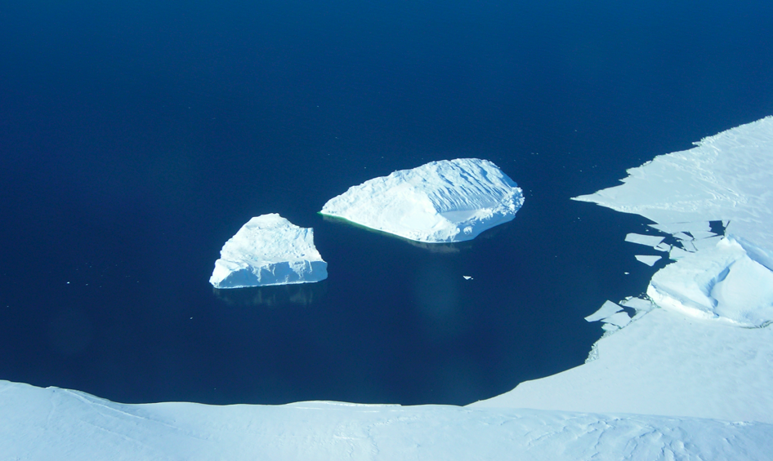
Physical characteristics and processes that occur in each box are cataloged

Slide 5





Mathematical equations that represent the physical characteristics and processes are entered for each box

Slide 6
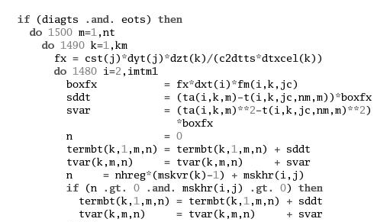
Equations are converted to computer code and climate variables are set

Slide 7

A supercomputer solves all the equations, passing results to neighboring boxes and calculating the next set of initial conditions

Slide 8
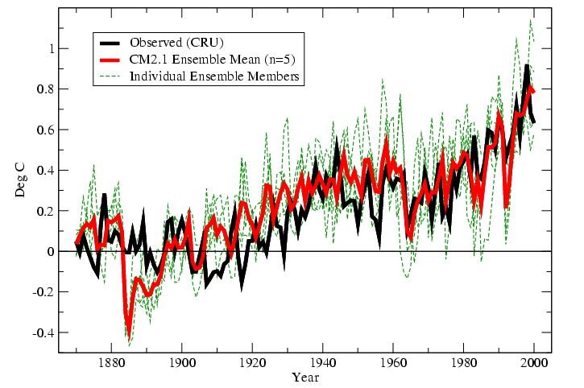
Models are tested and refined by simulating past climate then checking how well the results match observations
Notes:
The black trend line in the graph above shows Earth’s observed mean surface temperature from 1880 through 2000. The red trend line shows the average result of many computer simulations of Earth’s past climate over that same span. As model outputs match real-world observations, scientists gain increasing confidence in their understanding of the climate system and their ability to simulate how it works.

Slide 9
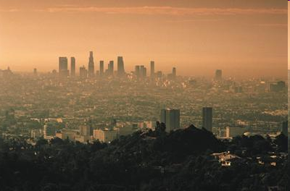
Models that successfully approximate past climate are considered valid for modeling future scenarios
Notes:
Photo courtesy U.S. Environmental Protection Agency
NOAA's Observations, Modeling, and Research on Climate Variability and Change
9

Slide 10
Climate models project temperature increases
for various carbon dioxide emission scenarios
Studies suggest that a further increase of only 2°F would lead to severe, widespread, and irreversible impacts on Earth’s environment.^{1,2,3}
IPCC models successfully simulated climate conditions from 1900 to 2000.
Notes:
This graph shows observed and projected changes in average global temperature under three different IPCC emissions scenarios. None of these scenarios, not even the one called “lower,” includes the implementation of policies to limit climate change or to stabilize atmospheric concentrations of heat-trapping gases. Rather, differences are due to different assumptions about changes in population, the rate of adoption of new technologies, economic growth, and other factors. Recent carbon dioxide emissions are, in fact, above the highest emissions scenario developed by the IPCC. Whether this trend will continue is uncertain.
The shaded areas show the likely ranges while the lines show the average projections from numerous climate models. Changes are relative to the 1960-1979 average global temperature. Figure courtesy of the Global Climate Change Impacts report (www.globalchange.gov)
¹O’Neill, B.C. and M. Oppenheimer, 2004: Climate change impacts are sensitive to the concentration stabilization path. Proceedings of the National Academy of Sciences, 101(47), 16411-16416.
²Schneider, S.H. and M.D. Mastrandrea, 2005: Probabilistic assessment of ‘dangerous’ climate change and emissions pathways. Proceedings of the National Academy of Sciences, 102(44), 15728-15735
³Lenton, T.M., H. Held, E. Kriegler, J.W. Hall, W. Lucht, S. Rahmstorf, and H.J. Schellnhuber, 2008: Tipping elements in the Earth’s climate system. Proceedings of the National Academy of Sciences, 105(6), 1786-1793.

Slide 11
Research groups around the world have developed a range of respected climate models
Modeling groups also work together, averaging results from their models with other models that used the same initial conditions.
These multi-model results are called “ensembles.”
Notes:
NOAA's Observations, Modeling, and Research on Climate Variability and Change
11

Slide 12
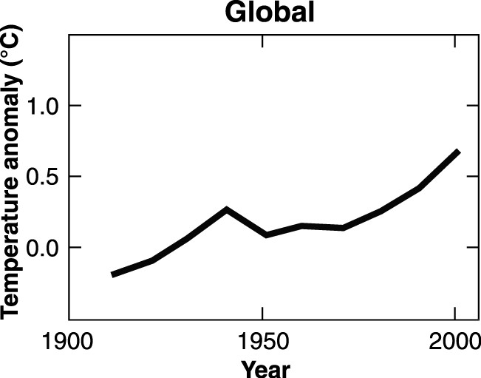
We can use climate models to link effects to their causes
1.0
0.5
Temperature anomaly (°C)
0.0
1900
1950
2000
Observations relative to 1901-1950 average
IPCC, 2007, SPM
Notes:
The black line shows observed global average temperature “anomaly” over the last century. The 0.0 mark on the Y-axis represents the average global temperature from 1901 to 1950. The black trend line shows how global temperature in each subsequent year compared to the average from 1901 to 1950. Any significant departure from average is called “anomaly.”

Slide 13
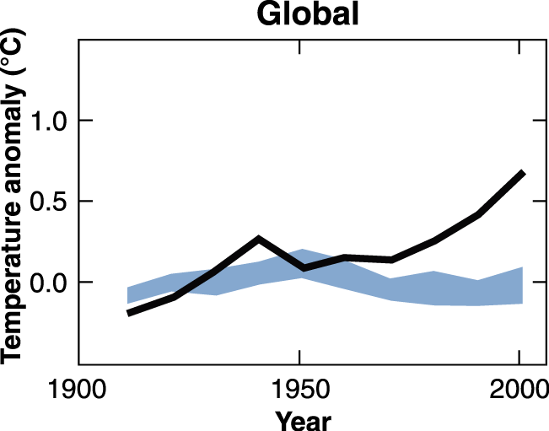
Models predict how global average temperatures would have changed due to natural forces only
1.0
0.5
Temperature anomaly (°C)
0.0
1900
1950
2000
Model predictions for natural forcings
Observations relative to 1901-1950 average
IPCC, 2007, SPM
Notes:
The blue band shows how global average temperatures would have changed due to natural forces only, as simulated by climate models.

Slide 14
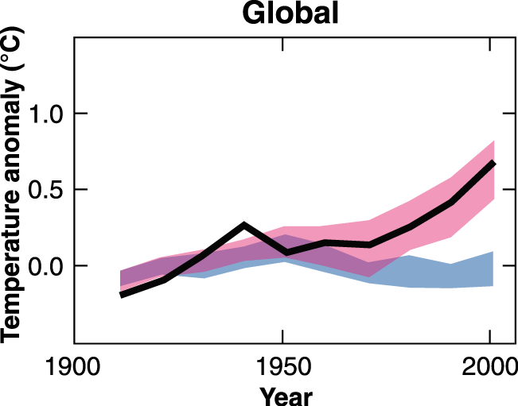
Models attribute global warming mainly to human origins
1.0
0.5
Temperature anomaly (°C)
0.0
1900
1950
2000
Model predictions for natural & human forcings
Model predictions for natural forcings
Observations relative to 1901-1950 average
IPCC, 2007, SPM
Notes:
The red band shows model projections of the effects of human and natural forces combined. As the blue band indicates, without human influences, temperature over the past century would actually have first warmed and then cooled slightly over recent decades. But with human influences, models predict a significant warming. As the model prediction agrees with observed temperature, scientists have high confidence that they understand why our world has warmed over the last century — mainly due to human emission of carbon dioxide and other greenhouse gases.

Slide 15
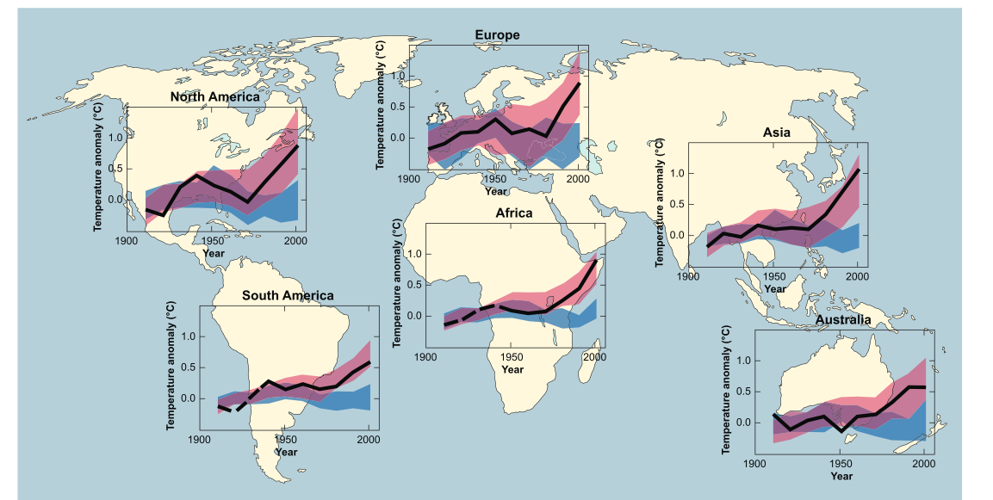
The pattern holds true on every inhabited continent
Model predictions for natural & human forcings
Model predictions for natural forcings
Observations relative to 1901-1950 average
IPCC, 2007
Notes:
15

