Slide 1
How Tall are our Trees?
Measuring Local Trees with Image J
Suzanne Elliott
September 2008

Slide 2
What is Image J
An image processing and analysis tool
It was developed by the National Institutes for Health (NIH)
It is free to download http://rsb.info.nih.gov/ij/features.html
It is used by a wide range of scientists and other professionals

Slide 3
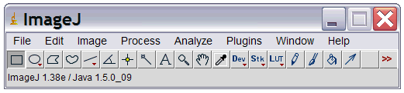
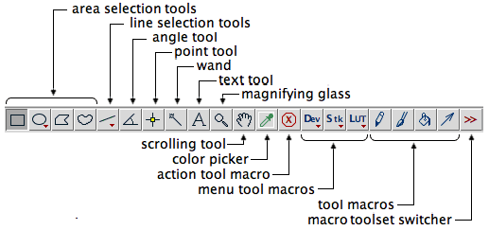
The Main Menu
Menu Bar →
Tool Bar →
Status Bar →
Toolbar
http://rsb.info.nih.gov/ij/docs/menus/edit.html

Slide 4
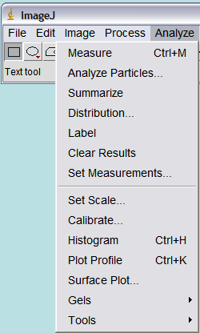
Analyze Menu -Set Scale

Slide 5
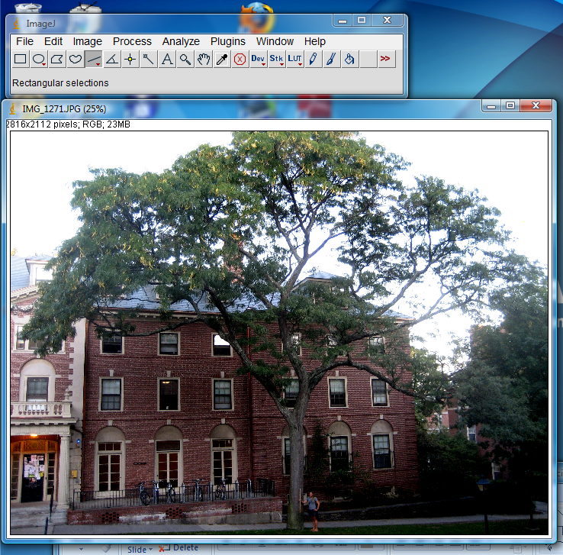
How to measure tree height and crown spread
Take a photo of the tree with a meter stick for reference
Open that photo in Image J

Slide 6
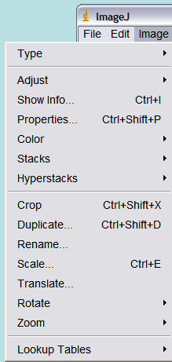
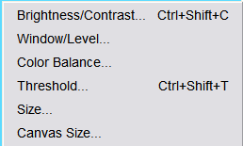
Image Adjust
Crop and adjust the contrast if needed

Slide 7
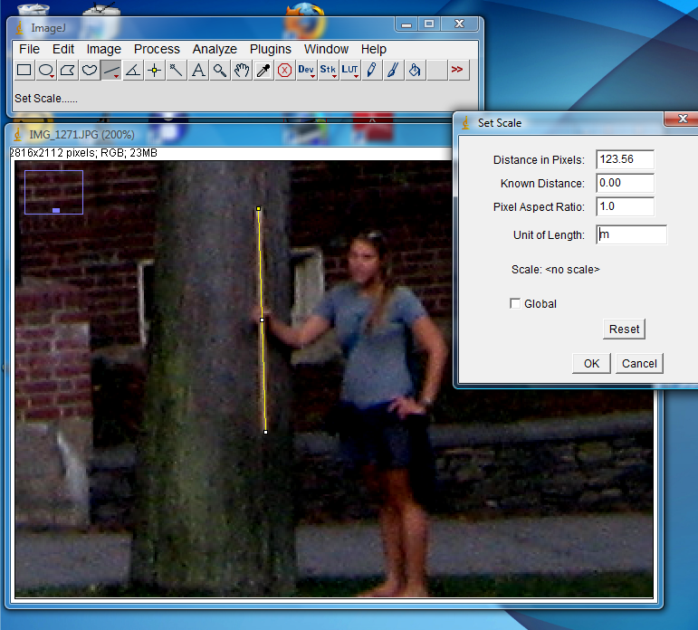
Set the Scale
1.Use the magnifying tool to enlarge the meter stick
2.Use the line tool to draw a line the length of the meter stick
3. Go to analyze set scale
4. Change the units to meters 5. Change known distance to 1
6. Click OK

Slide 8
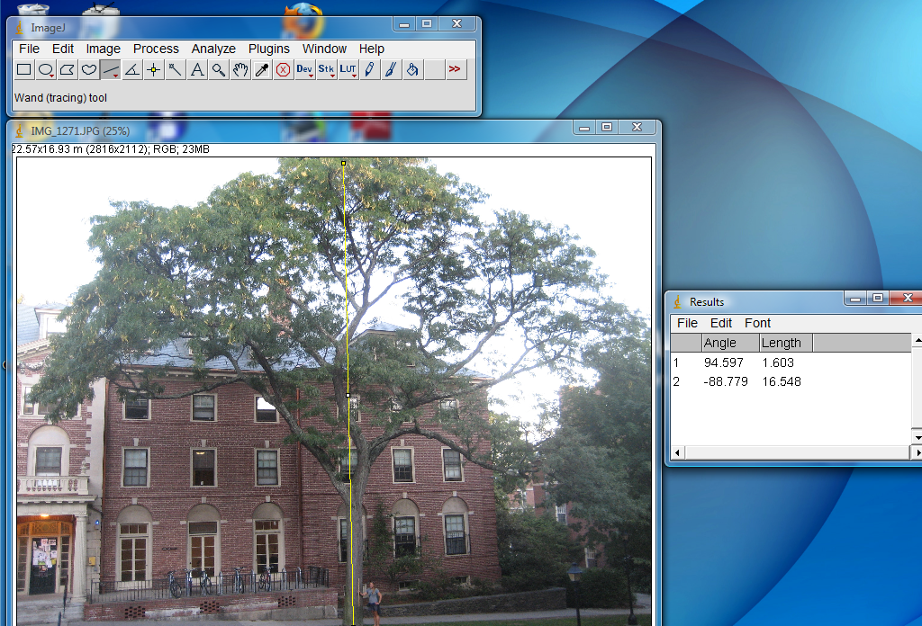
Measure the height and crown
1. Draw a line the length of the tree
2. Select measure from the analyze toolbar this transfers the data to a results window.

Slide 9
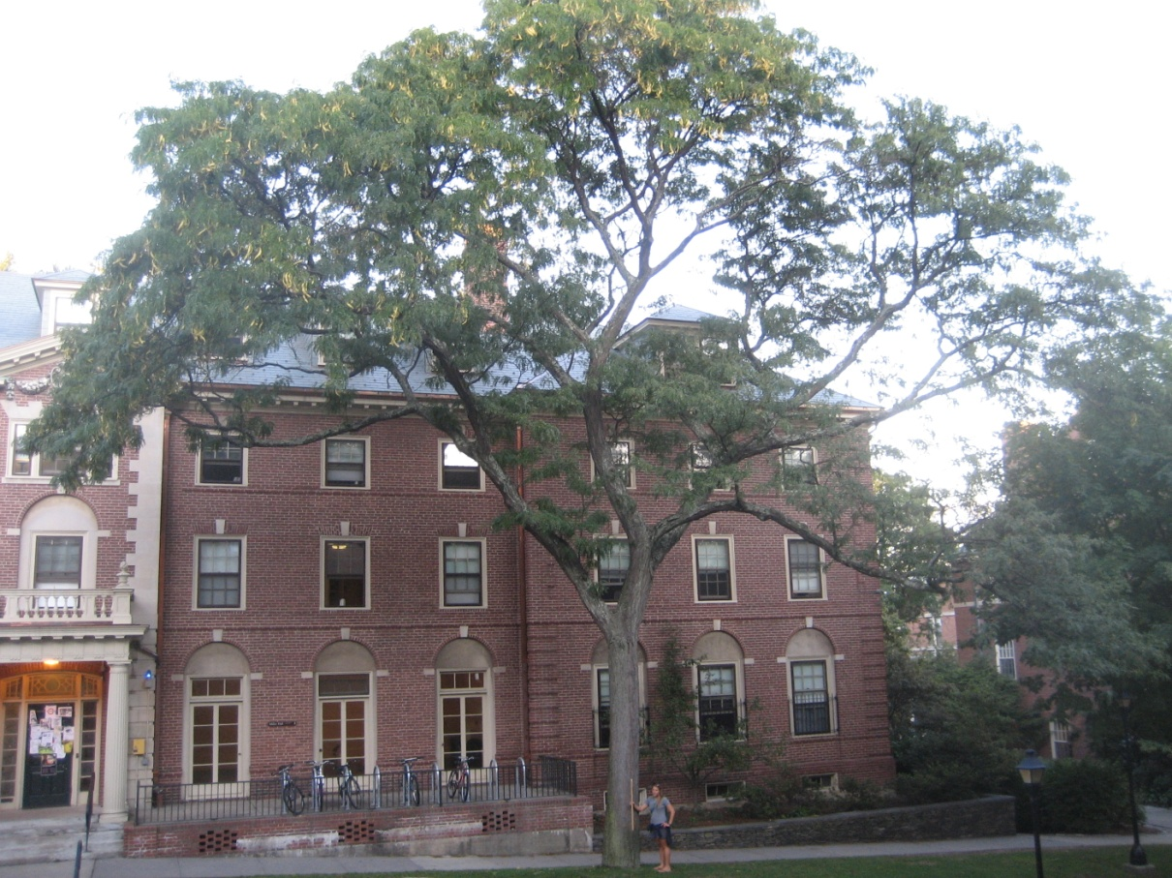
Sample Student Slide
Honey Locust Gleditsia triacanthos
This tree is located on the Pembroke Campus of Brown University.
It is 16.5 meters tall and it has a crown span of 22 meters.

Slide 10
Resources/credits
http://rsb.info.nih.gov/ij/docs/concepts.html
http://rsb.info.nih.gov/ij/docs/pdfs/ImageJ.pdf thiis is a useful guide on Image J basics

