Slide 1
Climate and Biomes
Instructional PowerPoint to accompany Google Earth activity located at:
http://serc.carleton.edu/eslabs/weather/4b.html

Slide 2
Teaching Instructions:
This PowerPoint is designed to be used as a supplement to the Google Earth activity described on this page: http://serc.carleton.edu/eslabs/weather/4b.html
Pre-lab Preparation:
Print the PowerPoint 2 slides per page, preferably in color. If possible, laminate the cards for longevity. Prepare enough sets of cards for each of the lab teams.
Print the a copy of the Whittaker classification scheme diagram for each lab team.
Optional: Provide a world map or globe for each lab team. Calculators may also be helpful for calculating average annual precipitation and temperature.
Day of Activity:
Students read the information on the cards and then sort the cards into stacks matching them to the Whittaker classification scheme.
When teams are finished sorting the cards, share the PowerPoint with the class. Discuss their answers, and compare with the Biome Type information given in the PPT (notes).
Alternately, have the students fill in a chart with the following information: name of the city; average precipitation and temperature; and biome type. Collect and grade the charts.

Slide 3
Name of City, Country elevation lat long
Image of biome
Climatograph
Insert a picture of your home area here.
Insert your Climatograph here: source of climatographs
Weather.com type in your city name. On your cities weather page, click the link for historical data. Set up and copy your local climatograph here.
Notes:
Biome Type: description and any other notes.

Slide 4
Sample biome worksheet chart

Slide 5
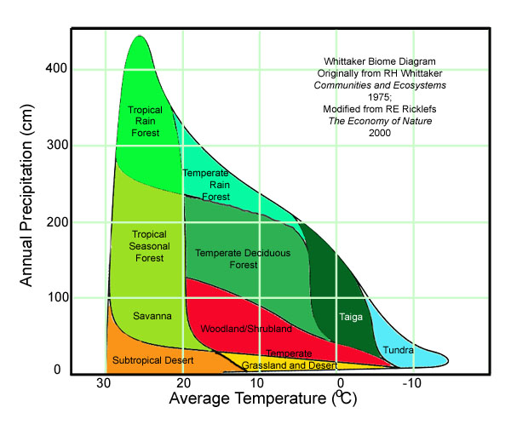
Notes:
Whittaker Diagram

Slide 6
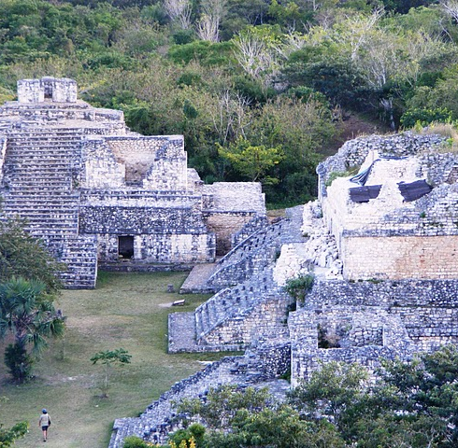
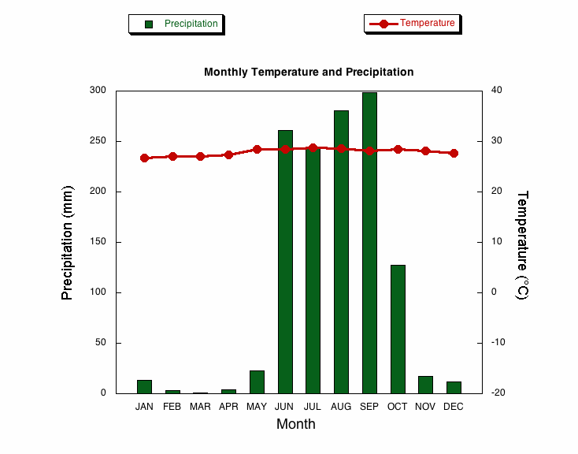
Acapulco, Mexico
Elev: 3 m Lat: 16 ° 50' N Long: 99 ° 56'W
Image of biome
Climatograph
Notes:
Biome Type: Tropical and Subtropical Dry

Slide 7
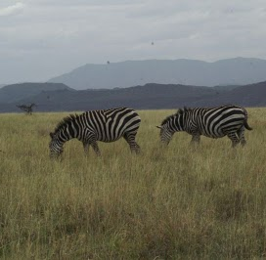
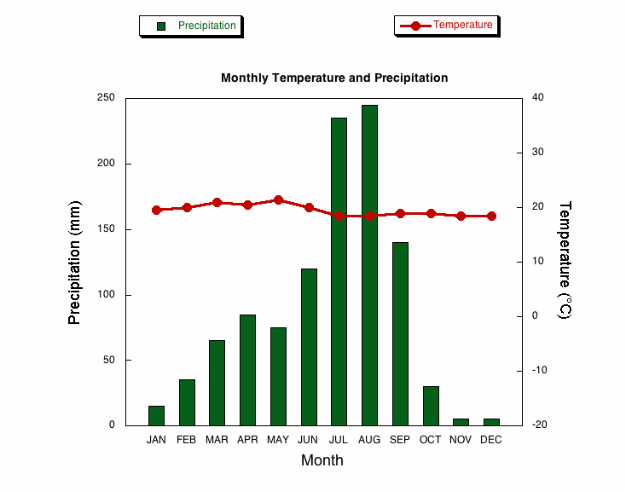
Addis Ababa, Ethiopia
Elev: 2450m Lat: 09 ˚ 20' N Long:38 ˚ 45' E
Image of biome
Climatograph
Notes:
Biome Type: Montane Grasslands and Shrublands

Slide 8
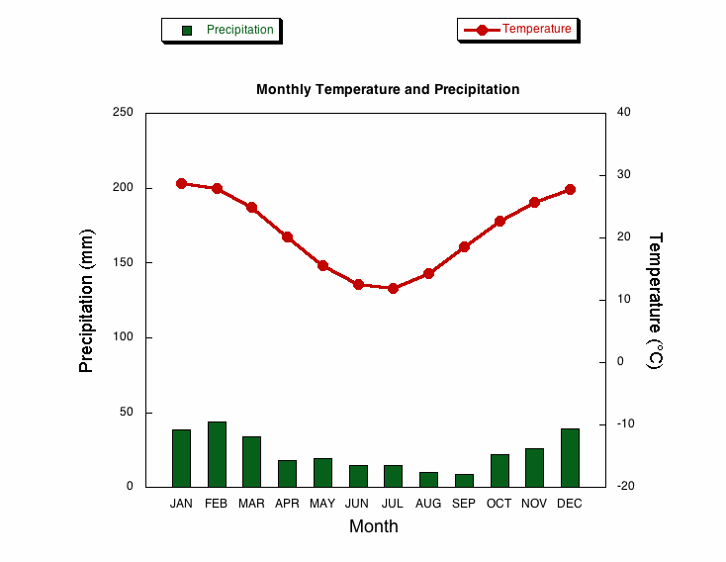
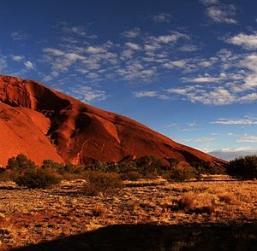
Alice Springs, Australia
Elev: 6.1m Lat: 23 ° 48' S Long:133 ° 53' E
Image of biome
Climatograph
Notes:
Biome Type: Desert and Xeric Shrubland

Slide 9
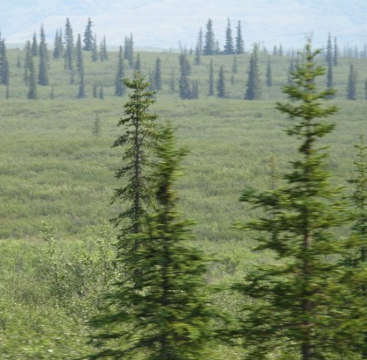
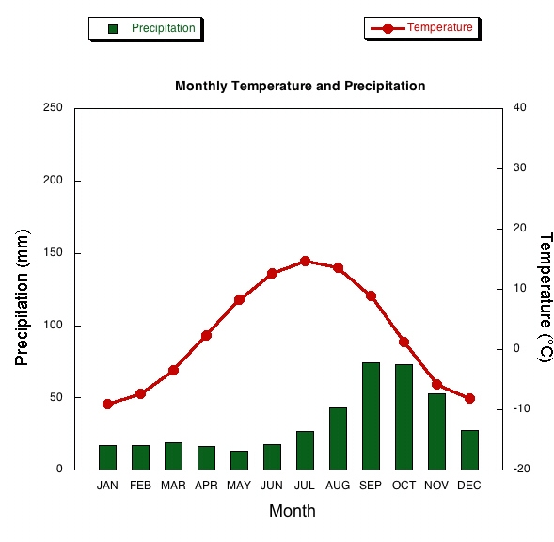
Anchorage, AK (USA)
Elev: 34.7 m Lat:61° 11'N Long:150° 00'W
Image of biome
Climatograph
Notes:
Biome Type: Tundra, Boreal Forest

Slide 10
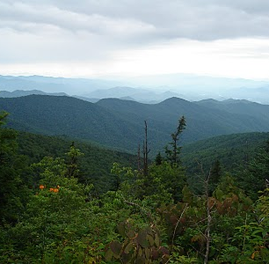
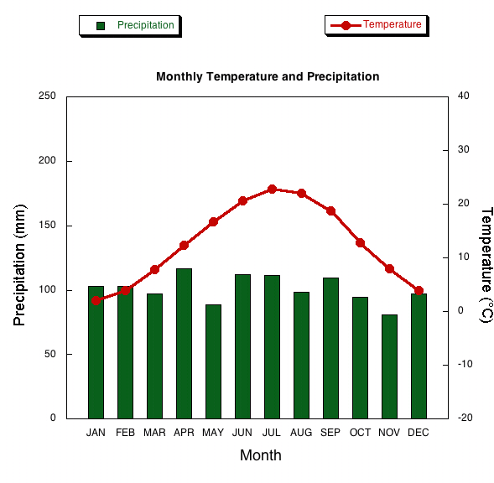
Asheville, NC (USA)
Elev: 652.3 m Lat: 35˚ 26'N Long:82˚ 32'W
Image of biome
Climatograph
Notes:
Biome Type: Temperate Broadleaf Forest

Slide 11
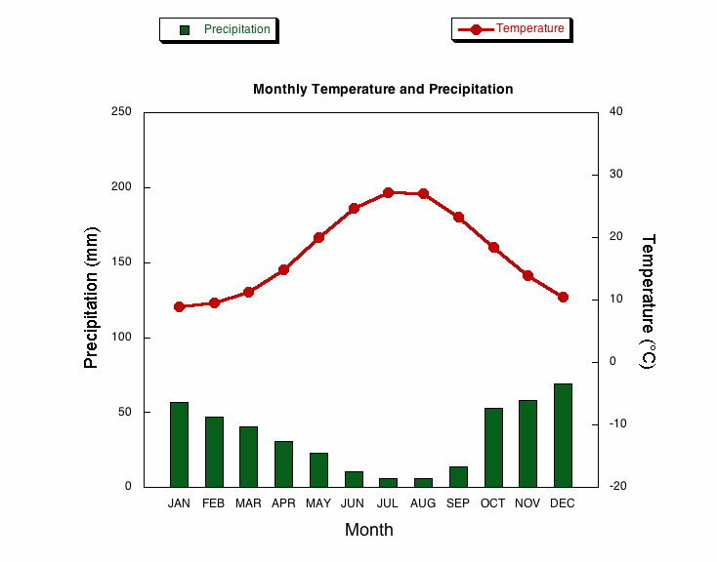
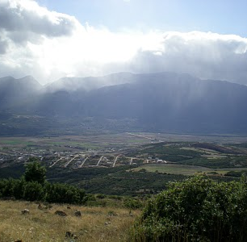
Athens Greece
Elev: 107 m Lat: 37 ° 58' N Long:23 ° 43' E
Image of biome
Climatograph
Notes:
Biome Type: Mediterranean Forest

Slide 12
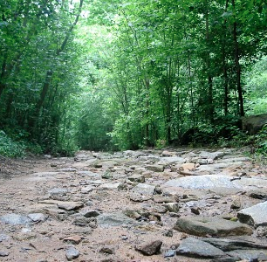
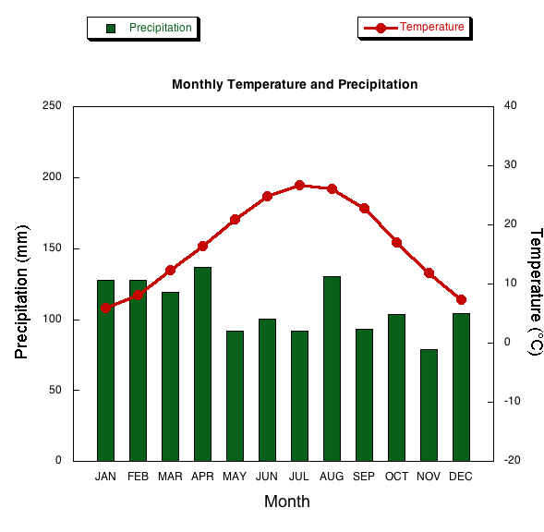
Atlanta, GA (USA)
Elev: 307.8 m Lat: 33˚ 38'N Long:84˚ 26'W
Image of biome
Climatograph
Notes:
Biome Type: Temperate Broadleaf Forest

Slide 13
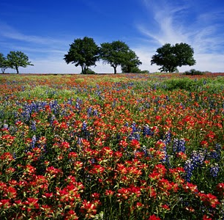
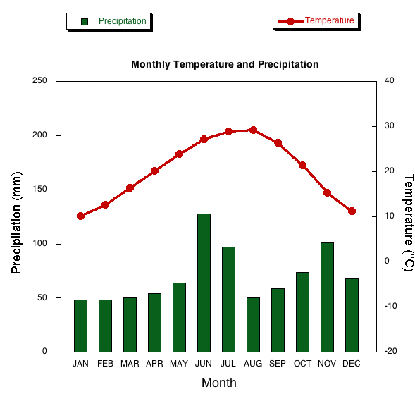
Austin, TX (USA)
Elev: 189.3 m Lat: 30° 18'N Long: 97˚ 42'W
Image of biome
Climatograph
Notes:
Biome Type: Temperate Broadleaf Forest

Slide 14
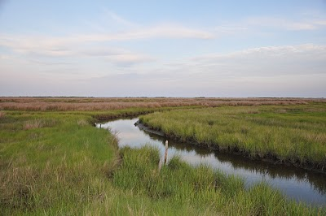
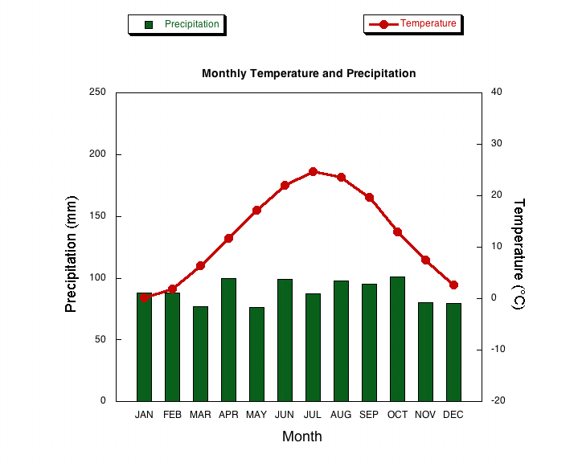
Baltimore, Maryland, (USA)
Elev: 45.1 m Lat: 39º 10'N Long: 76º 41'W
Image of biome
Climatograph
Notes:
Biome Type: Tidal Marsh, Temperate Broadleaf Forest

Slide 15
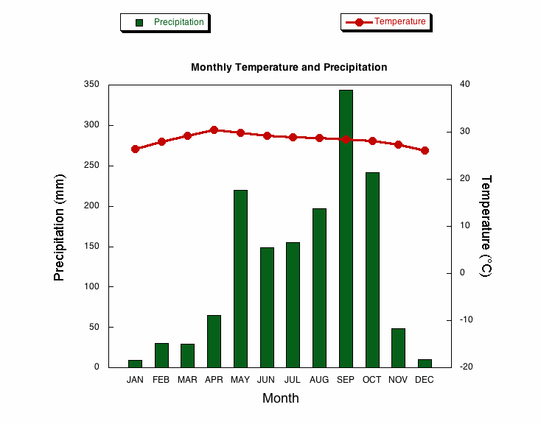
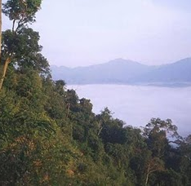
Bangkok , Thailand
Elev: 16.2 m Lat: 13 ° 44' N Long: 100 ° 30' E
Image of biome
Climatograph
Notes:
Biome Type: Tropical and Subtropical Moist Broadleaf

Slide 16
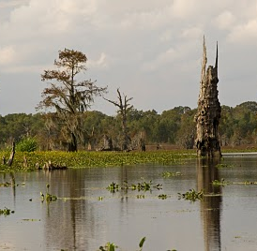
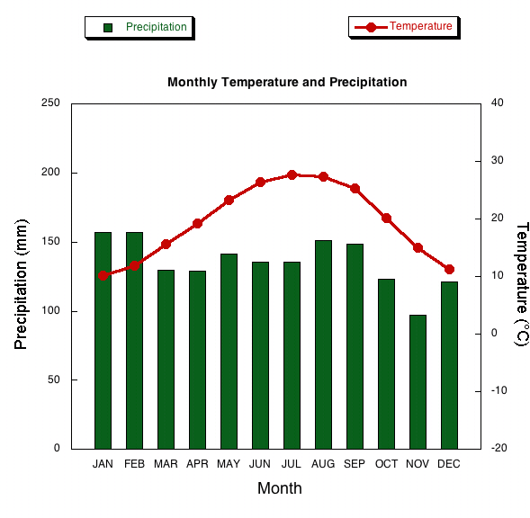
Baton Rouge, LA (USA)
Elev: 19.5 m Lat: 30˚ 32'N Long: 91˚ 09'W
Image of biome
Climatograph
Notes:
Biome Type: Wetlands

Slide 17
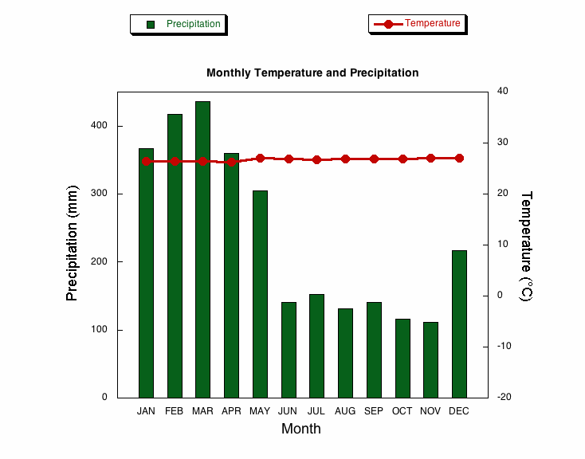
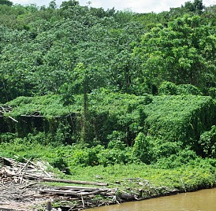
Belem, Brazil
Elev: 12.8 m Lat: 01 ° 27' S Long: 48 ° 29'W
Image of biome
Climatograph
Notes:
Biome Type: Tropical and Subtropical Moist Broadleaf

Slide 18
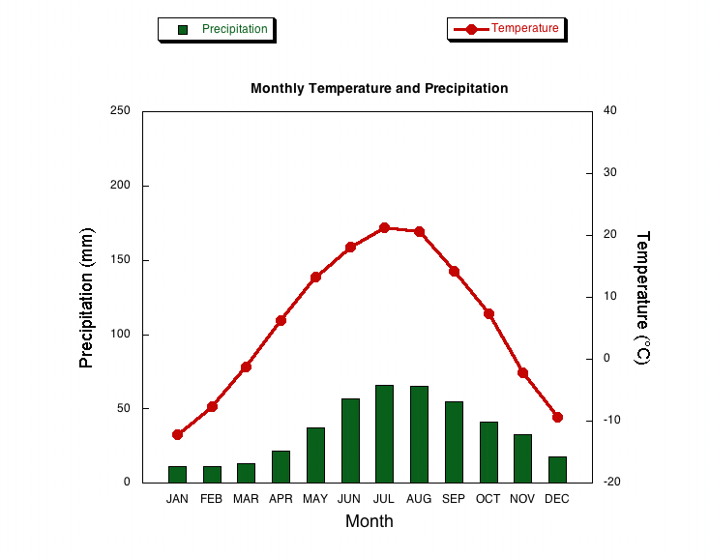
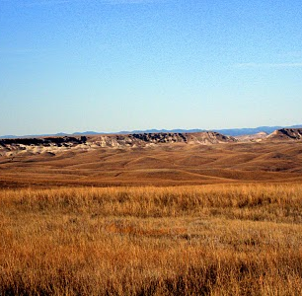
Bismark, ND (USA)
Elev: 503.2 m Lat: 46˚ 47'N Long: 100˚ 45'W
Image of biome
Climatograph
Notes:
Biome Type: Grassland

Slide 19
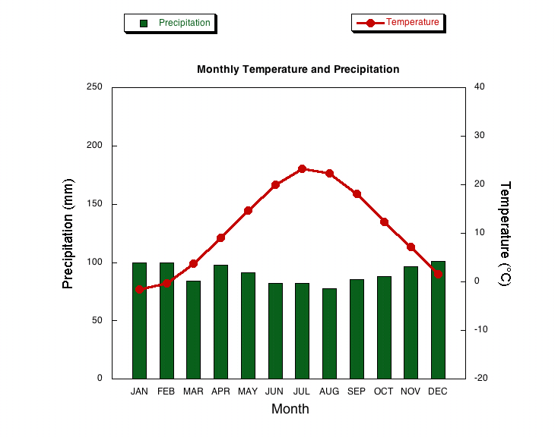
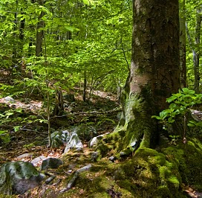
Boston, MA (USA)
Elev: 6.1 m Lat: 42˚ 22'N Long: 71˚ 01'W
Image of biome
Climatograph
Notes:
Biome Type: Temperate Broadleaf Forest

Slide 20
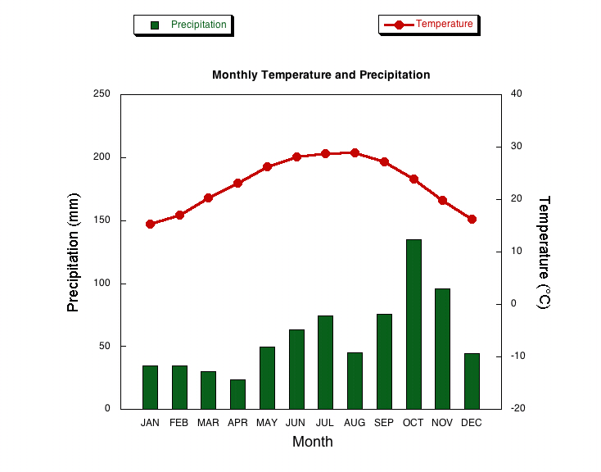
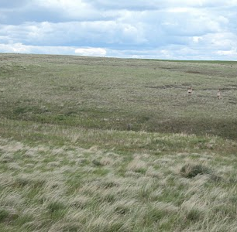
Brownsville, TX (USA)
Elev: 5.8 m Lat: 25˚ 54'N Long: 97˚ 26'W
Image of biome
Climatograph
Notes:
Biome Type: Tropical and Subtropical Grasslands, Savannas & Shrubland

Slide 21
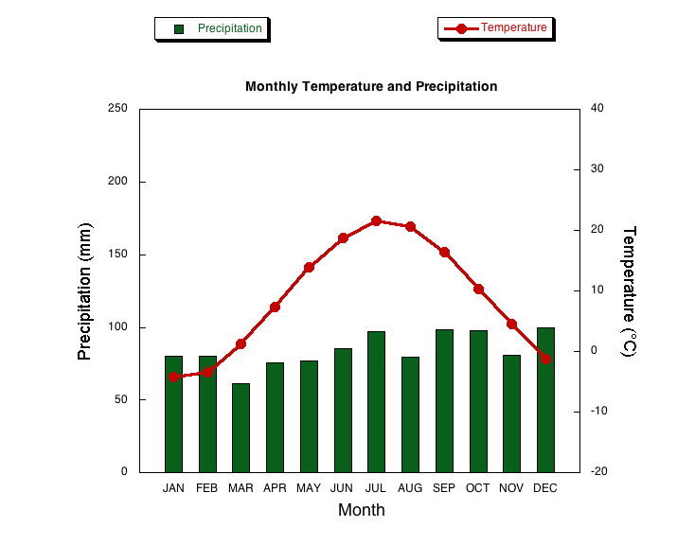
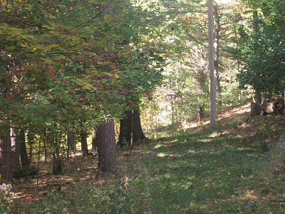
Buffalo, New York (USA)
Elev: 214.9 m Lat: 42º 56'N Long: 78º 44'W
Image of biome
Climatograph
Notes:
Elev:214.9 m Lat: 42º 56'N Long: 78º 44'W
Biome Type: Temperate Broadleaf Forest

Slide 22
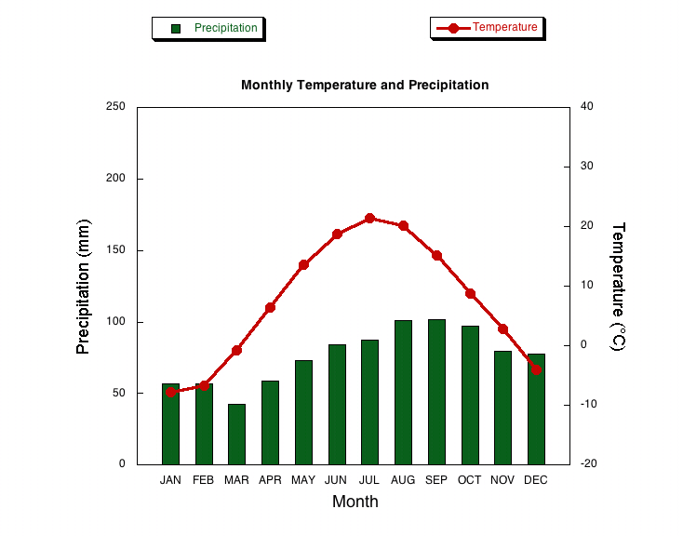
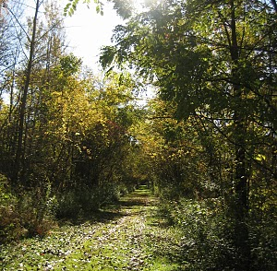
Burlington, VT (USA)
Elev: 100.6 m Lat: 44˚ 28'N Long: 73˚ 09'W
Image of biome
Climatograph
Notes:
Biome Type: Temperate Forest

Slide 23
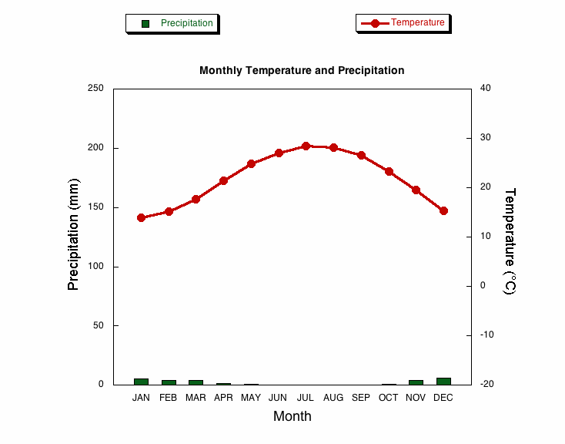
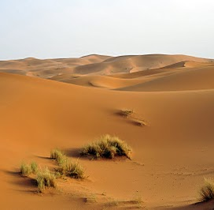
Cairo, Eygpt
Elev: 116.1 m Lat: 29 ˚ 52' N Long: 31 ˚ 20' E
Image of biome
Climatograph
Notes:
Biome Type: Desert and Xeric Shrubland

Slide 24
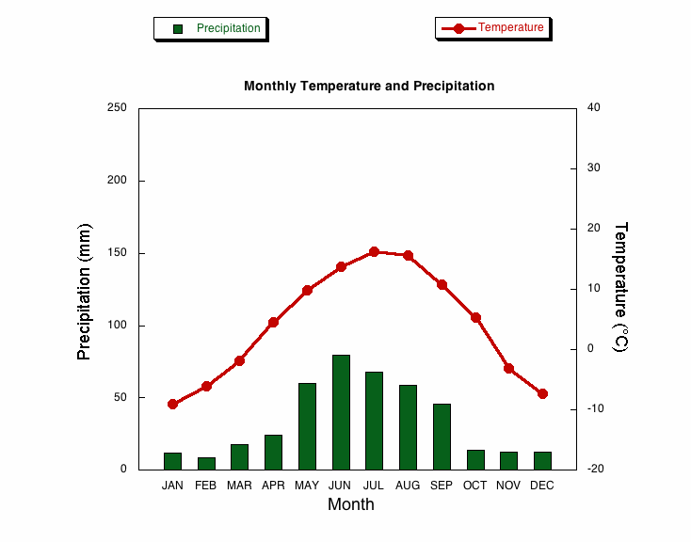
Calgary, Alberta (Canada)
Elev: 1079 m Lat: 51° 06' N Long: 114° 01'W
Image of biome
Climatograph
Notes:
Biome Type: Temperate Grasslands, Savannas & Shrubland

Slide 25
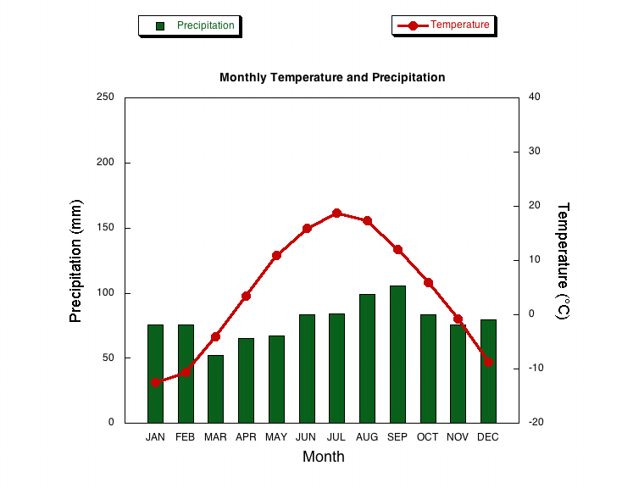
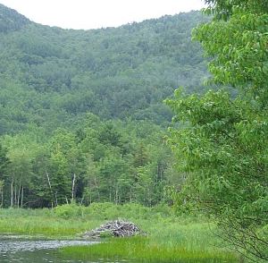
Caribou, ME (USA)
Elev: 109.2 m Lat: 46° 52'N Long: 68° 02'W
Image of biome
Climatograph
Notes:
Biome Type: Temperate Broadleaf Forest

Slide 26
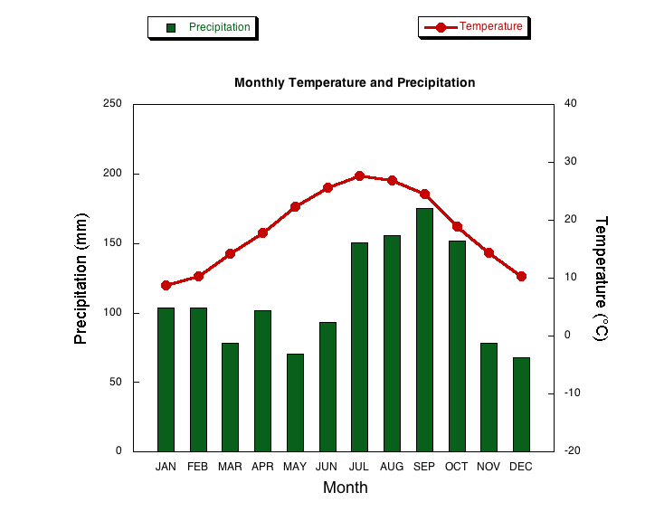
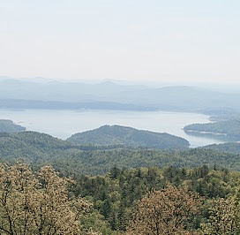
Charleston, SC (USA)
Elev: 12.2 m Lat: 32° 54'N Long: 80˚ 02'W
Image of biome
Climatograph
Notes:
Biome Type: Temperate Coniferous Forest

Slide 27
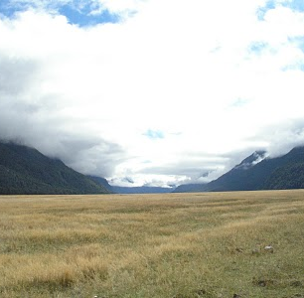
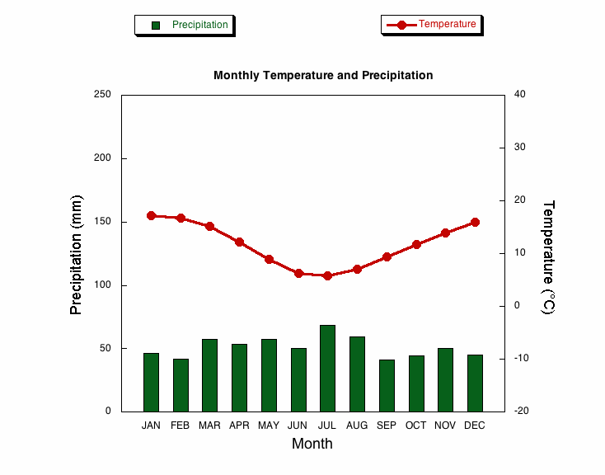
Christchurch, New Zealand
Elev: 36 m Lat: 43 ° 29' S Long: 172 ° 36' E
Image of biome
Climatograph
Notes:
Biome Type: Temperate Grasslands, Savannas & Shrubland

Slide 28
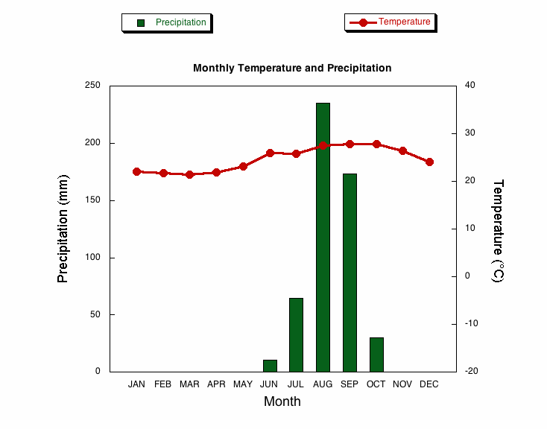
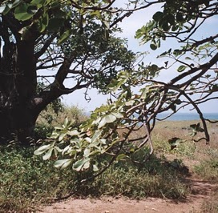
Dakar, Senegal
Elev: 39.9 m Lat: 14 ˚ 42' N Long: 17˚ 29' W
Image of biome
Climatograph
Notes:
Biome Type: Tropical and Subtropical Grasslands, Savannas & Shrubland

Slide 29
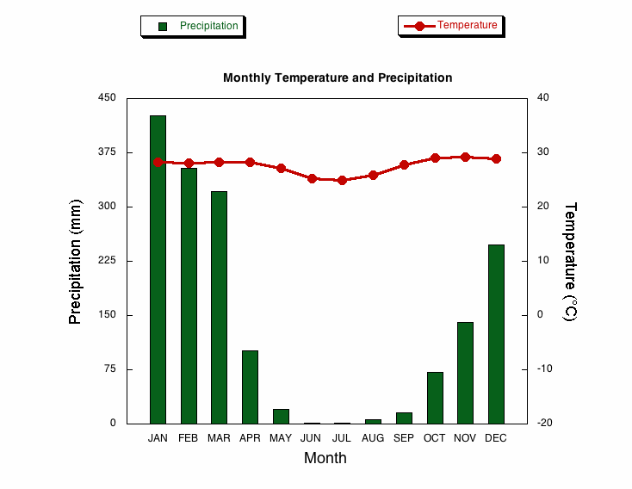
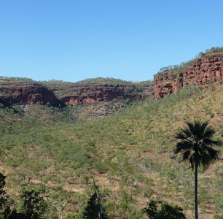
Darwin, Australia
Elev: 31.7 m Lat: 15˚ 25' S Long: 130˚ 52' E
Image of biome
Climatograph
Notes:
Biome Type: Tropical and Subtropical Grasslands, Savannas & Shrubland

Slide 30
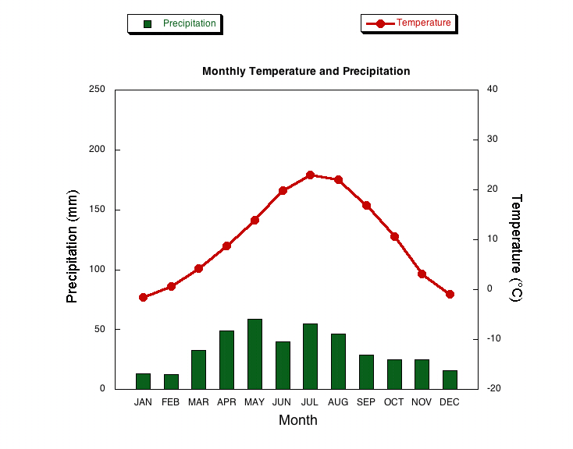
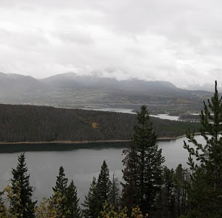
Denver, CO (USA)
Elev: 1611.2 m Lat: 39° 46'N Long: 104˚ 52'W
Image of biome
Climatograph
Notes:
Biome Type: Temperate Coniferous Forest

Slide 31


Des Moines, IA (USA)
Elev: 291.7 m Lat: 41˚ 32'N Long: 93˚ 40'W
Image of biome
Climatograph
Notes:
Biome Type: Temperate Grasslands, Savannas & Shrubland

Slide 32


Fairbanks, AK (USA)
Elev: 141.1 m Lat: 64˚ 49'N Long: 147˚ 51'W
Image of biome
Climatograph
Notes:
Biome Type: Boreal Forest

Slide 33


Fresno, CA (USA)
Elev: 101.5 m Lat: 36° 47'N Long: 119° 43'W
Image of biome
Climatograph
Notes:
Biome Type: Oak savanna

Slide 34


Green Bay, WI (USA)
Elev: 209.7 m Lat: 44˚ 29'N Long: 88˚ 08'W
Image of biome
Climatograph
Notes:
Biome Type: Temperate Broadleaf Forest

Slide 35


Hilo, HI (USA)
Elev: 9.1 m Lat: 19˚ 43'N Long: 155˚ 04'W
Image of biome
Climatograph
Notes:
Biome Type: Tropical and Subtropical Moist Broadleaf

Slide 36


Jackson, MS (USA)
Elev: 94.5 m Lat: 32° 19'N Long: 90° 05'W
Image of biome
Climatograph
Notes:
Biome Type: Temperate Broadleaf Forest

Slide 37


Lubbock, TX (USA)
Elev: 991.8 m Lat: 33˚ 39'N Long: 101˚ 49'W
Image of biome
Climatograph
Notes:
Biome Type: Temperate Grasslands, Savannas & Shrubland

Slide 38


Miami, FL (USA)
Elev: 10.7 m Lat: 25˚ 49'N Long: 80˚ 18'W
Image of biome
Climatograph
Notes:
Biome Type: Tropical and Subtropical Moist Broadleaf

Slide 39


Moscow, ID (USA)
Elev: 810.8 m Lat: 46˚ 43'N Long: 116˚ 58'W
Image of biome
Climatograph
Notes:
Biome Type: Temperate Coniferous Forest

Slide 40


Omsk, Russia
Elev: 85 m Lat: 54˚ 58' N Long: 73˚ 20' E
Image of biome
Climatograph
Notes:
Biome Type: Temperate Grasslands, Savannas & Shrubland

Slide 41


Phoenix, AZ (USA)
Elev: 337.4 m Lat: 33° 26'N Long: 112˚ 00'W
Image of biome
Climatograph
Notes:
Biome Type: Desert and Xeric Shrubland

Slide 42


Portland, OR (USA)
Elev: 13.7 m Lat: 43° 39'N Long: 70° 18'W
Image of biome
Climatograph
Notes:
Biome Type: Temperate Broadleaf Forest

Slide 43


Reykjavik, Iceland
Elev: 28 m Lat: 64 ˚ 09' N Long: 21 ˚ 56' W
Image of biome
Climatograph
Notes:
Biome Type: Tundra

Slide 44


Salt Lake City, UT (USA)
Elev: 1287.8 m Lat: 40˚ 47'N Long: 111˚ 58'W
Image of biome
Climatograph
Notes:
Biome Type: Desert Wetlands

Slide 45


San Diego, CA (USA)
Elev: 4.0 m Lat: 32˚ 44'N Long:117˚ 10'W
Image of biome
Climatograph
Notes:
Biome Type: Mediterranean, Woodlands and Shrubland

Slide 46


Santiago, Chile
Elev: 520 m Lat: 33˚ 27' S Long: 70˚ 42'W
Image of biome
Climatograph
Notes:
Biome Type: Mediterranean, Woodlands and Shrubland

Slide 47


Saskatoon, Canada
Elev: 515.1 m Lat: 52˚ 08' N Long: 106˚ 38'W
Image of biome
Climatograph
Notes:
Biome Type: Temperate Grasslands, Savannas & Shrubland

Slide 48


Vancouver, BC (Canada)
Elev: 38.7 m Lat: 49 ˚ 17' N Long: 123 ˚ 05'W
Image of biome
Climatograph
Notes:
Biome Type: Temperate Coniferous Forest

