Slide 1

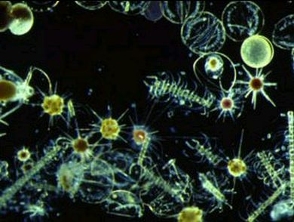
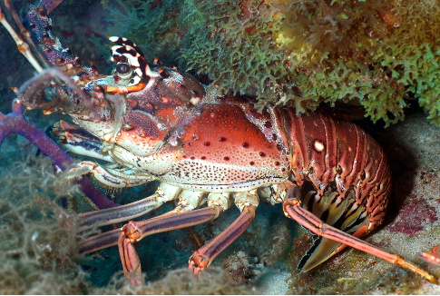
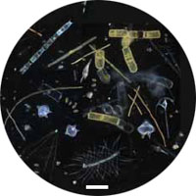
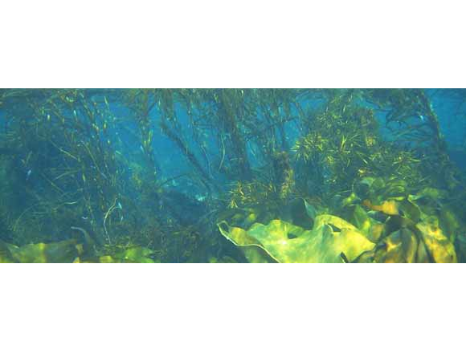
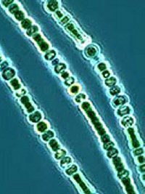
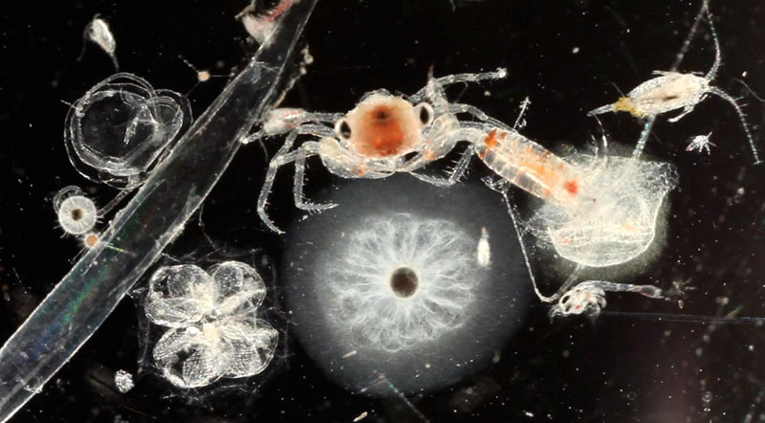
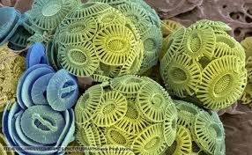
The Biological Carbon Pump
Phytoplankton
Shelled Organisms
Marine Microbes
Cyanobacteria
Zooplankton
Coccolithophorres
Notes:
The algae and protists are freshwater – not marine organisms
We would need more pictures phytoplankton, zooplankton, marine microbes, shelled organisms
If we use a coccolith here – we need a more recognizable image
I think we need a picture of ocean phytoplankton, fish, bacteria (not cynobacteria) a shelled orgnaism (ie a crab/coccolith)

Slide 2
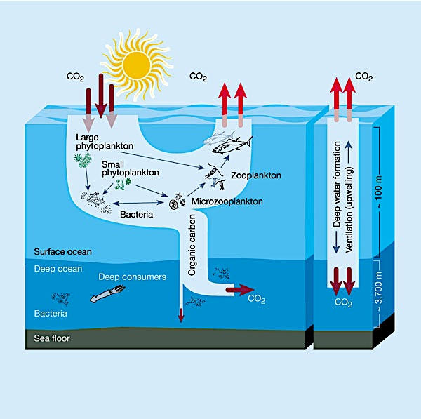
Biological Carbon Pump
Is a process by which CO2 in surface ocean water is transformed by ocean organisms into carbon compounds used to build living matter.
These carbon compounds are transferred to deep ocean layers through dead organisms, fecal material and calcified skeletons and shells.
Biological Pump
Physical Pump

Slide 3
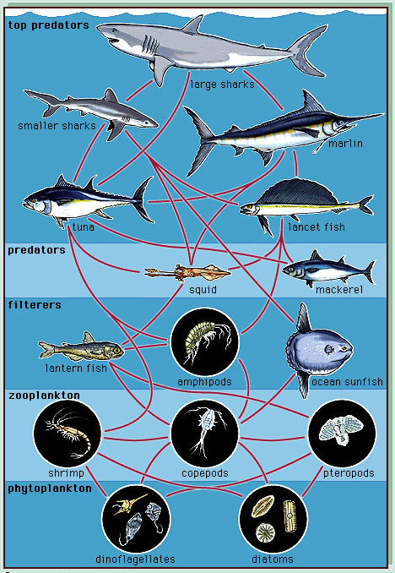
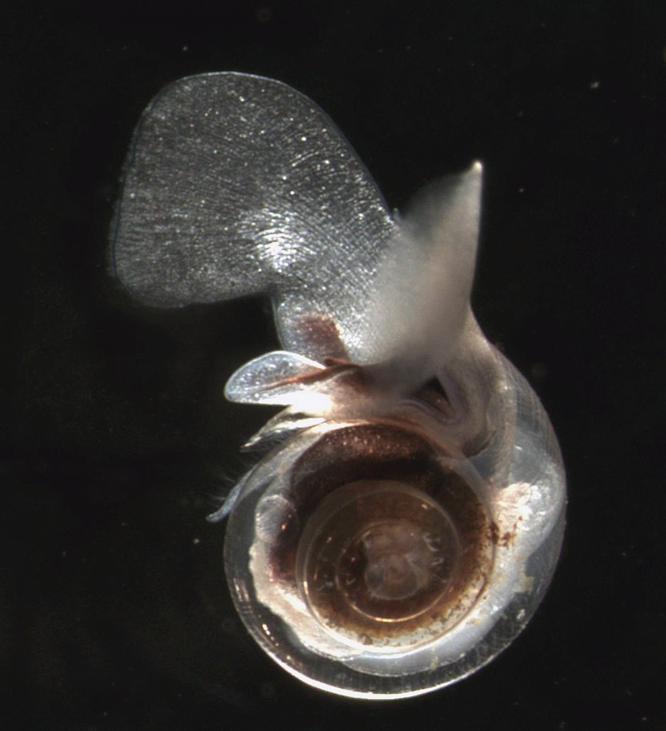
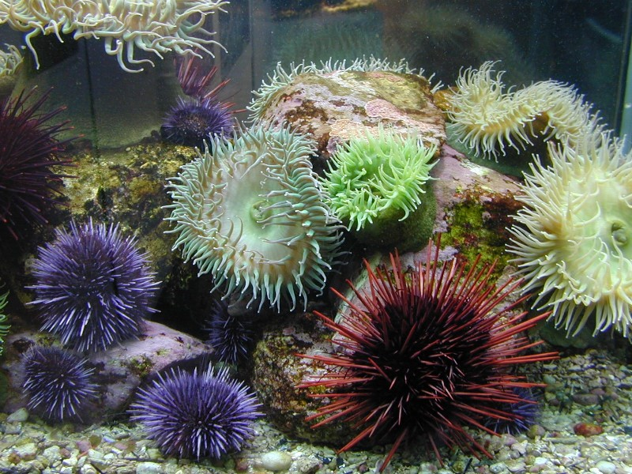
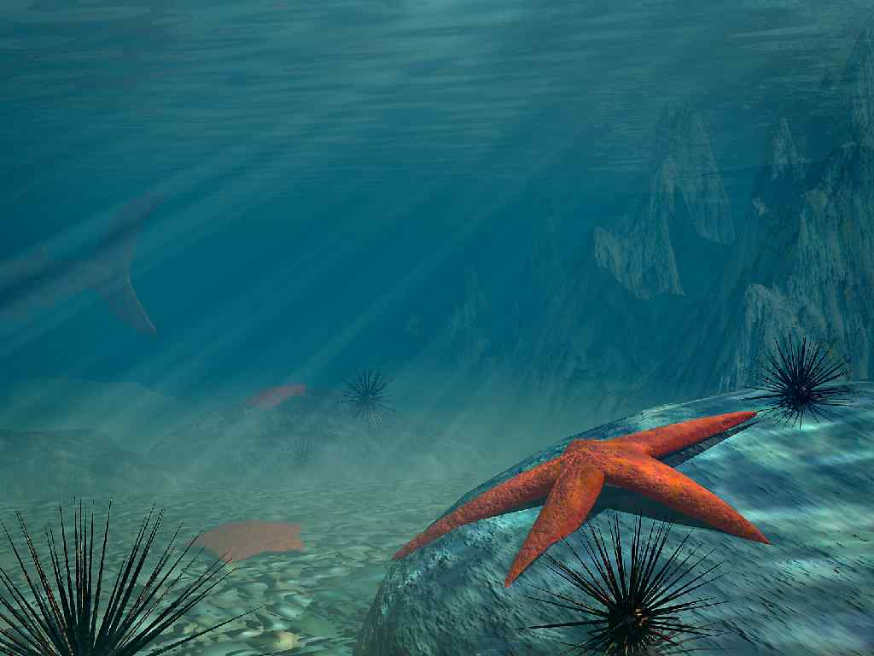
The Biological Carbon Pump removes and stores dissolved ocean CO2 through two different processes:
Photosynthesis and food chains
Shell-building organisms
Notes:
Picture of lobster or crab, coccolithophore

Slide 4
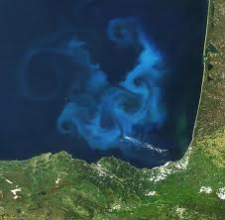
Removal by Photosynthesis
Like trees on land, countless unicellular microscopic plants called phytoplankton absorb CO₂ from ocean surface water.
Large phytoplankton blooms occur when plenty of sunlight, CO2 and nutrients are available. Important nutrients include nitrogen, iron and B12.
Phytoplankton
NASA Phytoplankton Bloom
Notes:
Can you label these images Phytoplankton and Nasa: Phytoplankton Bloom

Slide 5
Phytoplankton use energy from Sun, CO2 and H20 to photosynthesize
CO₂
Photosynthesis
Phytoplankton
Notes:
Possible heading Phytoplankton use energy from Sun, CO2 and H20 to photosynthesize/.

Slide 6
Cell Respiration
Like all living things, phytoplankton respire. When phytoplankton break down the food they produced from photosynthesis, they release energy and some CO2 is released back into the water.
Some respired CO2 “undissolves” and goes back into the atmosphere. Some respired CO2 is taken up by phytoplankton, shell-building organisms and some moves into ocean currents.

Slide 7
CO₂
Photosynthesis
Respiration
Phytoplankton

Slide 8
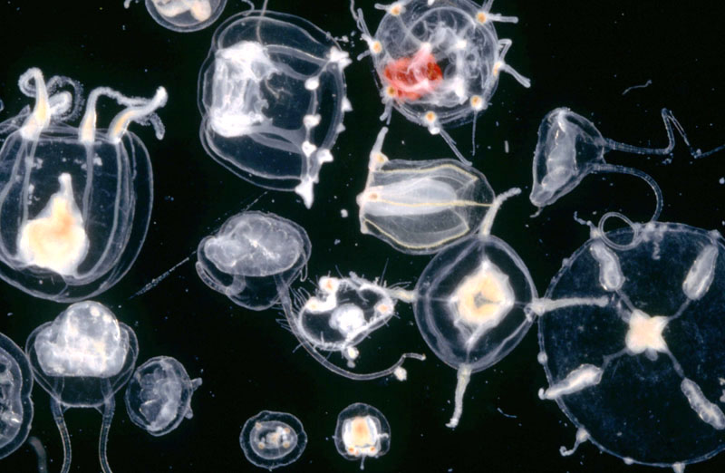
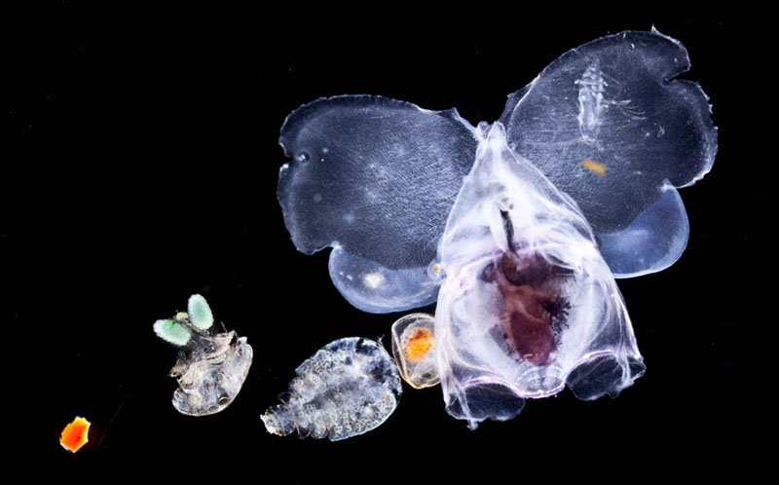
Food Chains and Consumption
Tiny zooplankton (floating animals) consume phytoplankton for food and energy.
Thus, carbon compounds are moved into the food chain.

Slide 9
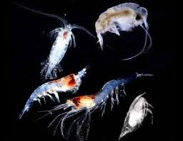
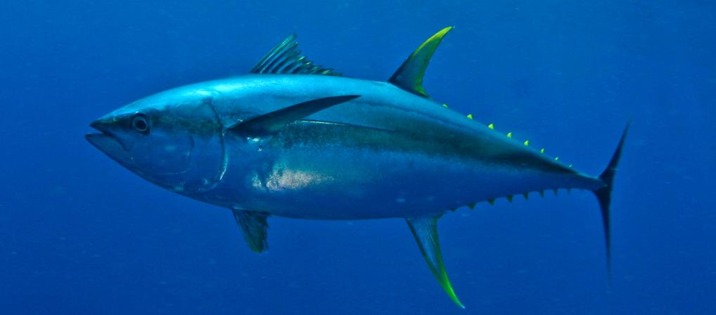
CO₂
CO₂
CO₂
Photosynthesis
Respiration
Phytoplankton
Respiration
Consumed by
Zooplankton
Consumed by
Higher Level Consumers
Notes:
Can we need to draw CO2 and C in here.

Slide 10
Decomposers, Feces and Dead Stuff – Oh My!
Most dead, decaying bodies and fecal matter are dissolved by ocean water, decomposed by bacteria, or consumed by animals as they slowly sink towards the bottom of the ocean.
Only a small amount reaches the bottom sediments (about 1-2%)
Bacterial decomposition releases CO2 into the cold water of the deep ocean currents during respiration.
Thus, carbon may stay in deep ocean currents for hundreds of years and in sediments for thousands to millions of years.

Slide 11
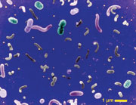
CO₂
Photosynthesis
Respiration
Phytoplankton
Consumed by
Zooplankton
Decomposition
Bacteria

Slide 12
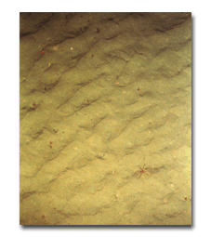
CO₂
CO₂
CO₂
Photosynthesis
Respiration
Phytoplankton
Respiration
Consumed by
Zooplankton
Decomposition
Consumed by
Bacteria
Higher Level Consumers
CO₂
Decomposition
C
Ocean Sediment
Notes:
Can we need to draw CO2 and C in here.

Slide 13
Stop and Think:
If phytoplankton populations decreased, you might expect:
CO2 in the atmosphere to decrease
B. CO2 in the atmosphere to increase
Explain your choice!

Slide 14
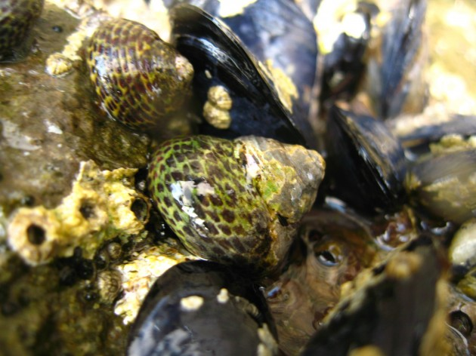
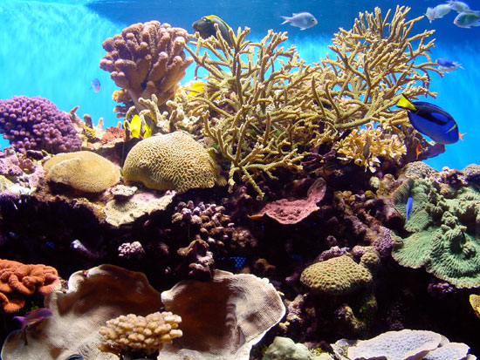
Removal of CO₂ by Shell-building organisms
Notes:
coccolithofores

Slide 15
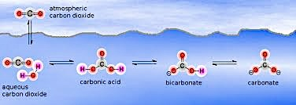
Use of CO₂ by Shell-building Organisms
Shell-building phytoplankton and animals build their shells from carbonate ions.
The carbonate ions are produced when dissolved CO₂ combines with seawater H₂0 to produce carbonic acid(H₂CO₃), bicarbonate(HCO₃-) and carbonate ions (CO₃2-)
Notes:
Image of a crab or lobster here or coccolithophore
Is there any way to make the picture of the reaction clearer?

Slide 16
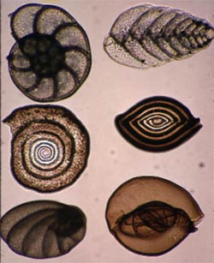
When shelled organisms die, their shells sink to the bottom of the oceans and accumulate as carbonate-rich ocean sediments.
However, most shells dissolve before reaching bottom sediments, especially in deep, cold water!
Most of the carbon that reaches deep ocean sediments are from shell-building plankton like the foraminifera and coccolithophores pictured below.
Notes:
Picture of coccolithophores and forams

Slide 17
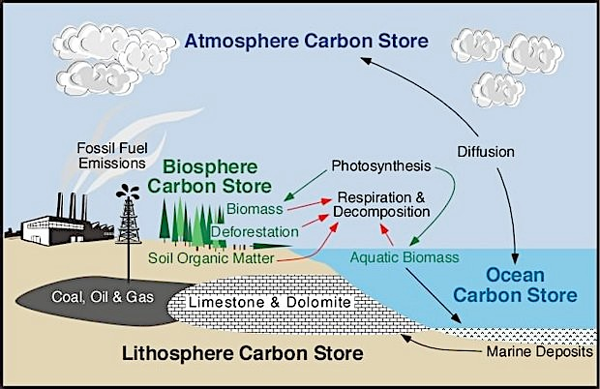
Some carbon-rich ocean sediments eventually become part of the rock cycle. This time scale takes millions of years.
Notes:
I want to use one or the other – which ever can be made clearer.

Slide 18
Take Home Point!
The Biological Pump plays a central role in the stability of the global carbon cycle by removing CO2 from atmosphere and storing carbon compounds in:
Food Chains (for short time scales - minutes to years)
2. Shells (for medium – very long time scales – years to millions of years )
3. Deep Ocean Currents (for long time scales – hundreds of years)
4. Sediments (for very long time scales – millions of years)

Slide 19
Stop and Think
2. Many mountain tops contain fossils of shelled creatures that once lived in the ocean. Carbon is locked up in these fossils. Which of the Earth’s spheres could this carbon have traveled through on its journey to these mountain-tops?
A. Geosphere
B. Geosphere and biosphere
C. Geosphere, biosphere and hydrosphere
D. Geosphere, biosphere, hydrosphere and atmosphere

Slide 20
Credits
Created by Barbara MacEachern and Candace Dunlap TERC
Zooplankton/Phytoplankton images:
Plankton chronicles http://www.planktonchronicles.org/en/episode/11

