Slide 1
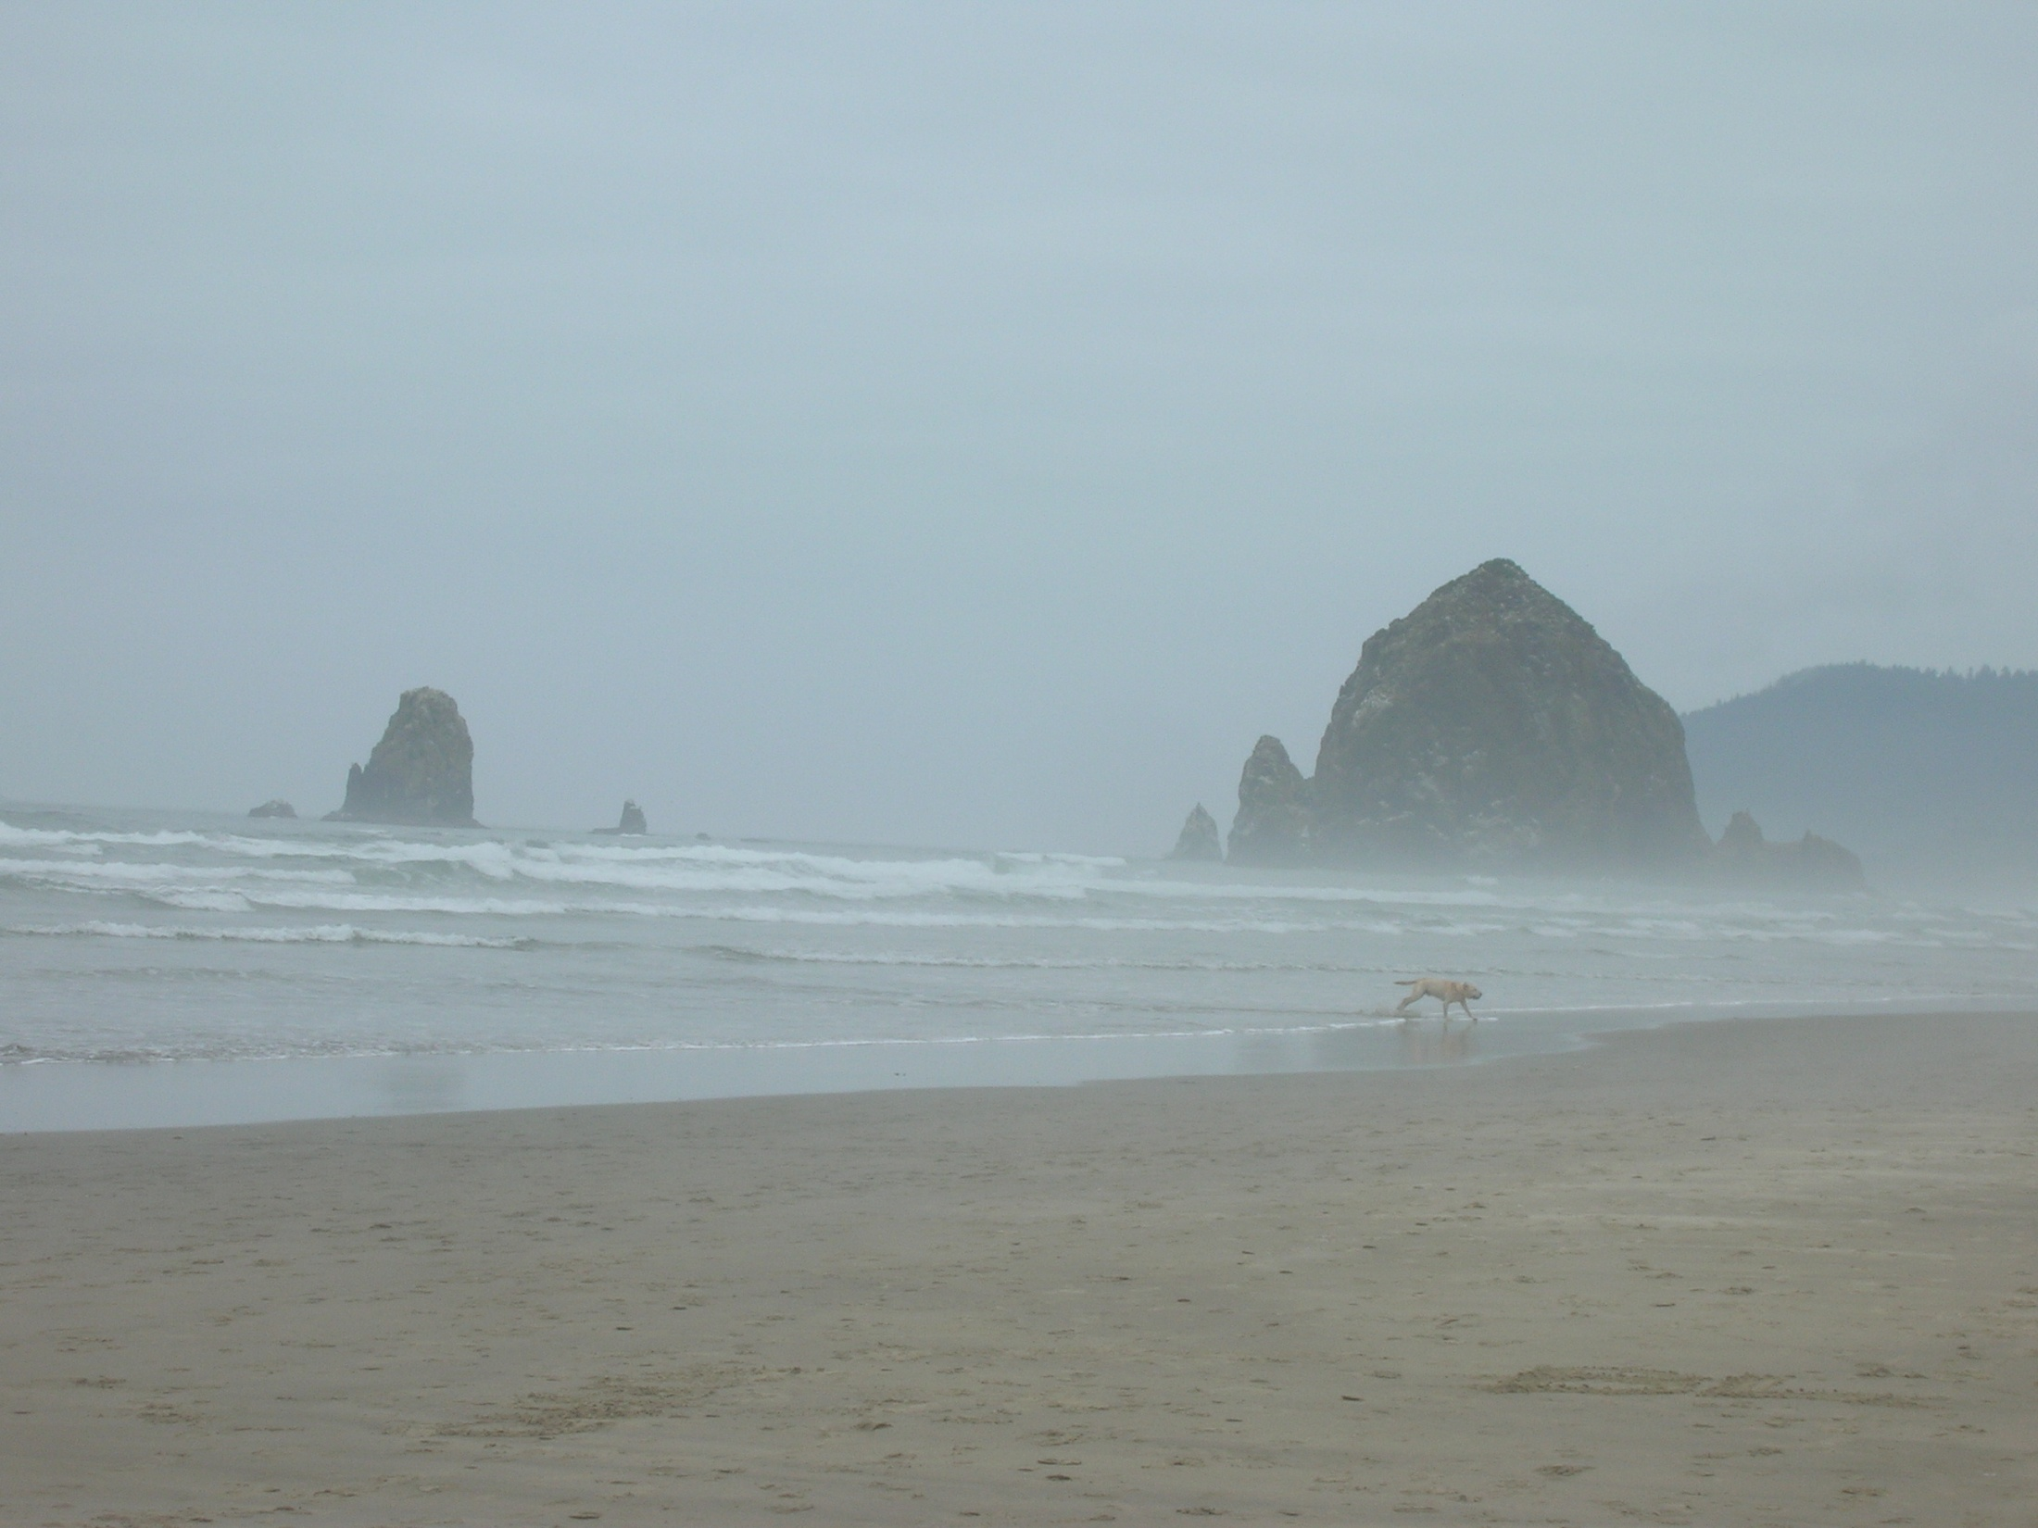
Women in the Geosciences, 2011
Suzanne O’Connell
Earth & Environmental Sciences
Wesleyan University
Mary Anne Holmes
Earth & Atmospheric Sciences
University of Nebraska-Lincoln

Slide 2
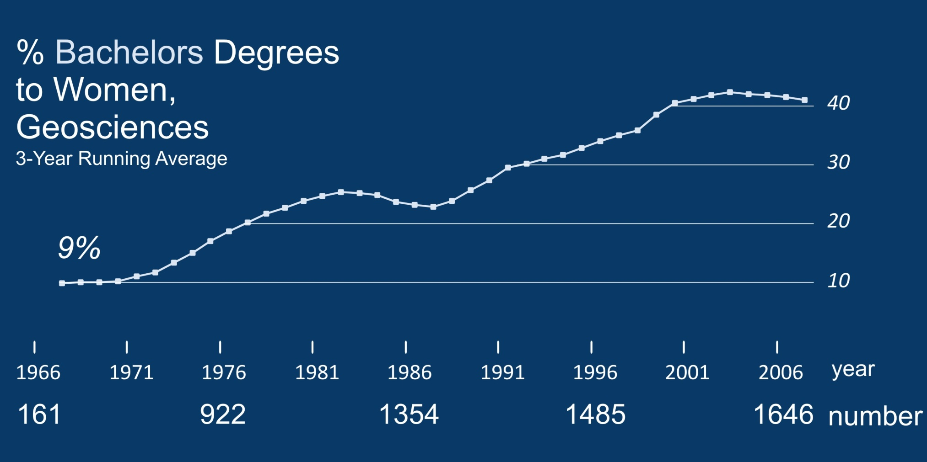
43%

Slide 3
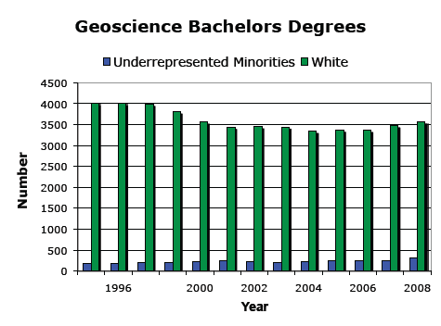

Slide 5
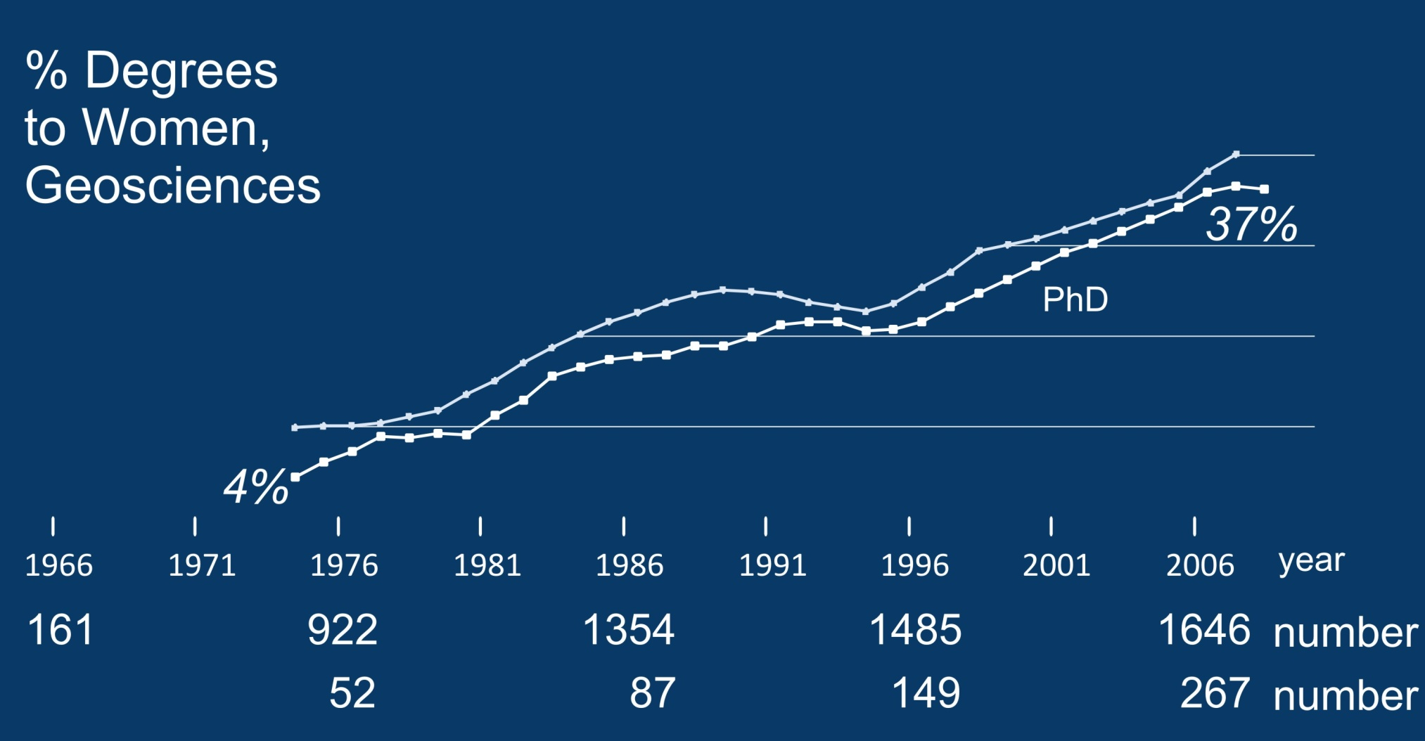
40
30
20
10

Slide 6
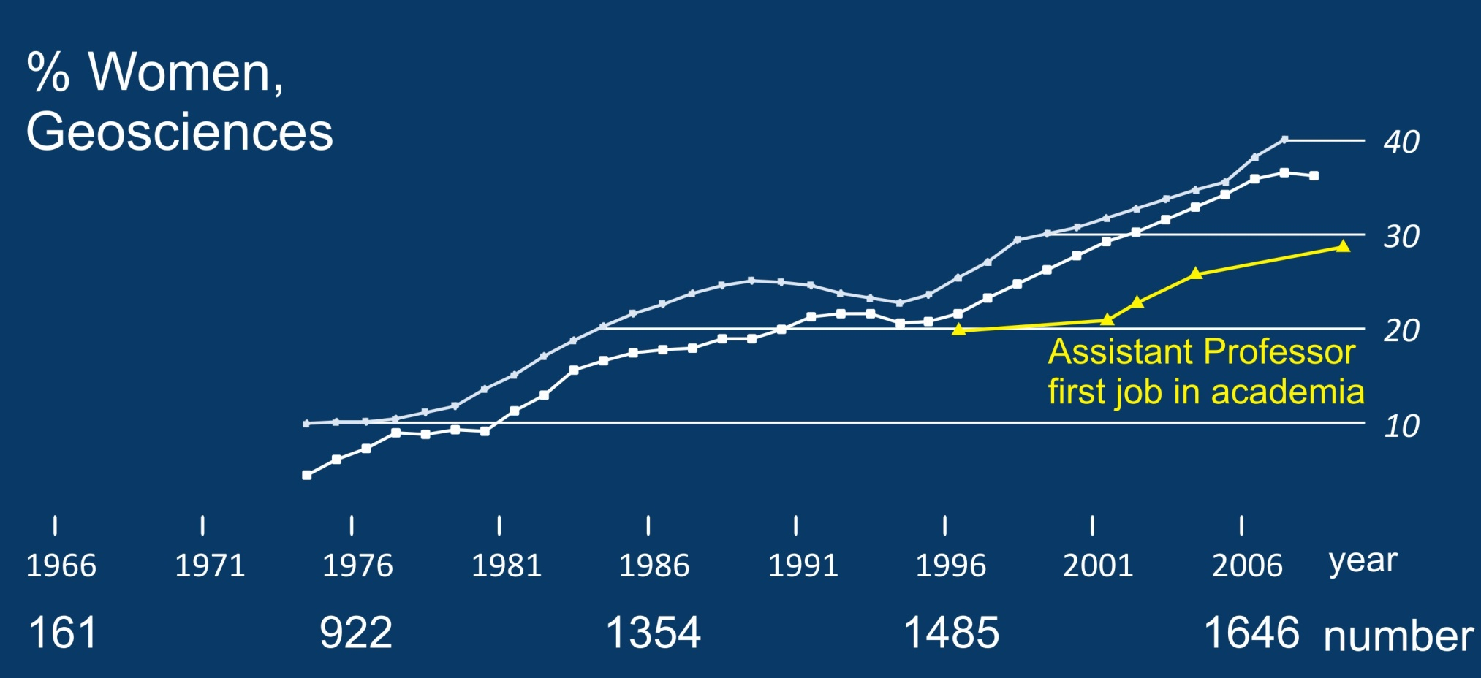
Degree data from NSF
Academic data from AGI

Slide 7
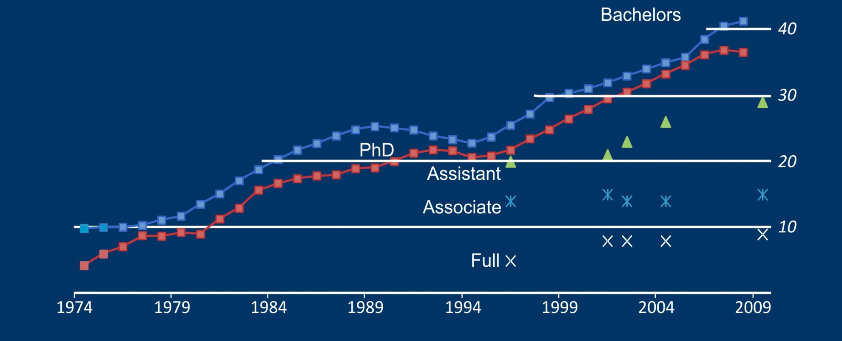
% Women,
Geosciences
Recruiting new faculty…

Slide 8
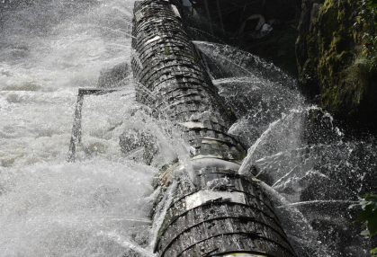
Where are they going??

Slide 9
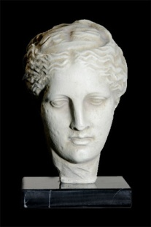
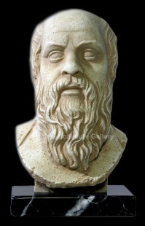
I’ve Considered Leaving the Geosciences

Slide 10
Why Would You Leave?
Men’s Responses
Women’s Responses

Slide 11
AGU Potential Book:
Field Guide for Increasing (Gender) Diversity in the Geosciences (Faculty)

Slide 12

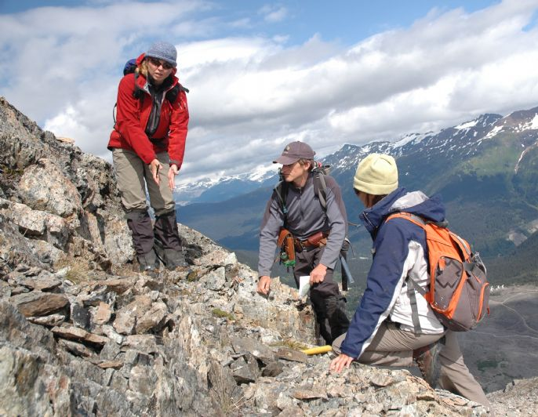

Three Levels of Gender Identity
Individual
Interactional
Institutional
Risman, 2004
Notes:
Pink Brain, Blue Brain; Lise Eliot

Slide 13
Interactional
Institutional
Problems with Advisor
Problems with Advisor
Family Issues
Family Issues

