Slide 1

8
ADP Network Science Framework Call
Laura Slover, V.P. Content and Policy
Stephen Pruitt, Director of Science

Slide 2
Agenda
  Overview of the Conceptual Framework for Science and Next Generation Science Standards Development Process
  Key Similarities and Differences between Common Core State Standards and the Next Generation Science Standards
  State Participation in the Review of the Conceptual Framework for Science

Slide 3

Overview of Science Development Process
NRC Process
Achieve Process

Slide 4
Why Science? Why now?
  Why New Science Standards?
  Previous documents from the National Research Council (NRC) and American Association for the Advancement of Science (AAAS) used to guide science education are over 10 years old
  New developments in cognitive science
  Rapid advances in the natural sciences and engineering
  Call for new, internationally-benchmarked standards

Slide 5
Conceptual Framework for Science and the
Next-Generation Science Standards
The Framework and Standards will
  Impart a coherent and sharpened focus on the core ideas of the major fields
  Take into consideration the knowledge and skills required for science literacy, college readiness, and for pursuing further study in STEM fields
  Integrate conceptual knowledge and science practices
  Base decisions on evidence—to the degree possible—as well as on professional judgment
  Reflect the expectations that high-performing countries hold for students
  Provide a platform for the development of aligned, high quality assessments, curricula and instructional materials.

Slide 6
Conceptual Framework for Science and the Next-Generation Science Education Standards
  Two-Step Development Process
  Carnegie Corporation of New York is funding two phases of work led by NRC and Achieve, linked by a joint work plan
  National Research Council (NRC) will create a conceptual framework for the new standards that will identify and articulate the core ideas by early 2011.
  AAAS and NSTA and Achieve are working in partnership with NRC to solicit feedback on the framework
  Achieve will take the lead in developing aligned science standards in partnership with states and key stakeholders by late 2011 or early 2012.
  State and educator involvement is critical to the successful development and implementation of high-quality science standards

Slide 7
Development Process Principles for
Conceptual Framework and Next Generation Science Standards
  Transparency
  Partnership
  Broad involvement of stakeholders
  Expert review

Slide 8
Two Step Process
  Conceptual Framework for Science Development
  Scientific community provides key leadership in development
  Feedback from all stakeholders including states, K-12 educators, scientific community, higher education, business community and general public will be considered during development
  Standards Development
  States and educators provide key leadership in development
  Feedback from all stakeholders including states, K-12 educators, scientific community, higher education, business community and general public will be considered during development
  NRC will check for fidelity of standards with framework

Slide 9
What is purpose of the Conceptual Framework for Science ?
"The Framework is designed to help realize a vision for science and engineering education in which students actively engage in science and engineering practices in order to deepen their understanding of core ideas in science over multiple years of school.“ – NRC Draft Framework
  Ensure accuracy of science content and practice
  Provide intellectual guidance for the standards
  Blend current understanding of teaching and learning with new developments in science

Slide 10
How is the Conceptual Framework for Science different from standards?
  Conceptual Framework – representation of core ideas in science with examples of performance expectations
  Standards – elaboration of core ideas into K-12 learning expectations

Slide 11
Phase I – NRC Study Committee
  Highly respected scientists from multiple disciplines
  Experts on science education
  Experts on learning sciences
  Experts on education systems and policy
  Supported by 4 design teams

Slide 12


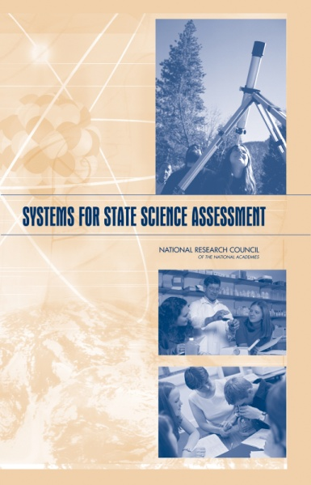
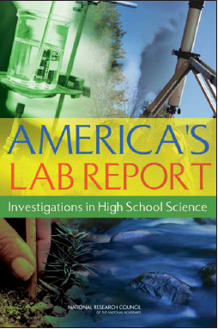


A Framework based on Research on Learning and Teaching

Slide 13
Phase I – NRC Process for Development of the Conceptual Framework for Science
  Build on current initiatives and past experiences
  Hold stakeholder meetings for informed input
  Conduct study committee and design teams
  Draft conceptual framework released July 12, 2010
  Seek public feedback
  Finalize draft in early 2011
  DEADLINE FOR SUBMITTING FEEDBACK – AUGUST 2, 2010

Slide 14
Phase II – Achieve Process for Development of Next Generation Science Standards
  After the final Conceptual Framework for Science is released by the NRC in 2011, Achieve will engage states and other key stakeholders (including CCSSO, NGA, SHEEO) in the development and review of the new standards
  Writing Teams
  Critical Stakeholder Team
  Strategic Advisory Team
  Comprehensive Feedback Loops
  Revision of multiple standards drafts based on stakeholder and public input
  NRC Study Committee check of fidelity of standards based on framework

Slide 15


Similarities and
Differences in Common Core State Standards Process and Next Generation Science Standards

Slide 16
Similarities and Differences in CCSS and Next Generation Science Standards
Similarities | Differences
States provide key leadership role in development and feedback of Next Generation Science Standards | Two Step Process Scientific community provides key leadership role in the Conceptual Framework Development
Broad Stakeholder Engagement | The field of science standards development is in a different place than ELA and mathematics
State engagement in development and feedback | States are not being asked to sign on prior to development
Development of rigorous, internationally benchmarked, college and career ready standards | States will decide after the standards are developed to adopt individually or in “common”

Slide 17

  State Participation in the Review of the Conceptual Framework for Science

Slide 18
State Input on Conceptual Framework for Science
  Avenues for State Input
  Council of State Science Supervisors (CSSS)
    8 Regional Meetings
    Each state allowed $1,300 in travel
    Each region submits collective feedback to CSSS who submits feedback to NRC
  AAAS (scientists/researchers) and NSTA (science teachers/science education faculty) are collecting feedback to share with NRC
  BOSE website http://www.nas.edu/bose
  DEADLINE FOR FEEDBACK AUGUST 2

Slide 19
Feedback Structure
  Question #1 – Vision for science education (Chapter 1)
  Question #2 –Core Disciplinary Ideas (Chapter 3)
  Question #3 – Cross cutting Elements (Chapter 4)
  Question #4 - Practices (Chapter 5)
  Question #5 – Prototype learning progressions (Chapter 7)
  Question #6 – General Feedback
  Question #7 – Additional comments

Slide 20
Questions?

Slide 21
Contact Information
Laura Slover
Vice President of Content and Policy Research
lslover@achieve.org
Stephen Pruitt
Director of Science
spruitt@achieve.org
www.achieve.org

