Slide 1
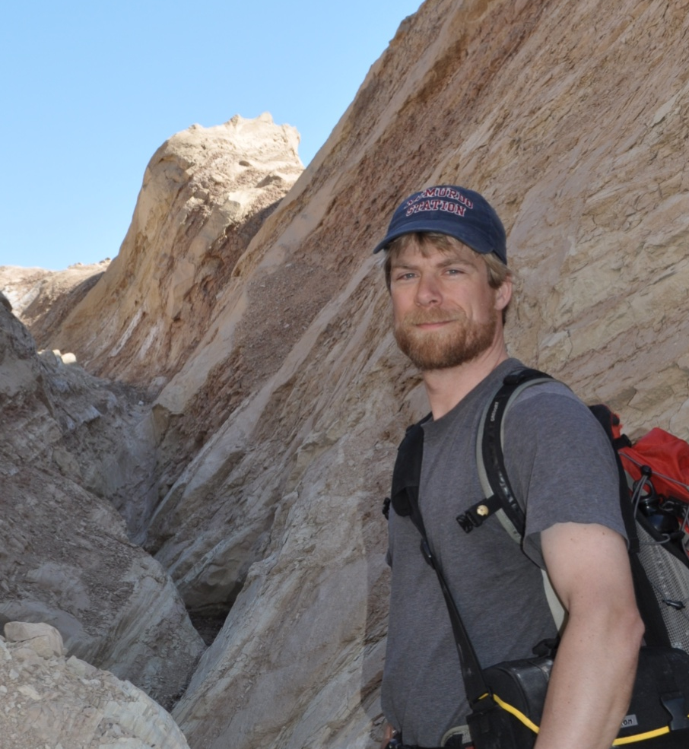

Slide 2
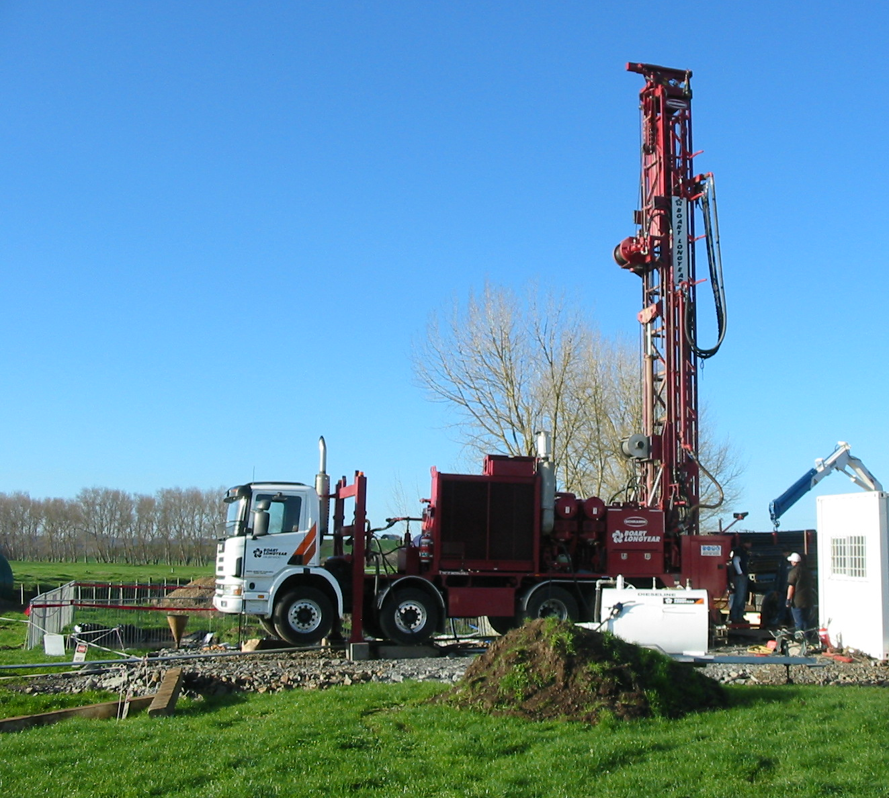

Pumpin’ Frack Mash,
It’s a Gas, Gas, Gas!
Devin Castendyk
Earth Sciences Department
State University of New York,
College at Oneonta

Slide 3


Slide 4
Overview
Issues surrounding natural gas development in central New York
Project goals
Project description
Student feedback

Slide 5
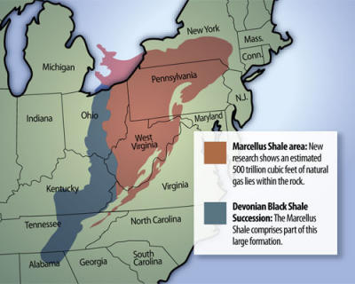
Location of the
Marcellus Black Shale

Slide 6
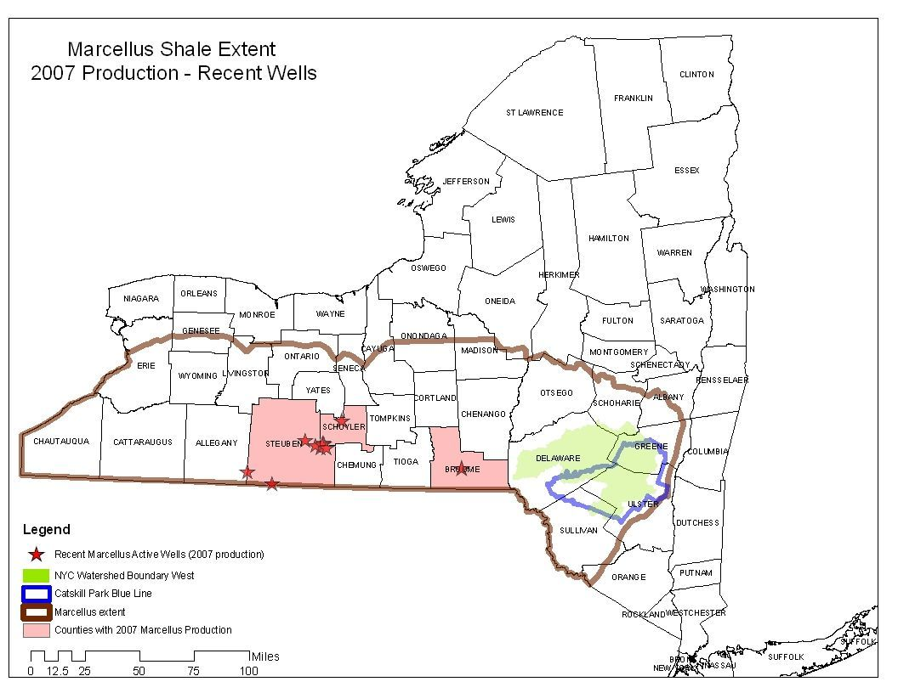

Slide 7
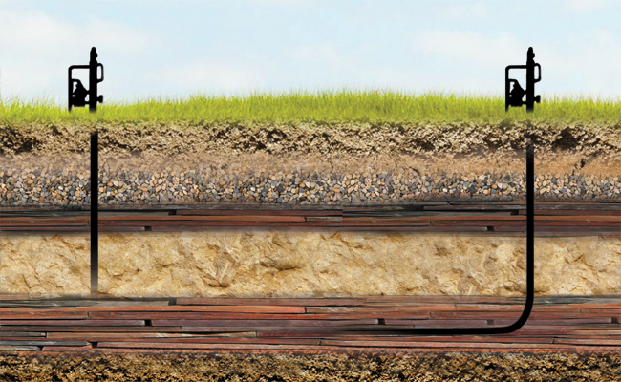
Vertical Well vs. Horizontal Well

Slide 8
Local Fears
Fracking fluids will contaminant water supply aquifers with endocrine disruptors, methane, or other undesirable substances
Drilling fluid storage ponds will overflow during rain events, or leak into underlying groundwater, and negatively impact local streams
Sediment load in streams will increase
Local roads will be destroyed by heavy trucks
Flowback water will be improperly disposed
Local stream flow will be diminished by the volume of water required for fracking
It will be noisy and look ugly

Slide 9
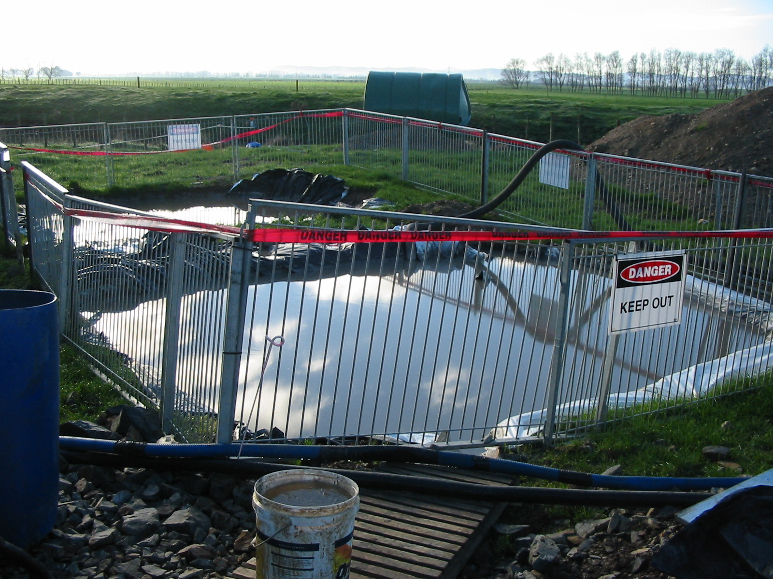

Slide 10
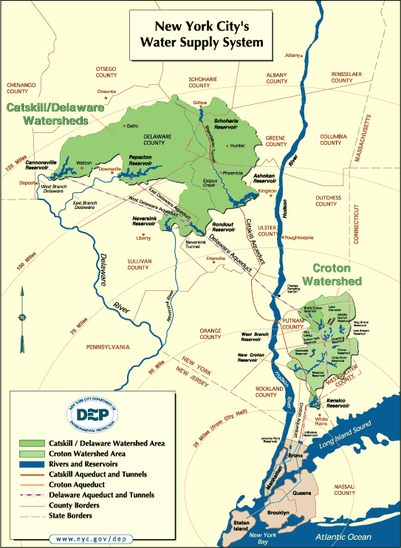

Slide 11
We use gas!
50% of homes in New York State are heated with natural gas
98% of SUNY Oneonta heated with natural gas
New York State is the 4th largest gas user
Most comes from Texas, Oklahoma, Louisiana, and Canada

Slide 12
Some Local Desire
Royalties from gas drilling will be an enormous boost for local farmers
Drilling will temporarily increase local jobs and tax base
Drilling will temporarily increase state tax revenue (SUNY is BROKE)
Local energy is preferred to imported energy

Slide 13
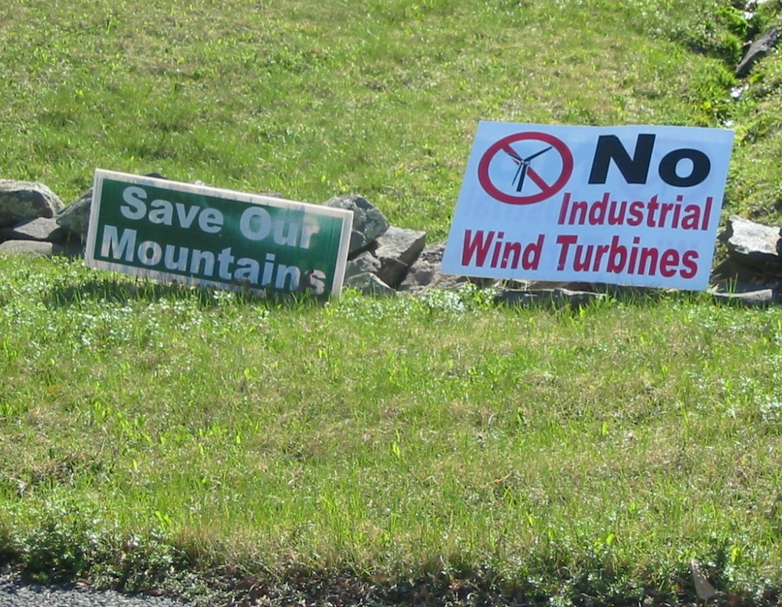
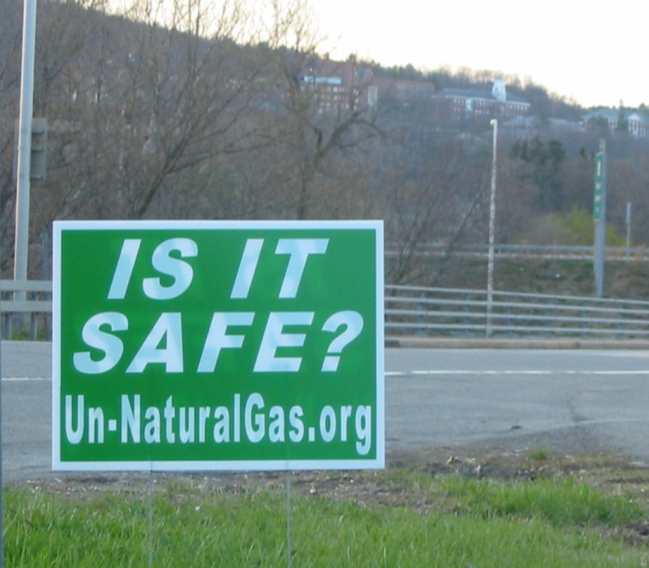
A History of Opposition
Proposed biofuel power plant, 2006 – No!
Proposed wind farm, 2007 – No!
Proposed natural gas, 2008 - ???

Slide 14
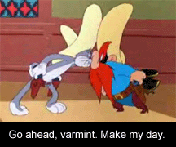
Local Differences of Opinion
An opportunity to learn local geology, hydrology, economy, sociology, laws, and decision making
An opportunity for critical thinking and evaluation of a “real world” topic

Slide 15
Term Project Goals
To make a holistic evaluation of energy development
To experience what it is like to be an consultant
To research a contemporary energy issue facing the local community
To differentiate good information from poor information
To synthesize and defend an argument (pro-development or anti-development)
To develop writing and speaking skills
Ideal class size = 16 to 25 students

Slide 16
Part 1 – Introduction
Introduce local issues on the first day of class
Proposed drilling on campus – all students received $1000 scholarship if successful
Students will work in teams as environmental consultants to decide if this project should go ahead
Students will write two reports and given an oral presentation before community members

Slide 17
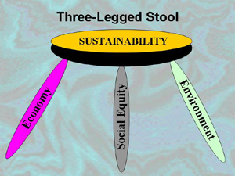
Part 2 – Theme teams
Provide class with 4 or 5 themes related to the issue:
  Geology and Resource Production
  Water Resources
  Economics
  Social Impacts
Group class into teams of 4 or 5 students where each team is assigned a theme. Works best if students can choose which theme they wish to work on.
Evaluation 1: Each group submits a work plan at the end of the class, and choose a manager.

Slide 18
a. Geology and Production Theme
Geologic nature of the resource
Local stratigraphy
Hydrogeology and flow paths to the surface environment and/or water supply aquifers
The production process
Mitigation measures used to avoid contamination

Slide 19
b. Water Resources Theme
Identify local water uses
Determine how much water development will use
Construct a water balance and determine if there is enough water for development
Determine potential contaminants of concern and water quality guidelines
Determine local water users that might be negatively affected by development

Slide 20
c. Economics Theme
Existing local employment opportunities
Average local income
Expected increase/decrease in jobs resulting from development
Expected change to local and state taxes as a result of development
Determine the price of an environmental bond designed to cover the cost of surface water and groundwater cleanup in the event of an accident

Slide 21
d. Social Theme
Conduct a survey of students or local home owners to identify major concerns and determine the popularity of the proposal
Differentiate valid concerns from invalid concerns
Identify strategies that would mitigate local fears
Design a public relations program for gas companies that will alleviate local concerns

Slide 22
Part 3 – Field Trip
Second week of semester
Class field trip to an outcrop of the gas producing unit
Discuss local income and social attitudes
Inspect local water resources
Evaluation 2: Teams submit a 5 page reports ½ way through the semester

Slide 23
Part 4 – New Teams
½ way through the semester
4 new teams are assigned
Each team is composed of one “expert” from each of the previous teams
Each team is given a copy of each report generated by the previous teams to use as a reference

Slide 24
Part 4 - Continued
2 teams are told they have been hired by the gas company to defend and promote the development of natural gas on campus.
2 teams are told they have been hired by a local environmental group to oppose the development of natural gas on campus.
Evaluation 3: All teams prepare a 5 page report defending this position (due at the end of the semester).
Evaluation 4: All teams prepare an oral presentation.

Slide 25
Part 5 – Debate
Last week of the semester
Select members of the local community are invited to attend oral presentations:
  City council members, alumni professors, watershed managers, environmental groups, faculty
Each group gives a 15 minute presentation followed by questions
Invited guests decide which team presented the best argument and whether drilling will occur on campus

Slide 26
Student Reactions
Students feel this is a “real world” experience, especially working on a local topic and debating it before locals
Students include this experience on their job resumes
Students continue to buzz about the project years after it is concluded
Interaction with community gives meaning to the research
And, as Mick would say, “It’s a gas, gas, gas!”

Slide 27
Questions???

