Slide 1



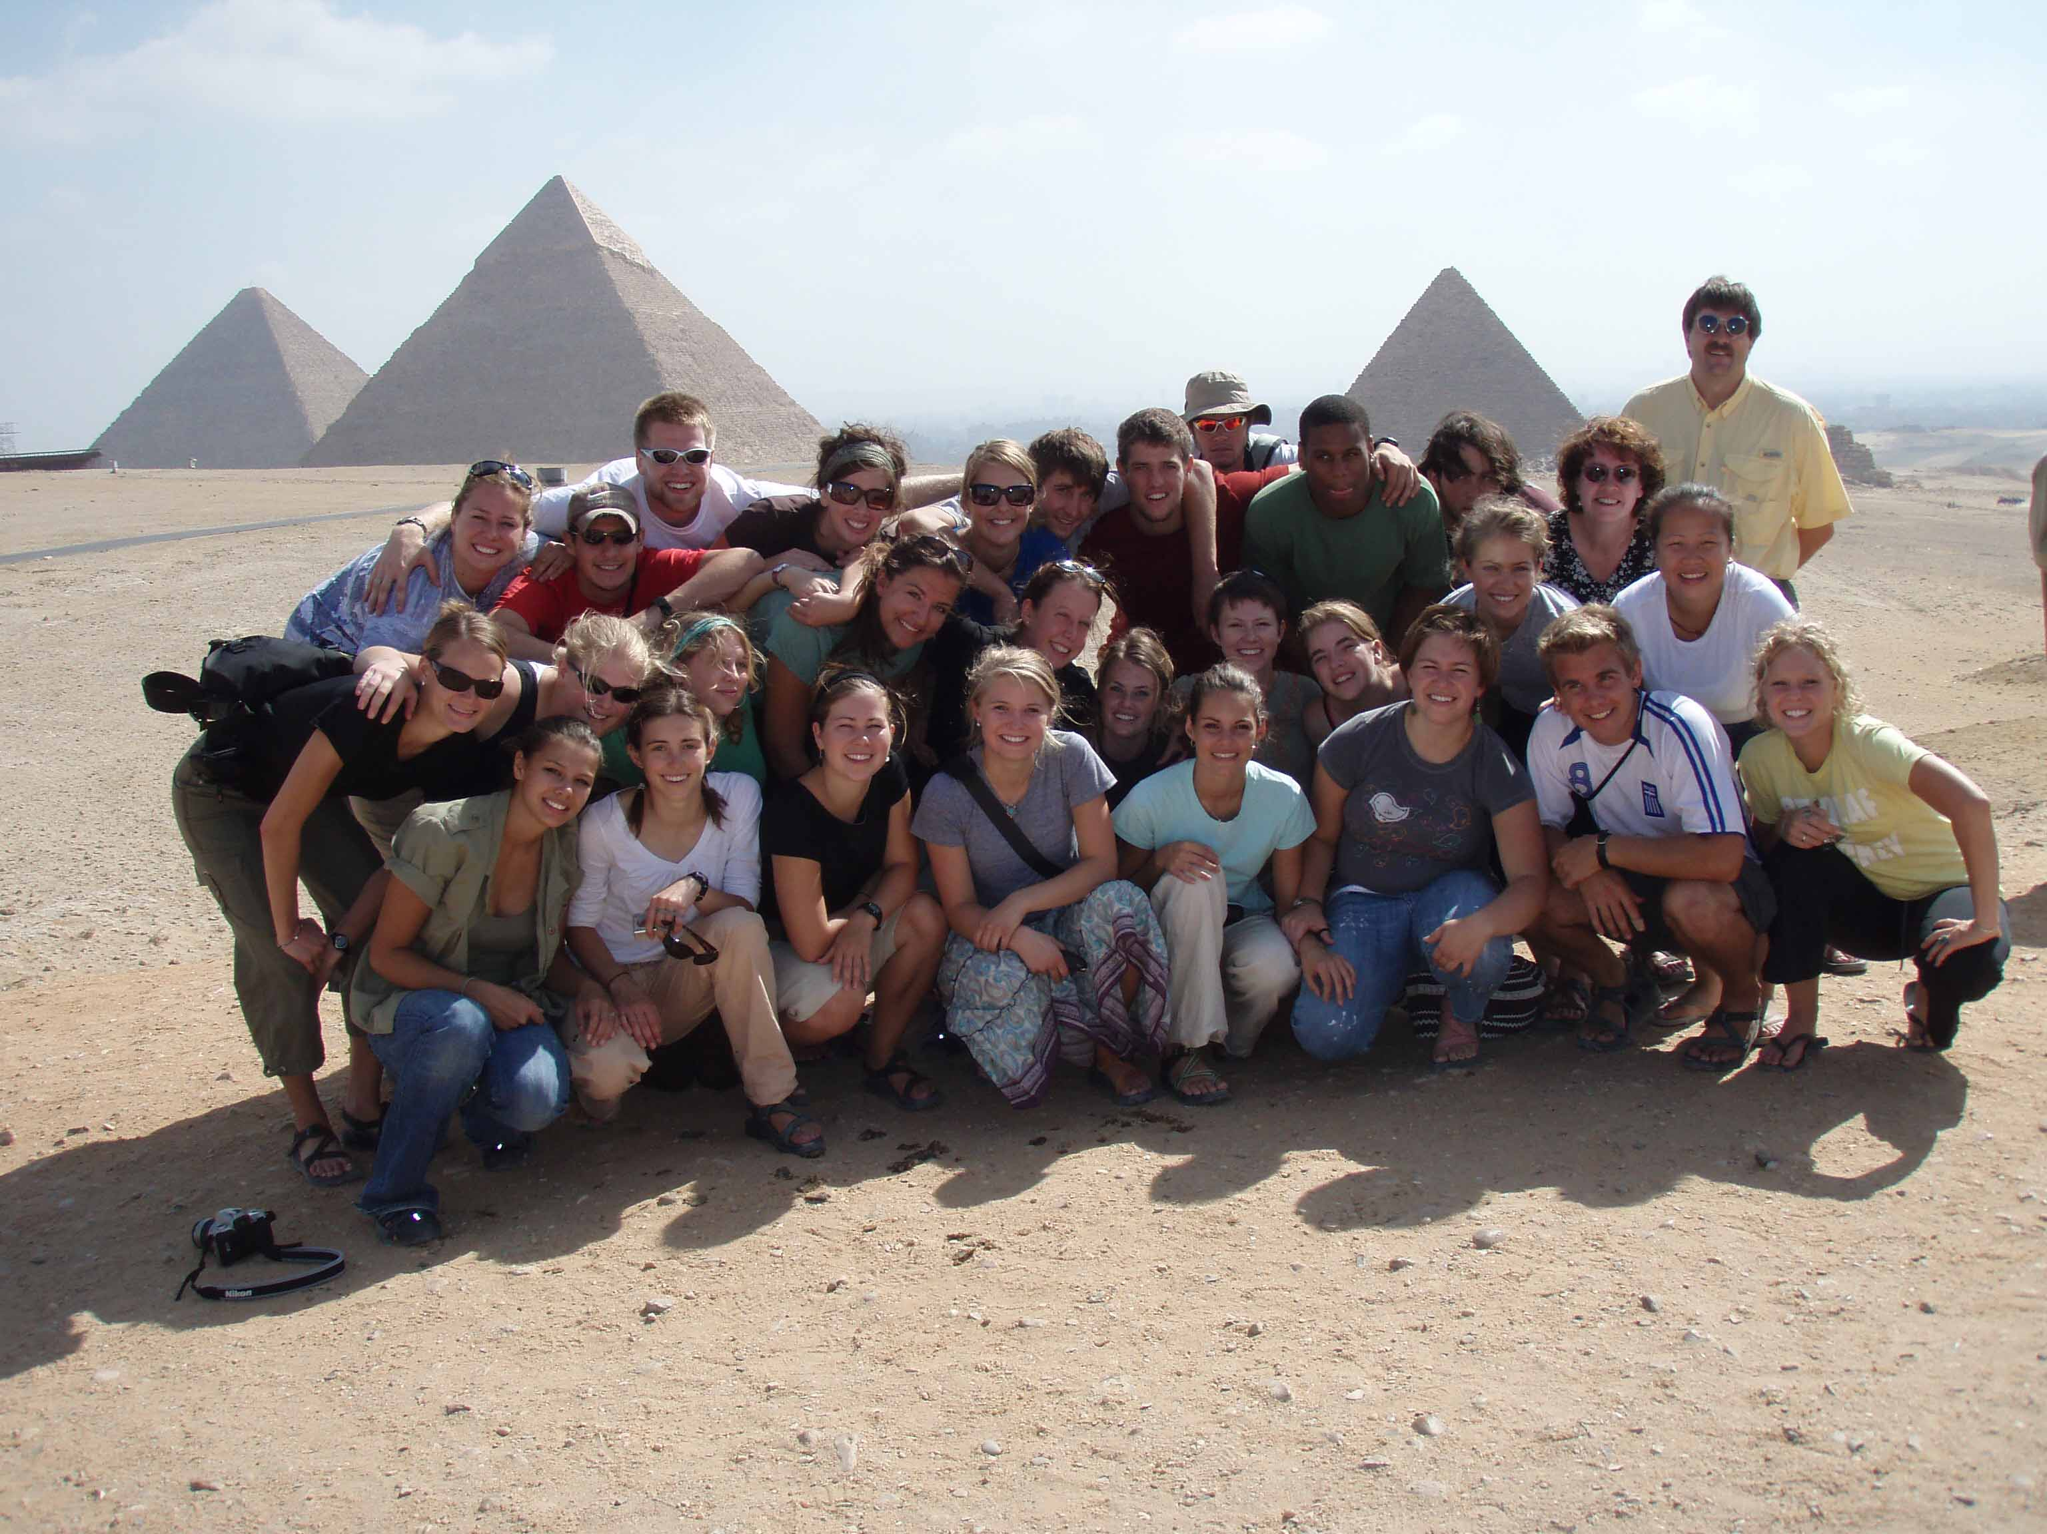











Around the World of Psychology in 150 Days
Donna K. McMillan & Gary M. Muir
St. Olaf College, Northfield, MN
Overview of Global Semester
Global Semester (“Global”) is a five month study abroad program in which 26-28 students travel as a group with two faculty supervisors.
Extends over Fall semester and the January Interim.
The group travels to seven different countries: Switzerland, a country of the faculty supervisor’s choice (e.g., Greece, Germany), Egypt, India, Thailand, Hong Kong & mainland China, and South Korea.
Students complete five courses: four courses taught by on-site faculty (history, art, religion, and sociology) and one course in the faculty supervisor’s discipline - psychology. Most of these courses meet St. Olaf general education requirements.
A tenured St. Olaf faculty member leads the program (accompanied by an assistant supervisor – often a spouse), teaching a relevant course in his/her discipline.
Global is a 44-year old tradition at St. Olaf. Some students choose to attend St. Olaf specifically to participate in the Global program or have had parents/family participate previously.
One of the major goals of the program is to return with the same number of students as started it.
The Psychology Course
Overview:
• The supervisor’s Psychology course examines ways in which
culture influences people and their behavior.
  • Integrates traditional academic and experiential learning.
  • Primarily discussion-based, but includes mini-lectures.
  • Meets throughout the five-month period.
Topics:
• The nature and challenges of cross-cultural research in psychology
• The development of psychology across different cultures
• Culture and…
…cognition, e.g., cultural influences on intelligence & perception
…personality, e.g., culture-specific vs. universal concepts
…gender, e.g., gender stereotypes and sex roles
…emotion, e.g., experience of emotion, and display rules
…social behavior, e.g., individualism and collectivism, and
behaviors such as aggression, helping, and conformity
…conceptions of psychological well-being, e.g., notions of mental
health, and approaches to treatment
Field Excursions:
Excursions to locations such as the pyramids and Valley of the Kings, places of worship, museums, city markets, and universities facilitate interaction with local people and provide experiential learning opportunities
Assignments:
Participation, including discussion preparation: 20%
Academic journal: 20%
Quizzes/ Tests: 40%
Integrative paper: 20%
Sample Readings:
Bond, M. H. (1992). Beyond the Chinese face: Insights from psychology. Oxford University Press.
Levine, M. (2000). The positive psychology of Buddhism and yoga. Mahwah, NJ: Lawrence Erlbaum Associates.
Nisbett, R.E. (2003). The geography of thought: How Asians and Westerners think differently… and why. New York: The Free Press.
Stevens, M., and Wedding, D. (Eds.). (2009). The handbook of international psychology. New York, N.Y: Routledge.
Triandis, H.C. (1994). Culture and social behavior. New York: McGraw-Hill.
International Association for Cross-Cultural Psychology (2011, June 1). Online Readings in Psychology and Culture (ORPC). Retrieved from http://orpc.iaccp.org/index.php.
Students
26-28 students
Students apply for the Global program. Students applications include essays, letters of recommendation, and an interview with a selection committee.
Because Global is a liberal arts program, students come from a variety of majors. There are no prerequisites for the courses.
Most students are juniors or seniors.
The student group tends to be predominantly female.
Students participate in committees to help facilitate necessary tasks, e.g., Transportation, Social, and Bathroom Committees.

