Slide 1
www.europa.edu
The website OF THE European Union
Introducing the European Union
Slides courtesy of:

Slide 2

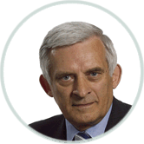
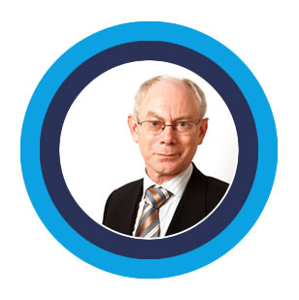
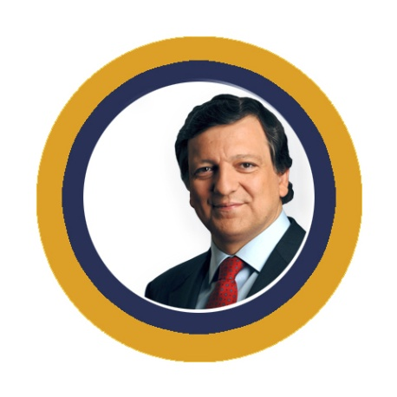
Three key players
The European Parliament
- voice of the people
Jerzy Buzek, President of
of the European Parliament
The council of Ministers
- voice of the Member States
Herman Van Rompuy, President of the European Council
The European Commission
- promoting the common interest
José Manuel Barroso, President
of the European Commission

Slide 3
How EU laws are made
Legislation in the EU
Citizens, interest groups, experts: discuss, consult
Commission: makes formal proposal
Parliament and Council of Ministers: decide jointly
National or local authorities: implement
Commission and Court of Justice: monitor implementation

Slide 4
The European Parliament – voice of the people
4 Decides EU laws and budget together with Council of Ministers
4 Democratic supervision of all the EU’s work
Number of members elected in each country (January 2010)
17
Finland
13
8
Austria
Latvia
Romania
33
Belgium
22
Lithuania
12
Slovakia
72
13
France
17
Germany
6
Bulgaria
99
Luxembourg
Slovenia
7
Cyprus
6
22
Greece
Malta
5
Spain
50
Czech Republic
Hungary
25
18
22
22
Netherlands
Sweden
Ireland
Denmark
12
Poland
50
72
13
United Kingdom
6
Italy
72
22
Estonia
Portugal
Total
736

Slide 5
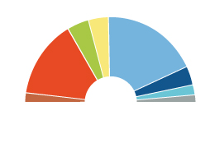
The European political parties
Number of seats in the European Parliament
per political group
(January 2010)
Alliance of Liberals and
Democrats for Europe
84
European People’s Party
(Christian Democrats)
265
Greens/European Free Alliance
55
Progressive Alliance of Socialists and Democrats
184
European Conservatives
and Reformists
54
Europe of Freedom
and Democracy
32
European United
Left - Nordic Green Left
35
Total : 736
Non-attached members 27

Slide 6

Council of Ministers – voice of the member states
4One minister from each EU country
4Presidency: rotates every six months
4Decides EU laws and budget together
with Parliament
4Manages the common foreign and
security policy

Slide 7
Council of Ministers – number of votes per country
Germany, France, Italy and the United Kingdom
29
Spain and Poland
27
Romania
14
Netherlands
13
Belgium, Czech Republic, Greece, Hungary and Portugal
12
Austria, Bulgaria and Sweden
10
Denmark, Ireland, Lithuania, Slovakia and Finland
7
Estonia, Cyprus, Latvia, Luxembourg and Slovenia
4
Malta
3
Total:
345
“Qualified majority” needed for many decisions:
255 votes and a majority of member states
From 2014: 55% of the Member States with 65% of the population

Slide 8

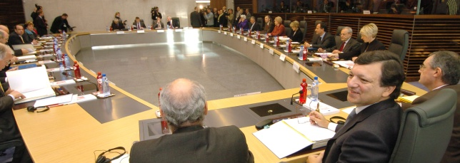
The European Commission – promoting the common interest
27 independent members,
one from each EU country
4Proposes new legislation
4Executive organ
4Guardian of the treaties
4Represents the EU on the international stage

Slide 9
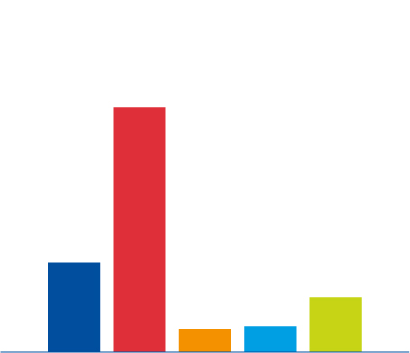
EU population in the world
Population in millions, 2009
1339
500
307
128
142
EU
China
Japan
Russia
United States

Slide 10
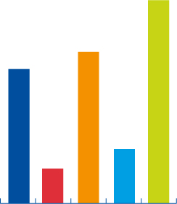

How rich is the EU compared to the rest of the world?
38 700
27 800
25 100
12 508
9819
12 200
4 400
3 329
1 326
468
EU
China
Japan
Russia
United States
EU
China
Japan
Russia
United States
Size of economy: 2008 gross domestic product
in billion of euros
Wealth per person: 2008 gross domestic product
per person

Slide 11
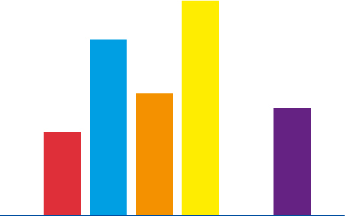
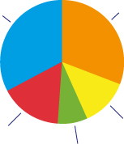
Energy sources in a changing world
Energy in the EU
Fuel used in EU in 2008, as share of total
Share of fuel imported from outside the EU in 2008
100%
Gas
25%
84%
Oil
36%
60%
54%
45%
Coal
18%
Nuclear
13%
Renewables
8%
0%
Coal
Oil
Gas
Nuclear
(uranium)
Renewables
All types of fuel

Slide 12

Improving health and the environment
Pollution knows no borders – joint action needed
EU action has helped bring:
4 Cleaner bathing water
4 Much less acid rain
4 Lead-free petrol
4 Free and safe disposal of old electronic equipment
4 Strict rules on food safety from farm to fork
4 More organic and quality farming
4 More effective health warnings on cigarettes
4 Registration and control of all chemicals (REACH)
© Van Parys Media

Slide 13
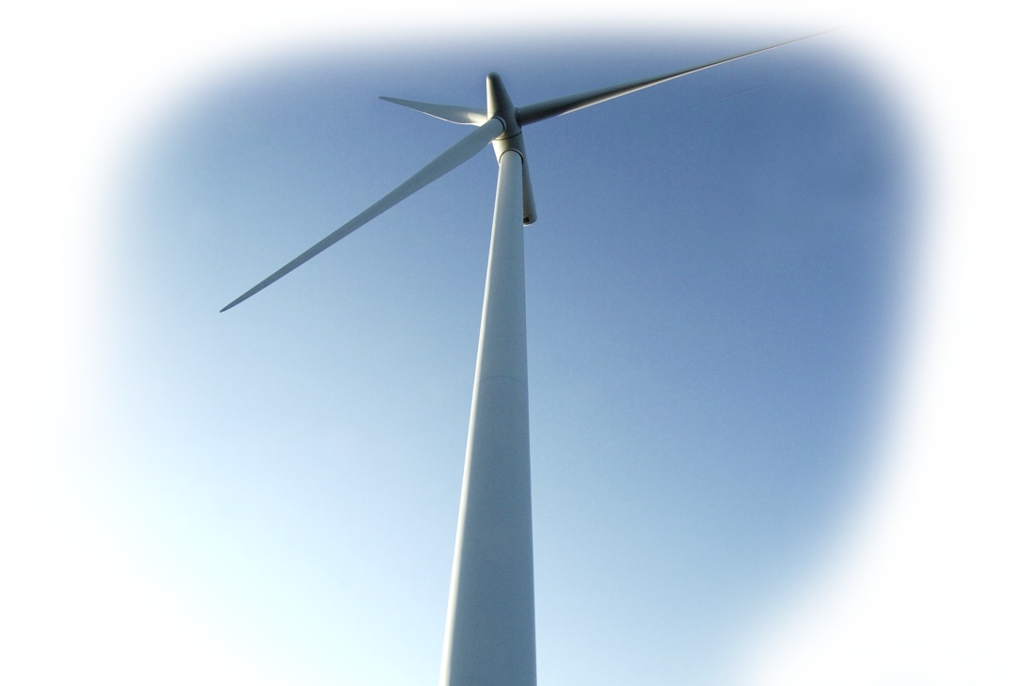
Climate change – a global challenge
To stop global warming, EU leaders decided in 2007 to:
4 reduce greenhouse gas emissions
by 20% by 2020 (30% if other developed
countries do likewise)
4 improve energy efficiency by 20% by 2020
4 raise the share of renewable energy
to 20% by 2020 (wind, solar, hydro
power, biomass)

