Slide 1
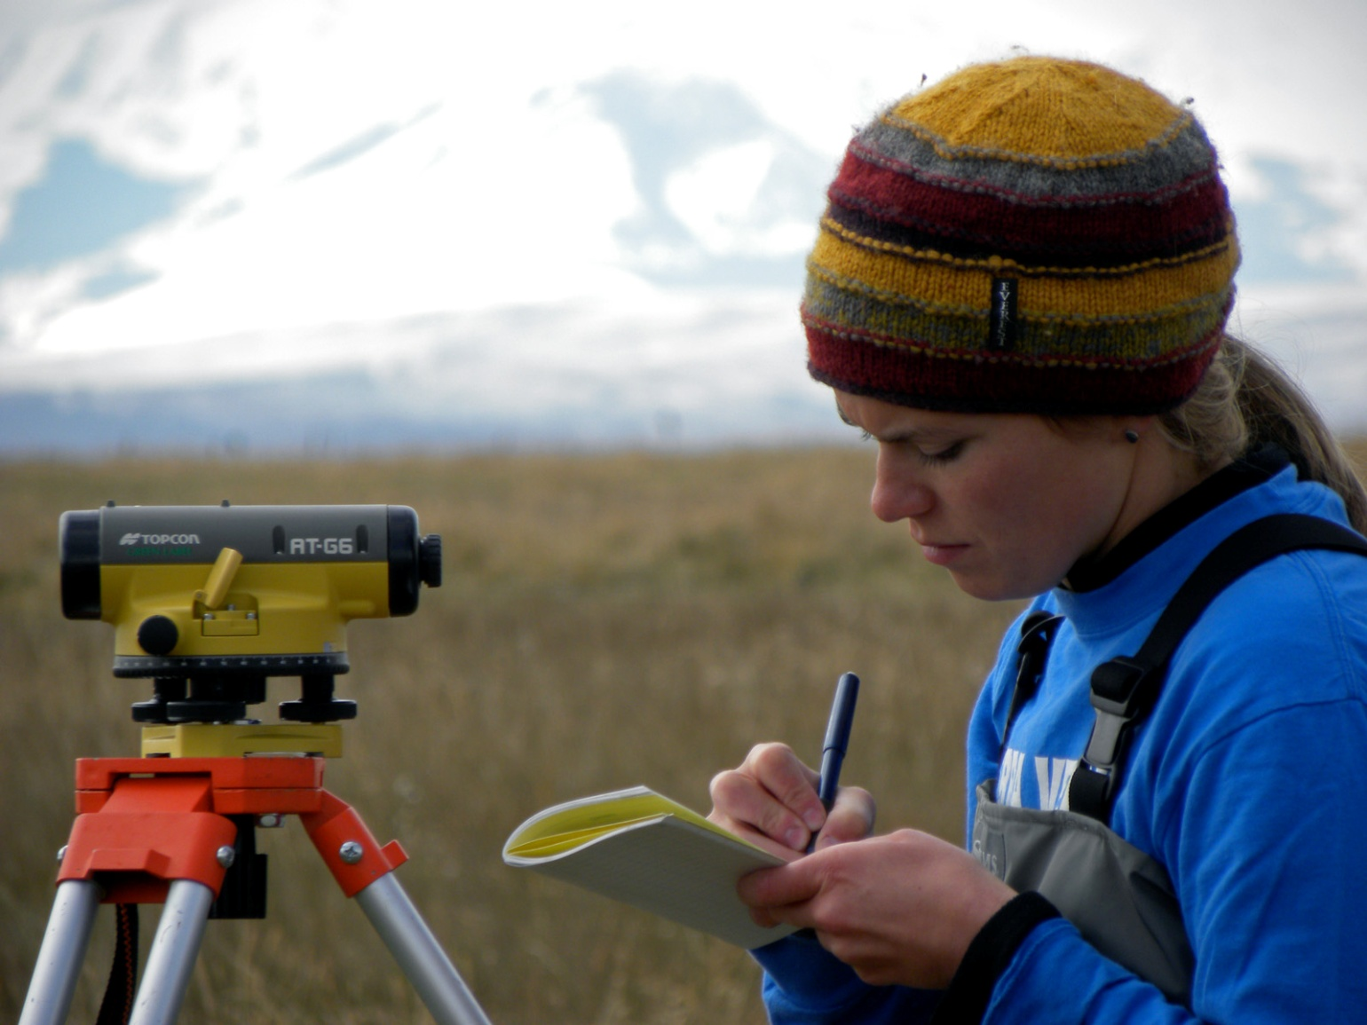

Experience One: Teaching the Geoscience Curriculum in The Field Through Experiential Immersion Learning
Robert C. Thomas & Sheila Roberts
Department of Environmental Sciences
The University of Montana Western r_thomas@umwestern.edu

Slide 2
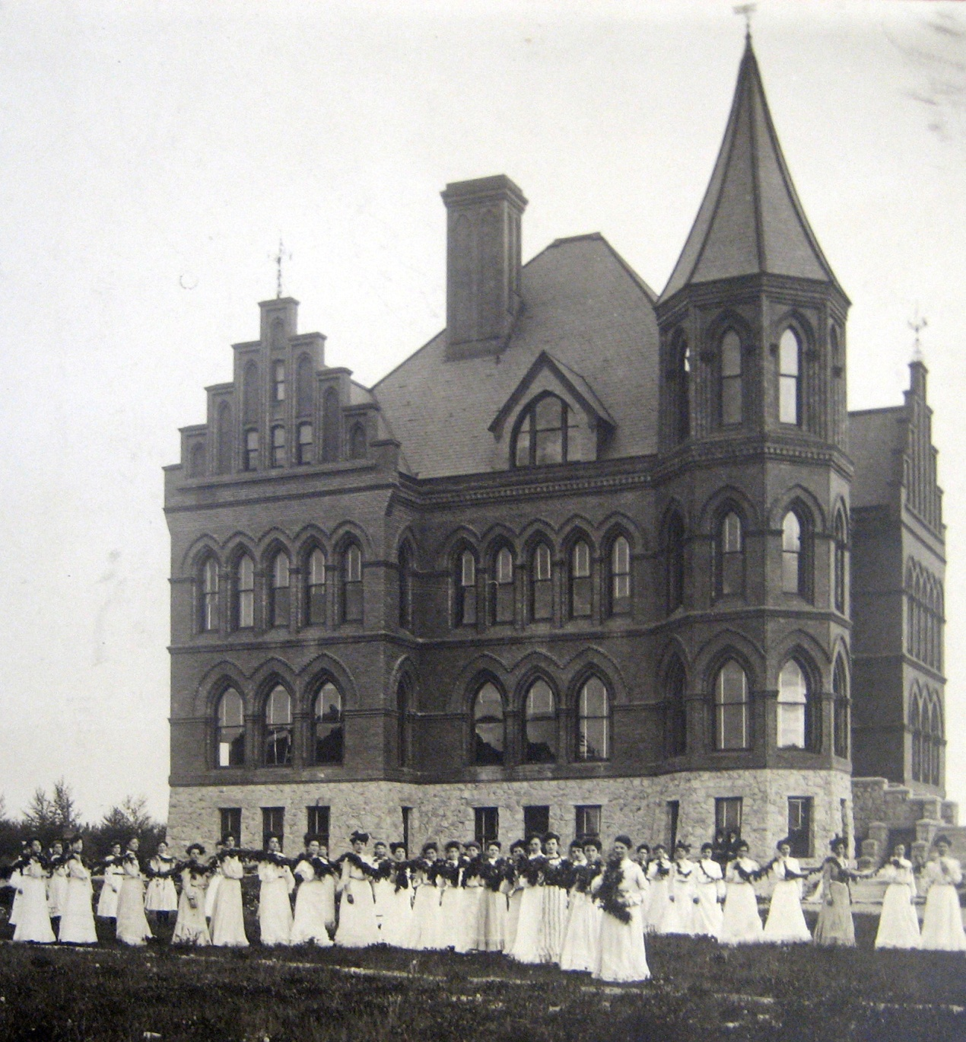
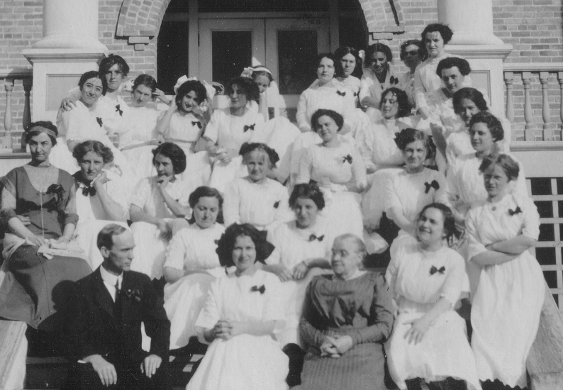

A Need For Change at Montana Western
A Need For Change
UMW was one of the last normal schools (teacher’s college) remaining in the U.S. in the 1990s.
Two degree programs (elementary and secondary education) remained viable after years of program eliminations.
The campus survived numerous closure attempts and was politically and financially vulnerable.
Small size (~800 students) was viewed as a sign of weakness by decision makers in the Montana University System.
Montana State Normal School – 1890s

Slide 3
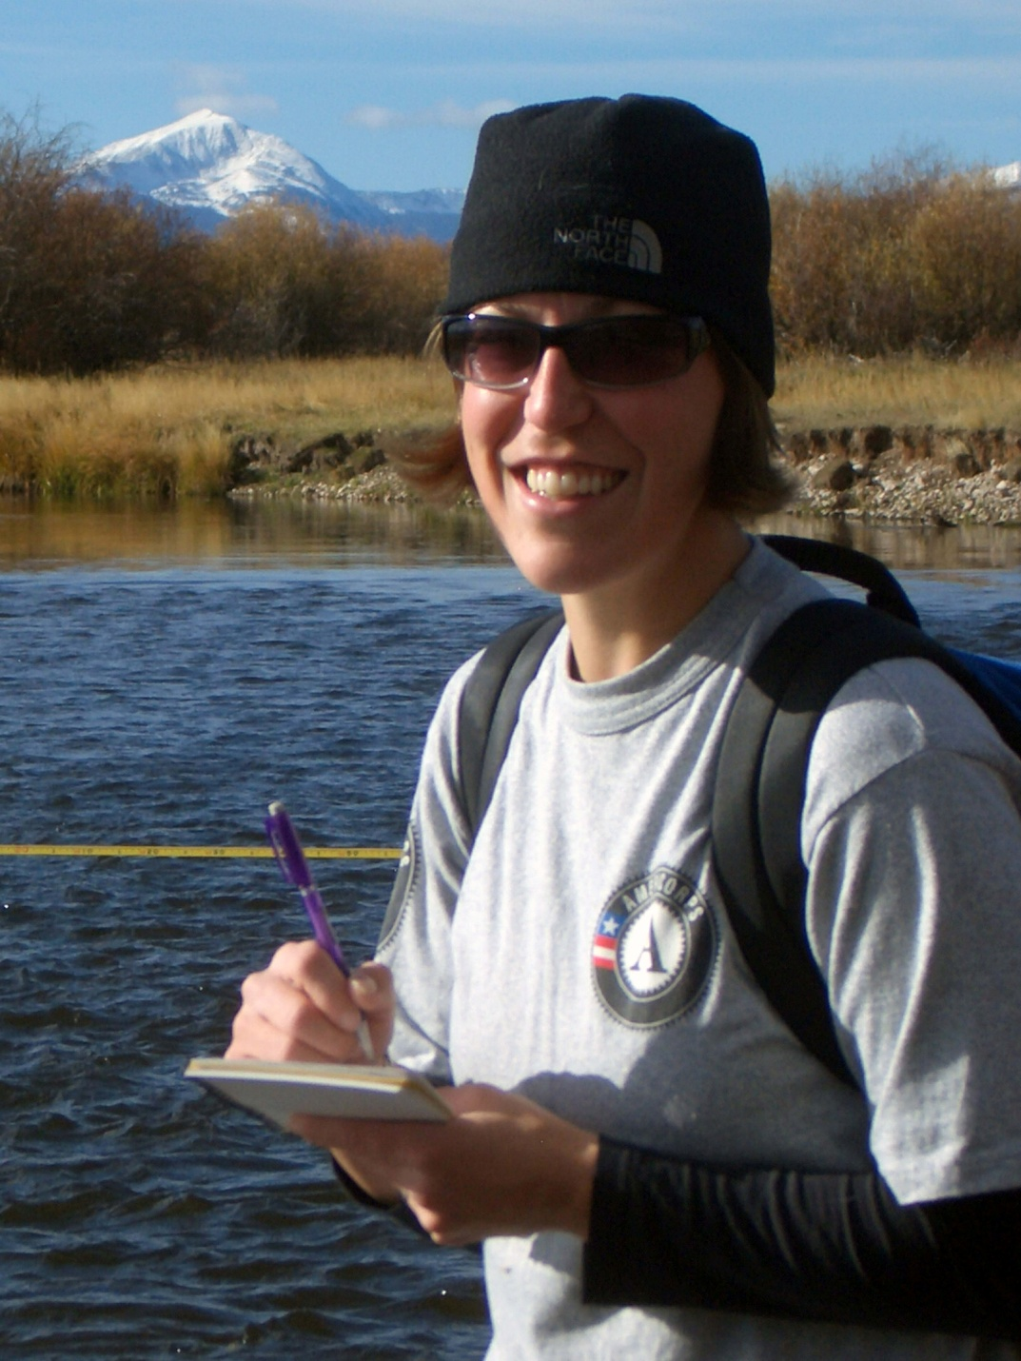
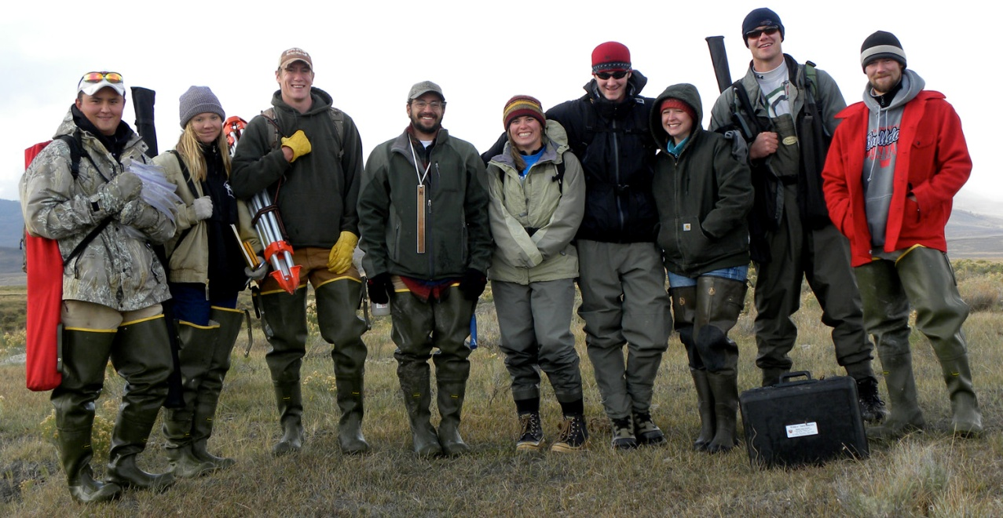
A Desire for Change at Montana Western
A Desire For Change
Some faculty concluded that authentic practice in the discipline is the best possible learning experience for our students.
Incorporation of authentic practice is best done through experiential immersion learning in the field.
We (the geoscientists) wanted student portfolios to be filled with field-based examples of skills and knowledge.
UMW today!

Slide 4
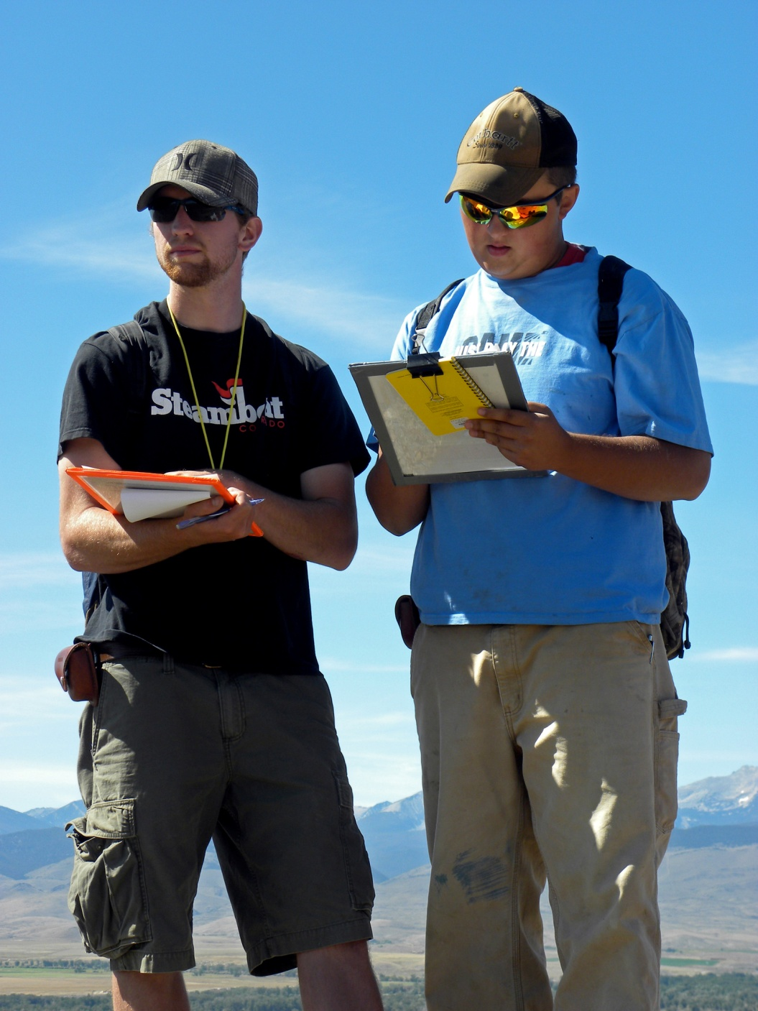

Experience One in the Geosciences
Experience One in the Geosciences
Students take one class at a time for 18 instructional days.
Geoscience students meet anytime between 8:15 a.m. and 3:15 p.m.
All classes have a field component and many are taught in the field.
Students are immersed with limited distractions.
Student assessment is based on application of knowledge.

Slide 5
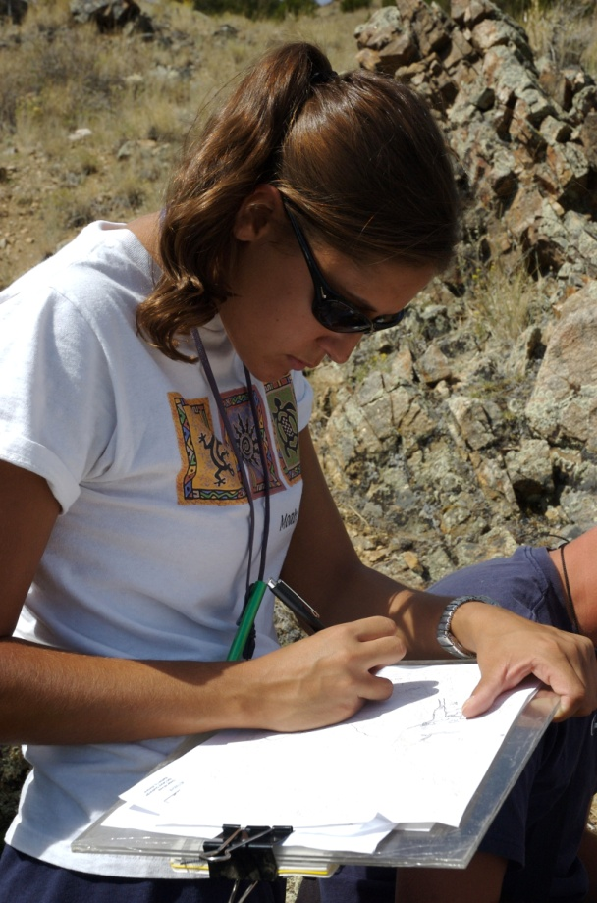
UMW Geoscience Curriculum
BS: ENVIRONMENTAL SCIENCE
BIO 214 General Botany
CHMY 131 General Chemistry
CHMY 132 General Chemistry
ENVS 221 Scientific Communications
ENVS 269 Map, Compass and GPS
ENVS 348 Soil Science
ENVS 391 Geographic Information Systems
ENVS 429 Environmental Field Studies*
ENVS 441 Sustainable Natural Resource Management
GEO 150 Environmental Geology
GEO 226 Rocks, Minerals and Resources
M 171 Calculus I
M 172 Calculus II
PHYS 233 General Physics (Calculus-based)
PHYS 234 General Physics (Calculus-based)
STAT 217 Statistics
ENVS 400 Environmental Sciences Internship
and/or
ENVS 498 Environmental Sciences Thesis
OPTION IN GEOLOGY
GEO 230 Geology of the American West
GEO 315 Structural Geology*
GEO 378 Surficial Processes*
GEO 409 Sedimentation and Stratigraphy
GEO 421 Hydrology
GEO 431 Environmental Geochemistry
GEO 494 Geology Seminar
OTHER OPTIONS:
Geochemistry
Sustainable Natural Resource Management
Wetlands Management
OTHER GEOSCIENCE DEGREES:
BS: Environmental Interpretation
Option: Geological Naturalist

Slide 6
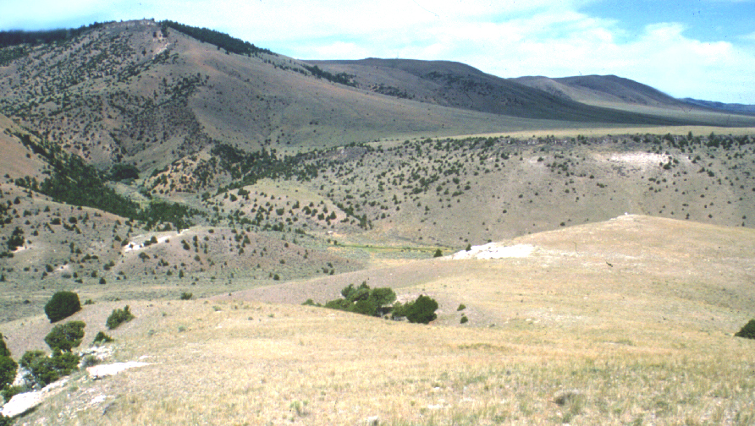
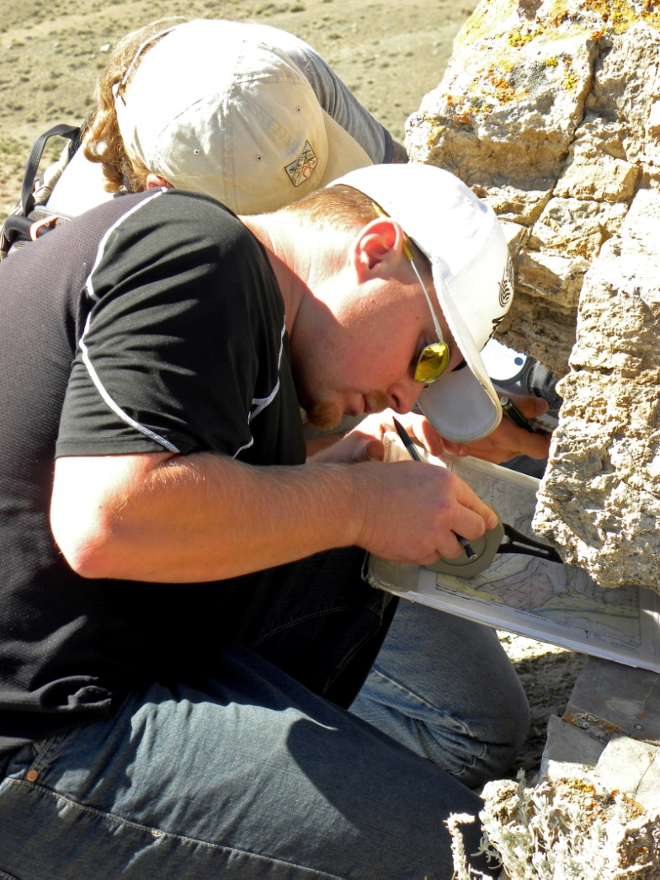
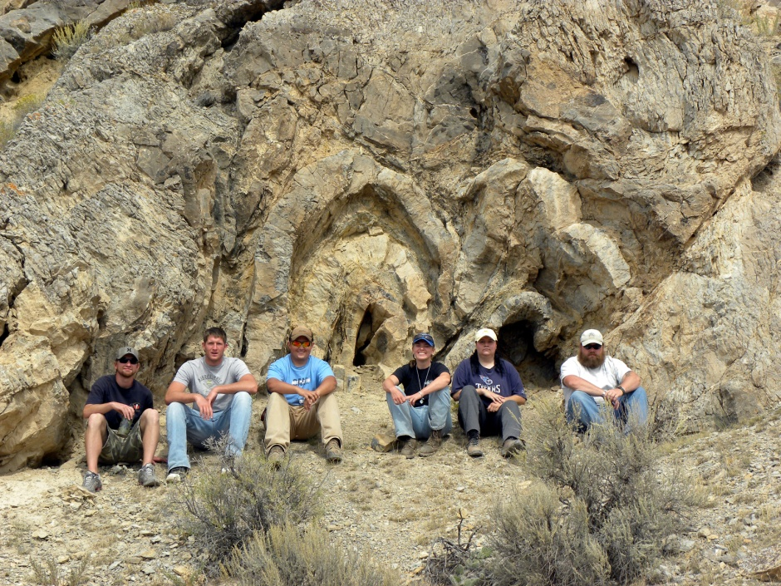
Structural Geology
Structural Geology
Field course designed around tectonic settings.
Focus on skills, data interpretation and concepts.
Land management question applied to the data.
Assessment based on project reports.
U
D

Slide 7
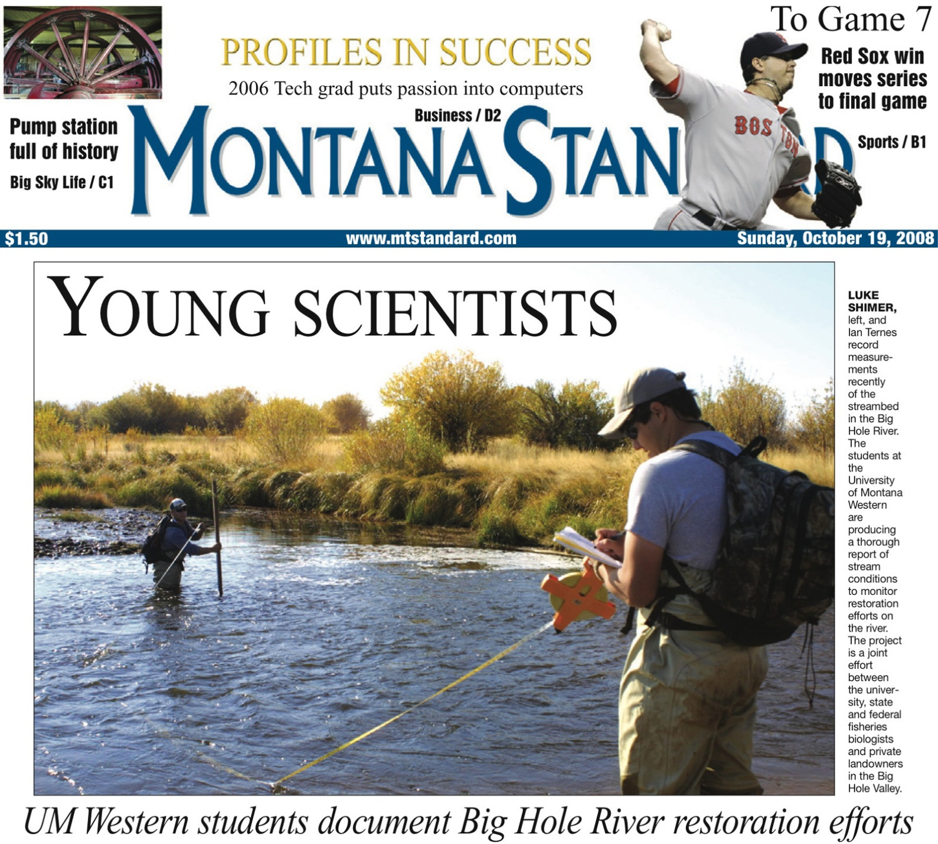
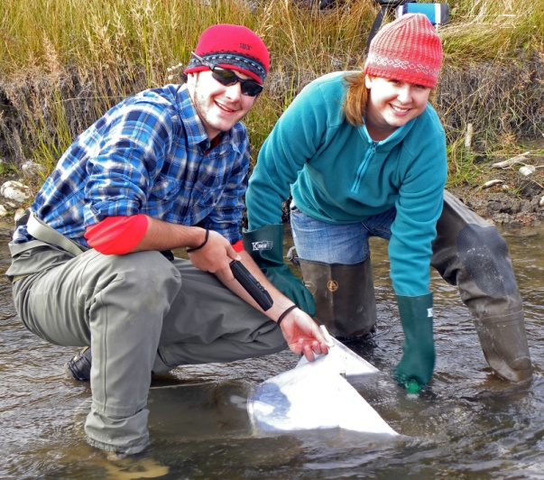
Environmental Field Studies
Environmental Field Studies
Capstone field course where students apply their skills and knowledge to collaborative projects with land-management agencies.
Emphasis on integration of field data to provide recommendations for management solutions.
Students produce a professional assessment report that is submitted to federal and state agencies.
Current focus on assessment of riparian restoration for endangered fluvial Arctic grayling.

Slide 8
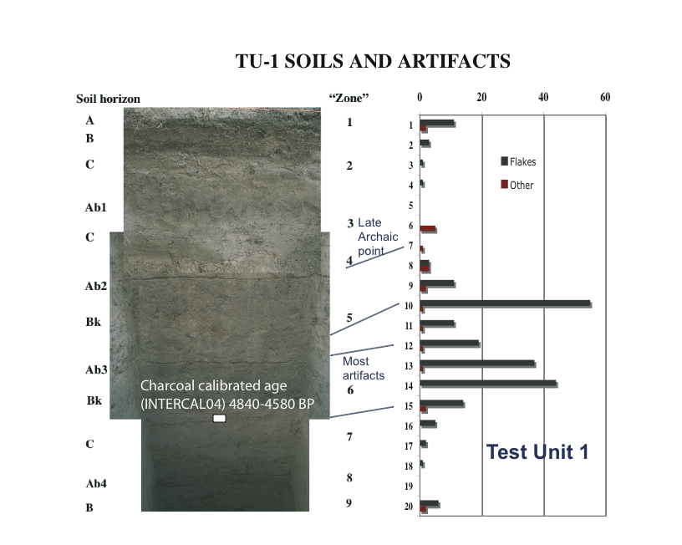
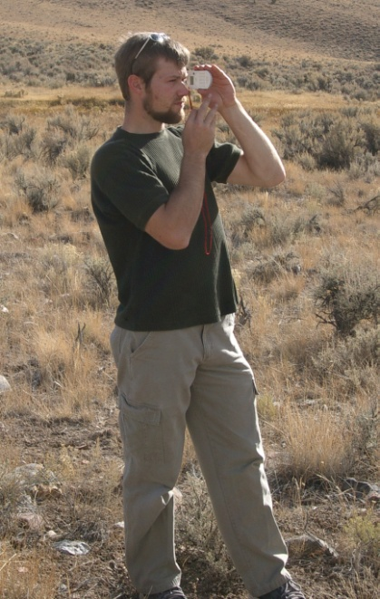
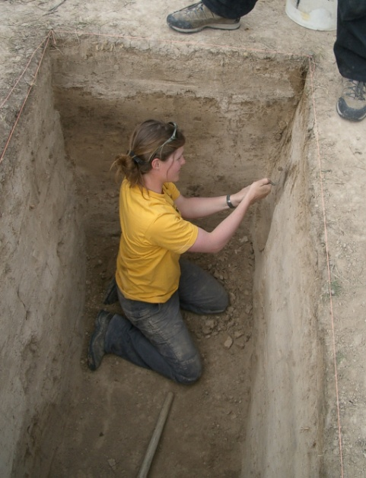
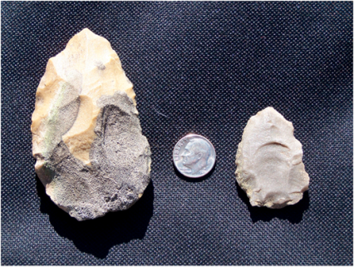
Surficial Processes and Linking Classes
Surficial Processes
Introductory short-course in the first week.
Rest of class centers on a new original-research field project, usually cooperating with a Federal, State, or local land-management agency.
Students participate in the entire process –planning, accomplishing, and presenting their work.
“Mini lectures,” agency personnel, textbook, and primary literature provide the conceptual background.
Research projects may be linked to subsequent classes (esp. Soil Science and Environmental Geochemistry) for interdisciplinary reinforcement.

Slide 9
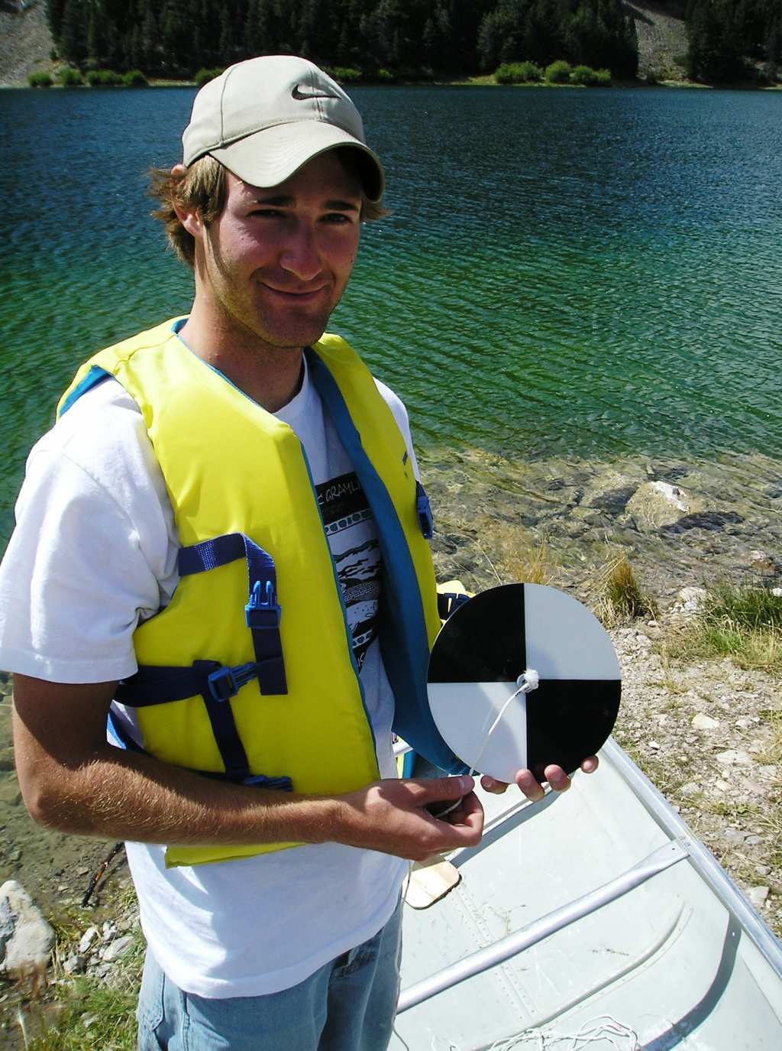

Outcomes of a Field-Based Curriculum
Outcomes
Students learn concepts more deeply than in lecture-based classes because they have more direct experience.
Students gain a better understanding of the processes of scientific inquiry because they do primary research.
Students learn field and lab skills that are difficult to incorporate into traditionally-scheduled classes.
Student resumes are filled with evidence of skills, report writing, publications and professional presentations.
Students make direct connections between understanding Earth systems and managing the actions of human society.

Slide 10
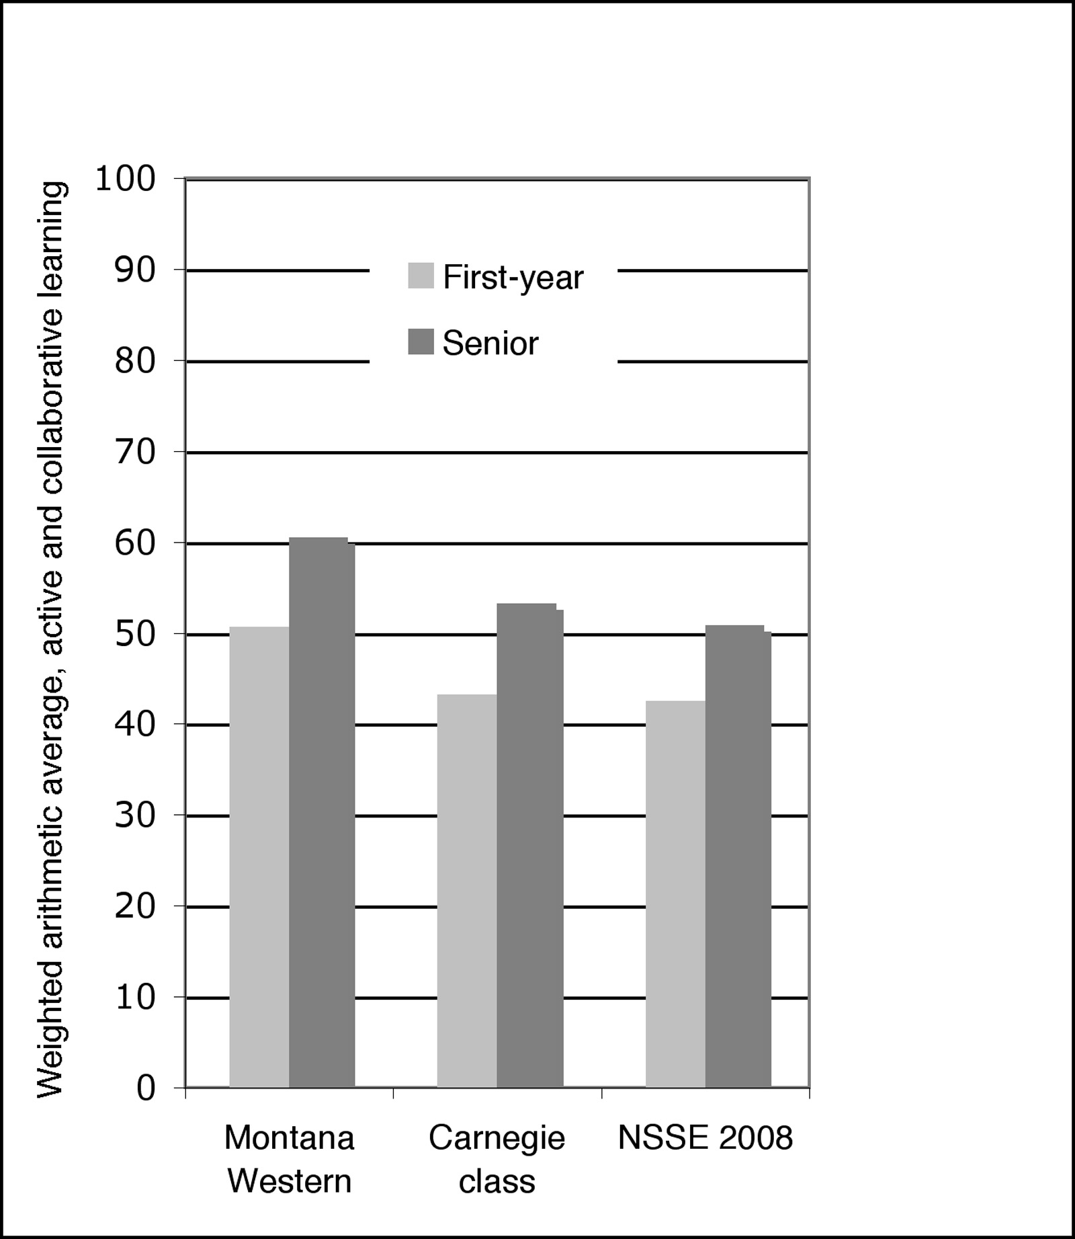
Assessment of Learning Goals
Assessment of Learning Goals
Performance has improved on all forms of assessment.
2006 Noel-Levitz Student Satisfaction Inventory survey (SSI) showed significant improvement over a 1998 (pre-immersion scheduling) survey.
2006 Cornell Critical Thinking testing showed significant improvement over pre-immersion scheduling testing.
2008 National Survey of Student Engagement (NSSE) scores were higher than other universities in most categories:
              Level of academic challenge
              Student-faculty interaction
              Active and collaborative learning
(Thomas and Roberts, in press)

Slide 11
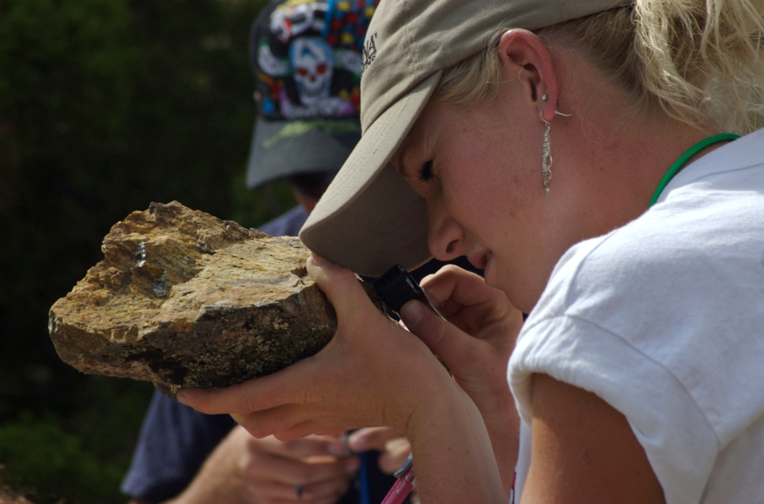
Challenges of a Field-Based Curriculum
Challenges of a Field-Based Curriculum
Getting started
Faculty burnout
Field equipment and transportation
Safety and physical disabilities
Rapid access to literature
Rapid access to lab results
Presentation of project results
Student adjustment to experiential immersion learning
Don’t attempt a hybrid!

