Slide 1
Rates of global climate variation:
Evaluating past records to understand implications of modern climate change

Slide 2
Misinformation and misconceptions:
It was cold and snowy last year, so the Earth isn’t warming anymore
Global climate has been warmer in Earth’s past, so modern climate change is no big deal
Atmospheric CO₂ concentration has been higher in Earth’s past therefore Earth’s natural cycles can accommodate anthropogenic input.

Slide 3

What is climate vS weather?
“Climate is what you expect, weather is what you get.” – Robert A. Heinlein, science fiction author
Notes:
ADD PICS

Slide 4
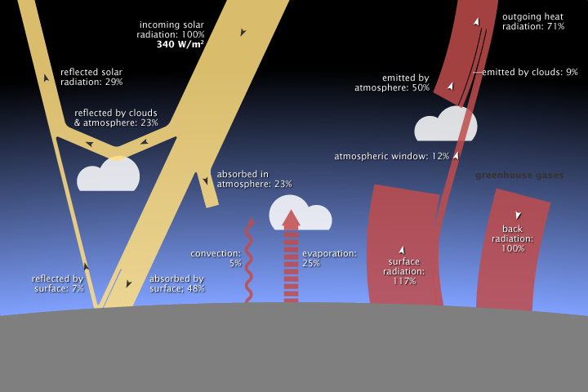
What controls global temperature?
Balance between input and output of heat
Source: NASA Earth Observatory
Notes:
Solar energy is the major source of heat input
Heat lost to space
Greenhouse gases can increase retention of heat at the Earth’s surface

Slide 5
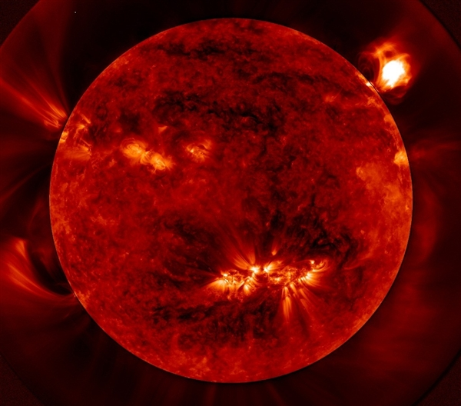
Billions of years
“Faint Young Sun” – 30% weaker than today
Source: NASA, Solar Dynamics Observatory
Notes:
Faint young sun paradox – sun 30% weaker than today, but liquid water existed on Earth. High CO2 concentration may have counteracted.

Slide 6
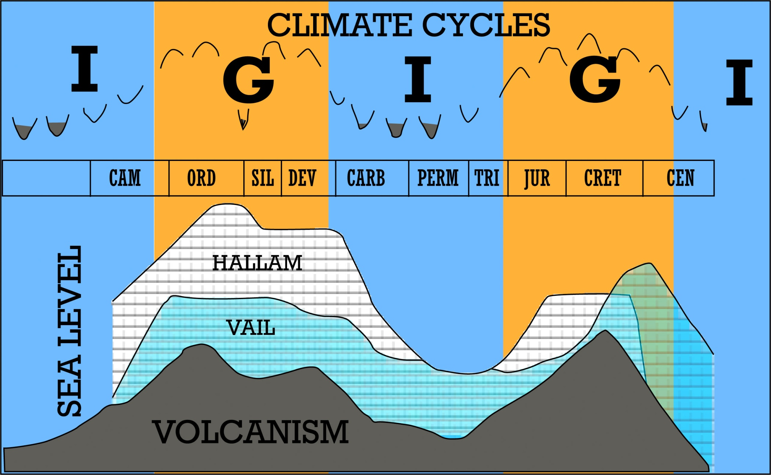
Millions of years
Fischer, 1982
Notes:
Plate tectonics – mountain building can drawdown CO2

Slide 7
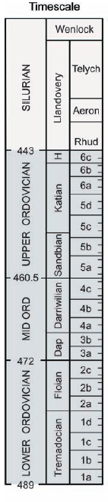
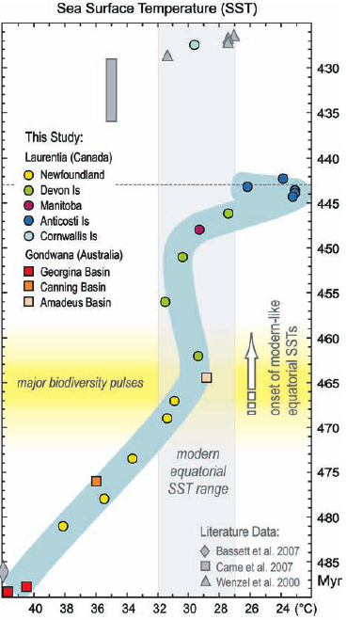
Millions of years example
Trotter et al. 2008
Notes:
Here’s an example in the Late Ordovician, when the supercontinent, Gondwana, migrated poleward, volcanism likely shut off, and weathering of silicates caused drawdown of CO2.
5 degree change over 5 Myr

Slide 8
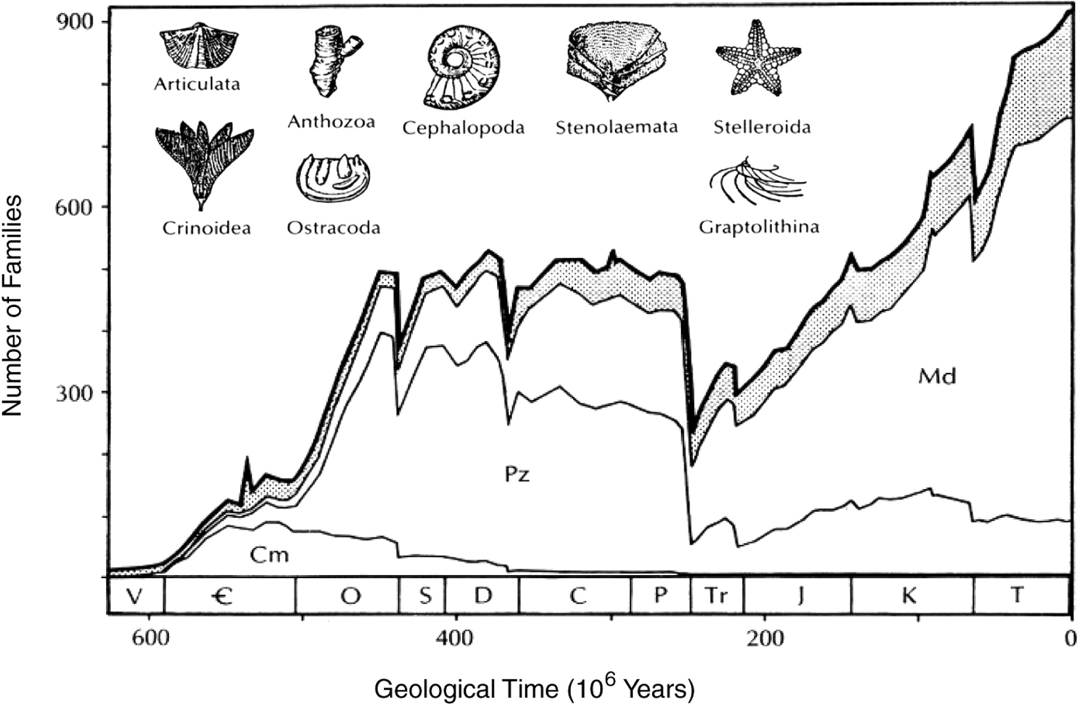
Millions of years example
Sepkoski (1990)
Notes:
This slow change in seawater temperature resulted in mass extinction.

Slide 9
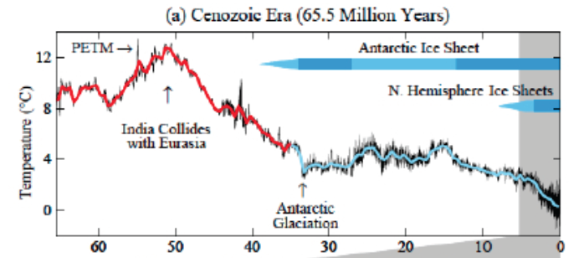
Millions of Years - Example
Hanson and Sato (2011)
Notes:
Collision of India with Eurasia produced the Himalayas – resulted in increased silicate weathering, CO2 drawdown, and cooling.

Slide 10
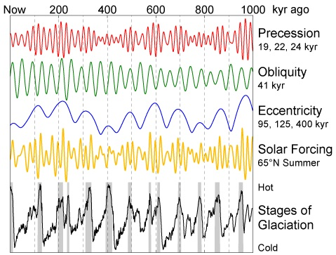
Tens to hundreds of thousands of years
Source: Encyclopedia of Earth
Notes:
Climate forcing is a result of changes in Earth’s orbit. Global temperature correlates with orbital patterns, however, is not the only mechanism driving climate change on this scale. Atmospheric CO2 fluctuations also influence climate – range from 180 ppm in cold periods to 280 ppm in warm periods.

Slide 11
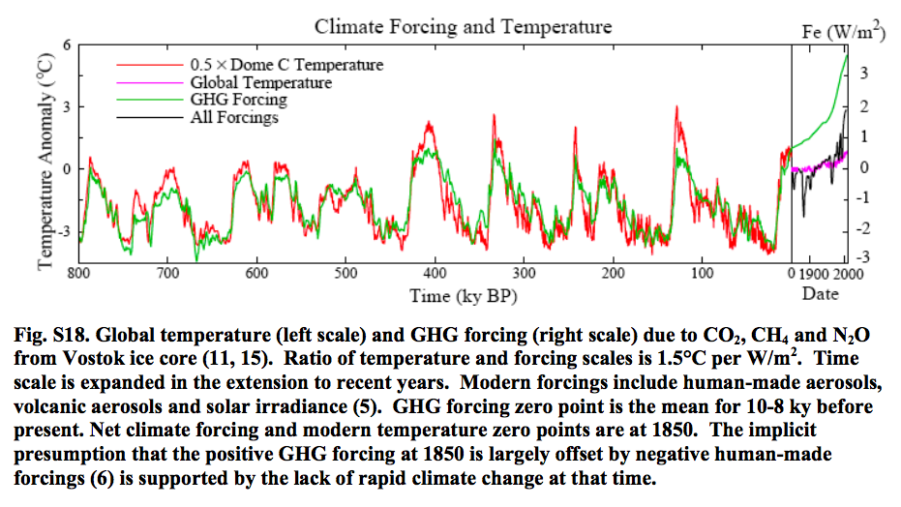
Tens to hundreds of thousands of years
Source: Open Source Systems, Science, and Solutions
Notes:
Pre-industrial solar forcing is estimated at 0 to -0.1 W/m2. Wattage required to shift from ice age to a warm period is 3.4 W/m2

Slide 12
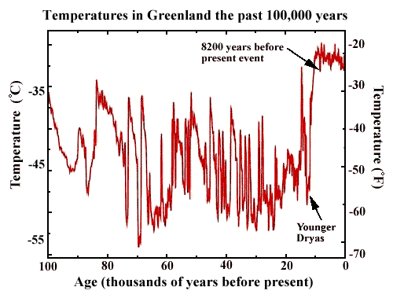
Tens to hundreds of thousands of years example
Cuffy and Clow, 1997
Notes:
Changes in melting of sea ice can change ocean currents, altering the transport of heat. This may have been the driver behind the Younger Dryas. This event is linked to the adoption of agriculture.

Slide 13
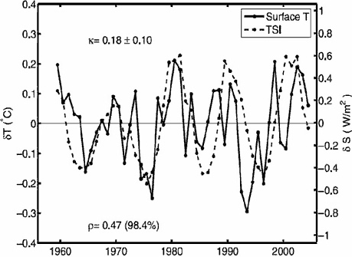
Less than 100 year variation
Camp, 2007
Notes:
11-year solar cycle – small climate impact.
Volcanic eruptions increase aerosols in the atmosphere (e.g., Little Ice Age).

Slide 14
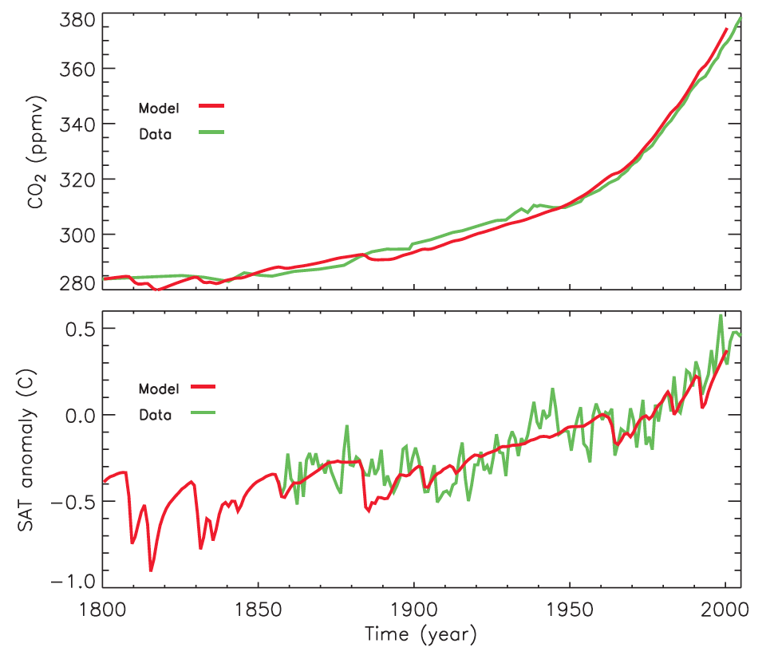
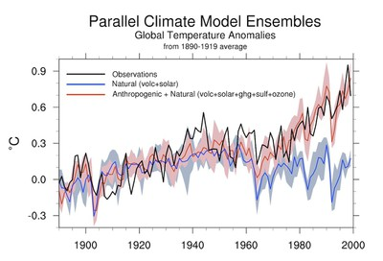
Less than 100 year variation
Zickfield et al., 2009
Source: Open Source Systems, Science, and Solutions

Slide 15
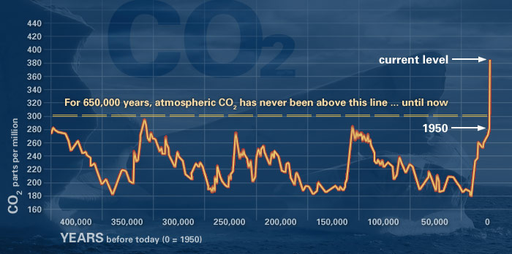
CO₂ Emissions
Source: NASA/NOAA
Notes:
CO2 input in to the atmosphere will take 100’s to 1000 years to equilibrate with the ocean because of the large carbon inventory of the atmosphere and ocean. After equilibration with the ocean, pCO2 will be 20-25% more than pre-industrial values.
CO2 can be drawn down by reaction with silicates, but this take hundred of thousands of years (estimated 7% will still be in the atmosphere in 100,000 years).

Slide 16
Summary & Conclusions
Cause of Climate Change | Number of Years
Anthropogenic | 1-100
Volcanism | 1-1000
Solar variability | 10-1000
Air-sea interaction | 1-100,000
Orbital variation | 10,000-100,000
Plate tectonics | 100,000-100,000,000
Climate is different than weather – what happens in any given year isn’t necessarily an indication of climate change.
Climate forcing outside of anthropogenic input of CO₂ exist, but generally act on long time scales.
Response to CO₂ input cannot keep pace with rate of input.

Slide 17
Excellent Resource:
NOAA website:
http://www.ncdc.noaa.gov/paleo/ctl/about1.html

