Slide 1
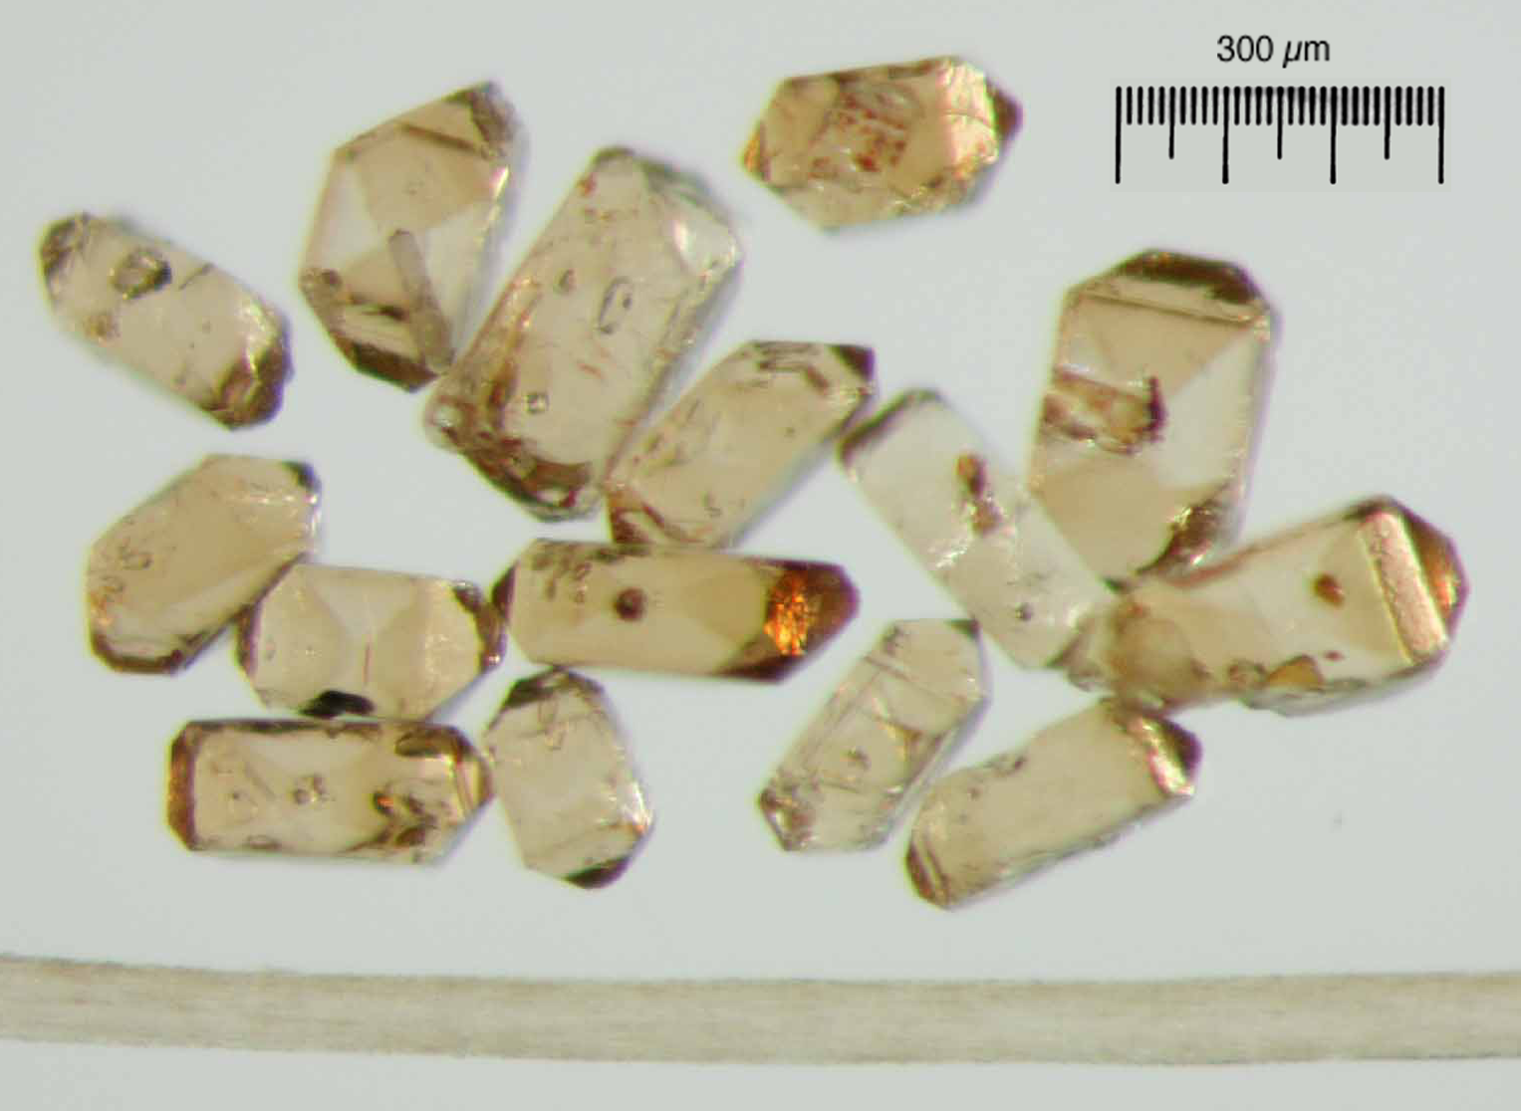
Dates, Durations and Rates:
Integrating Geochronology and Process
Mark Schmitz
Department of Geosciences
Boise State University
Teaching about Time
Arizona State University
February 27, 2012

Slide 3
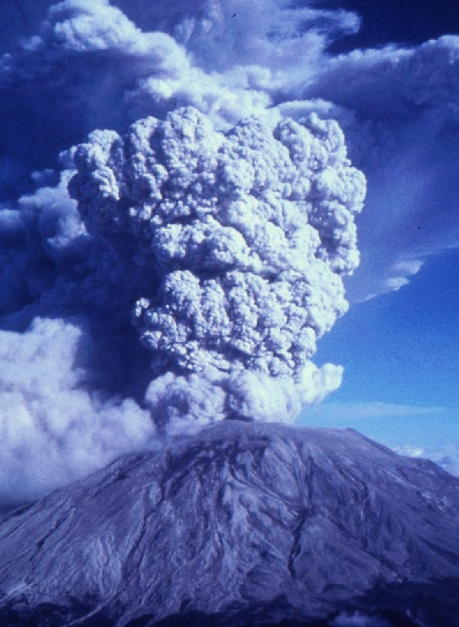
Explosive volcanic eruptions deposit ash layers over thousands of square kilometers, on time scales of weeks to months or years.
These geologically “instantaneous” events provide time markers in the geological record in the form of tuffs, or volcanic “ash beds”.
And they contain “clocks” in the form of zircons…

Slide 4
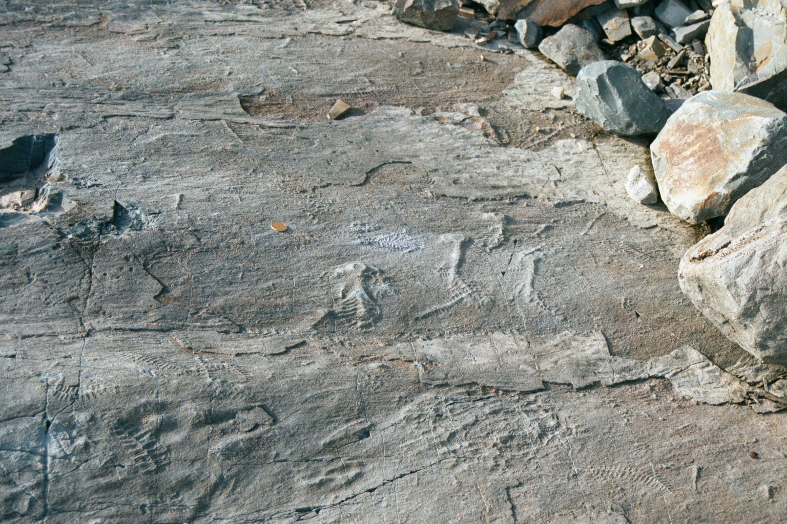

Slide 5
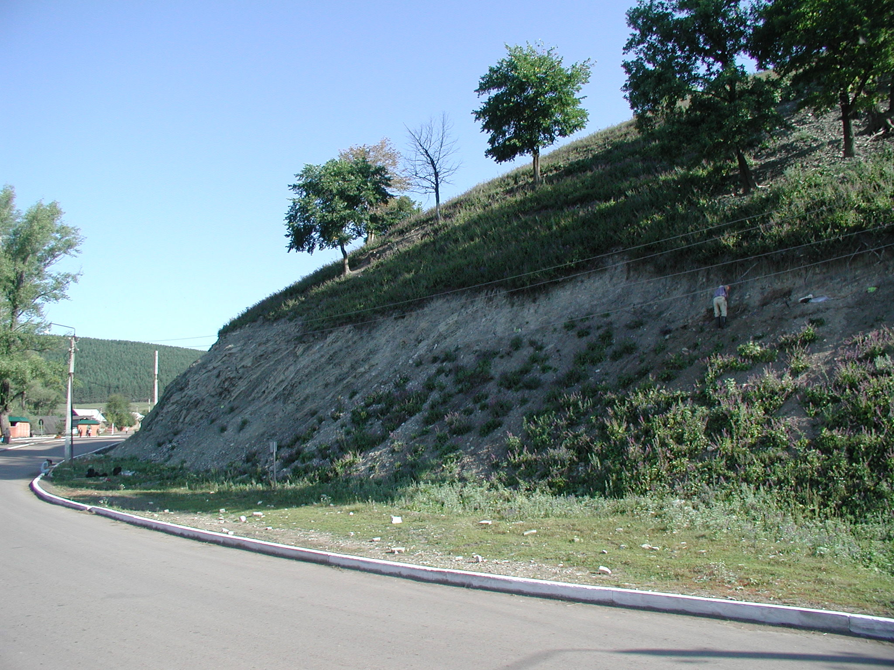
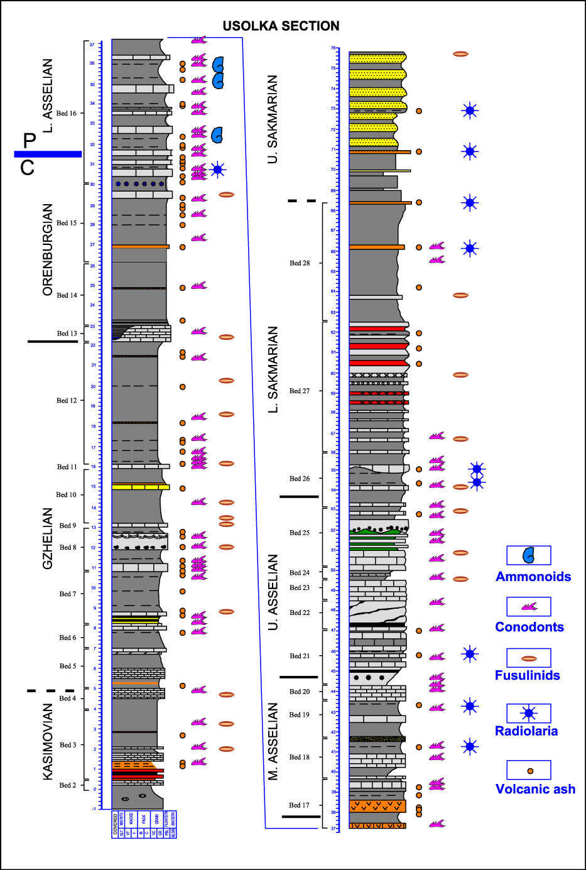
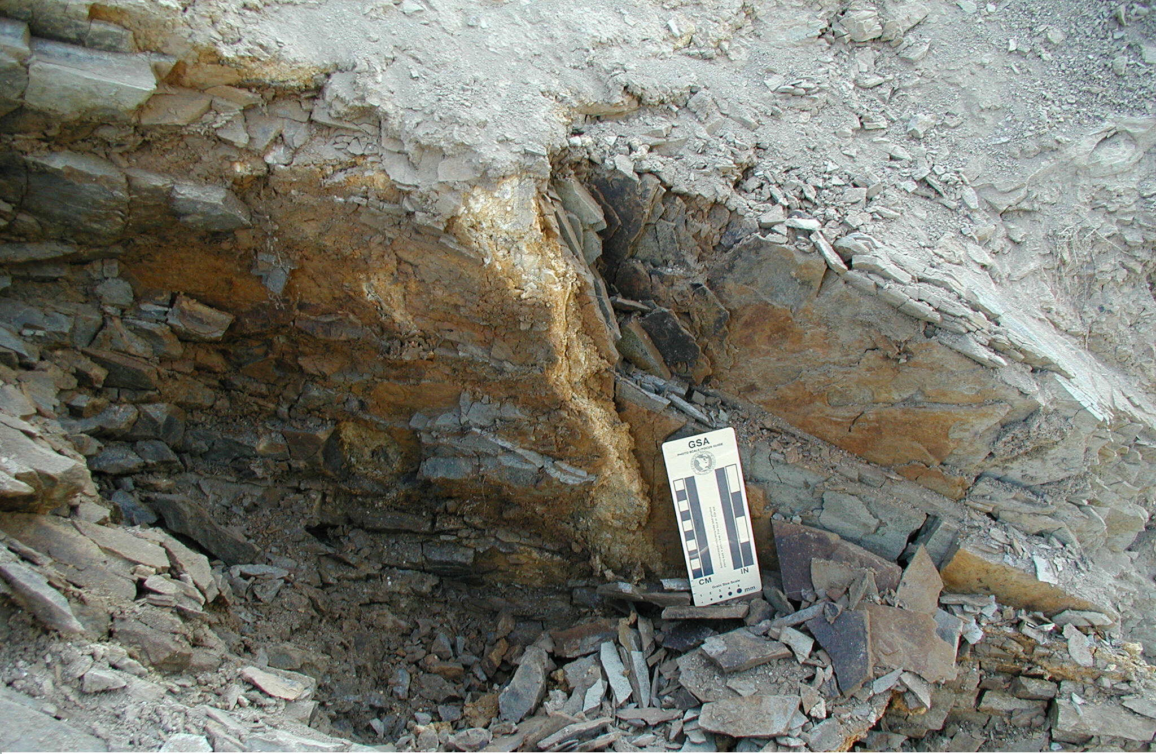

Slide 6
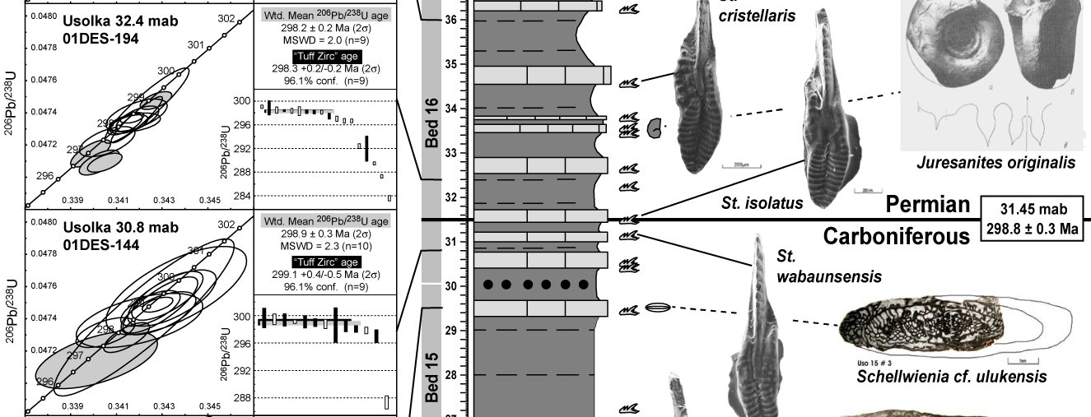
Radiometric dates can bracket the age of an event—e.g. the appearance of an organism
Given multiple precise and accurate dates, we can also determine a duration, that then calibrates a process rate (rock accumulation)

Slide 7
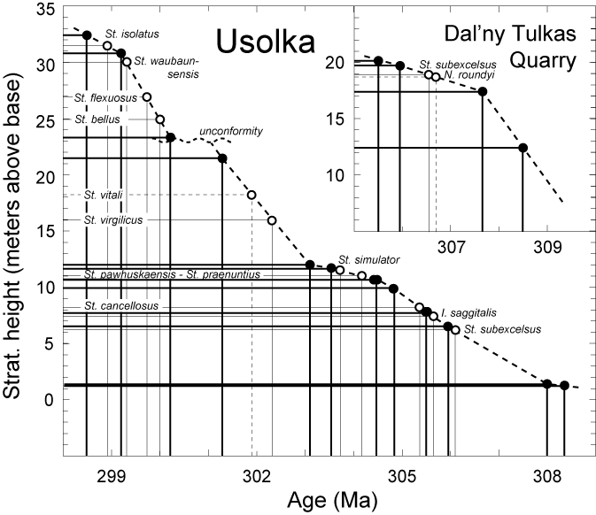
The more dates, the better the model…
… and the more the realities of changes in rate, and/or hiatuses come into focus

Slide 8
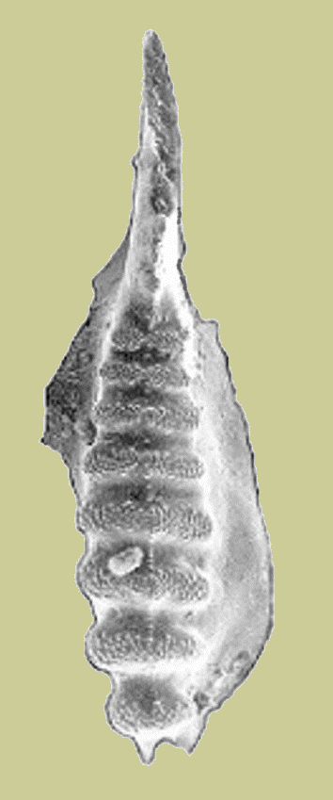
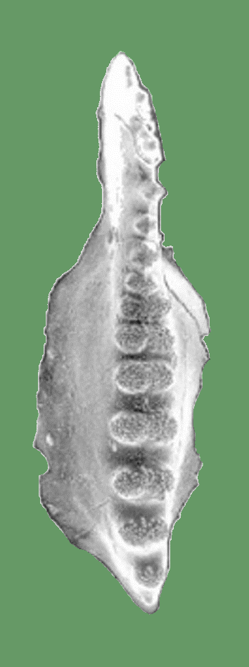
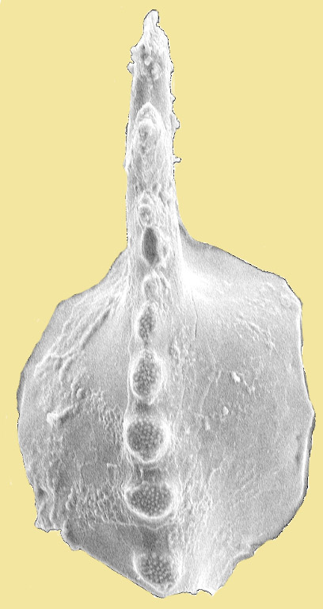
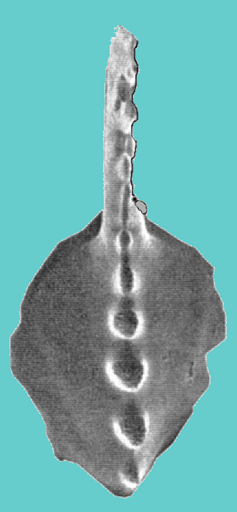
Rates of morphological change and evolution
Nonetheless… rock accumulation rates can be transformed into rates of change in fossil organisms—in this case, changes in the morphology of conodont species defining a “chronocline”
S. whitei
S. anceps
S. binodosus
S. merrilli

Slide 9
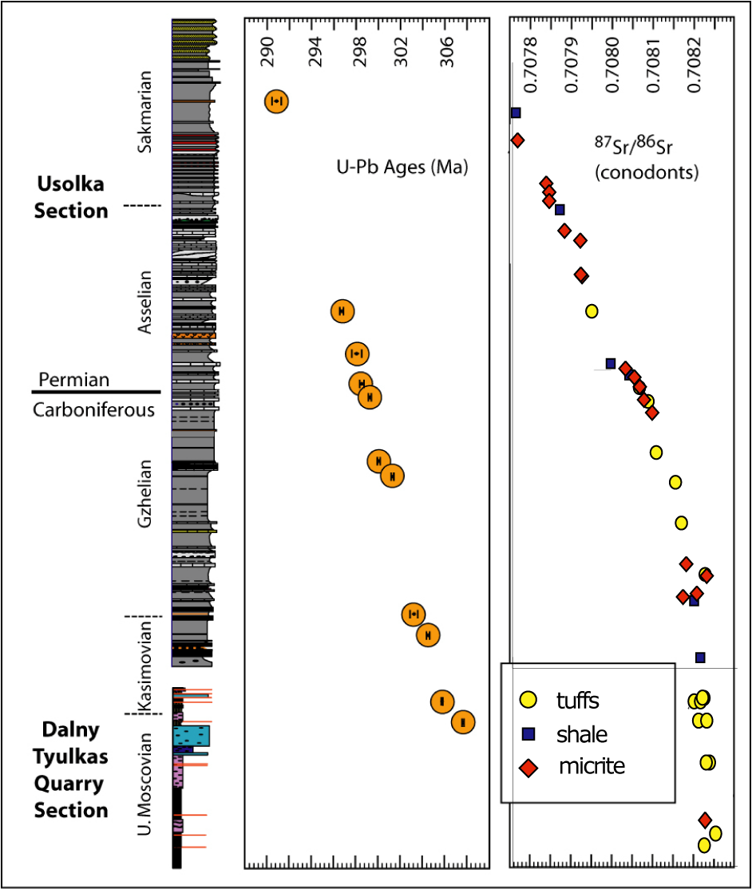
Chemo-stratigraphy
Rock accumulation models can be transformed into rates of change of chemical proxies for Earth systems, like the Sr isotope composition of seawater

Slide 10
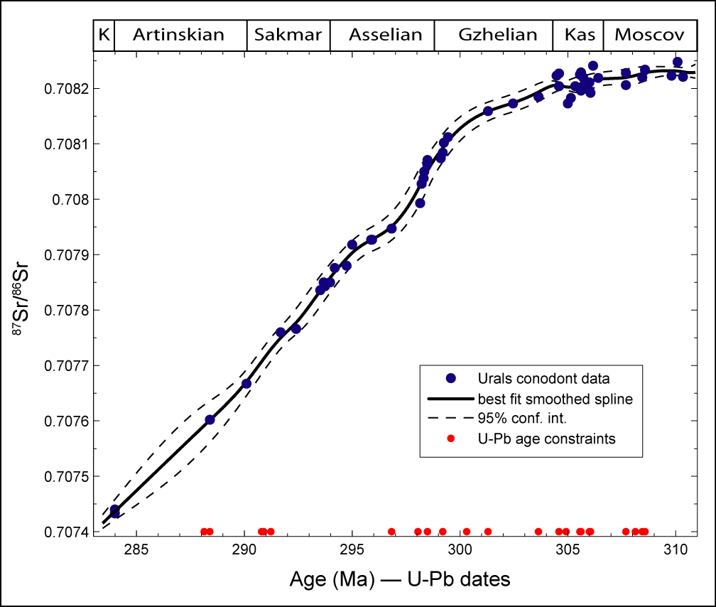
Quantitative Sr Isotope Geochronology
Smoothed spline fit with 95% conf. limit envelope from ⁸⁷Sr/⁸⁶Sr reproducibility (≤10 ppm) and varying error on interpolated age model

Slide 11
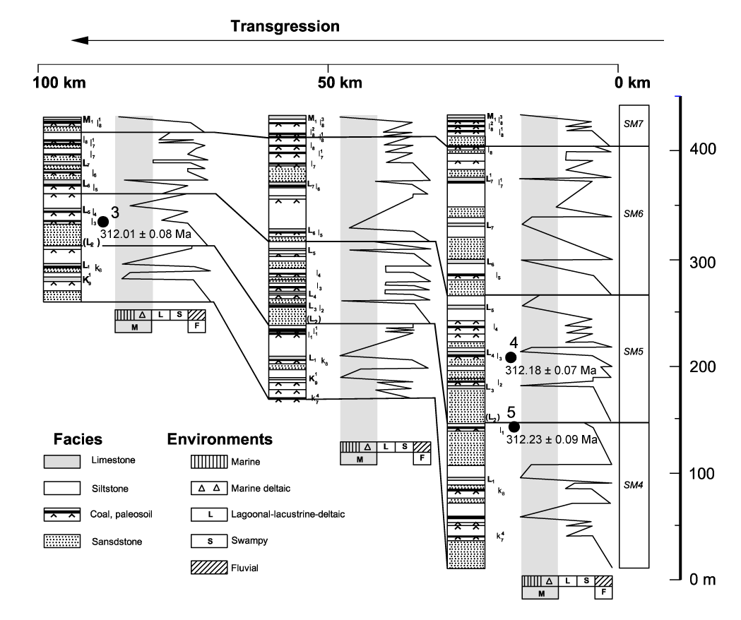
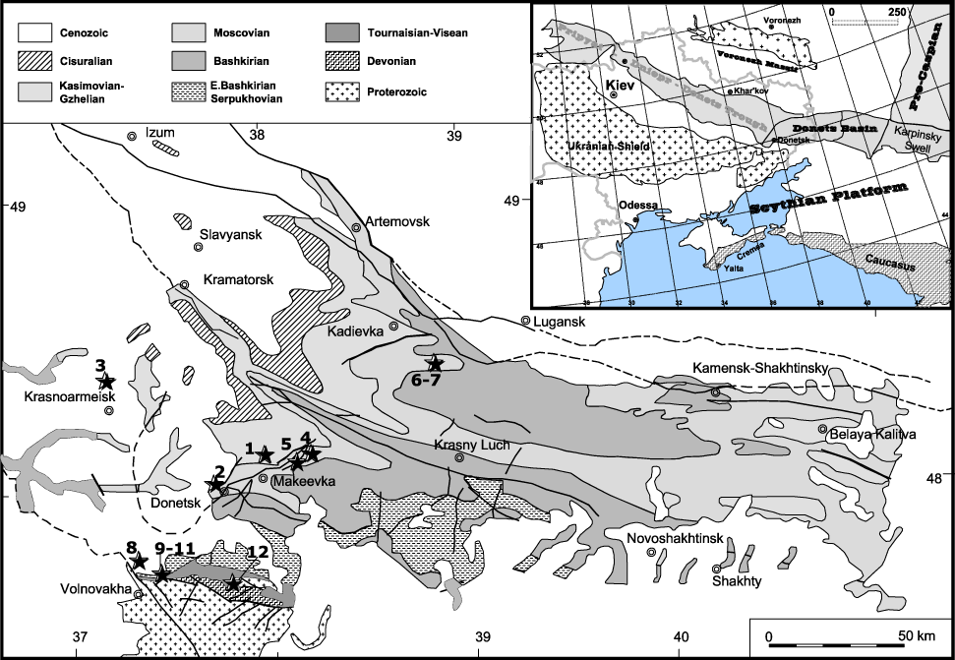
Cyclothems… Donets Basin, Ukraine
Cyclic, paralic transgressive-regressive carbonate-clastic sedimentation throughout the Carboniferous
Davydov et al. (2010) G-cubed, doi:10.1029/2009GC002736

Slide 12
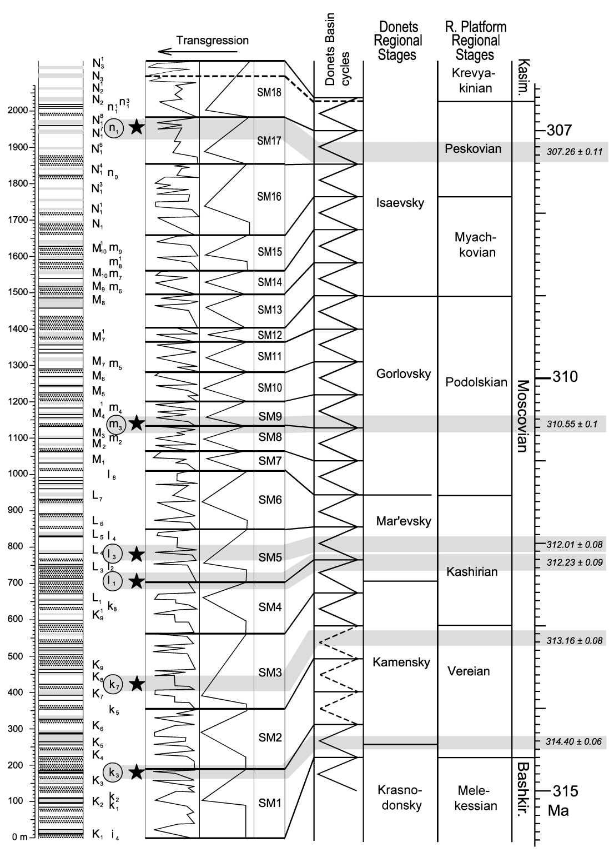
Cyclothem calibration
U-Pb zircon ages provide ten independent constraints consistent with bundling of high frequency short-period (ca 100 ka) eccentricity-forced fluctuations into 4th order sequences driven by ca 405 ka (long period eccentricity) forcing
Davydov et al. (2010) G-cubed,
doi:10.1029/2009GC002736;
Izart et al. (1996) Tectonophysics 268:189-209

Slide 13
Cyclothem
calibration
U-Pb zircon ages provide ten independent constraints consistent with bundling of high frequency short-period (ca 100 ka) eccentricity-forced fluctuations into 4th order sequences driven by ca 405 ka (long period eccentricity) forcing
Davydov et al. (2010) G-cubed,
doi:10.1029/2009GC002736;
Izart et al. (1996) Tectonophysics 268:189-209
Notes:
Add Kasimovian Gzhelian figure and emphasize the stability of th 405 ka cycle over 16 million years; predictive age model with 100 ka resolution through key interval of LPIA waxing and waning

Slide 14
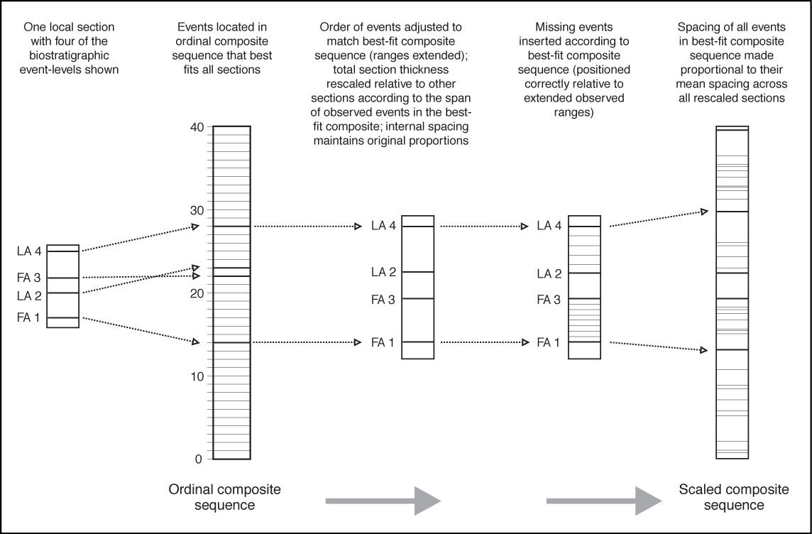
Calibrating Quantitative Biostratigraphy:
Constrained Optimization (CONOP)

Slide 15
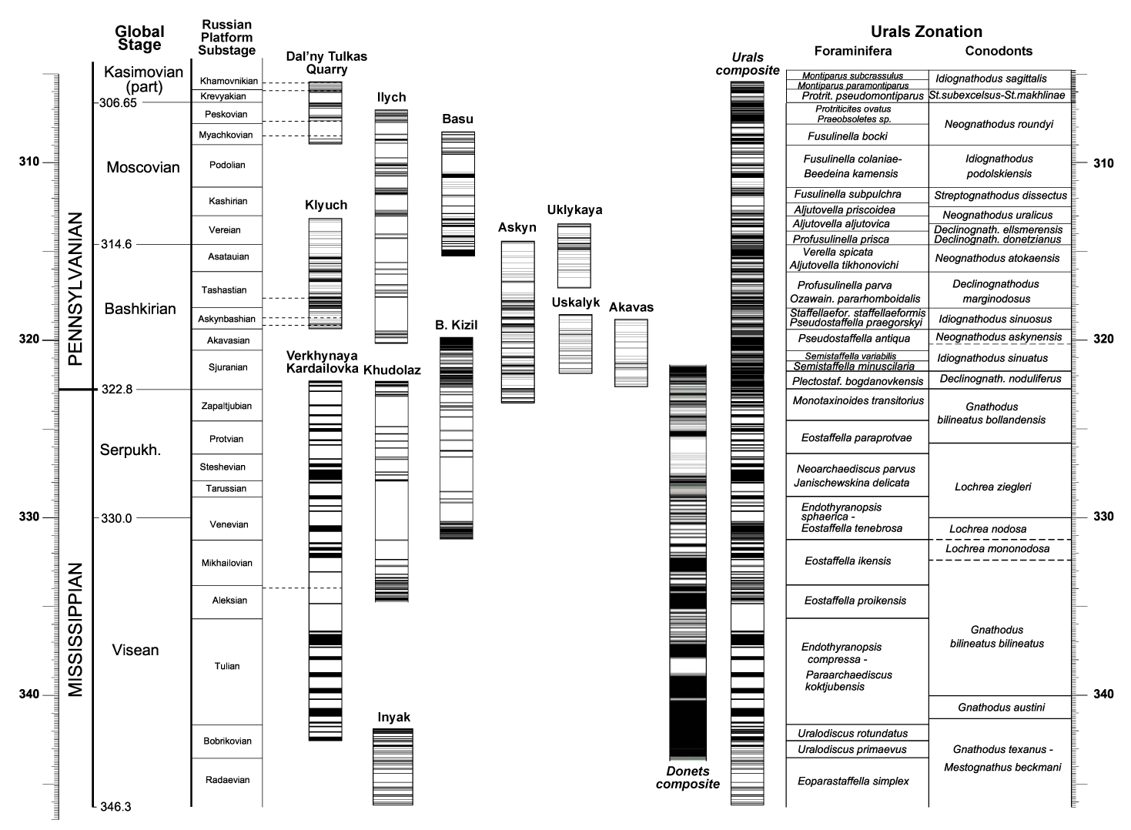
Visualizing Fossil Succession
Schmitz and Davydov (2010) GSA Bulletin, in review

Slide 16
Radiometric Dates can…
Provide absolute ages of geologic phenomena
Test correlation between events separated in space
Test hypotheses of causality between events
Establish the duration of time between dated events
Infer rates of change of proxies and processes between dated events
Calibrate other age proxies like cyclostratigraphy or biostratigraphy

