Slide 1



Representation and Understanding of Temporal Information
On the Cutting Edge – Professional Development for Geoscience Faculty
Teaching About Time Workshop
Ilyse Resnick

Slide 2
Premise of talk
The representation of extreme temporal magnitudes is subject to the same forces that guide our comprehension of conventional time
Misconceptions reflect cognitive processes
While there may also be a lack of knowledge or barriers to learning, even when these issues are corrected for biases in event recollection will be guided by cognitive capacities
Notes:
The hypothesis that I am presenting here, is that …..
There is going to be an issue of knowledge that influences misconceptions, and we will talk about that a little bit more before we jump into the main thrust of the paper. However, my argument is that even when these knowledge based issues are corrected for, biases in geologic event recollection will be guided by cognitive capacities

Slide 3
Comparison of the construction of conventional time and geologic time
Conventional Time | Geologic Time
Unitization | Geologic Time Scale divisions
Change | Global Stratotype Section and Point (GSSP)
Predictability | Predictability
Hierarchical organization | Eons, eras, periods, epochs
Notes:
Discrete boundaries
Varying levels of abstraction

Slide 4
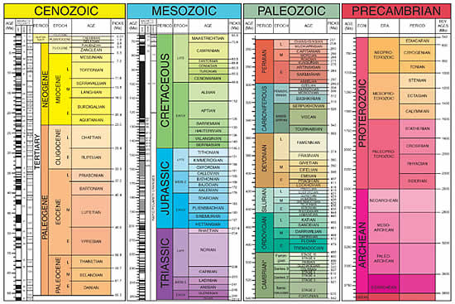
2009 Geologic Society of America Official Geologic Time Scale

Slide 5
Category Adjustment Model of
Event Estimation
Huttenlocher et al. (1988)
  Combination of metric and categorical information
  Retrieval of information at level required
  Use of event boundaries to estimate dates
  Variation occurs due to imprecision of event boundaries
  Without lower-level information, retrieval automatically defaults to higher-level
Notes:
Metric=culturally established units (week, month, year, period, era, eon) and individually relevant units (academic year, personal divisions of geologic ages)
Contextual= salient info in environment
Example: remembering holiday, remembering dino extinction
Recall and duration biases
- Saliency of events within the Geologic Time Scale
- Known events on the Geologic Time Scale are disproportionately located

Slide 6
Implications of a
Category Adjustment Model on
Representations of Extreme Magnitudes
Saliency of events near boundaries
  Boundaries can be located at ends of the Geologic Time Scale or locally within specific sections
Increased variation within conceptual categories
Disproportionately located events will skew representation of duration
  Presentation of events during Phanerozoic and not during Precambrian will result in students overestimating duration in Phanerozoic and underestimating duration in Precambrian

Slide 7
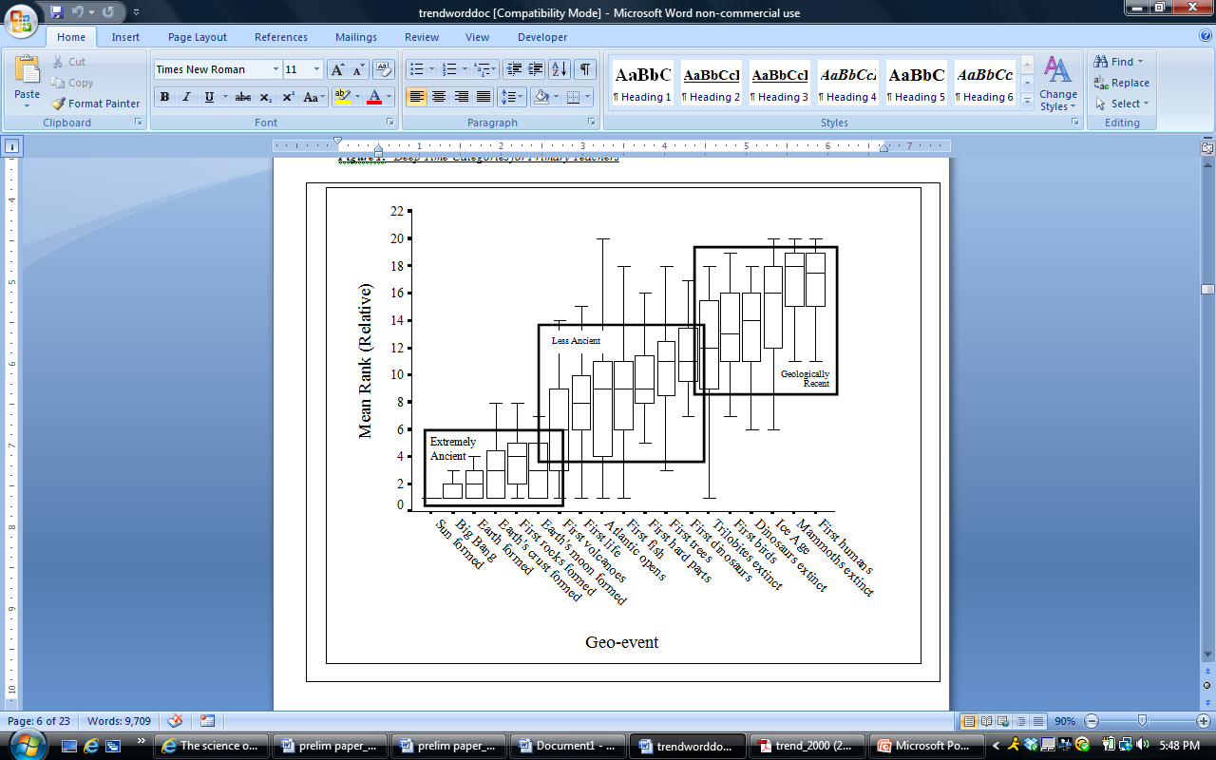
Temporal categories of geologic time assigned by in-service teachers, taken from Trend, 2001
Notes:
Non-scientists make few distinctions
Consensus between clusters, variation within

Slide 8
Which of the figures below do you think most closely represents changes in life on Earth over time?
Choose one: A B C D E
Geologic time assessment item from the Geoscience Concept Inventory

Slide 9
Forward Telescoping
People report events occurring more recently than they actually occurred (Huttenlocher, et al., 1988; Neter & Waksberg, 1964)
Forward telescoping is also a common error people make regarding geologic events (Hofstadter, 1985; Trend, 1998, 2000, 2001; Catley & Novick, 2008)
Forward telescoping may occur because of an inherent asymmetry in our experience with the passage of time (Zakcs & Tversky, 2001)
  A decrease in the accuracy of memory over time may result in the reliance on larger event boundaries (Huttenlocher, et al., 1988)
  Our memory for recent events should be OK
  There will therefore be more error in the placement of events as you move backward in time, and less error in backward dating as you move closer to the present
  An aggregate forward bias of reported dates is expected by this model (Huttenlocher, et al., 1988).

Slide 10
Implication of a
Category Adjustment Model on Teaching Extreme Scales
Rich category descriptions
Emphasize hierarchical relationships
  Tell causal story at multiple levels of temporal scale
  Commonality between epoch, period, era, and eon
Anchor points of salient events
  Number and location of anchor points may influence representation of magnitude
Notes:
Perhaps this is already done in practice, and differs only in emphasis
What is it about the jurassic that fits inside the mesozoic that fits inside the phanerozoic

Slide 11

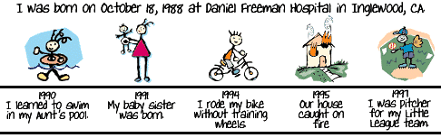
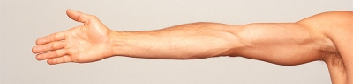
A Common Strategy: Spatial Analogy
Going from one unfamiliar magnitude to another
Too big a jump from one magnitude to another magnitude
Psychological barriers based on pre-existing spatial or functional characteristics
Notes:
Citations?

Slide 12
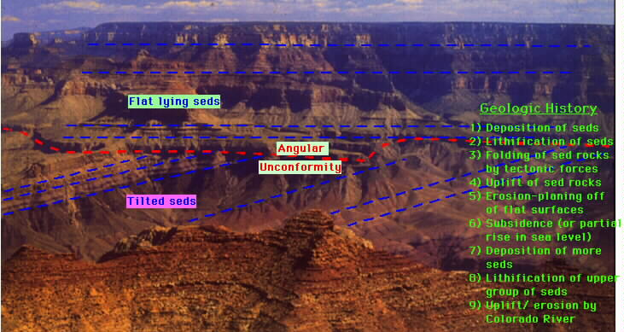
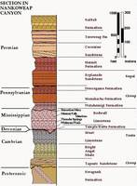
Spatial Analogy is Important
Temporal information is stored in spatial arrays
Time is organized and structured in terms of the observable system of space (Boroditsky, 2001; Clark, 1973; Gentner, 2001; Lakoff & Johnson, 1980)

Slide 13
Hierarchical Alignment Activity
Spatial analogy = meter stick
Start with smaller scales (Boyer and Levine, under review)
Progressive alignment (Genter, Loewenstein, & Hung, 2007)
  Multiple opportunities
  Size of scales to the same measurement
Scale time lines to a meter stick
- Personal
- Human lifespan
- American history
- Recorded history
- Human evolution
  - Cenozoic
  - Phanerozoic
  - Proterozoic
  - Archean
  - Hadean
Notes:
Research on the psychology of learning spatial scaling in young children (Boyer and Levine, under review) offers some suggestions for how best to use analogies to learn about scaling
Rather than try to align scales of unfamiliar mag
Provide multiple opportunities and progressively increase the magnitudes of the temporal scales (e.g., align one year to a meter, a student’s lifetime to a meter, history of western civilization to a meter…). The opportunities to align different time scales may help the student learn to attend to the single dimension of time.nitude, start by aligning smaller temporal scales (e.g., aligning one year to a meter), and :

Slide 14
Hierarchical Alignment Activity
For each time line:
- Indicate length
- Locate specific events
- Locate where all previous time lines would begin on current time line
Dark
Ages
Middle Ages
Fall of
Rome
Personal
Human lifespan
Iron Age
6,000
years
ago
American history
Bronze Age
0 years
ago
Example of time line: Recorded History
Ancient History
Copper Age

Slide 15
Examples of timelines
Homo sapiens
Homo erectus
Holocene
Homo habilis
Recorded history
Pilocene
Australopithecines
Miocene
Human evolution
Oligocene
Split from chimps
Tertiary
Human Evolution:
Eocene
Cenozoic:
Paleocene

Slide 16
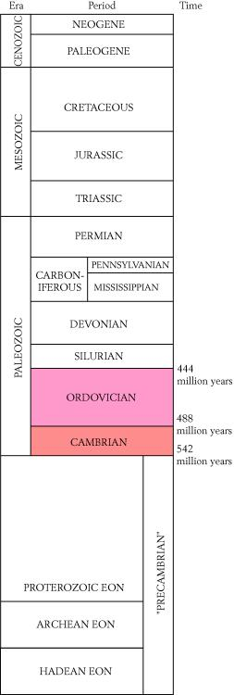
Methods
Participants
A college-level, introductory-level geoscience course
71 control group and 49 intervention group
Procedure
Intervention group = stratigraphy lab + progressive alignment activity
Control group = only the stratigraphy lab
Both groups were taught about geologic time in normal class instruction
Completed outcome measures one month later

Slide 17
Question is on the left Analysis of responses is on the right

Slide 18
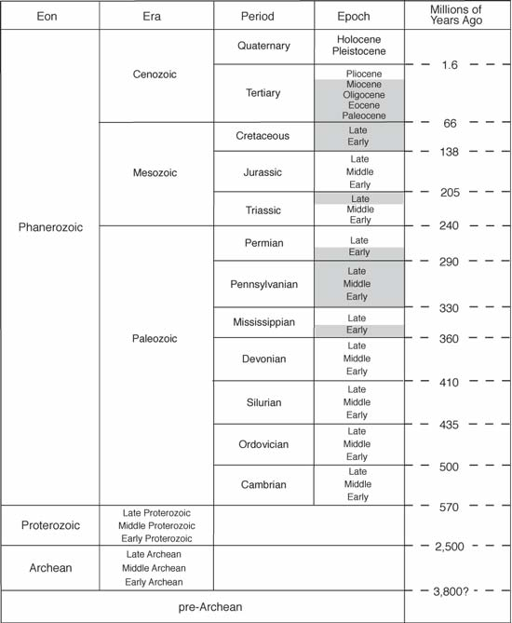
According to the diagram above, which of the following statements is true?
A.) The Proterozoic Eon lasted much longer than the Phanerozoic Eon
B.) The Proterozoic Eon was much shorter than the Phanerozoic Eon
C.) The Jurassic Period ended 205 million years ago
D.) The Pre-Archean Eon is the most recent time span

Slide 19
Most common error
Correct Response

Slide 20
Most common error
Correct Response

Slide 21
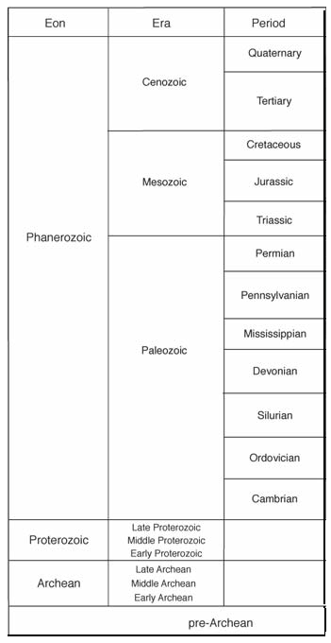
Reptiles were the dominant land animals during the Mesozoic Era, but mammals
were dominant during the ______?
  A.) Cenozoic Era
  B.) Paleozoic Era
  C.) Cretaceous Period
  D.) The Pre-Archean Eon

Slide 22
Summary of results
The intervention group showed a reduction in the magnitude of temporal location errors compared to the control group.
The intervention group demonstrated a more accurate sense of the relative proportions of the magnitude of time between geological events.
The intervention and control groups did not differ significantly on an item that was knowledge-based and did not require an understanding of magnitude.

Slide 23
Implications and future directions
Hierarchical alignment activity is an effective way to teach the magnitude of geologic time
Refine hierarchical alignment activity
  Providing richer categories
  Providing themes to hierarchical relationships
With the category adjustment model, you would expect to similar patterns at small temporal scales and large/small spatial scales
Other factors in representation of time:
  direction

Slide 24
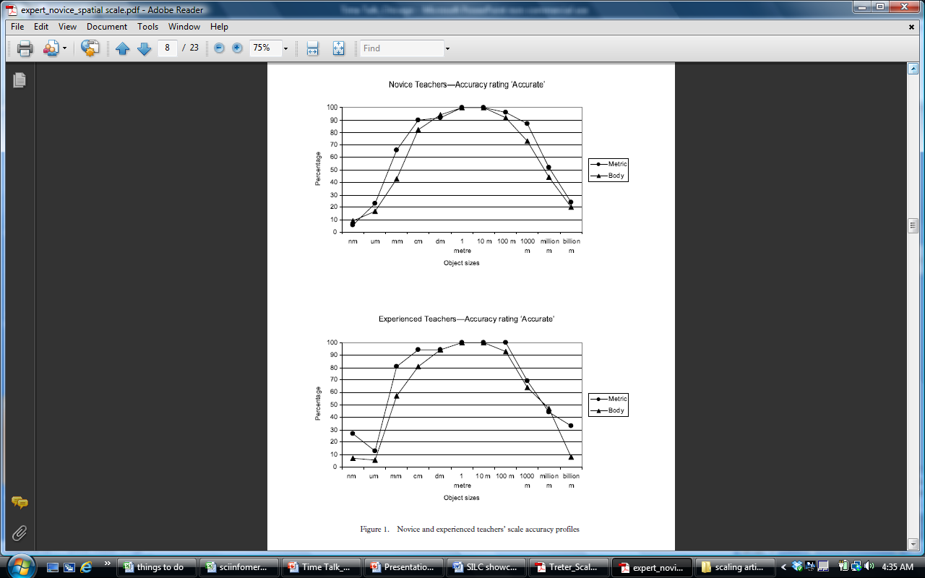
Taken from Jones, et al., 2008

Slide 25

Questions and Comments
Contact Information:
ilyse.resnick@temple.edu http://www.silccenter.org/

Slide 26
Preconceived notions
  “The most important single factor influencing learning is what the learner already knows. Ascertain this and teach him accordingly.” (1968, p. vi)
Reject new ideas
Compartmentalize new and old ideas
Merge new ideas with existing ideas
Notes:
We should still note the role of knowledge in understanding geologic time.
Religious beliefs are often a major obstacle in understanding geologic time. Choose religion, believe in both evolution and religion, accept science but assign a higher deity
However, main thrust of presentation is cognitive
Transition: geologic time is hard to understand. One way people do is analogy. Can align geologic time with more familiar time lines, like a personal timeline, or align geologic time to spatial structure, like to a football field. Spatializing time is very common not just with geologic time.

