Slide 1
Geologic Time and other
BIG Numbers
Roger Steinberg
Del Mar College
Corpus Christi, TX
February 26-28, 2012

Slide 2
Understanding Geologic Time
Earth is 4.6 billion years old—but how many years is that?
How can students comprehend this or any big number?
1. Conceptually
2. Visually
3. Quantitatively
Let’s start with one million: One Million Dots

Slide 3
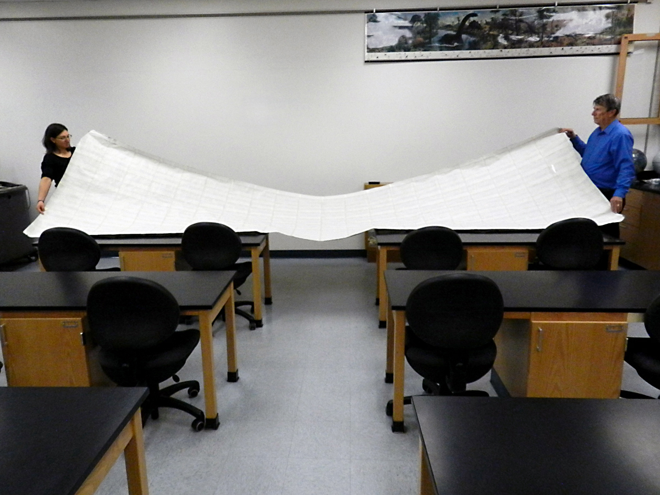
One Million Dots
50 inches by 200 inches

Slide 4

5000 Dots by Hand
Cut and tape 200 of these: (5000) (200) = 1,000,000

Slide 5
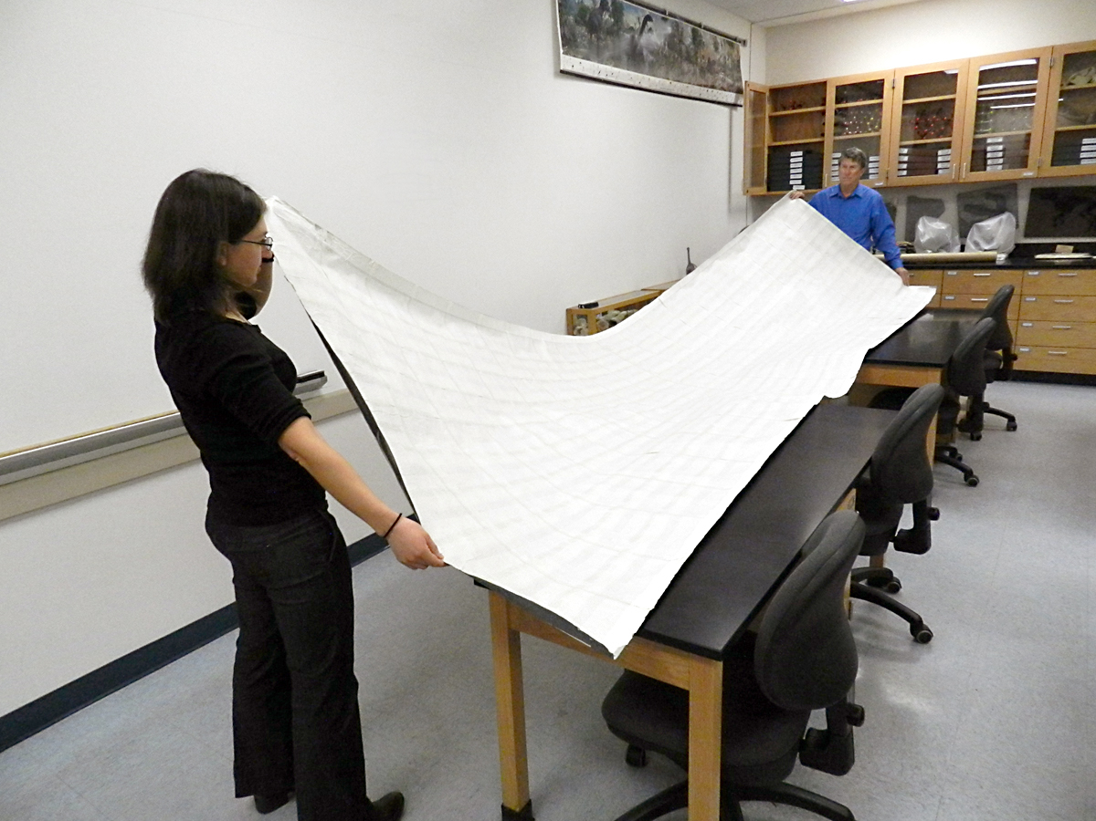
One Million Dots

Slide 6
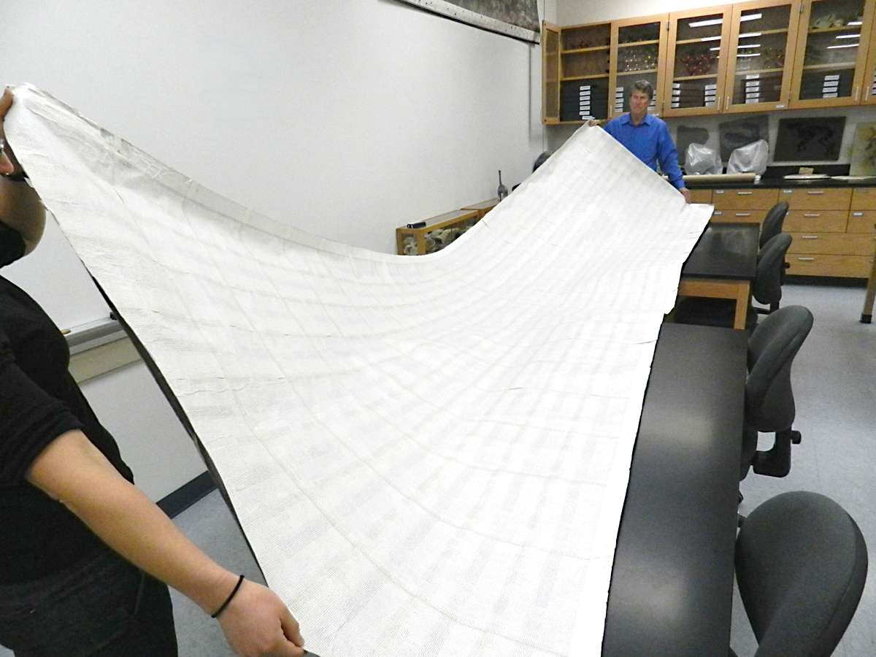
One Million Dots

Slide 7

One Million Dots

Slide 8

5000 Dots by Computer

Slide 9

125,000 Dots

Slide 10

4,600,000,000 Dots?
Replace each dot with a 50” by 200” sheet
of 1 million dots = 5,000,000,000
92 rows instead of 100 = 4,600,000,000
= 208’ by 1533’
Compared to a football field:
160’
300’

Slide 11


208’
The size of the paper needed for 4.6 billion dots:
1.3 football fields wide
5.1 football fields long!
1533’

Slide 12
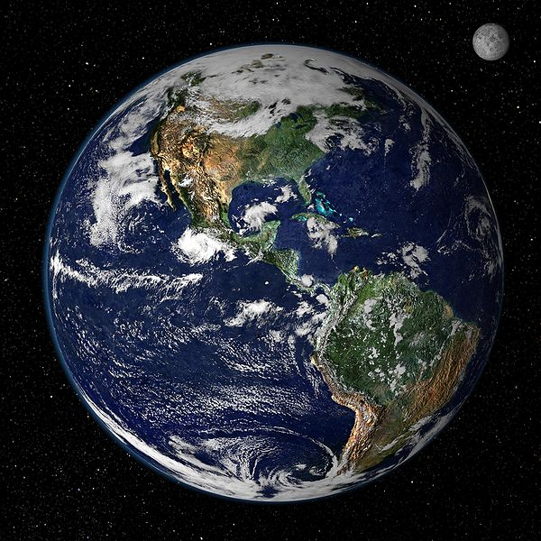
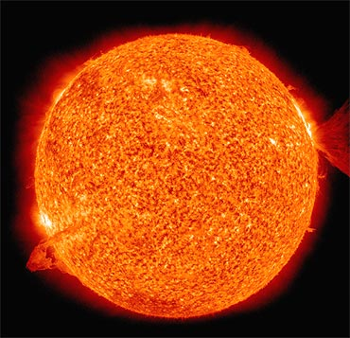
Other Big Numbers
Visualizing the Solar System
Diameter of Sun
= 865,000 miles
Diameter of the Earth = 7930 miles
93,000,000 miles from Sun

Slide 13


Visualizing the Solar System
Shrink Sun to a gulf ball = 1.7 in. diameter
Earth is 0.155 in. diameter
= medium-grained sand
St. Peter Sandstone Sand
…15.2 feet away

Slide 14

Visualizing the Solar System
Shrink Sun to a gulf ball = 1.7 in. diameter
Pluto is 0.0028 in. diameter
= very fine sand/silt
…600 feet away

Slide 15

Visualizing the Solar System
Shrink Sun to a gulf ball = 1.7 in. diameter
Alpha Centauri is also a gulf ball ≈ 1.7 in. diameter
…768 miles away

Slide 16
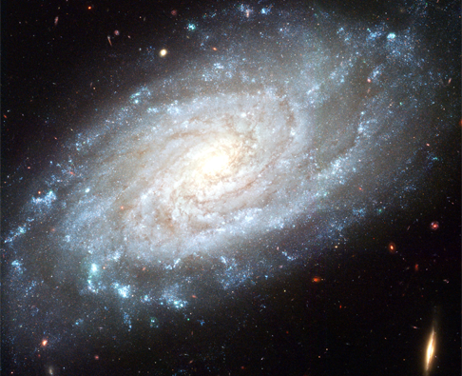
Visualizing the Milky Way Galaxy
A barred spiral galaxy ≈ 100,000 light years in diameter
Contains 100 billion to 400 billion stars

Slide 17
Visualizing the Milky Way Galaxy
If the Sun is a gulf ball = 1.7 in. diameter
The model of the entire galaxy of stars will have 100-400 billion spheres, some up to 100 times larger, and some 100 times smaller than the Sun, spanning a disk about 18,310,000 miles in diameter.
(77 times the distance from the Earth to the Moon)!

Slide 18
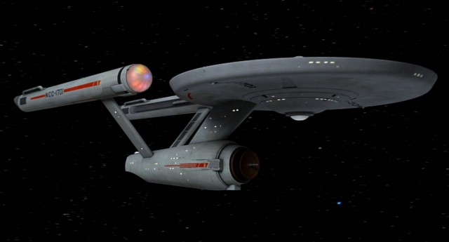
Visualizing the Milky Way Galaxy
Who has been abducted by space aliens?
(What happens in Geology class, stays in Geology class. . .)
One question for your ‘friends’: How did they get here?
The vastness of interstellar space is the reason that the starship Enterprise, even traveling at Warp Factor 9, never left the Milky Way Galaxy!

Slide 19

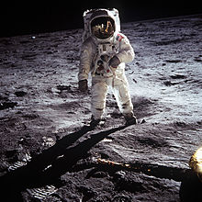
Distances in Space
Let’s go to the Moon:
Distance = 239,000 miles
At 60 miles/hour, our Winnebago will make it in
166 days (nonstop).
Apollo made it in 3 days

Slide 20

Distances in Space
Distance to the Sun
93,000,000 miles
At 60 miles/hour, our Winnebago will make it in
177 years (nonstop).

Slide 21

Distances in Space
Distance to Jupiter
484,000,000 miles
At 60 miles/hour, our Winnebago will make it in
921 years (nonstop).

Slide 22

Distances in Space
Distance to Pluto
3,627,000,000 miles
At 60 miles/hour, our Winnebago will make it in
6903 years (nonstop).

Slide 23

Distances in Space
Distance to Alpha Centauri
24,780,000,000,000 miles
At 60 miles/hour, our Winnebago will make it in
47,113,849 years (nonstop).

Slide 24

Distances in Space
Distance to Andromeda
2,520,000 light years, or
1.487 × 10¹⁹ miles
At 60 miles/hour, our Winnebago will make it in
28,287,670,000,000 years (nonstop).

Slide 25
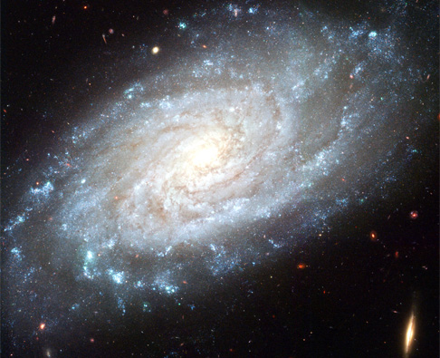
Visualizing the Universe
How many stars are in the Universe?
100 billion (100,000,000,000) stars in the average galaxy

Slide 26
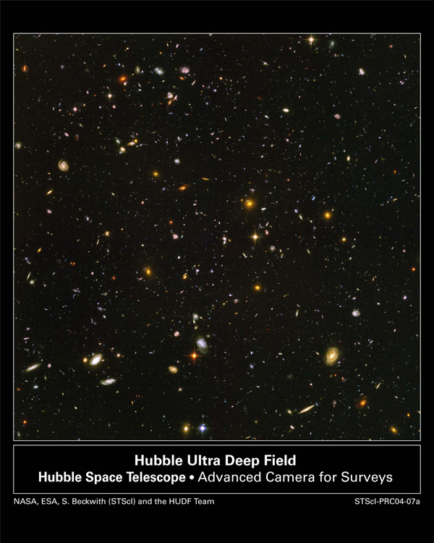
Visualizing the Universe
How many galaxies are in the Universe?

Slide 27
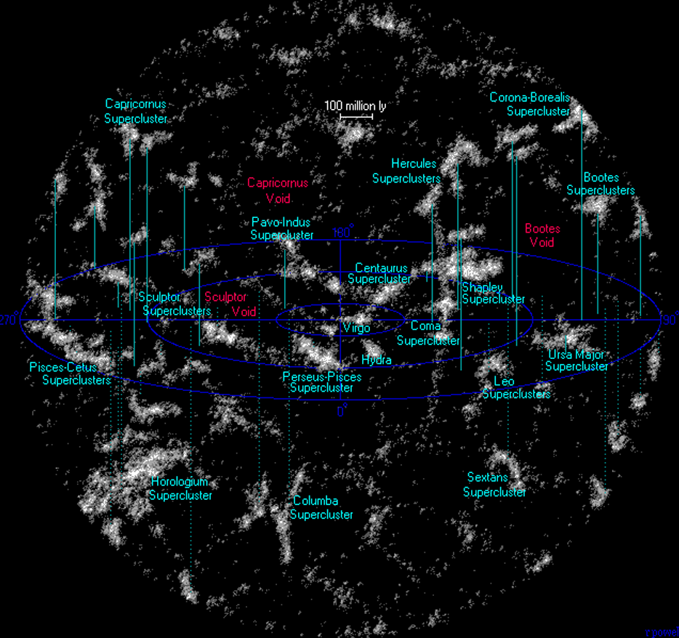
Visualizing the Universe
Neighboring superclusters of galaxies
1 trillion galaxies in the Universe

Slide 28
Visualizing the Universe
How many stars are in the Universe?
100,000,000,000 × 1,000,000,000,000 = 10²³ stars
100 sextillion
100,000,000,000,000,000,000,000
Recent data indicates there could be 3 times this many
or 300,000,000,000,000,000,000,000
Dokkum and Conroy, Nature, Dec. 2010
How many is that? Is that a lot?

Slide 29

Visualizing the Universe
3 × 10²³ stars (300 sextillion) in the Universe
... the total number of stars in the universe is greater than all the grains of sand on all the beaches of the planet Earth. (Carl Sagan)
How many grains of sand are there?
7.5 × 10¹⁸
http://www.hawaii.edu/suremath/jsand.html
Padre Island, TX

Slide 30
Visualizing the Universe
3 × 10²³ stars (300 sextillion) in the Universe
“That's a huge number to grasp, even for astronomers who are used to dealing in light years and trillions,” Conroy said.
"It's fun because it gets you thinking about these large numbers.” Conroy looked up how many cells are in the average human body – 50 trillion or so – and multiplied that by the 6 billion people on Earth. And he came up with about 300 sextillion.
So the number of stars in the universe "is equal to all the cells in the humans on Earth – a kind of funny coincidence," Conroy said.
(Charlie Conroy, Department of Astrophysical Sciences, Princeton University)

Slide 31

Visualizing the Universe

