Slide 1

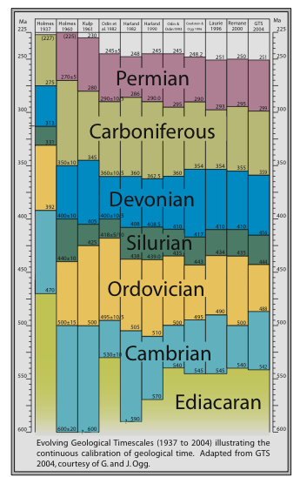
WHAT IS EARTHTIME?
EARTHTIME is an organized, community-based international scientific initiative aimed at sequencing Earth history through the integration of high-precision geochronology and quantitative chronostratigraphy.
A major goal is the development of the geochronological techniques necessary to produce temporal constraints with uncertainties ≤ 0.1 percent of the radioisotopic ages.

Slide 2
WHY EARTHTIME?
The current geological time scale represents the amalgamation of radiometric dates of widely differing quality.
Much of the existing time scale is insufficient to resolve interpolated time to better than approximately 1- >5 million years for the Paleozoic and Mesozoic.
Yet innovations in geochronology and chronostratigraphy now make it feasible to develop a time scale where interpolated time can be highly resolved (<< 0.1%) with a unified, cooperative, international effort.

Slide 3
OPPORTUNITIES
Rates of biological evolution
Rates and causes of extinctions/recoveries
Origin of chemostratigraphic anomalies
Rapidity of climate change in deep time
Synchrony of chemostratigraphic and biostratigraphic “events”
Calibration of sequence stratigraphic architecture
Relationships between tectonics and biology
Correlation between faunal provinces

Slide 4
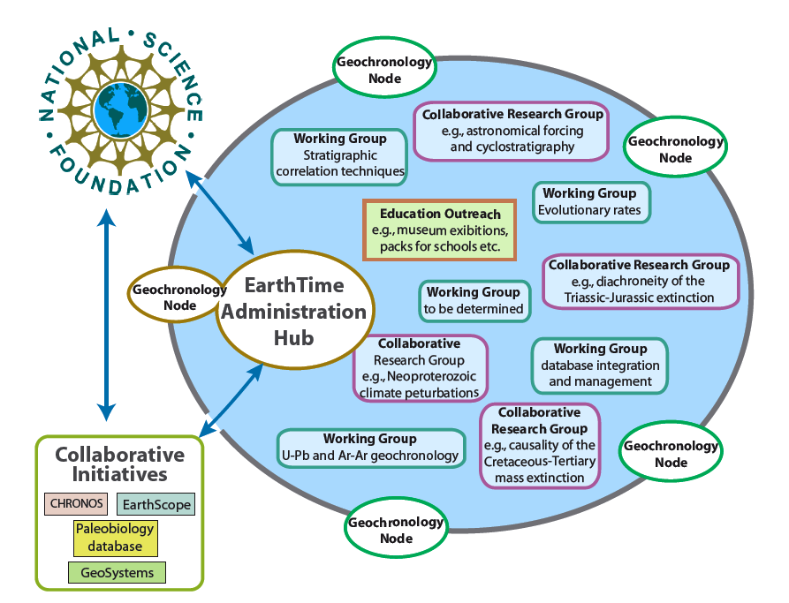
ORGANIZATION

Slide 5
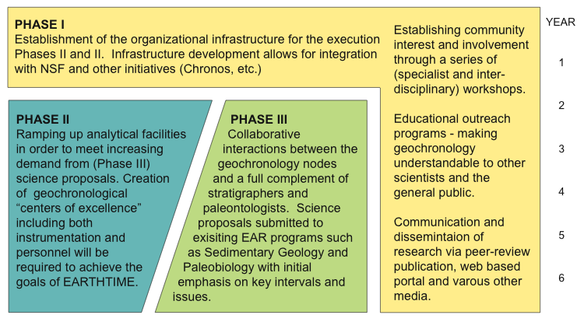
IMPLEMENTATION

Slide 6
SUCCESSES
5-year EARTHTIME Hub funding from Instrumentation and Facilities
Five community workshops between 2003 and 2011
Multiple annual EARTHTIME theme sessions at meetings including AGU, GSA, EGU, AAPG, PS
Parallel initiatives in Europe — GTSNext, EARTHTIME-EU
Several new and expanded geochron facilities
Intercalibration of U-Pb laboratories through development of tracers and standards
Identification of >1% dispersion between ⁴⁰Ar/³⁹Ar laboratories, and between U-Pb and ⁴⁰Ar/³⁹Ar dates on the same standards
Numerous EARTHTIME style collaborations fostered around critical intervals (LPIA, K-P boundary, T-J boundary, E-O boundary, Cretaceous OAEs, PETM) and chronostratigraphic integration

Slide 7
ONGOING CHALLENGES
Resolving the >1% dispersion between ⁴⁰Ar/³⁹Ar laboratories (current pipette experiment)
Refining the intercalibration between U-Pb, ⁴⁰Ar/³⁹Ar, and astronomical clocks
Developing geoinformatics for geochronology (EarthChem, Geochron, CIRDLES)
Increasing the bandwidth and access to geochronology labs to meet the burgeoning demand from community
Increasing the effectiveness of community outreach and inreach for understanding the science and practice of geochronology

Slide 8
Visit the websites:
http://www.earth-time.org/
http://www.geochron.org/
http://earthtime-eu.eu/earthtime/

