Slide 1




Sharing what we do
~
Wrestling with Time using 50 minute group activities for hundreds of students.
Dep’t Earth and Ocean Sciences
Stuart Sutherland: http://www.eos.ubc.ca/about/faculty/S.Sutherland.html
Francis Jones: http://www.eos.ubc.ca/about/faculty/F.Jones.html
Department of Earth and Ocean Sciences, UBC.
Notes:
FIRST TWO SLIDES ARE FOR THE SERC WORKSHOP ONLY, FEBRUARY 2012.

Slide 2
Group activities for hundreds
Group work must be standard practice in class
Focus on process not answers.
It’s all about making thinking visible.
Clarity of learning goals is crucial
  For instructors
  For students less so
Orchestrate timing and activity resolution carefully.

Slide 3
EOSC 326
Activity 3
Please switch your cell phones off
No non-course related internet browsing
Please do not chat while the professor is lecturing
Notes:
NOTE: THIS IS THE FIRST PASS. WE FOUND IT TOO LONG FOR 50 MINUTES AND NEXT TIME WE WILL REDUCE THE NUMBER OF TASKS.

Slide 4
ACTIVITY 3
Purpose
1. To explore how we can correlate rocks using facies and biostratigraphy.
Progression
1. Construction of biozones
2. Correlation of several stratigraphic logs using sedimentary facies and fossils
3. Paleoenvironmental interpretation of a geological horizon

Slide 5
A
B
C
D
E
F
G
H
I
J
Fossil B and F are known to be useful fossils for correlation over a wide area. On the work sheet provided construct AND describe a biozone for B using base of range techniques – make sure you apply seriation first.
Notes:
FJ
Tweaked the lines and fonts to make them more visible
added grid to help compare different ranges for transfer to worksheets.

Slide 6
i>clicker: REVIEW: what is Seriation?
Placing fossils with the shortest range first
Placing fossils with the longest range first
Placing fossils that are least facies dependent first
Placing fossils in stratigraphic order
Placing fossils in paleonenvironmental order
Strategy:
Solo – quick vocabulary check

Slide 7
A
B
C
D
E
F
G
H
I
J
Fossil B and F are known to be useful fossils for correlation over a wide area. On the work sheet provided construct AND describe a biozone for B using base of range techniques – make sure you apply seriation first.
Notes:
FJ
Tweaked the lines and fonts to make them more visible
added grid to help compare different ranges for transfer to worksheets.

Slide 8
Exercise 3, part 1 Stu. IDs: 1________ 2 ________ 3 ________ 4 ________ 5 ________ 6 ________ 7 ________
Fossil B and F are known to be useful fossils for correlation over a wide area. On the work sheet provided construct AND describe a biozone for B using base of range techniques – make sure you apply seriation first.
Biozone Description:
Notes:
Page 1 of 3; Worksheet handed out, one per group.

Slide 9
E
C
G
B
J
H
D
A
F
I
Seriation applied

Slide 10
i>clicker: To construct a base of range biozone for B,
what extra information do you need ?
The abundance of the fossil through time
An understanding of the environment the creature lived in
Radiometric dates associated with the range of fossil B
Radiometric dates associated with the range of fossil F
Do not need any extra information
- Solo first …
- Peer discussion, then revote.

Slide 11
i>clicker: To construct a base of range biozone for B,
what extra information do you need ?
The abundance of the fossil through time
An understanding of the environment the creature lived in
Radiometric dates associated with the range of fossil B
Radiometric dates associated with the range of fossil F
Do not need any extra information
Strategy: Hardish question:
- Solo first …
- Peer discussion, then revote.

Slide 12
E
C
G
B
J
H
D
A
F
I
Seriation applied
Strategy:
- Now define the biozones (~1/2 minute to see what they are thinking)
- Check via next slide
Notes:
Grid removed to remove temptation that the grid represents something important.

Slide 13
Biozone F
Biozone B
Biozone
Undefined
E
C
G
B
J
H
D
A
F
I
Define Biozones:
Strategy:
Now write the biozone description, incorporating all
fossils into the description.

Slide 14
Biozone F
Biozone B
Biozone
Undefined
E
C
G
B
J
H
D
A
F
I
Biozone Description: Biozone B is defined at its base by fossil B and it’s top defined by the appearance of Fossil F (which defines the base of the following biozone). Biozone B is also characerized by fossil C and G both of which range below and above biozone B. Fossil E ranges into biozone B from the biozone below. Fossil H ranges within Biozone B and fossils J, D and A are present in biozone B but range into biozone F.
Notes:
One possible, well articulated, description of the biozones.

Slide 15
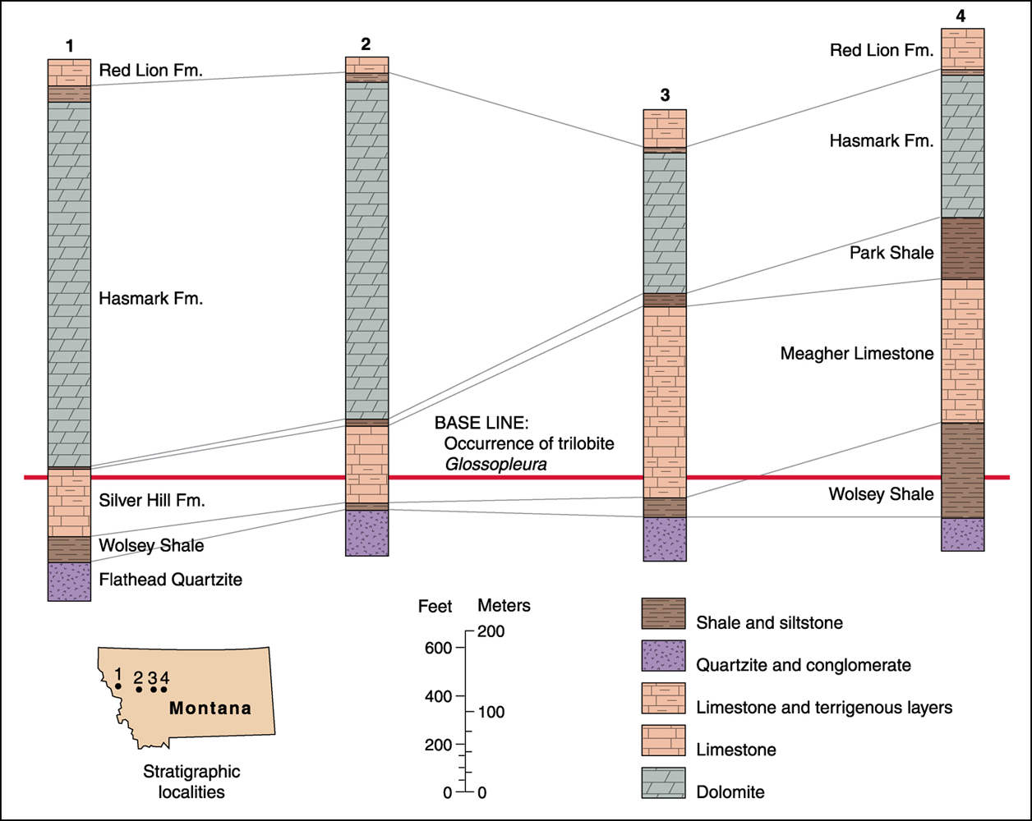
Exercise 3, part 2
6
WEST
5
Red Lion Fm.
7
Red Lion Fm.
Red Lion Fm.
Park Shale
Park Shale
Park Shale
FOSSIL X
FOSSIL X
FOSSIL X
FOSSIL X
FOSSIL X
Park Shale “pinches out”
FOSSIL X
Meagher Limestone
Wolsey Shale
Wolsey Shale
Wolsey Shale
FOSSIL B from part 1
Flathead Quartzite
Flathead Quartzite
Flathead Quartzite
1) Correlate the lithostratigraphic formations from log 4 through 5, 6 and 7
.
.
.
7
2) Note lowest 3 formations in logs 1 – 4. Do they indicate transgression or regression? Why?
6
5
Location of
Carbonates
Logs 1 – 7 in Montana
3) During the time of deposition of these sediments, is which direction do you think in landward? East or West? Explain why.
4) Why do you think the Hasmark Formation thins eastward?
5) Compared to Fossil B (from the previous part of the exercise) would fossil X be useful in chronostratigraphic correlation? Explain why.
6) On the next sheet: Draw a cross section of the sedimentary environment that might have existed at the time indicated by the base line fossil B (Glossopleura). If you can, indicate the position of the
logs, facies and stratigraphic formations.
Notes:
Page 2 of 3; Worksheet handed out, one per group.

Slide 16
Exercise 3, part 2
6
WEST
5
Red Lion Fm.
7
Red Lion Fm.
Red Lion Fm.
Park Shale
Park Shale
Park Shale
FOSSIL X
FOSSIL X
FOSSIL X
FOSSIL X
FOSSIL X
Park Shale “pinches out”
FOSSIL X
Meagher Limestone
Wolsey Shale
Wolsey Shale
Wolsey Shale
FOSSIL B from part 1
Flathead Quartzite
Flathead Quartzite
Flathead Quartzite
1) Correlate the lithostratigraphic formations from log 4 through 5, 6 and 7
.
.
.
7
2) Note lowest 3 formations in logs 1 – 4. Do they indicate transgression or regression? Why?
6
5
Transgression: coarse clastics to shale to offshore carbonates
Location of
Carbonates
Logs 1 – 7 in Montana
3) During the time of deposition of these sediments, is which direction do you think in landward? East or West? Explain why.
Land is to the East – thickness of shallow water deposits thickens to the East, deeper water deposits thicken to the West.
4) Why do you think the Hasmark Formation thins eastward?
Ocean to the West, water shallows to the East – as sea level rises over time the ocean-ward logs will record a thicker sequence of carbonates.
5) Compared to Fossil B (from the previous part of the exercise) would fossil X be useful in chronostratigraphic correlation? Explain why.
Fossil A facies independent. Fossil B restricted to shale facies – more of a environment tracking form.
6) On the next sheet: Draw a cross section of the sedimentary environment that might have existed at the time indicated by the base line fossil B (Glossopleura). If you can, indicate the position of the
logs, facies and stratigraphic formations.

Slide 17
Exercise 3, part 3
6
WEST
5
Red Lion Fm.
7
Red Lion Fm.
Red Lion Fm.
Park Shale
Park Shale
Park Shale
FOSSIL X
FOSSIL X
FOSSIL X
FOSSIL X
FOSSIL X
Park Shale “pinches out”
FOSSIL X
Meagher Limestone
Wolsey Shale
Wolsey Shale
Wolsey Shale
FOSSIL B from part 1
Flathead Quartzite
Flathead Quartzite
Flathead Quartzite
Notes:
Page 3 of 3; Worksheet handed out, one per group.

Slide 18
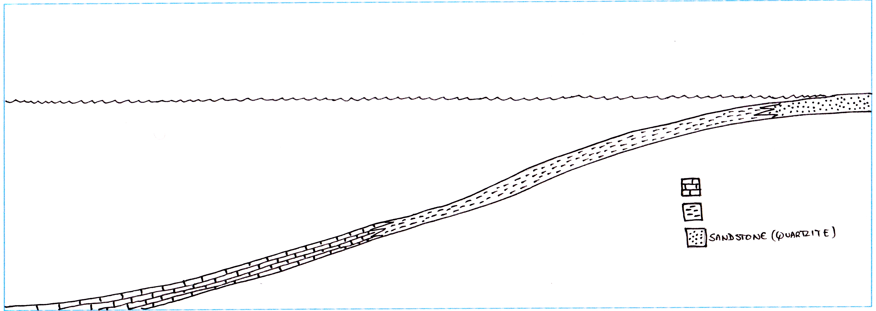
Exercise 3, part 3
6
WEST
5
Red Lion Fm.
7
Red Lion Fm.
Red Lion Fm.
Park Shale
Park Shale
Park Shale
FOSSIL X
FOSSIL X
FOSSIL X
FOSSIL X
FOSSIL X
Park Shale “pinches out”
FOSSIL X
Meagher Limestone
Wolsey Shale
Wolsey Shale
Wolsey Shale
FOSSIL B from part 1
Flathead Quartzite
Flathead Quartzite
Flathead Quartzite
“Time” surface controlled by fossil B
Proposed sea level at base of fossil B biozone
Note – I didn’t draw this too well so my proposed location of the facies changes above don’t match up too well with the proposed location of the facies boundaries on my reconstruction (follow the dashed lines)
Limestone
Shale
Sandstone (quartzite)

Slide 19
i>clicker: Consider the stratigraphic logs and your paleoenvironmental interpretation.
What would happen to a potential shoreline on your reconstruction if you run the “geological clock” forward?
Solo question
NO ANSWER
It would move East
It would move West
It would stay in the same location
There is not enough information available to tell
6
WEST
5
Red Lion Fm.
7
Red Lion Fm.
Red Lion Fm.
Park Shale
Park Shale
Park Shale
FOSSIL X
FOSSIL X
FOSSIL X
FOSSIL X
FOSSIL X
Park Shale “pinches out”
FOSSIL X
Meagher Limestone
Wolsey Shale
Wolsey Shale
Wolsey Shale
FOSSIL B from part 1
Flathead Quartzite
Flathead Quartzite
Flathead Quartzite

Slide 20
i>clicker: How can you predict which way the shoreline will move?
The logs indicate that sea level is rising
The logs indicate that sea level is falling
Fossil X is found in the Park Shale
Fossil B is found in three different formations
Solo question
NO ANSWER
6
WEST
5
Red Lion Fm.
7
Red Lion Fm.
Red Lion Fm.
Park Shale
Park Shale
Park Shale
FOSSIL X
FOSSIL X
FOSSIL X
FOSSIL X
FOSSIL X
Park Shale “pinches out”
FOSSIL X
Meagher Limestone
Wolsey Shale
Wolsey Shale
Wolsey Shale
FOSSIL B from part 1
Flathead Quartzite
Flathead Quartzite
Flathead Quartzite
Notes:
I suggest the following options:
Any of logs 1,2,3, or 4 indicate that sea level is rising.
Any of logs 1,2,3, or 4 indicate that sea level is falling
Logs 1 & 2 show sea level is lower than in logs 3 and 4.
Fossil X is found in the Park Shale
Fossil B is found in three different formations.

Slide 21
i>clicker: Consider the stratigraphic logs and your paleoenvironmental interpretation.
What would happen to a potential shoreline on your reconstruction if you run the “geological clock” forward?
Repeated question
Peers discuss
It would move East
It would move West
It would stay in the same location
There is not enough information available to tell
6
WEST
5
Red Lion Fm.
7
Red Lion Fm.
Red Lion Fm.
Park Shale
Park Shale
Park Shale
FOSSIL X
FOSSIL X
FOSSIL X
FOSSIL X
FOSSIL X
Park Shale “pinches out”
FOSSIL X
Meagher Limestone
Wolsey Shale
Wolsey Shale
Wolsey Shale
FOSSIL B from part 1
Flathead Quartzite
Flathead Quartzite
Flathead Quartzite

Slide 22
i>clicker: If you want to study the movement of ONE facies over time, which of the following fossils mentioned in this exercise (including part 1) would be the best fossil to use?
Solo only
- NO ANSWER
Fossil B
Fossil F
Fossil X
None
6
WEST
5
Red Lion Fm.
7
Red Lion Fm.
Red Lion Fm.
Park Shale
Park Shale
Park Shale
FOSSIL X
FOSSIL X
FOSSIL X
FOSSIL X
FOSSIL X
Park Shale “pinches out”
FOSSIL X
Meagher Limestone
Wolsey Shale
Wolsey Shale
Wolsey Shale
FOSSIL B from part 1
Flathead Quartzite
Flathead Quartzite
Flathead Quartzite

Slide 23
i>clicker: what criteria are you using to choose a fossil that can identify a particular paleoenvironment?
It is stratigraphically higher than others
It is stratigraphically lower than others
It occurs in a wide number of facies
It is tied to a particular facies
It evolved rapidly
6
WEST
5
Red Lion Fm.
7
Red Lion Fm.
Red Lion Fm.
Park Shale
Park Shale
Park Shale
FOSSIL X
FOSSIL X
FOSSIL X
FOSSIL X
FOSSIL X
Park Shale “pinches out”
FOSSIL X
Meagher Limestone
Wolsey Shale
Wolsey Shale
Wolsey Shale
FOSSIL B from part 1
Flathead Quartzite
Flathead Quartzite
Flathead Quartzite
Notes:
Reworded a bit for clarity.

Slide 24
i>clicker: If you want to study the movement of ONE facies over time, which of the following fossils mentioned in this exercise (including part 1) would be the best fossil to use?
Fossil B
Fossil F
Fossil X
None
Peers discuss!
6
WEST
5
Red Lion Fm.
7
Red Lion Fm.
Red Lion Fm.
Park Shale
Park Shale
Park Shale
FOSSIL X
FOSSIL X
FOSSIL X
FOSSIL X
FOSSIL X
Park Shale “pinches out”
FOSSIL X
Meagher Limestone
Wolsey Shale
Wolsey Shale
Wolsey Shale
FOSSIL B from part 1
Flathead Quartzite
Flathead Quartzite
Flathead Quartzite

