Slide 1
A
B
C
D
E
F
G
H
I
J
Fossil B and F are known to be useful fossils for correlation over a wide area. On the work sheet provided construct AND describe a biozone for B using base of range techniques – make sure you apply seriation first.
Notes:
FJ
Tweaked the lines and fonts to make them more visible
added grid to help compare different ranges for transfer to worksheets.

Slide 2
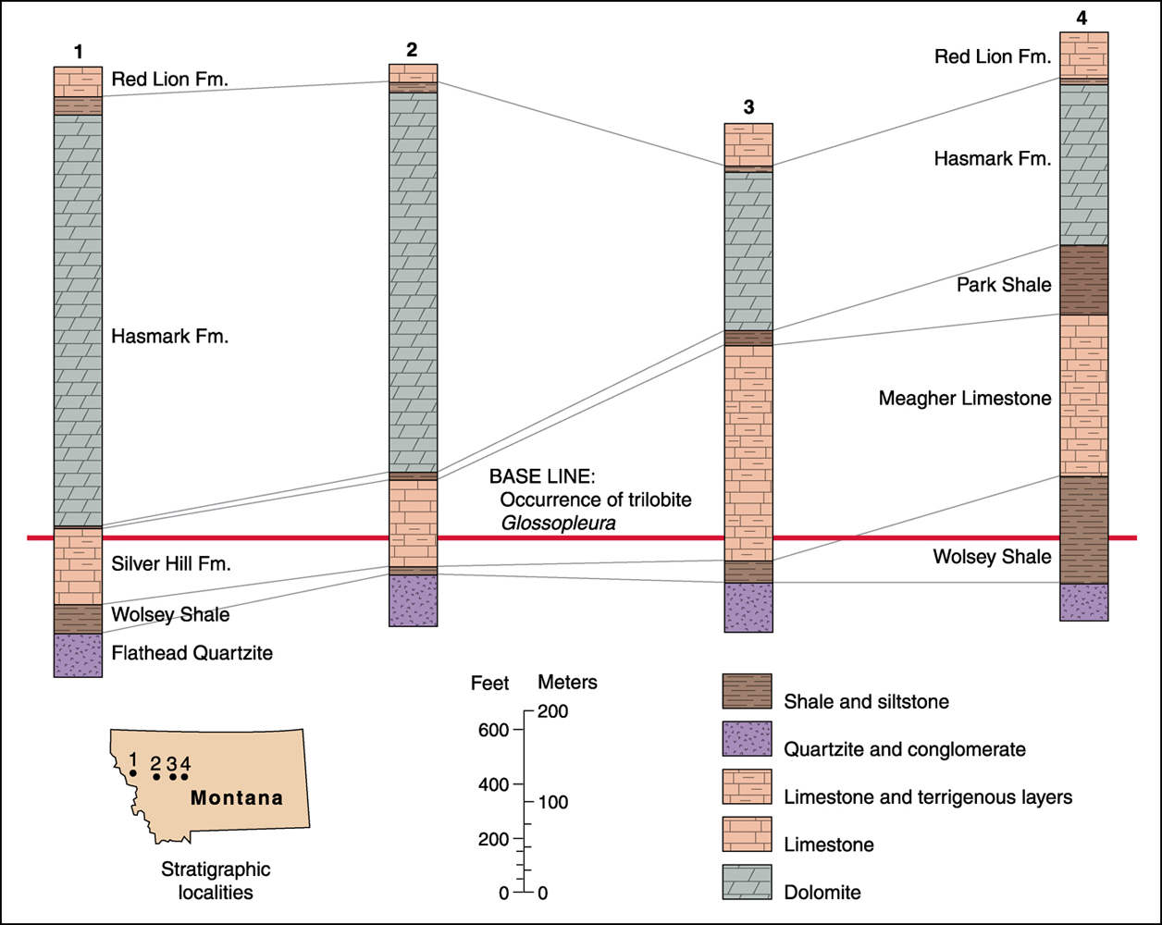
Exercise 3, part 2
6
WEST
5
Red Lion Fm.
7
Red Lion Fm.
Red Lion Fm.
Park Shale
Park Shale
Park Shale
FOSSIL X
FOSSIL X
FOSSIL X
FOSSIL X
FOSSIL X
Park Shale “pinches out”
FOSSIL X
Meagher Limestone
Wolsey Shale
Wolsey Shale
Wolsey Shale
FOSSIL B from part 1
Flathead Quartzite
Flathead Quartzite
Flathead Quartzite
1) Correlate the lithostratigraphic formations from log 4 through 5, 6 and 7
.
.
.
7
2) Note lowest 3 formations in logs 1 – 4. Do they indicate transgression or regression? Why?
6
5
Transgression: coarse clastics to shale to offshore carbonates
Location of
Carbonates
Logs 1 – 7 in Montana
3) During the time of deposition of these sediments, is which direction do you think in landward? East or West? Explain why.
Land is to the East – thickness of shallow water deposits thickens to the East, deeper water deposits thicken to the West.
4) Why do you think the Hasmark Formation thins eastward?
Ocean to the West, water shallows to the East – as sea level rises over time the ocean-ward logs will record a thicker sequence of carbonates.
5) Compared to Fossil B (from the previous part of the exercise) would fossil X be useful in chronostratigraphic correlation? Explain why.
Fossil A facies independent. Fossil B restricted to shale facies – more of a environment tracking form.
6) On the next sheet: Draw a cross section of the sedimentary environment that might have existed at the time indicated by the base line fossil B (Glossopleura). If you can, indicate the position of the
logs, facies and stratigraphic formations.

Slide 3
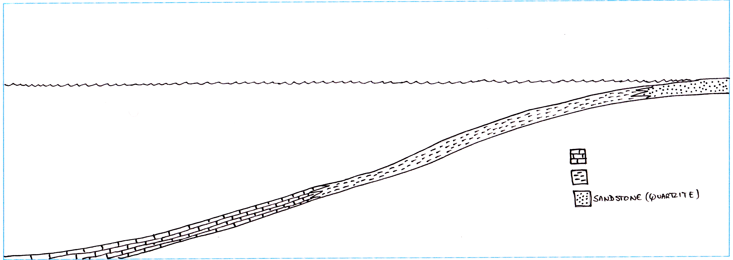
Exercise 3, part 3
6
WEST
5
Red Lion Fm.
7
Red Lion Fm.
Red Lion Fm.
Park Shale
Park Shale
Park Shale
FOSSIL X
FOSSIL X
FOSSIL X
FOSSIL X
FOSSIL X
Park Shale “pinches out”
FOSSIL X
Meagher Limestone
Wolsey Shale
Wolsey Shale
Wolsey Shale
FOSSIL B from part 1
Flathead Quartzite
Flathead Quartzite
Flathead Quartzite
“Time” surface controlled by fossil B
Proposed sea level at base of fossil B biozone
Note – I didn’t draw this too well so my proposed location of the facies changes above don’t match up too well with the proposed location of the facies boundaries on my reconstruction (follow the dashed lines)
Limestone
Shale
Sandstone (quartzite)

