Slide 1
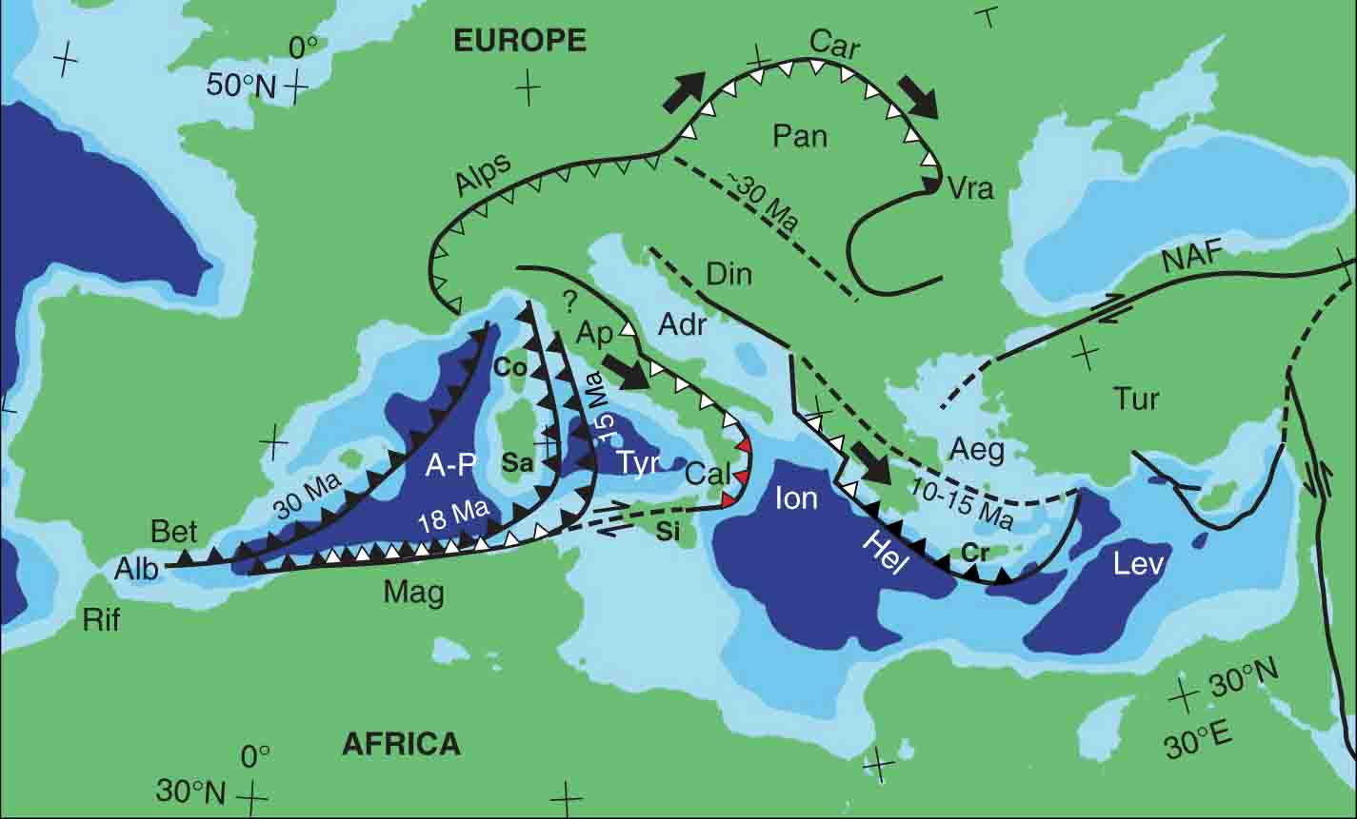
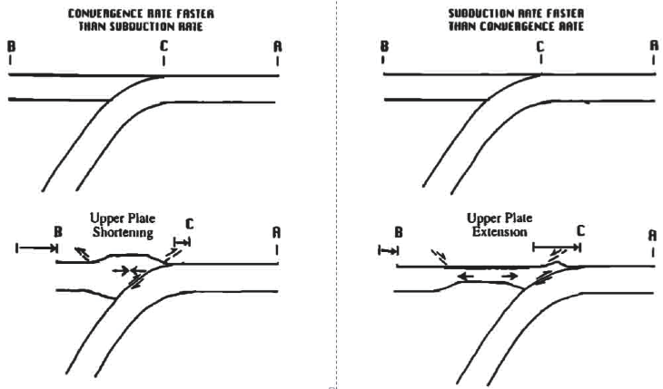
Arc-Parallel Strain in a Short Subduction-Rollback System
Margaret Reitz, Columbia University
Royden, 1993
Wortel and Spakman, 2000
Leonardo Seeber and Michael Steckler (Lamont-Doherty Earth Observatory)
Massimo Zecchin (OGS, Trieste), Ignazio Guerra (U of Calabria), Claudio Faccenna (Roma-Tre)
Notes:
Summary of subduction-rollback systems in the Mediterranean. These are unique subduction systems because the lengths of the downgoing slabs are short. This has important implications on mantle flow around the edges of the slab as well as upper plate structures. My poster is focused on the Calabrian Arc (center).

Slide 2
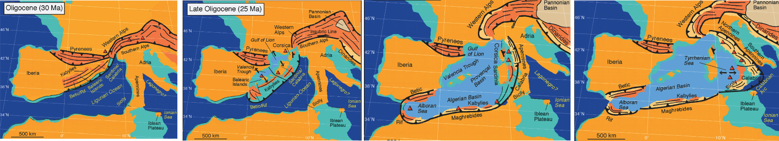
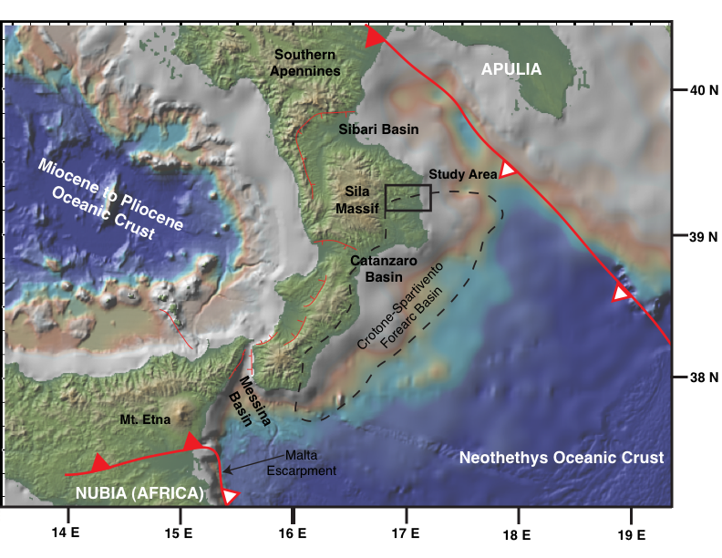
Serravallian (12 Ma)
Rosenbaum and Lister, 2004
Pliocene (5 Ma)
Present Day
Notes:
As the Calabrian Arc system has moved to the SE over the last 30 Myr, the arc has stretched and its curvature increased. I’m studying the older part of the forearc basin, now uplifted above sea level, (12 Ma to 3 Ma) to determine what structures are associated with this SE-ward motion, increasing curvature, and transition from collision (arc-continent collision forming the Apennines) and subduction.

