Slide 1
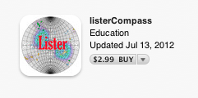
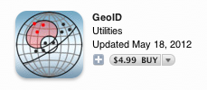

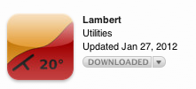


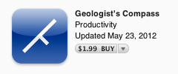



Using iPads in the Field
SERC – July, 2012
Lawrence Malinconico
Geology & Environmental Geosciences

Slide 2
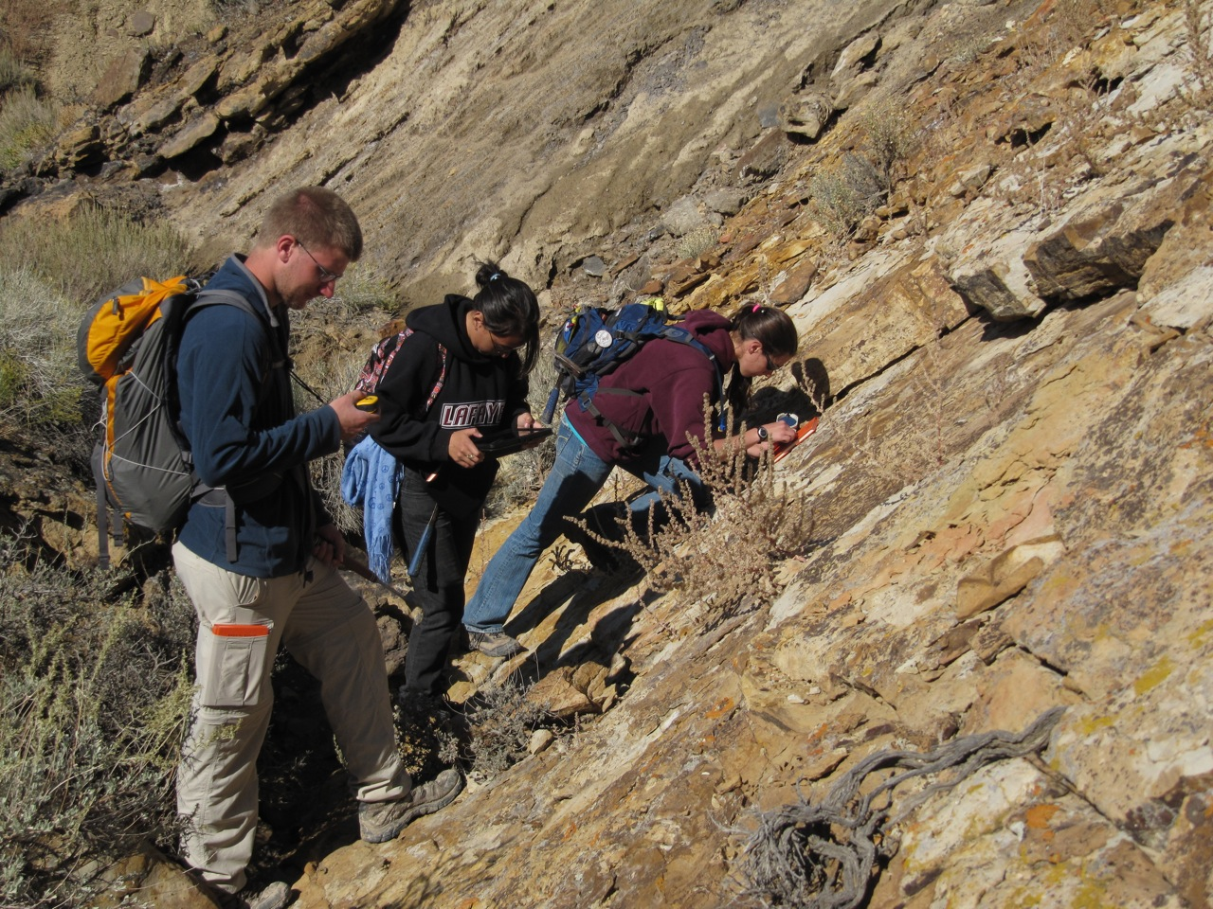
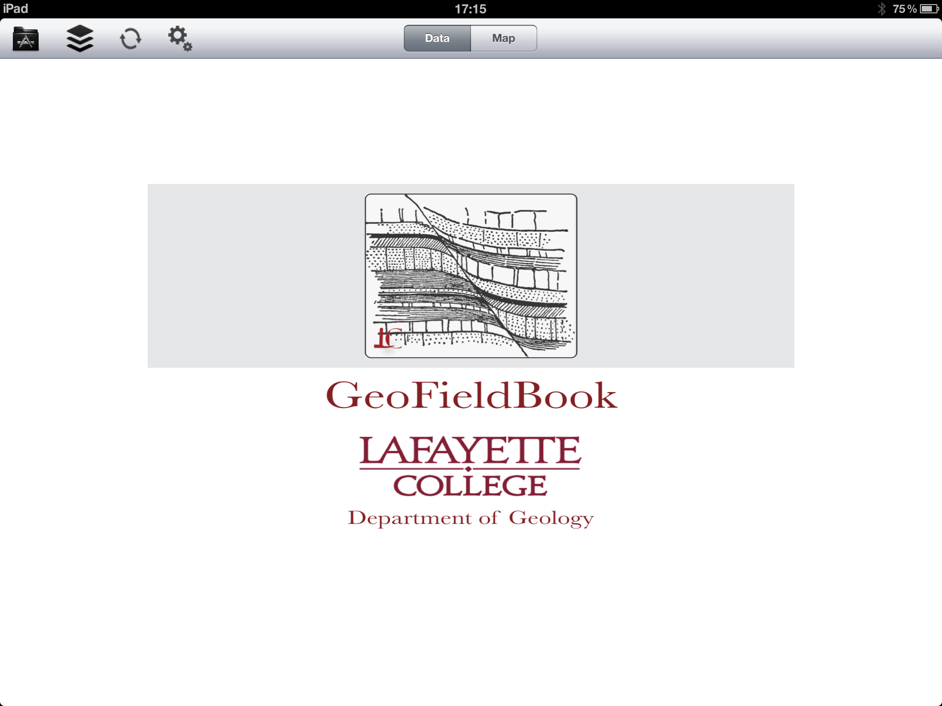
GeoFieldBook App for iPad
Interdisciplinary Development Project
Lawrence Malinconico, David Sunderlin & Chun-wai Liew
Geology & Environmental Geosciences, Computer Science
Geology 317, Wyoming, 2011

Slide 3

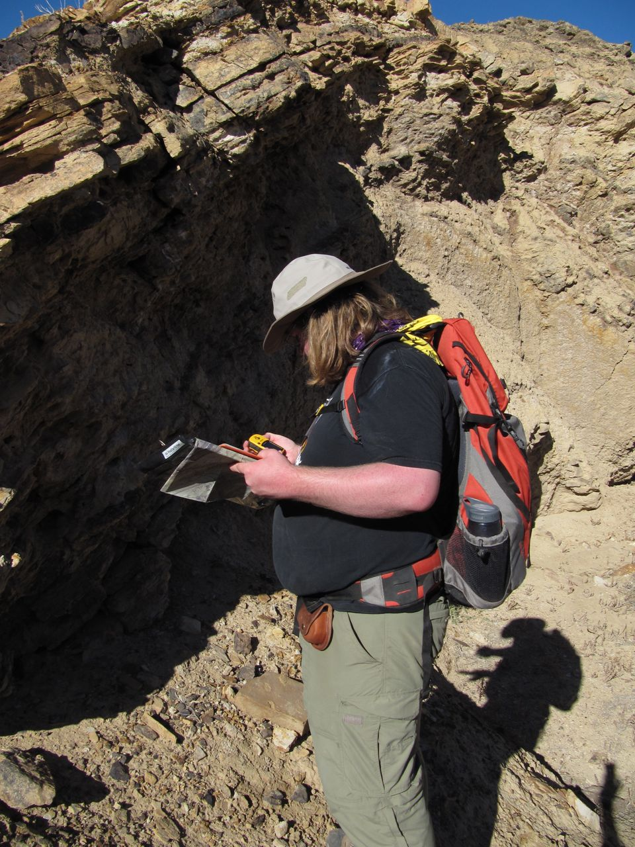
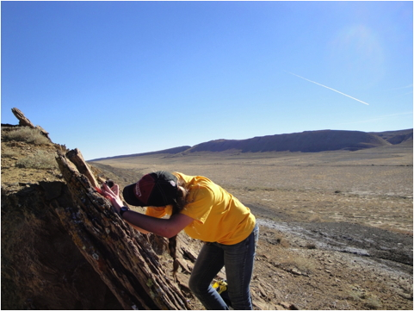
Program Background
One-year integrated Sed/Strat & Structure/Tectonics course.
No field camp requirement
“Capstone” project mid-way through second semester to Sheep Mountain Wyoming.
  Strat Section and formation descriptions
  Measured deformation
  Broader tectonic context: Laramide
Product: 50+ page Geologic History Report
  Map & cross-section (Illustrator)
  Depositional & Deformational History
  Stress analysis
  Tectonic Context
Geology 317, Wyoming, 2010

Slide 4
Rationale for App Development
While Geology is a field science interpretation has become very digital.
Question is how to bridge analog field methods with digital processing?
Observed geological mapping packages – but they were too “black box” for learning and not particularly stable and the platforms were too bulky
Evolved from discussions with Professors David Sunderlin and John Wilson in Geology and then with Professor Chun-wai Liew in Computer Science
Acknowledgements: NSF, Provost’s Office
Geology 317, Wyoming, 2010

Slide 5
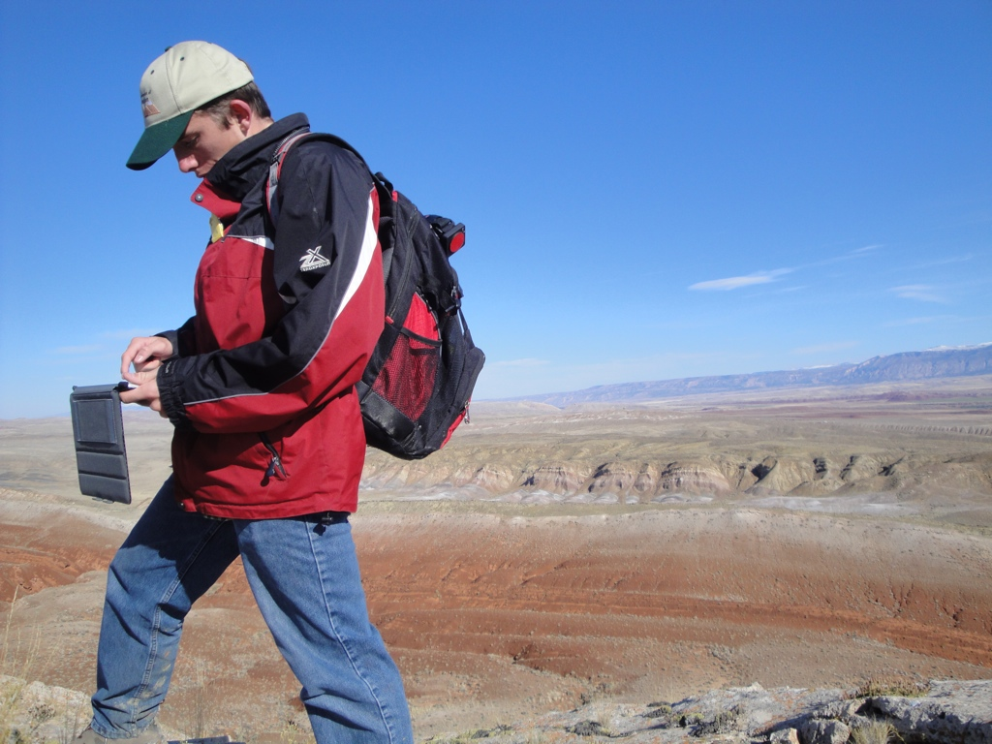
Pedagogical value in guiding field observations
Speedy data collection -- more time for synthesis
Smooth & accurate data transfer into mapping & processing programs

Slide 6
Increase iterative mapping/hypothesis capabilities in the field
Introduce stratigraphic data acquisition
Explore pedagogy of real-time data acquisition & analysis

Slide 7
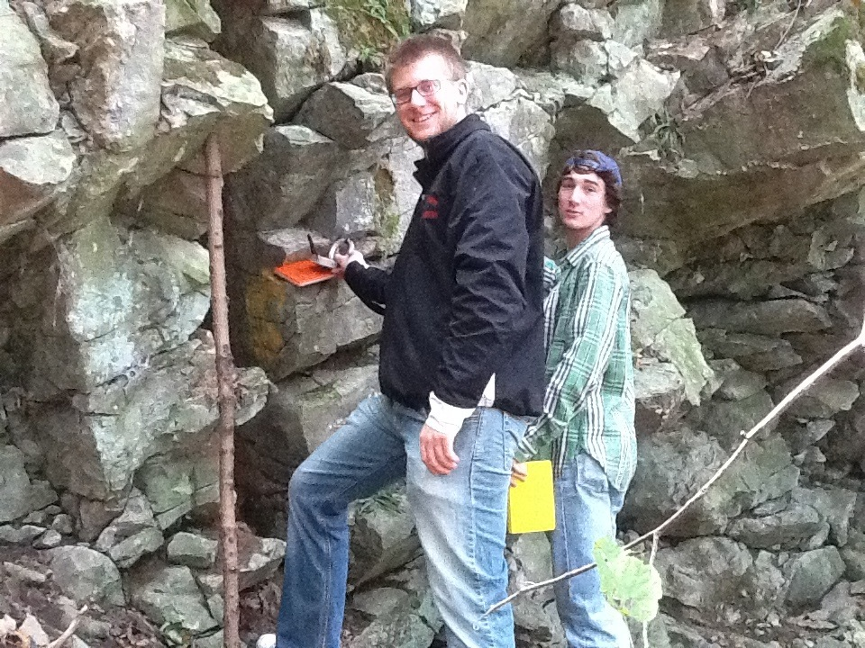

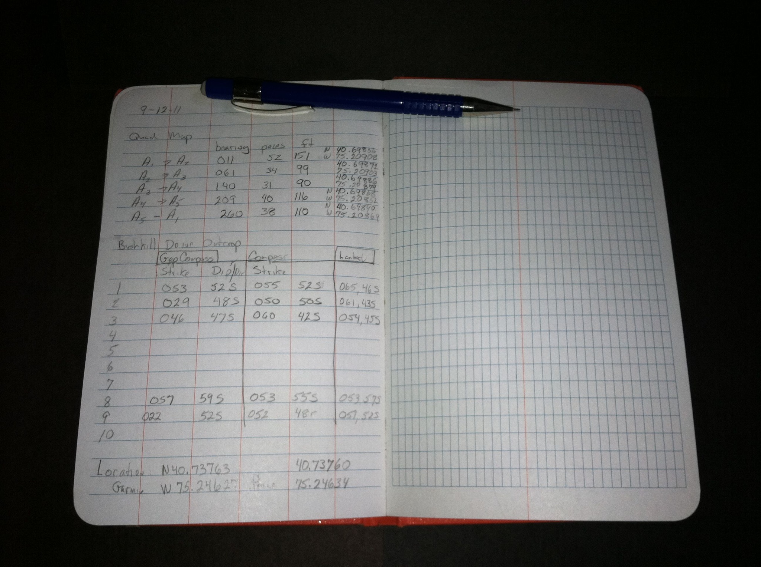
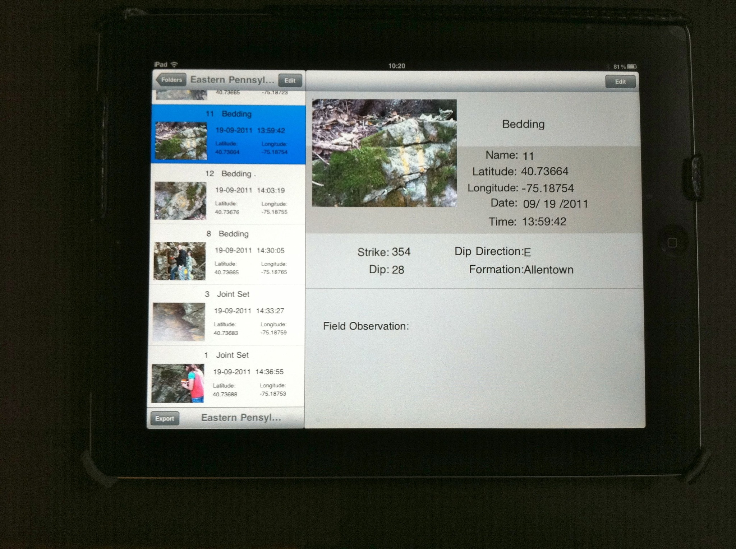
Objectives
To develop a digital method of recording field data – GeoFieldBook App
Use the rapidly evolving tablet technology that could mimic, and possibly replace the use of traditional field notebooks.
  2n & 3rd-generation Apple iPad
  Android-based tablets (perhaps)
Record ---> Transcribe ---> Excel & Google Earth ---> Geologic map &
Interpretation
Geology 317, eastern Pennsylvania, 2011

Slide 8
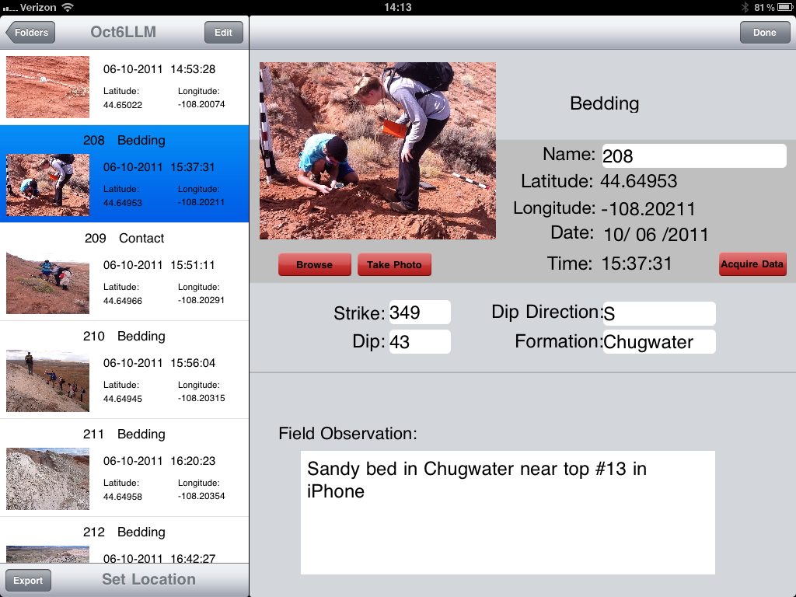
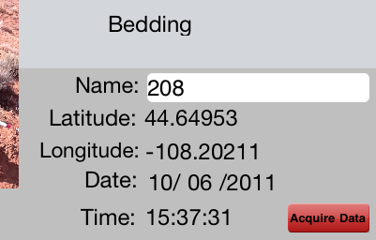
What the App Does & Advantages
Automatic logging of
  location information from the built-in gps
  date and time
  control on what data should be collected - especially important for students (minimize missing data in data set)
Imaging of each field location using the integrated iPad camera.
  images are geo-registered using the gps data and linked to record

Slide 9
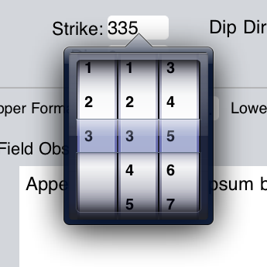
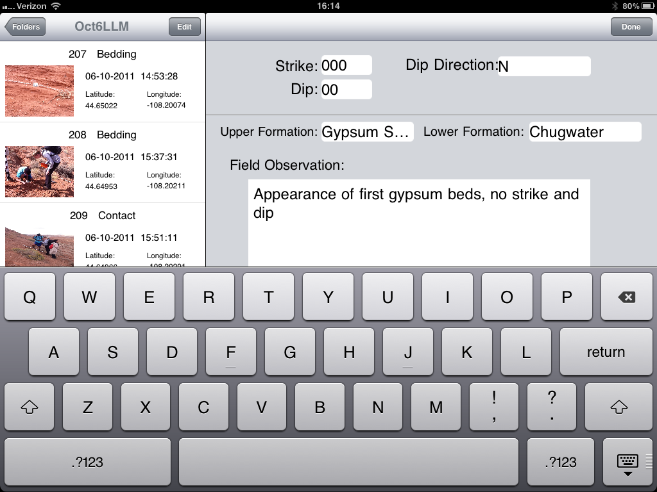
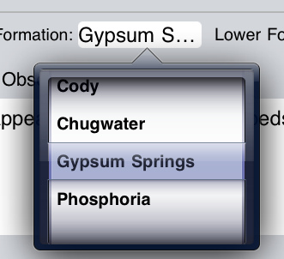
Advantages
Different screens have inputs for all of the information that should be recorded for a given type of location (contacts, faults, bedding, lithology, etc.).
  With blank pages in a traditional field book, students often forget to record some important information.
Pull-down menus with pre-loaded information reduces errors and standardizes format that allows for easier data sharing

Slide 10
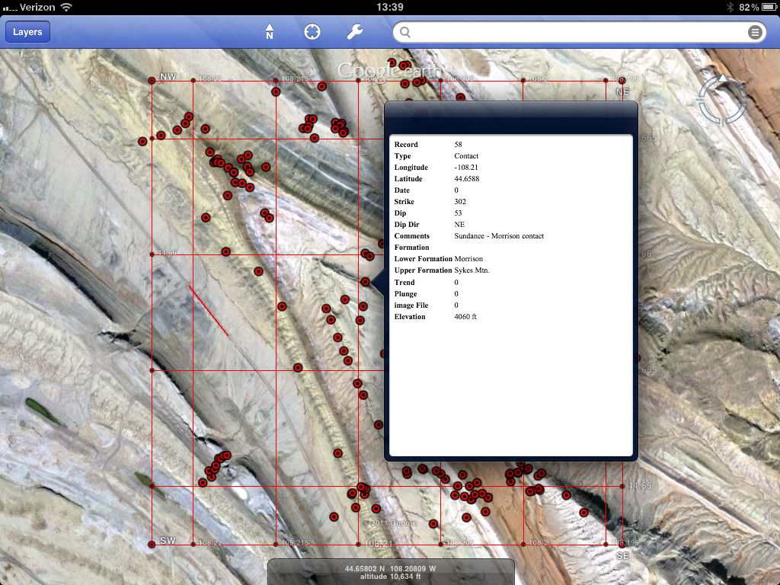
Advantages
(integration with other Apps)
Maps – on the ground navigation
  can now have an unlimited access to a collection of mapping bases
Data management
  Google Earth
  Map App
easy access to earlier
collected data

Slide 11
How to get the GeoFieldBook App
App Store: Search for GeoFieldBook (iPad only)
Links through Lafayette description site for the App
  http://sites.lafayette.edu/geofieldbook/
Version 2 (with map capability – see next page) should be available at the end of the summer

Slide 12
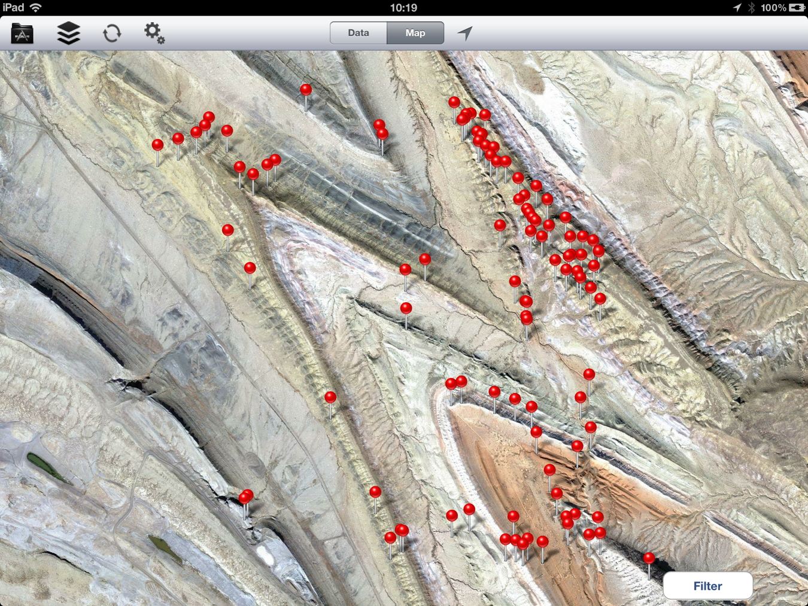
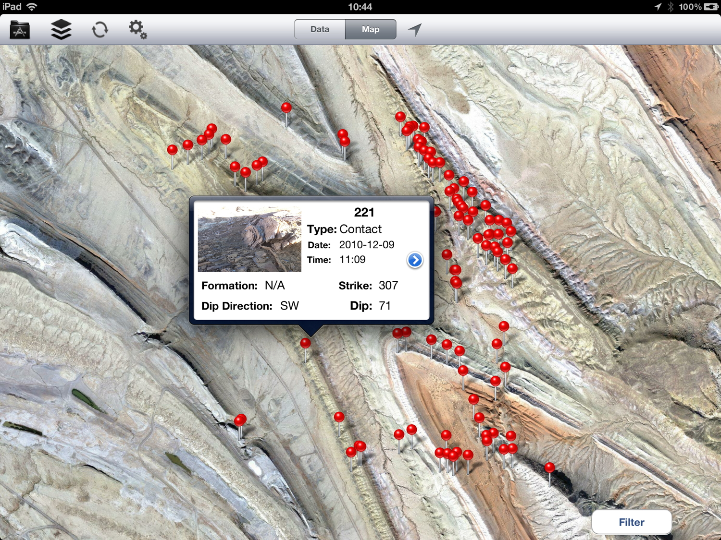
Next Generation Enhancements
Map Front End - use as field map base and for visual record of observation locations. Meta-data a linked to each mapped point
Input Existing Data Sets - allows for project continuation from pre-App data sets
Filter Displayed Observations – by data type, project or record.
Observations will eventually become Strike & Dip symbol (end of summer?)
-------------------------------------------------------
Auto Strike and Dip Measurements?

Slide 13

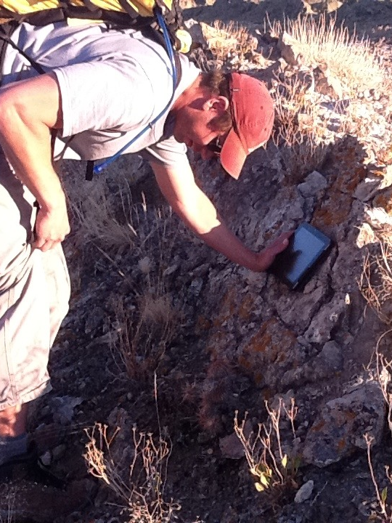
iPad Configuration
iPad Hardware Configurations
Can easily be used with a base-level iPad 2/3
  w/o cellular connection, requires scanning the map area at night with WiFi access to “cache” the map base.
  iOS 6 – Apple Maps?
Enhancements:
  Cellular connectivity allows real-time map base updates (pay-as-you-go plan works well)
Geology 317, Wyoming, 2011

Slide 14
Continued Field Testing & Evaluation
Questions to be answered
What additional Data Pages or Fields to an existing Page should be added?
Screen visibility in bright sun – still as issue
Durability – so far so good, including battery life
Ease of use – faster than writing
Connectivity with Excel, Google Maps, processing applications
Real (or near-real) Time feedback for students
Please use the App and provide us with feedback!
http://sites.lafayette.edu/geofieldbook/
Geology 317, Wyoming, 2010

Slide 15
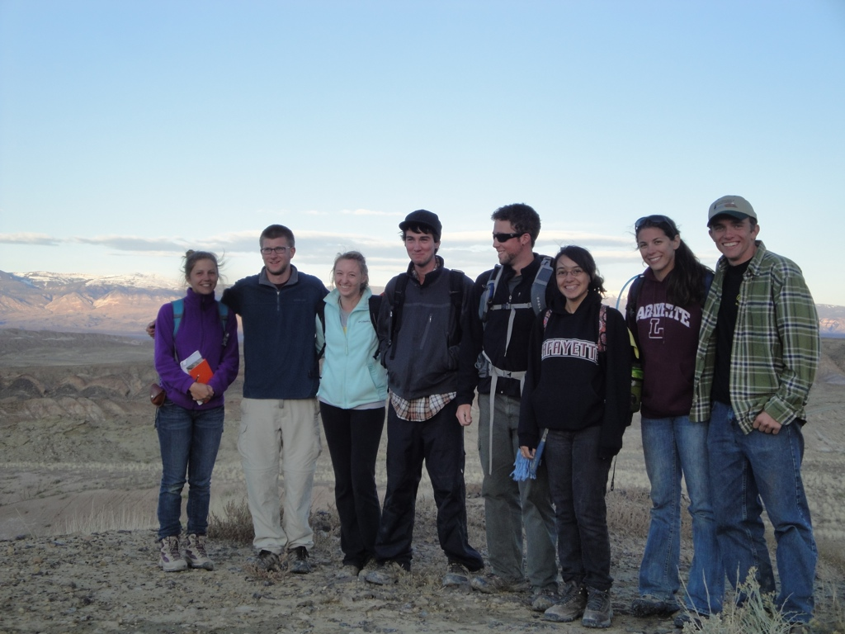
Demonstration & Questions

