Slide 1
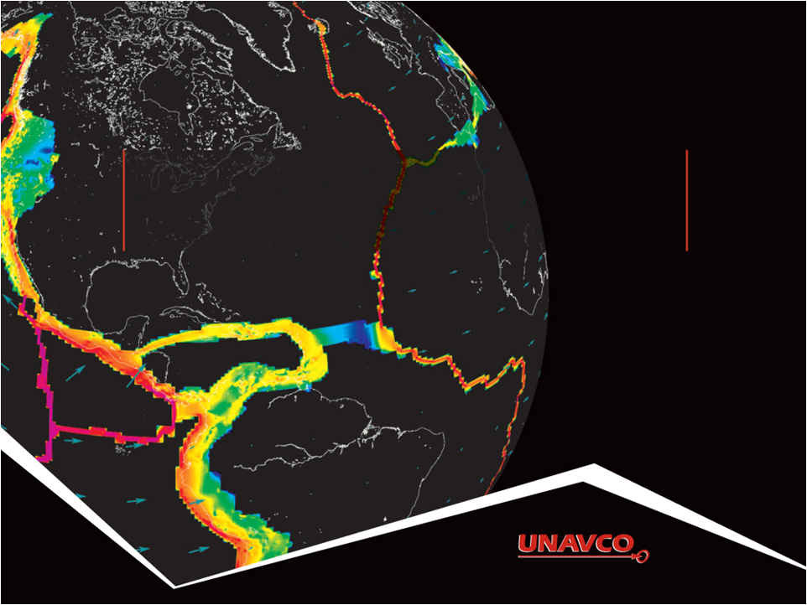
Using GPS velocities to understand crustal strain
Vince Cronin • Beth Pratt-Sitaula
Bill Hammond • Corné Kreemer • Shelley Olds Phil Resor • Nancy West

Slide 2
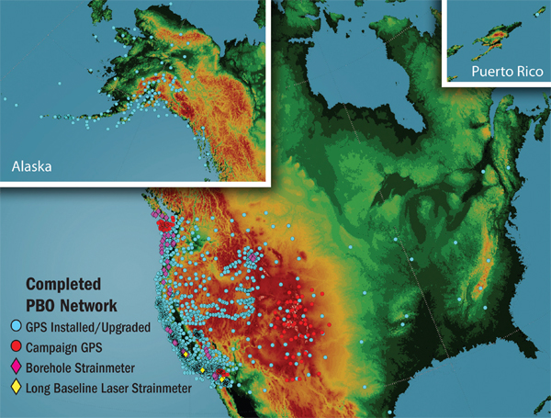
UNAVCO & PBO
UNAVCO: non-profit consortium that provides geodetic research support
Manages Plate Boundary Observatory (PBO): NSF EarthScope’s
GPS network of
1100 stations
(also campaign GPS,
terrestrial LiDAR,
InSAR…)

Slide 3
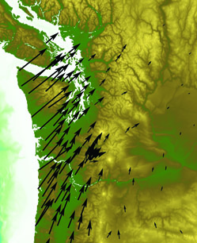
Module for Structural Geology Course
IN DEVELOPMENT but…
New approach with Infinitesimal rather than Finite Strain
Combines Structural, Geophysics, & Tectonics
Our GOALS for this presentation:
  Inform you module is coming
  Share curriculum development
  model
  Looking for feedback/suggestions
  Looking for possible Beta-testers
Notes:
Born out of discussions at UNAVCO’s biannual meeting last February.
I am but the mouthpiece and this is a group effort in which I am not the technical expert.

Slide 4
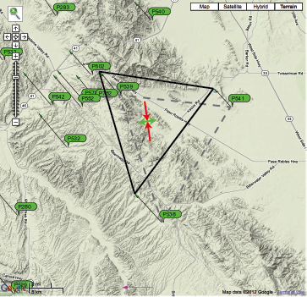
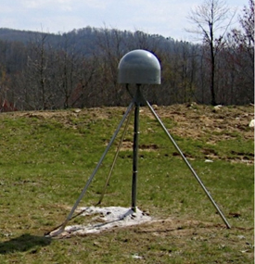
Module GOAL
Students use GPS data to gain a fundamental understanding of strain in the context of structural features and solving real geoscience problems (such as earthquake hazard)

Slide 5
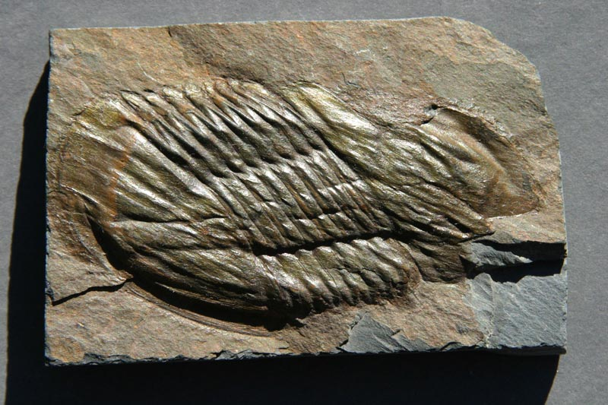
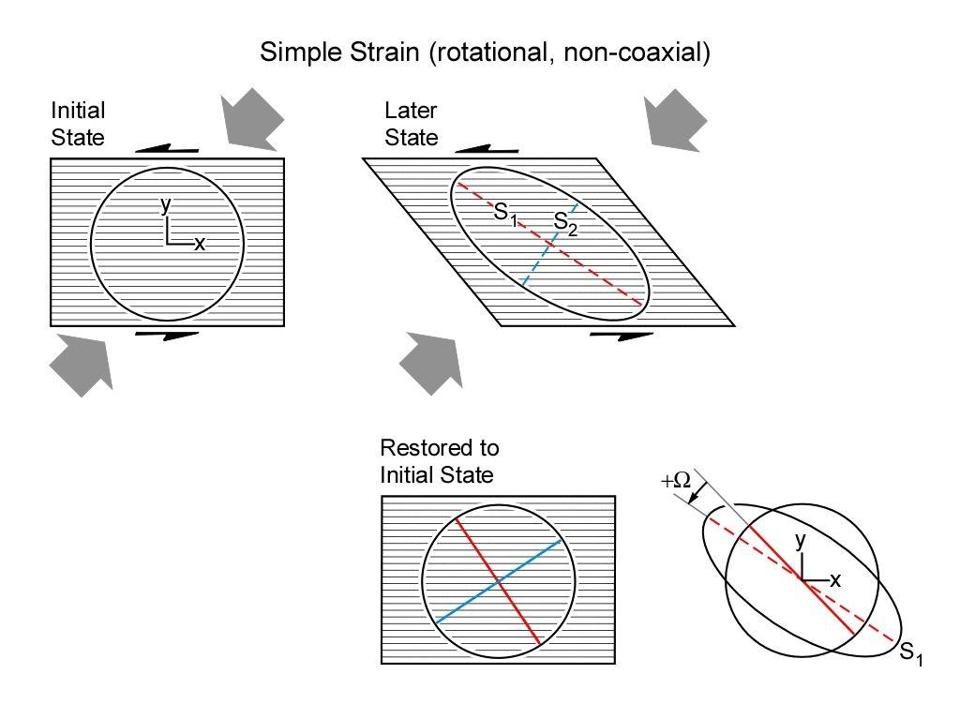
Moving beyond Finite Strain
Mushed trilobites still have a place, but we can do more
http://marlimillerphoto.com/SrD-53.html
Notes:
Structural geology naturally focused on observable past strain in rocks because that is what we could observe.
NOW however, through GPS, we can measure ongoing strain. For instance, ongoing strain has more real-world applications related to hazards.
This is gradually being integrated into structural texts, but we wanted to develop a module that would allow the classic concepts of translation, rotation, deformation to be addressed with GPS data.

Slide 6
Module Audience & Overview
Structural geology course (possibly geophysics or tectonics)
15-30 upper division students
~1 week time with in-class/lab and homework
Quantitative skills development assuming low base (but extensions for higher level)
Notes:
Give examples of Vince’s 3 hours/week plus lab and Phil’s 2 longer classes/week (likely to follow up on this later when he gets to focal mechanisms and field visits.

Slide 7

Module Development
Based on SERC’s InTeGrate module development process
3 Faculty Developers
(content & instructional expertise)
Assessment
specialist

Slide 8
UNAVCO Module Development
Faculty
Developers
Vince C (Baylor)
Phil R (Wesleyan)
Geodesy
Experts
Bill H & Corne K.
(UNReno)
Education
Specialists
Beth P & Nancy W
(UNAVCO)
Funded by UNAVCO (but with <<$ than InTeGrate)
Development workshop at UNReno in June 2012

Slide 9
Module GOAL
Students use GPS data to gain a fundamental understanding of strain in the context of structural features and solving real geoscience problems (such as earthquake hazard)
Notes:
Scale of triangles we would pick would be ~100km or less so calculations can be done in flat Earth, rather than curved. We had a lot of debate about this but decided on flat Earth because it better matches calculation typically found in Structural Geology texts.

Slide 10
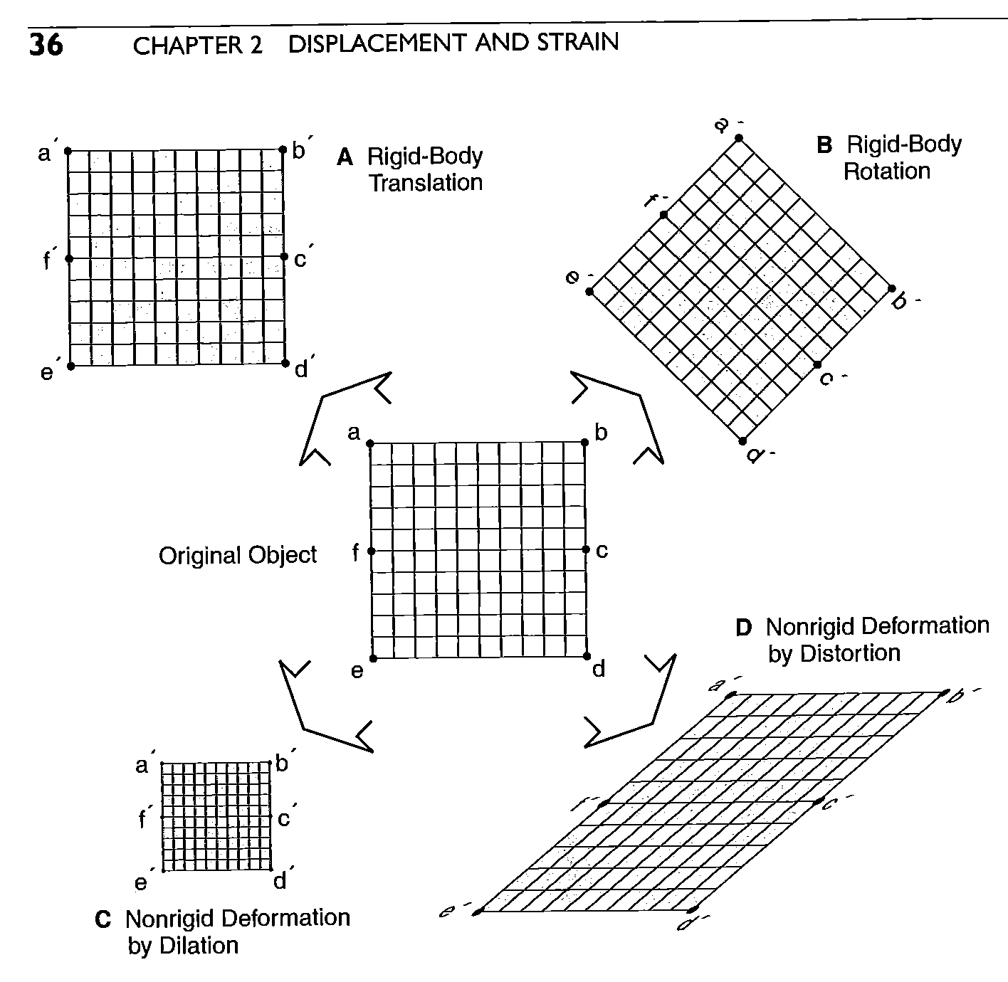
Strain
Translation
Rotation
Distortion
Davis et al, Structural Geology, 2012

Slide 11
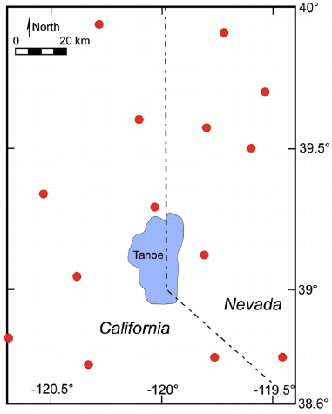
PBO GPS Stations, Tahoe Region
Notes:
There are several geodetic GPS stations operated by PBO in the Tahoe area, spaced between 20 and 50 km apart.

Slide 12
PBO GPS Stations, Tahoe Region
P147
P139
P149
Notes:
Any site you may need to work on in the Tahoe area will be located between three of these stations, and so we can directly measure the present-day strain around the site. For example, we choose three arbitrary GPS stations and imagine a site in the triangle between them.

Slide 13
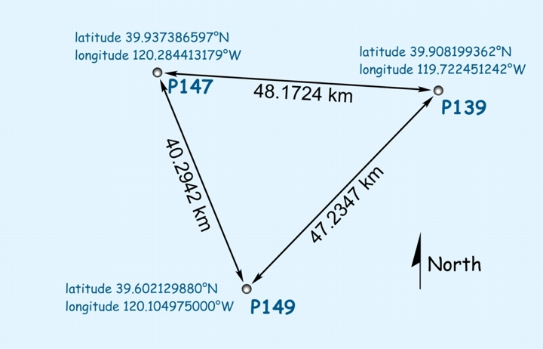
Strain between 3 GPS Stations
http://www.baylor.edu/csr
Notes:
The initial location of each GPS station is given on the web to sub-centimeter accuracy.

Slide 14
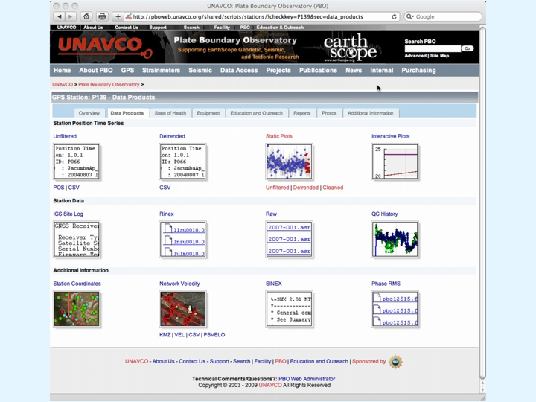
Notes:
The data for each station is presented in several formats on the web.

Slide 15
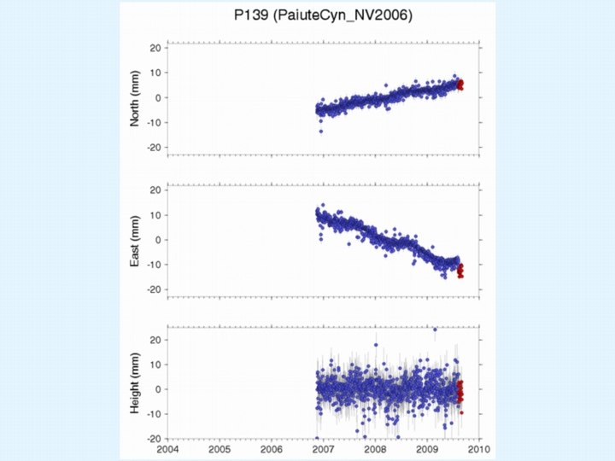
North-South
Locations
East-West
Locations
Up-Down
Locations
Notes:
For each station, the variation in position is measured in the north-south, east-west and up-down directions. Note that the data for this station began to be recorded in late 2006 and continue to the present, and that the vertical scales on these graphs are all +/- 20 millimeters. The slope of the time series is the average velocity in each of these directions.

Slide 16
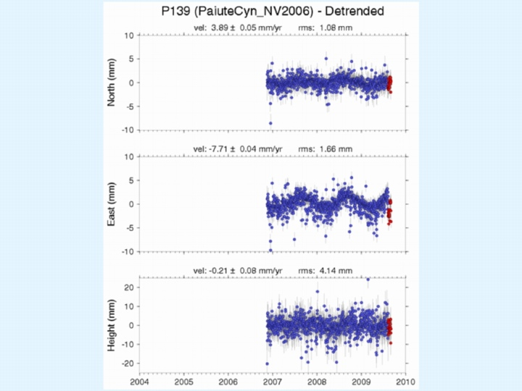
North-South
Velocity
East-West
Velocity
Up-Down
Velocity
31
Notes:
UNAVCO provides a velocity analysis, or you can analyze the raw data yourself.

Slide 17
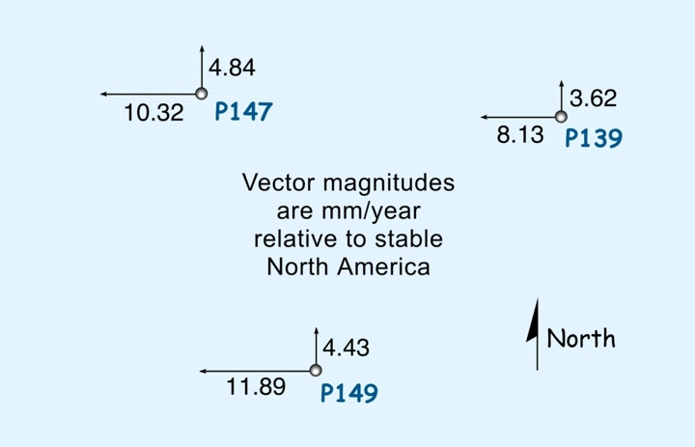
Strain between 3 GPS Stations
http://www.baylor.edu/csr
Notes:
We can plot the horizontal components of station velocity relative to stable North America.

Slide 18
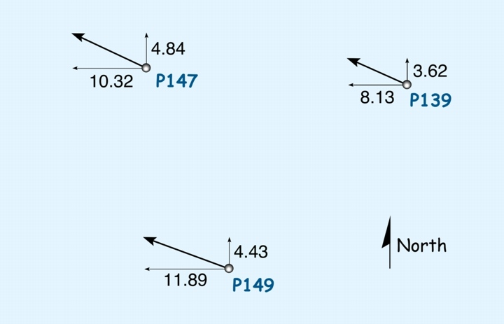
Strain between 3 GPS Stations
http://www.baylor.edu/csr
Notes:
We add them together to find the total velocity vector...

Slide 19
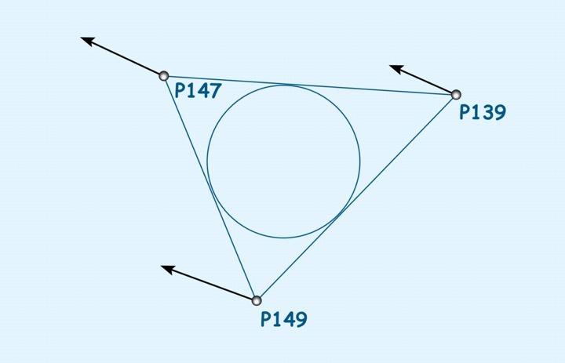
Strain between 3 GPS Stations
http://www.baylor.edu/csr
Notes:
...so a triangle or circle defined at some initial time between the GPS stations...

Slide 20
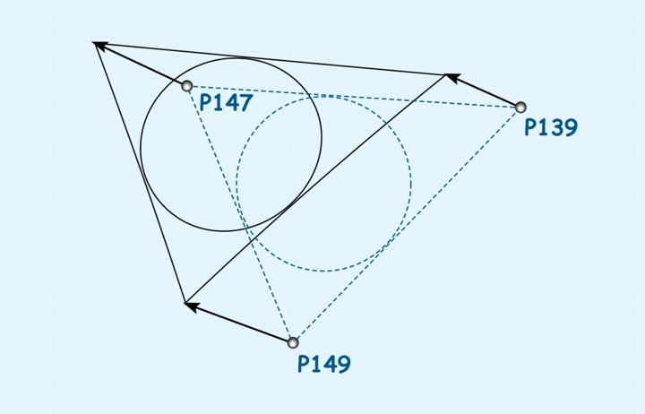
Strain between 3 GPS Stations
http://www.baylor.edu/csr
Notes:
...may be deformed, translated or rotated relative to stable North America.

Slide 21
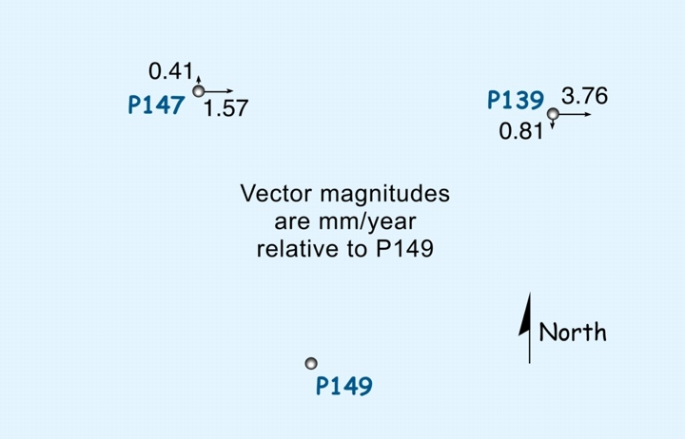
Strain between 3 GPS Stations
http://www.baylor.edu/csr
37
Notes:
So we represent the velocities relative to one of the three stations, for example station P149, and we subtract the velocity of station P149 from the velocities of the other stations...

Slide 22
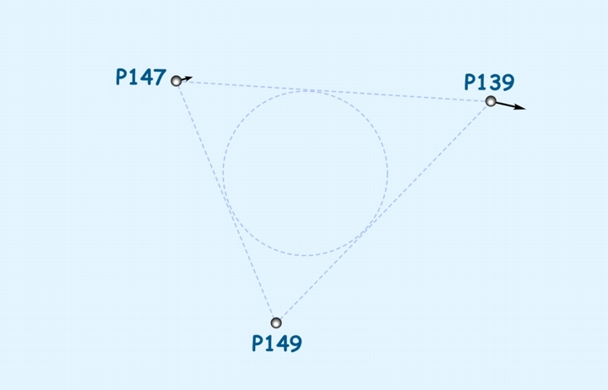
Strain between 3 GPS Stations
Velocities Relative To P149
http://www.baylor.edu/csr
Notes:
...re-draw our reference triangle and circle...

Slide 23
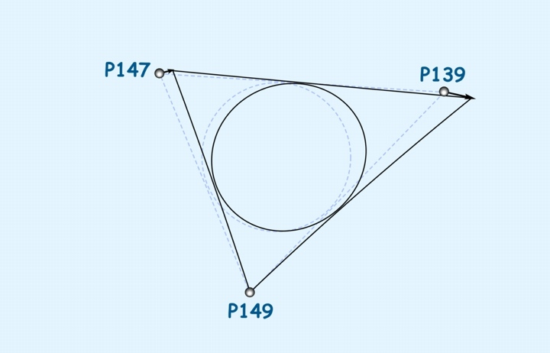
Strain between 3 GPS Stations
Strain Relative To P149
http://www.baylor.edu/csr
Notes:
...and use those relative velocities to define the deformed triangle and strain ellipse.

Slide 24
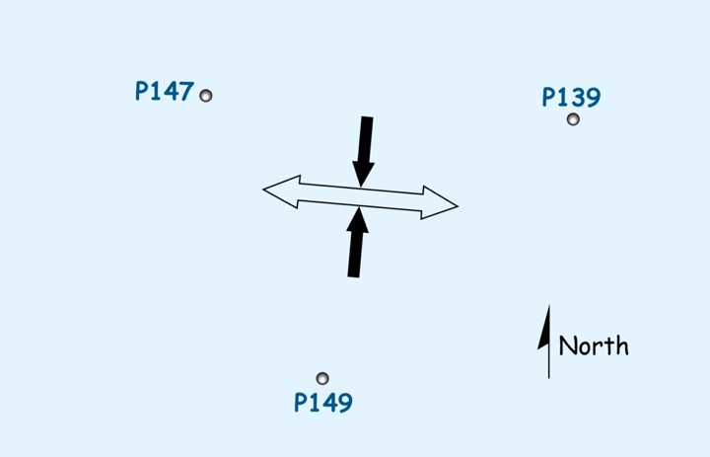
Strain between 3 GPS Stations
http://www.baylor.edu/csr
40
Notes:
The GPS data allow us to define the average directions of horizontal stretching and shortening.

Slide 25
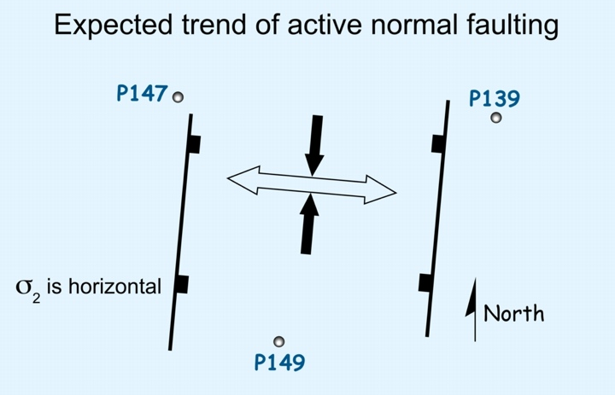
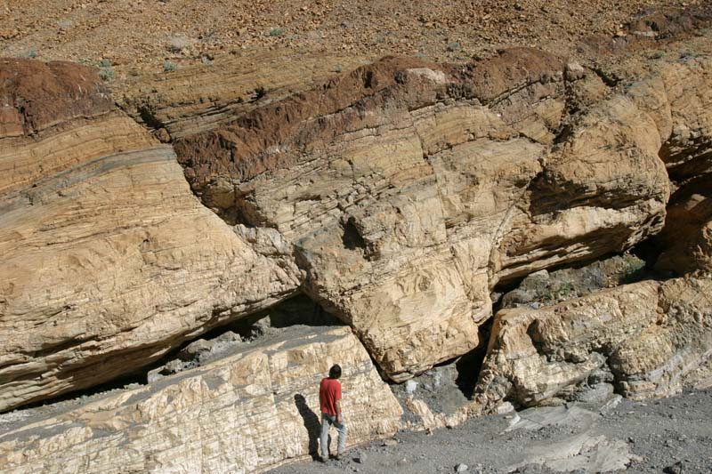
Strain between 3 GPS Stations
http://www.baylor.edu/csr
http://marlimillerphoto.com/SrF-03.html
Notes:
So one would expect that normal faults oriented perpendicular to the stretching direction might be active...

Slide 26
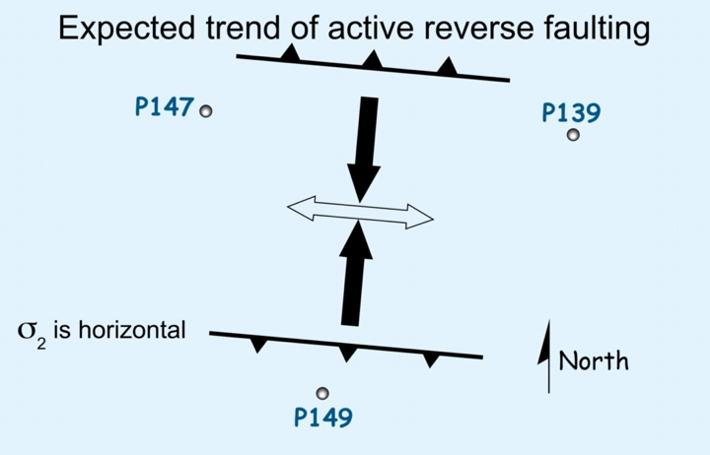
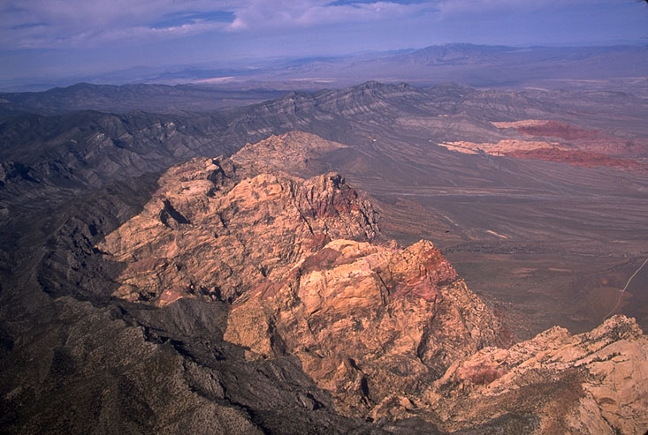
Strain between 3 GPS Stations
http://www.baylor.edu/csr
http://marlimillerphoto.com/SrF-27.html
Notes:
...and reverse faults perpendicular to the shortening direction might be active...

Slide 27
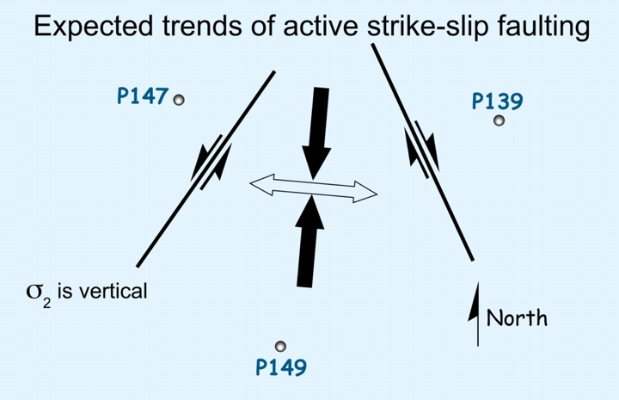
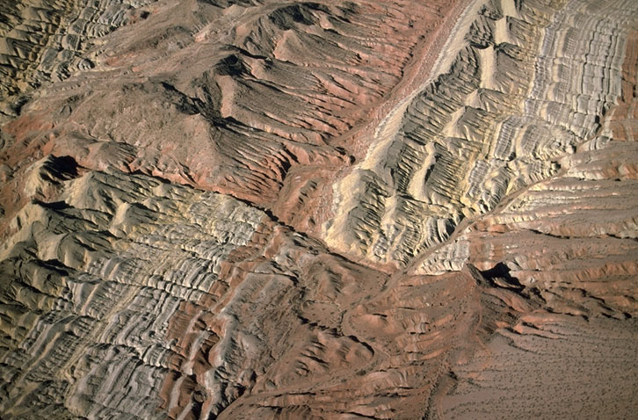
Strain between 3 GPS Stations
http://www.baylor.edu/csr
http://marlimillerphoto.com/SrF-38.html
Notes:
...and the orientation of active strike-slip faults can also be predicted.

Slide 28
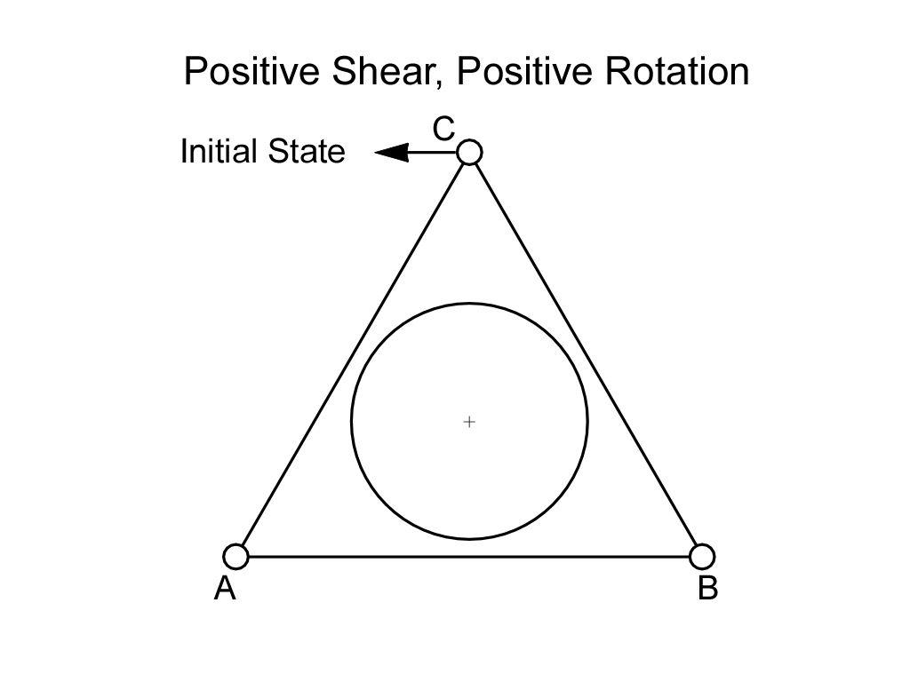

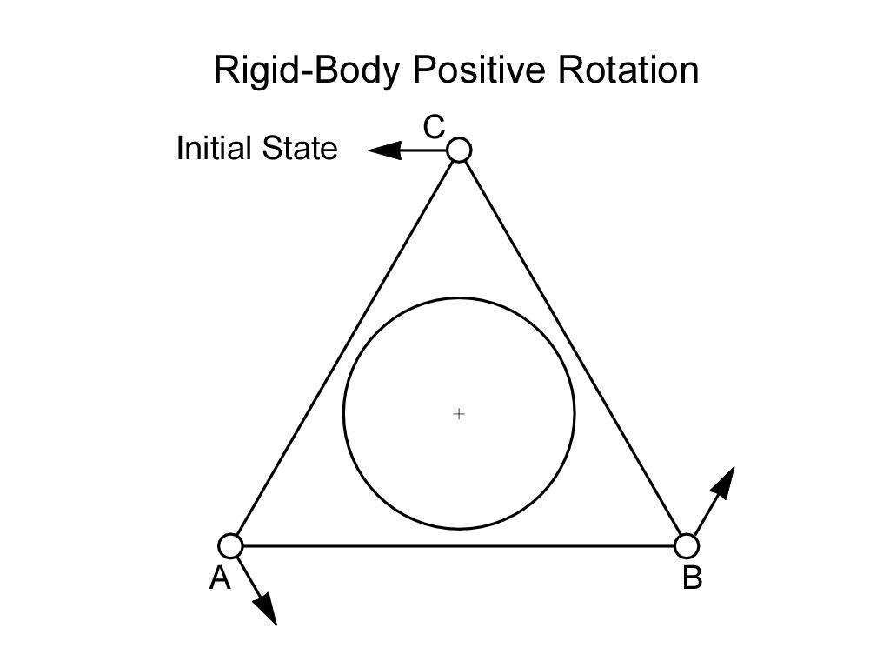
Preliminary Outcomes
Students are able to:
Describe meaning of GPS vectors
Describe strain qualitatively
based on velocity vectors
Back-envelope calculations
of strain rate (ex. across WA)
→mini lectures, group
activities (physical models,
small exercises), readings,
homework

Slide 29
Primary Outcomes
Students will be able to:
Access & download Plate Boundary Observatory (PBO) data for 3-station triangles
Do calculations to determine how triangle has rotated, translated, distorted
Analyze geological implications of strain and compare to:
  Local structures
  Regional earthquake hazard
  Focal mechanisms (optional)

Slide 30
Activities
More readings & mini-lectures
Students are assigned triangle sets and through jig-saw puzzle teams observe range of different strains
Final Assessment
  Students pick triangle set in area of personal interest; predict expected strain; calculate actual; compare and explain

Slide 31
Matrix algebra
Translation (rate) Rotation (rate) Distortion (rate)
Can be combined into matrix of form:
d = G m
And ultimately inverted to solve for
unknowns “m”
m = G⁻¹d
Notes:
There will also be an Instructor’s Guide to help adoption by others (especially non-geodesists)

Slide 32
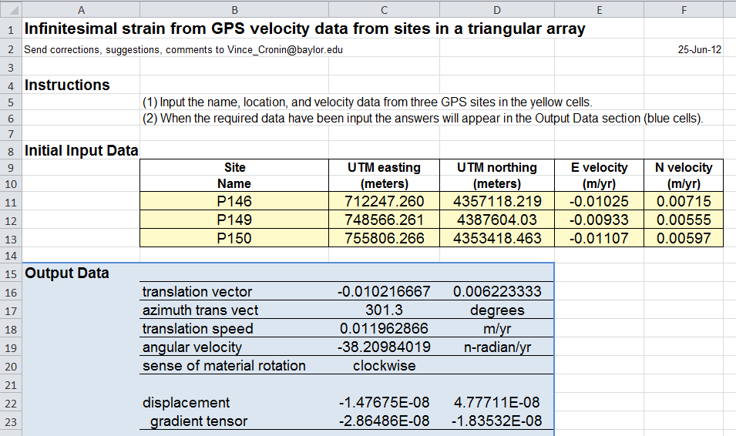
Excel calculator
Excel calculator is a “grey” box (some explanation)
→Extension with more student involvement in matrix algebra

Slide 33
For Discussion
Questions
Suggestions/requests
Interested beta-testers (winter-spring 2013)?
Notes:
How quantitative would you like it?
What calculators would you want? (Matlab? Python?)

Slide 34
Uncertainties
The uncertainty of our strain estimate is a function of the individual uncertainties in the velocity estimates (available from UNAVCO) and how these uncertainties map into the model space.
The data uncertainty can be expressed as a covariance matrix (covd) with diagonal values equal to the individual variances (σ ²), assuming that the error in each station’s velocity estimate is independent of the other stations.
For a linear equation of the form m=G⁻¹d (our inverse solution). The covariance of the model (covm) can then be expressed as (Menke, 1989)
or more simply as
where the inverse of the data covariance matrix (covd)⁻¹ is simply a diagonal matrix with values equal to 1/σ ² for each of the velocity estimates.

Slide 35

Earth Science Literacy
Big Idea 1. Earth scientists use repeatable observations and testable ideas to understand and explain our planet.
Big Idea 4. Earth is continuously changing.
Big Idea 8. Natural hazards pose risks to humans.

Slide 36
Quantitative Skills Development
Suggestions from SERC for Upper Division
Active engagement means students:
  Work on problems that interest them
  Design solution strategies
  Articulate math ideas in words and argue methods with peers
Confront misconceptions
  Ex. Make predictions and compare to actual
Multiple representations (numerical, graphical, verbal, etc)
Iteration (with timely feedback)
Appropriate use of technology

Slide 37
Assessment & Evaluation
Formative assessments (for students)
  Conversations
  Homework
  Quizzes
Summative assessments (for students)
  Lab write up
  Test/exam
Curriculum evaluation
  Rubric/s
  Faculty reflection
What does the student know?
What is the student learning so far?
What did the student learn?
Are effective design practices being used?
Are curricular goals being accomplished?

Slide 38
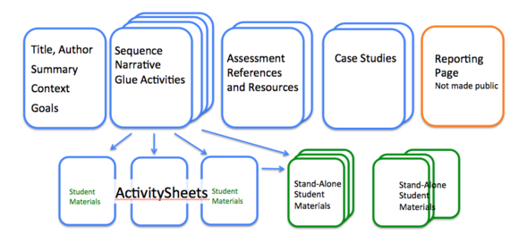
SERC’s InTeGrate Project
Develop curricula that will teach geoscience in the context of societal issues across the disciplines.
Create a population of college graduates poised to apply geoscience to viable solutions of current and future societal challenges
InTeGrate module elements

