Slide 1
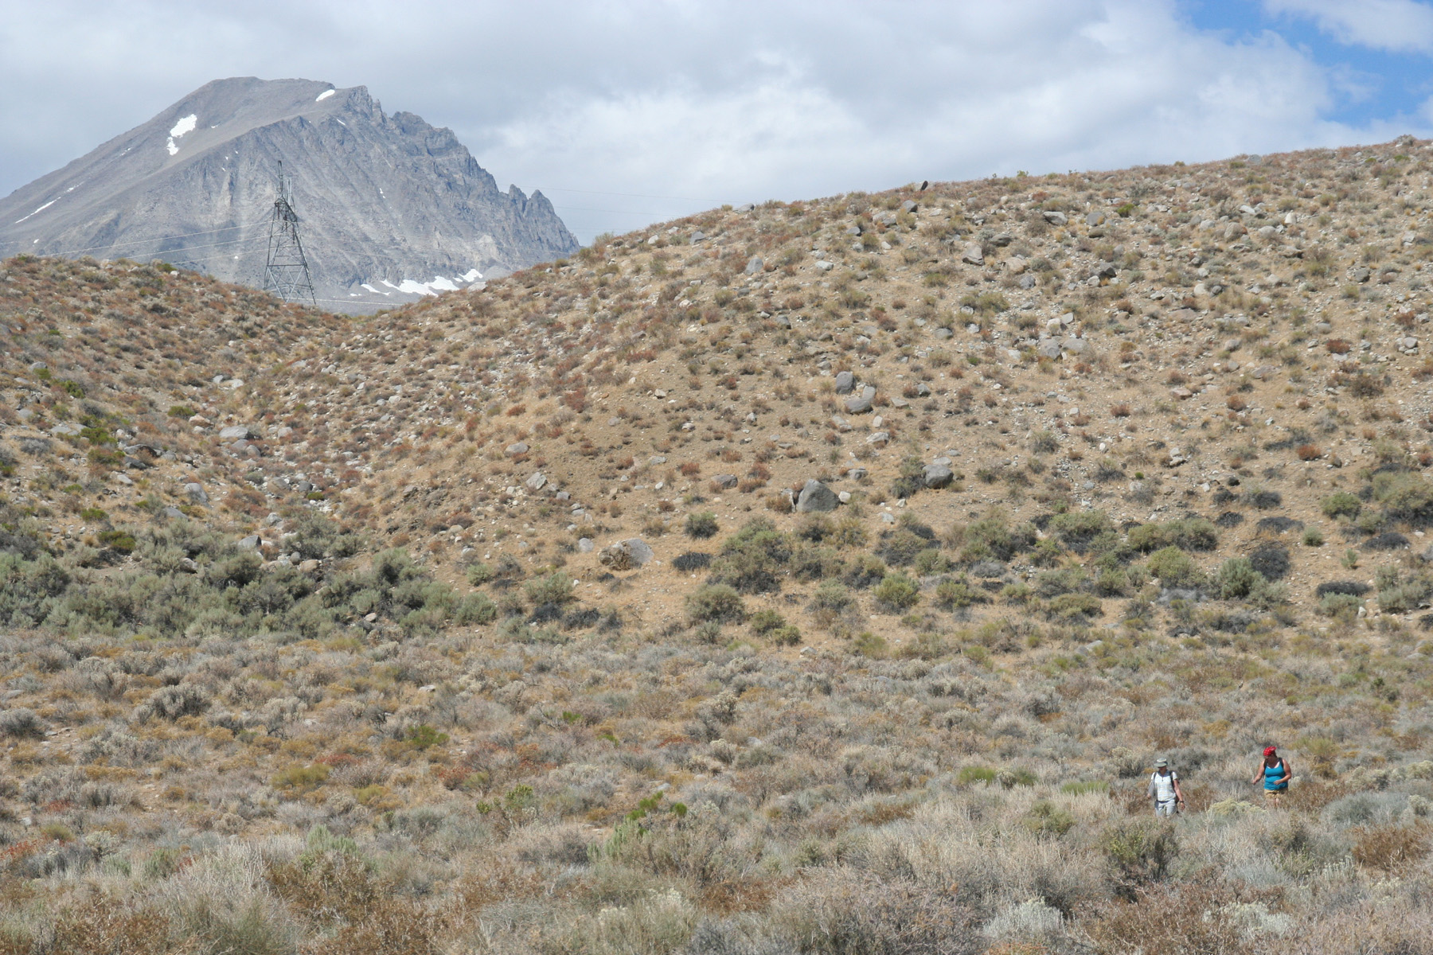
Recognizing and mapping faults using lidar, Google Earth, and field data
Anne E. Egger
Central Washington University
Teaching Structural Geology, Geophysics, and Tectonics in the 21st Century, July 15-19, 2012
Notes:
This is an exercise I designed for an “Introduction to Field Methods” course, which students can take after having only had one introductory geoscience course. The idea is that this is the course to “set the hook” – get them out into the field, show them the amazing things you can see and do with the geosciences, and get them excited about continuing in the major. At the same time, our goals are to introduce them to the skills and techniques of mapping in the field, including modern tools and techniques.
The key point, however, is that these students are getting their first taste of looking for things in the field that they’ve only heard about theoretically up to that point.

Slide 2
What do you see?
Notes:
As an expert, what do you see when you look at this picture:

Slide 3
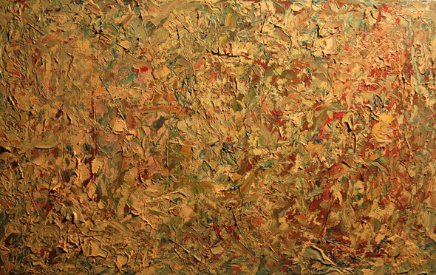
What they see:
“Chaos theory” from GraphicRiver.net
Notes:
As an introductory student from western Washington, here is an approximation of what they see when they look out on that same landscape. This is not a bad thing! They just need much more guidance in making the key observations that lead them to the interpretation of a fault. And we have lots of great tools at our disposal now to be able to do that.

Slide 4
Learning goals
Content: Students will be able to…
  Recognize and map a normal fault
  Recognize and map alluvial fans of different ages
  Draw a cross-section across a normal fault
Higher order thinking: Students will be able to…
  Synthesize information from the field, lidar data, and the literature to draw and interpret a map
  Interpret the geology of the map area in the larger tectonic context
Other skills: Students will be able to…
  Use Google Earth to explore the map area

Slide 5
Introduction to the Basin and Range
Notes:
Start with an introduction to the Basin and Range – tectonic context, what normal faults look like, what volcanic activity looks like in extensional settings.

Slide 6
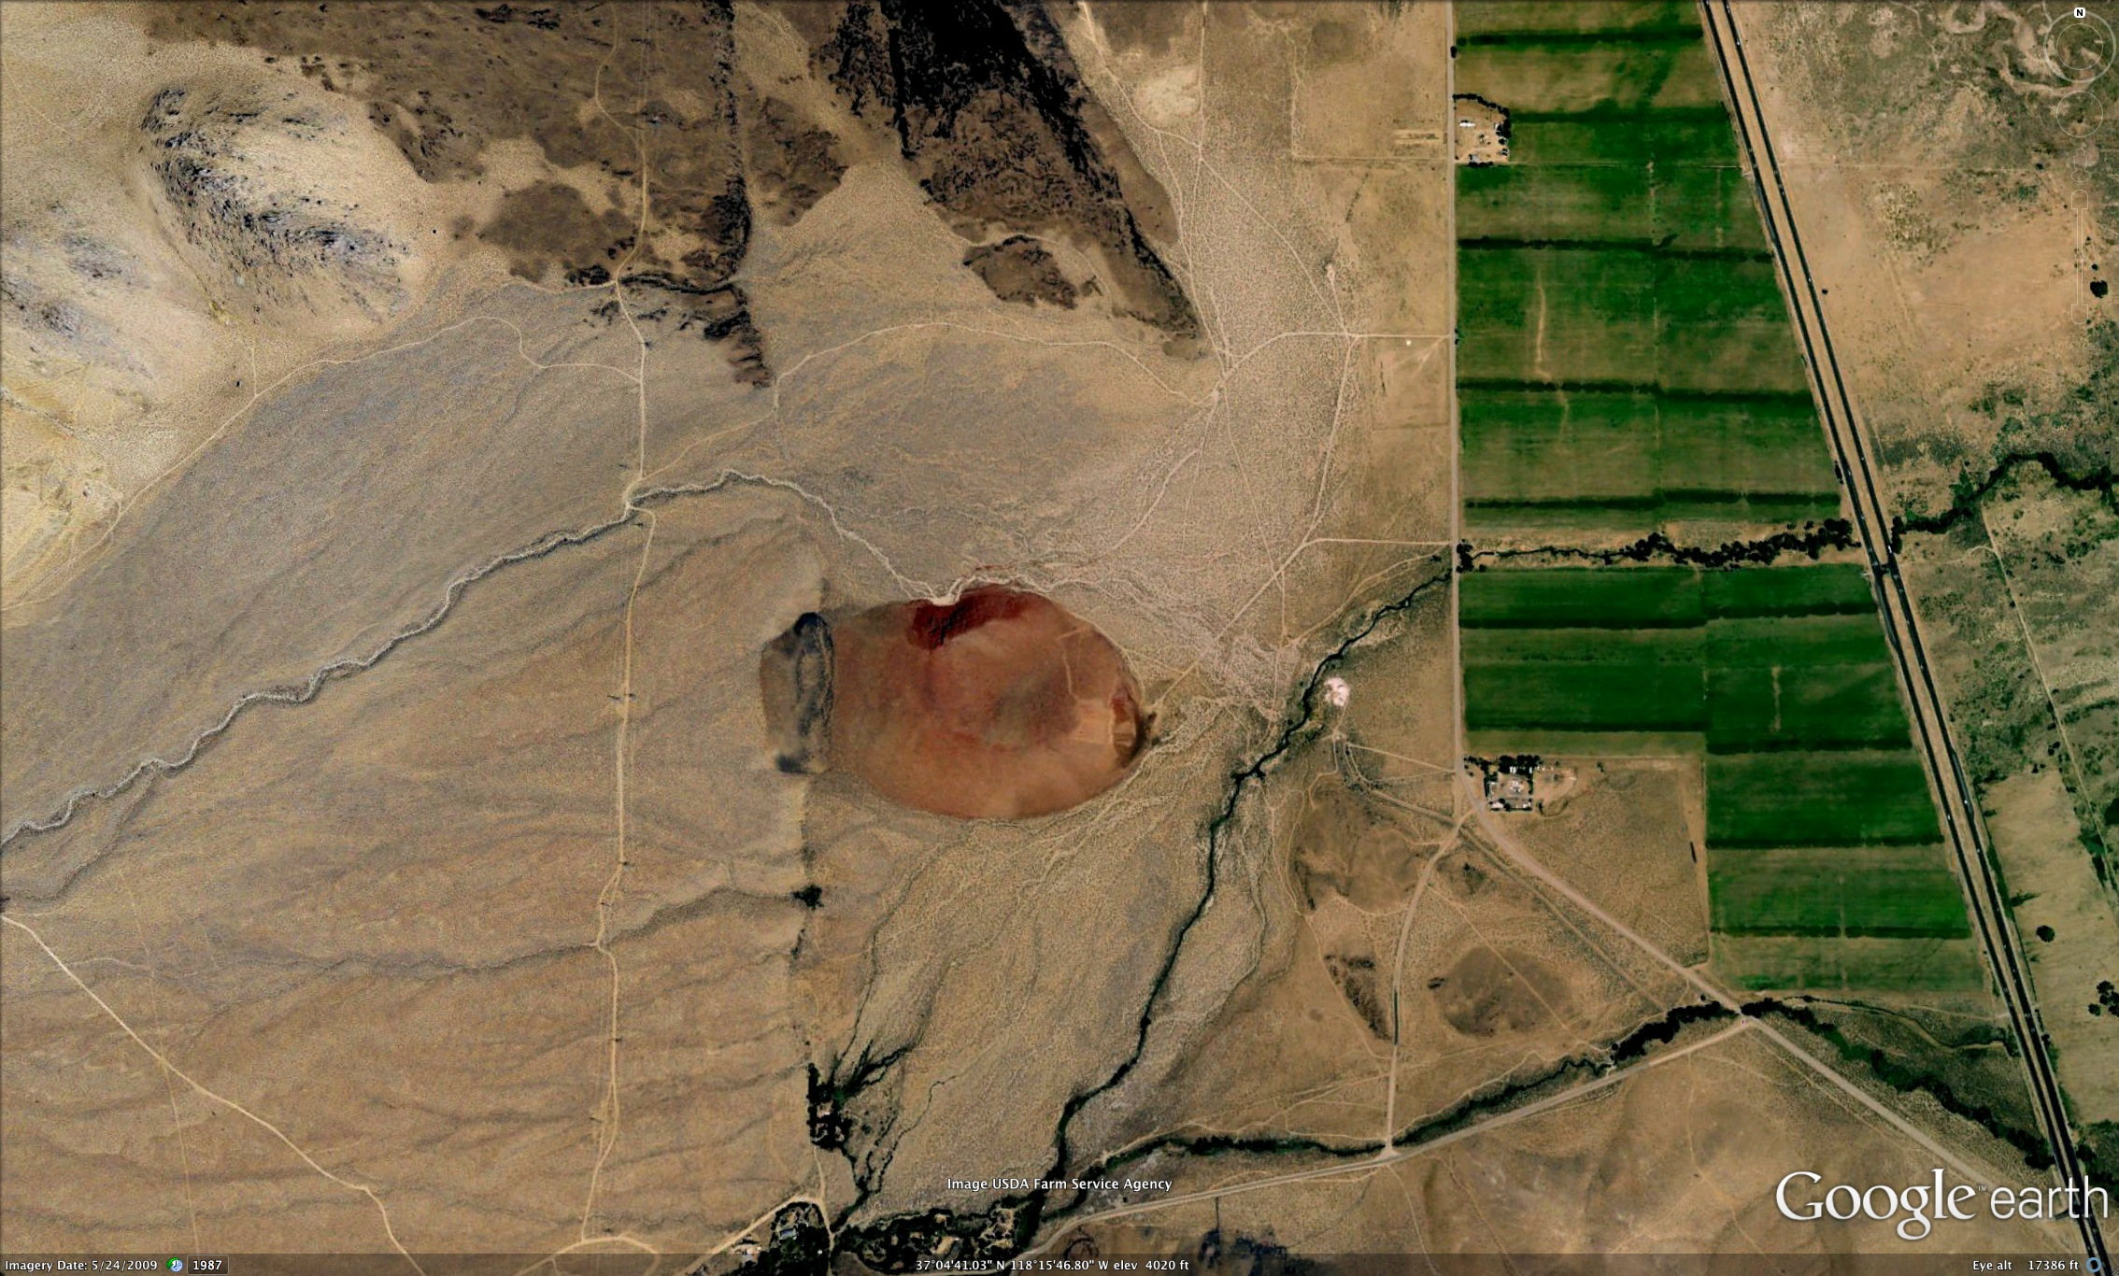
Introduction to the field area

Slide 7
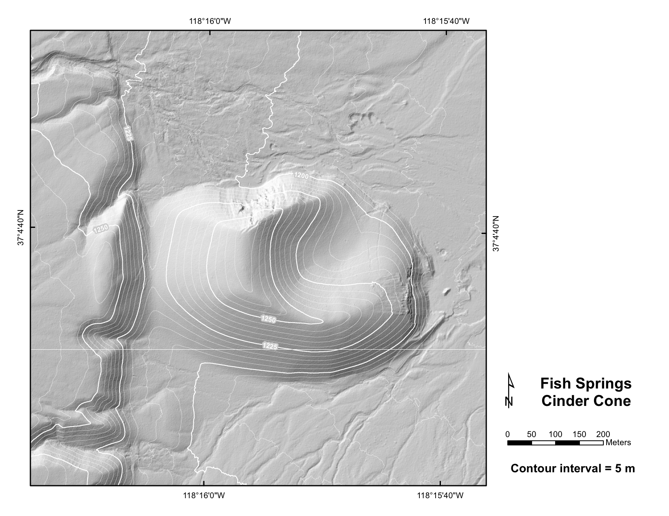
Notes:
Field map that they get the next morning. Over the course of the day, we talk about describing different units, the composition of the cinder cone, etc. Where to draw the tract of the fault on the map.

Slide 8
Where does the fault go?

Slide 9
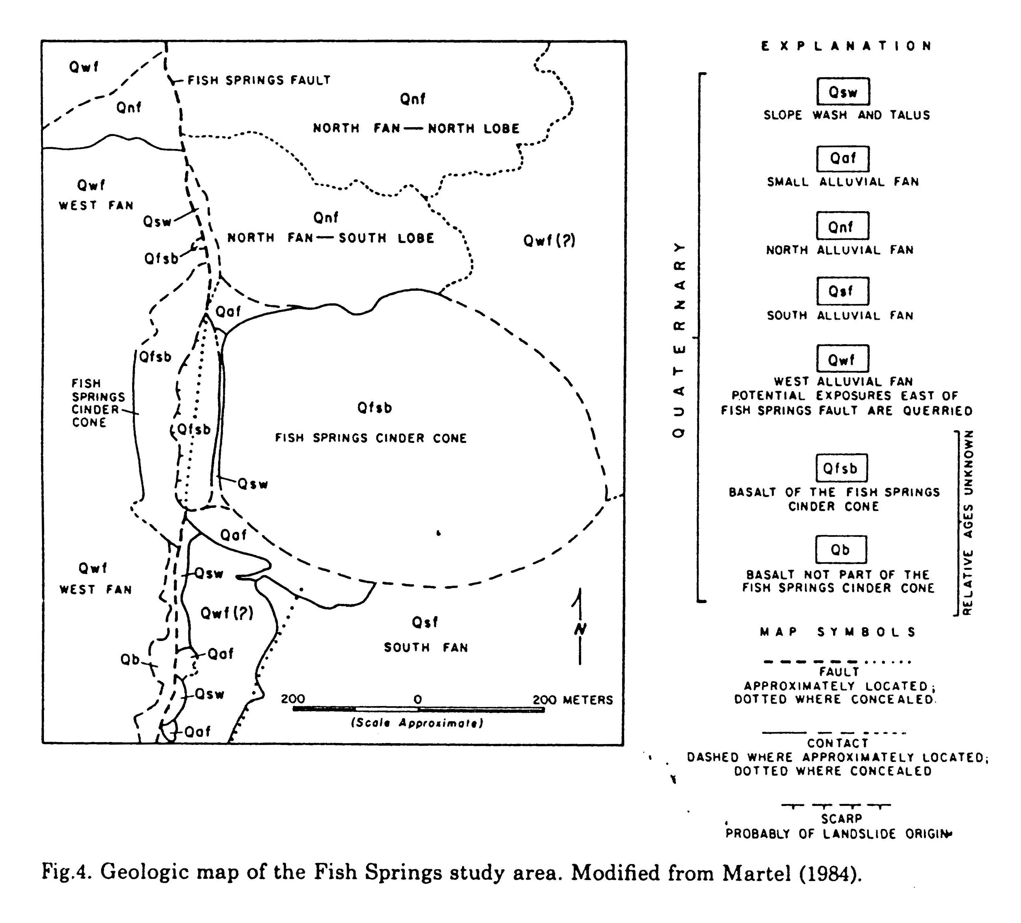
The literature
Martel, 1989

Slide 10
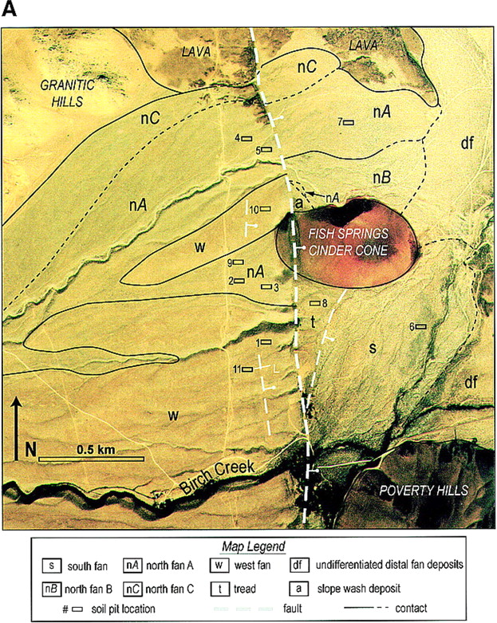
Zehfuss et al.,
2001

Slide 11
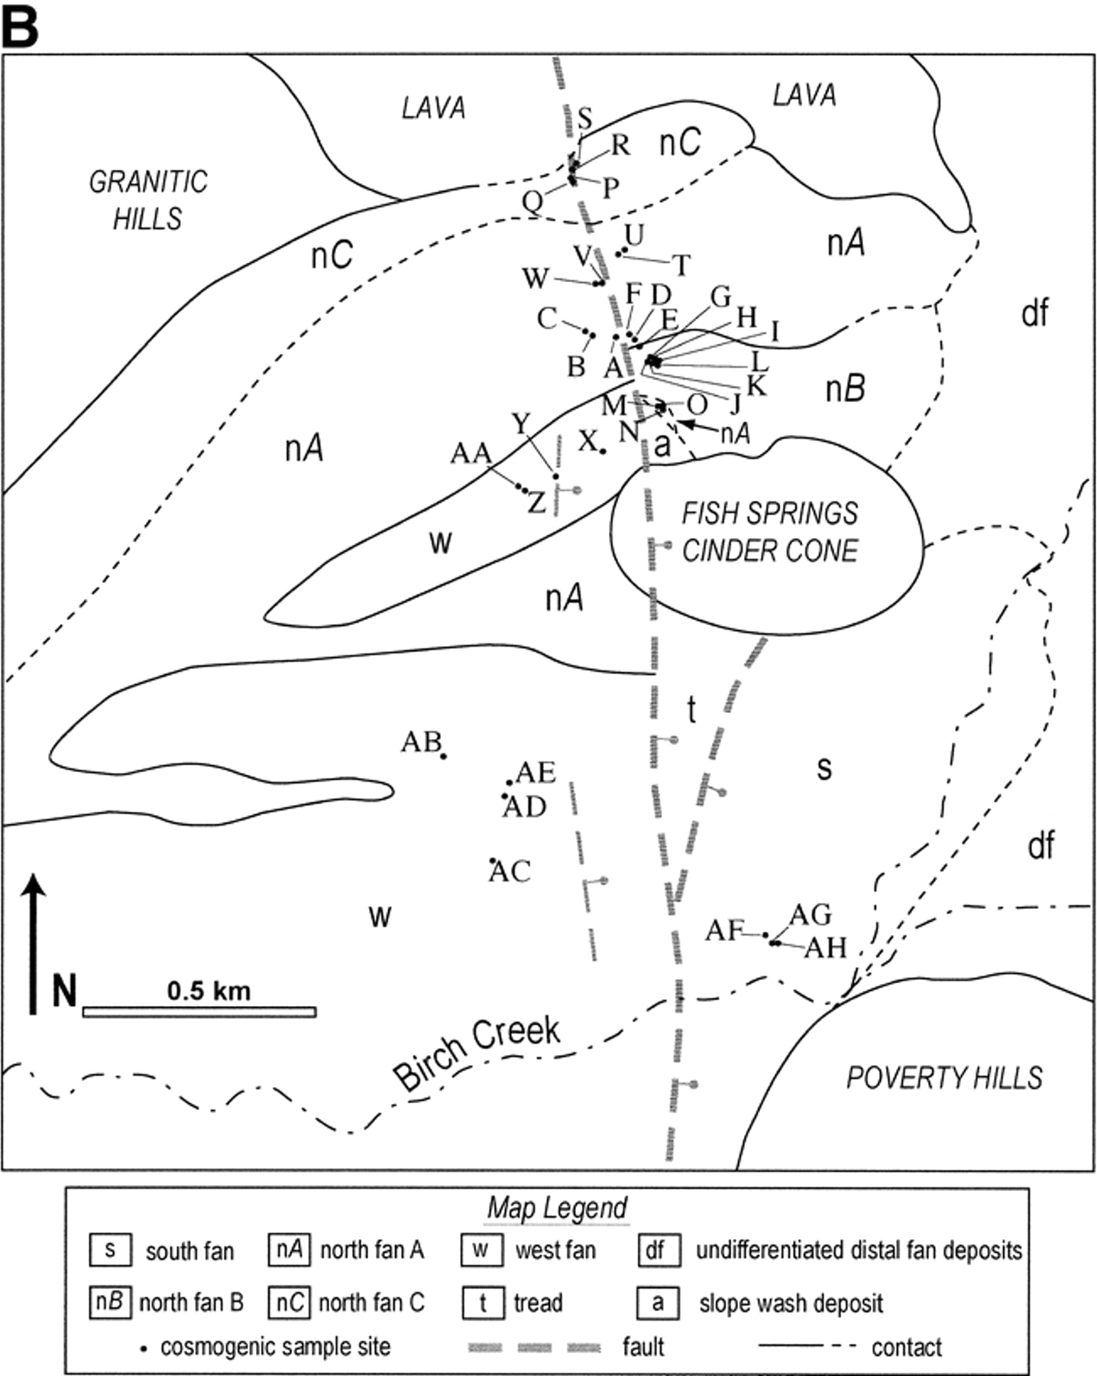
Zehfuss et al.,
2001

Slide 13
Notes:
They have a dataset that neither of those two authors had – the lidar! This gets them very excited.

Slide 14
Back to the field with
Google Earth…

