Slide 1

Teaching via NSG Pitfalls
Objective of this talk: Present a few specific examples of critical thinking via common pitfalls in near-surface geophysical data analysis
Most of the material can be found at either:
Books:
Baker, G.S., and Jol, H.J., eds., 2007, Stratigraphic Analysis using Ground Penetrating Radar: Geological Society of America, Special Paper 432. [ISBN 978-0-8137-2432-4]
Baker, G.S., 1999, Processing near-surface seismic-reflection data: A Primer: edited by R.A. Young, Society of Exploration Geophysicists Publications. [ISBN 1-56080-090-9]
Peer-Reviewed Journal Articles:
Baker, G.S., 2008, Improving our understanding of near-surface seismic reflection data quality: Invited contribution to The Leading Edge Special Issue, 27, 1526-1534.
Baker, G.S., *Jordan, T.E., and *Talley, J., 2007, An introduction to ground penetrating radar (GPR), in Baker, G.S., and Jol, H.M., eds., Stratigraphic Analyses Using GPR: Geological Society of America Special Paper 432, 1–18.
Baker, G.S., Steeples, D.W., Schmeissner, C., Pavlovic, M., and Plumb, R., 2001, Coincident imaging with seismic and GPR techniques: Geophys. Res. Lett., 28, no 4, 627-630.
Baker, G.S., Steeples, D.W., Schmeissner, C., and Spikes, K.T., 2000, Source-dependent frequency content of ultrashallow seismic reflection data: Bull. Seis. Soc. Amer., 90, 2, 494-499.
Gaines, D.P., Baker, G.S., Hubbard, S.S., Watson, D, Brooks, S., and Jardine, P., 2010, Detecting perched water bodies using near-surface seismic time-lapse travel-time tomography, in Miller, R.D., Bradford J,H, Holliger, K., eds., Advances in Near Surface Seismology and Ground-Penetrating Radar, Society of Exploration Geophysicists, Tulsa, OK, ISBN 9781560802242.
Gilcrist, L.E., Baker, G.S., Sen S., 2007, Preferred frequencies for three unconsolidated Earth materials: Applied Physics Letters, 91, 254-257.
Jordan, T.E., Baker, G.S., Henn, K., Messier, J-P., 2004, Using amplitude variation with offset and normalized residual polarization analysis of ground penetrating radar data to differentiate an NAPL release from stratigraphic changes: Journal of Applied Geophysics, 56, 41– 58.
Kowalsky, M. B., E. Gasperikova, S. Finsterle, D. Watson, G. Baker, and S. S. Hubbard, 2011, Coupled modeling of hydrogeochemical and electrical resistivity data for exploring the impact of recharge on subsurface contamination, Water Resour. Res., 47, W02509, doi:10.1029/2009WR008947.
Malinowski, M., and Baker, G.S., 2003, Experimental results of energy and soil-moisture effects on nonlinear deformation associated with near-surface seismic reflection sources: Journal of Environmental and Engineering Geophysics, 8, no 4, 221-226.
Talley, J., Baker, G.S., Becker, M.W., Beyrle, K., 2005, Four Dimensional Mapping of Tracer Channelization in Sub-Horizontal Bedrock Fractures using Surface Ground Penetrating Radar, Geophysical Research Letters, v. 32, p. 732-735.

Slide 2
Teaching via NSG Pitfalls
Concept #1
SURVEY DESIGN
Common Pitfall: “Sampling is not as important as technique”
Skills:
Solving basic sampling theory problems
Basic practical sampling
Learning Outcomes:
Understanding random, pseudo-random, and nonrandom
Improved ability to assess the limitations of any sampling protocol
Resource management

Slide 3

Teaching via NSG Pitfalls
SURVEY DESIGN
Common Pitfall: “Sampling is not as important as technique”
Taught in: Near-Surface Geophysics, Whole Earth Geophysics, Sequence Stratigraphy
Proceeded by: Lecture/reading on sampling theory
Type: In-Class Assignment (outdoors, if possible)

Slide 4
Teaching via NSG Pitfalls
Concept #2
REFLECTIONS
Common Pitfall: “Waves reflect off of regions having different properties”
Skills:
Basic wave theory (reflection, transmission, physical properties, convolution)
Learning Outcomes:
Understanding how waves behave
The importance of frequency and wavelength relative to target geometry

Slide 5

Teaching via NSG Pitfalls
REFLECTIONS
Common Pitfall: “Waves reflect off of regions having different properties”
Taught in: Near-Surface Geophysics, Whole Earth Geophysics, Sequence Stratigraphy
Proceeded by: Lecture/reading on waves, including reflection/transmission, Snell’s Law, physical properties of materials, convolution
Type: In-Class Assignment (part outdoors, part indoors)
Elastic Waves
Elastic Behavior -- the ability of a material to immediately return to its original size, shape, or position after being squeezed, stretched, or otherwise deformed. The material follows Hooke’s Law (σ = Cε).
Plastic (Ductile) Behavior -- a permanent change in the shape, size, etc., of a solid that does not involve failure by rupture.
Stress -- force per unit area (σ)
Strain -- change in shape or size (ε)
The Wave Equation
We’ll look at the scalar wave equation to mathematically express how elastic strain (dilatation, Δ) propagates through a material:
ρ δ²Δ = (λ + 2μ) ²Δ
δt²
where
Δ = ε_{xx} + ε_{yy} + ε_{zz}
and ² is the Lapacian of Δ, or
δ²Δ/δx² + δ²Δ/δy² + δ²Δ/δz²
Δ
Δ

Slide 6
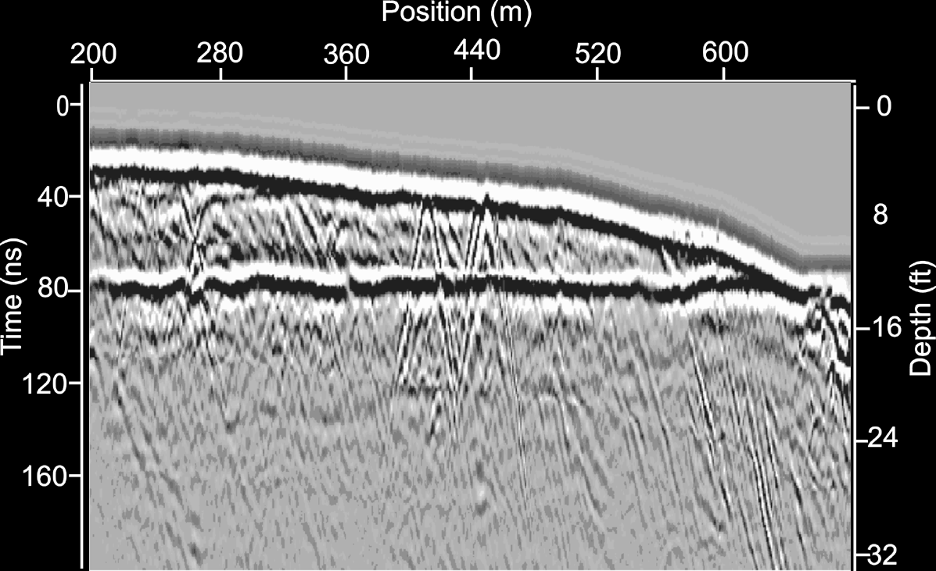
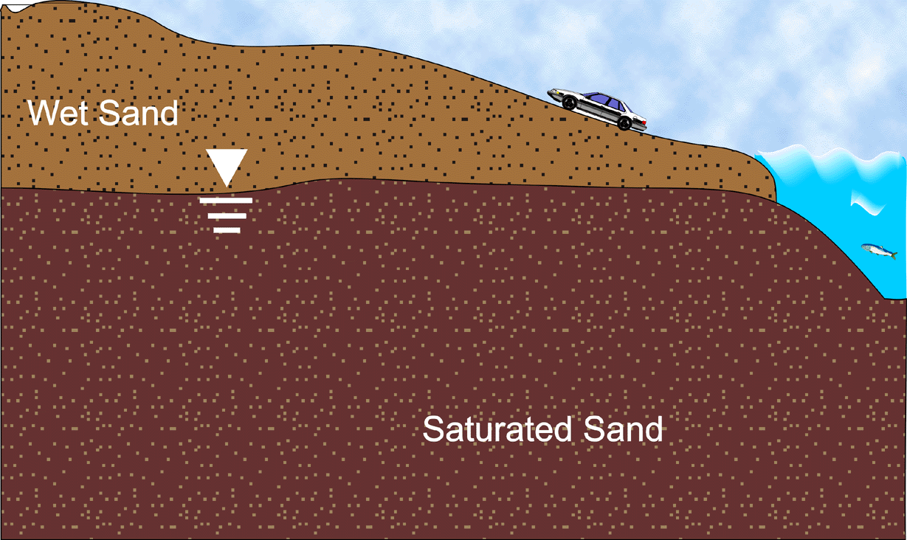
The water table is one the strongest reflecting horizons in GPR data because of the huge contrast in EM properties between water and air…
Teaching via NSG Pitfalls
REFLECTIONS
…but it is not always observed, even on excellent quality data…

Slide 7
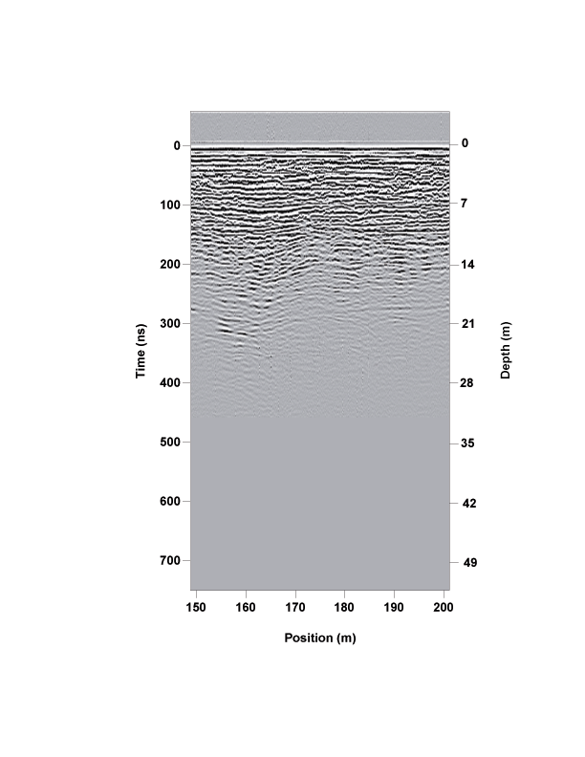
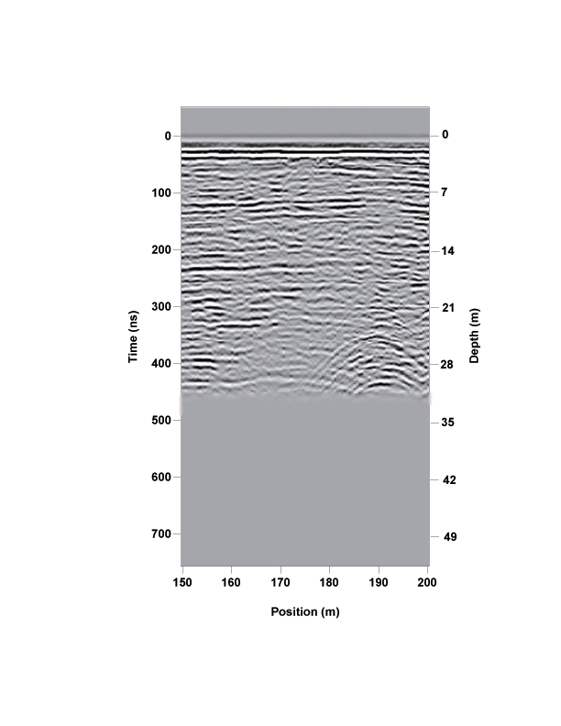
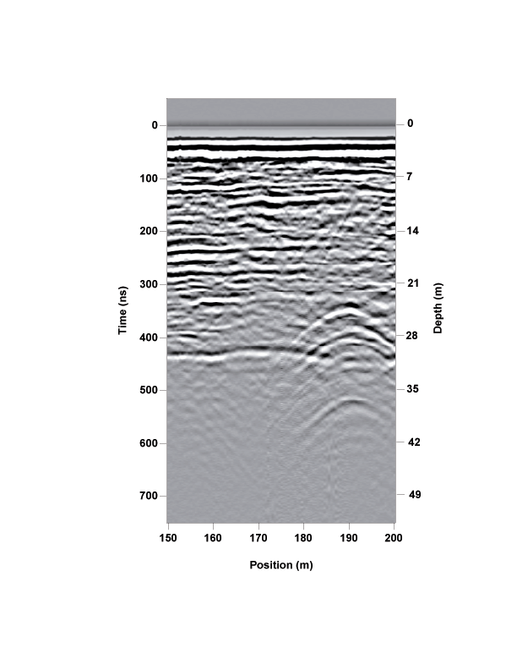
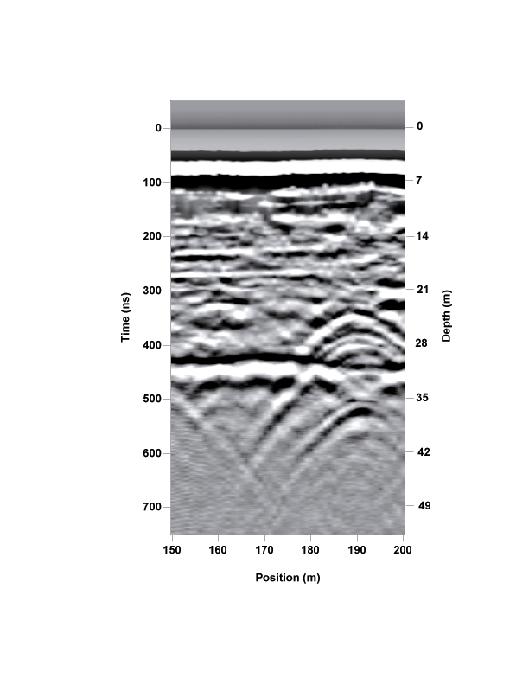
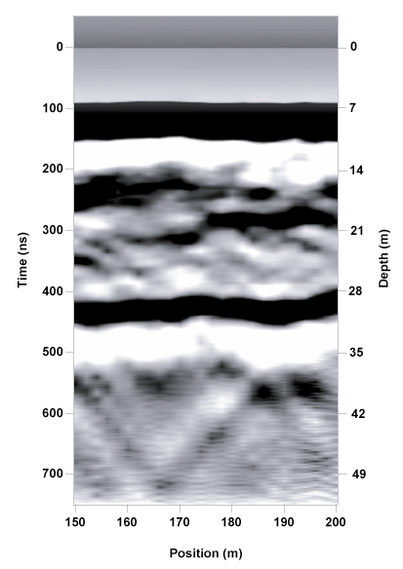
Teaching via NSG Pitfalls
REFLECTIONS
…but it is not always observed, even on excellent quality data. Why?
Data Courtesy Sensors & Software, Inc.
Hint: These GPR data were collected at the same location, one right after the other, but with different center-frequency antennae (L➔R: 200, 100, 50, 25, 12.5 MHz). The water table exists at about 28 meters depth, but is not observed on all sections.
Note: Although the higher-frequency data on the left do not penetrate with as much energy as the lower frequency data on the right, that is not the answer we’re looking for…

Slide 8
Teaching via NSG Pitfalls
Concept #3
SEISMIC SOURCE ENERGY
Common Pitfall: “More is better”
Skills:
Developing hypotheses
Practical results of the seismic wave equation
Fourier transforms
Learning Outcomes:
Skepticism of common beliefs
Mechanism for the “progress of science”

Slide 9
Teaching via NSG Pitfalls
SEISMIC SOURCE ENERGY
Common Pitfall: “More is better”
Taught in: Near-Surface Geophysics
Proceeded by: A fair amount of lecture/lab/exercises on seismics
Type: In-class Socratic discussion, walking through the following materials…

Slide 10
Effects of soil moisture and source energy on the frequency spectra associated with near-surface seismic reflection sources
Matthew S. Malinowski and Gregory S. Baker
  University of Tennessee
Research Supported by:
  USA-CRREL contract DACA42-01-C-0051
  National Science Foundation, Grant EAR-000223
  Geometrics

Slide 11
Effects of soil moisture and source energy on the frequency spectra associated with near-surface seismic reflection sources
  Introduction
  Data Collection
  Results
  Discussion
  Future Work

Slide 12
Effects of soil moisture and source energy on the frequency spectra associated with near-surface seismic reflection sources
  Introduction
  Data Collection
  Results
  Discussion
  Future Work

Slide 13
Introduction
Since the advancement of near-surface seismic techniques, researchers have noted the strong dependence that data resolution has on the frequency characteristics of the source.
Various field tests have been carried out to determine the data resolution obtained when using various sources (e.g., Miller et al., 1986; Miller et al., 1992; Miller et al., 1994; Miller, this meeting).
Clearly, source characteristics have a significant impact on data quality and resolution.
Why? (Quantitatively, not anecdotally!)

Slide 14
Introduction
Seismic reflections from depths of 1m or less have been observed (e.g., Baker et al., 1999).
The critical controllable factors in obtaining high resolution USR (ultrashallow seismic reflection) data are dense spatial sampling and high (>400 Hz) frequency content.
Frequency content is strongly controlled by the characteristics of the sources used to generate the seismic energy.
Again, why? (Quantitatively, not anecdotally!)

Slide 15
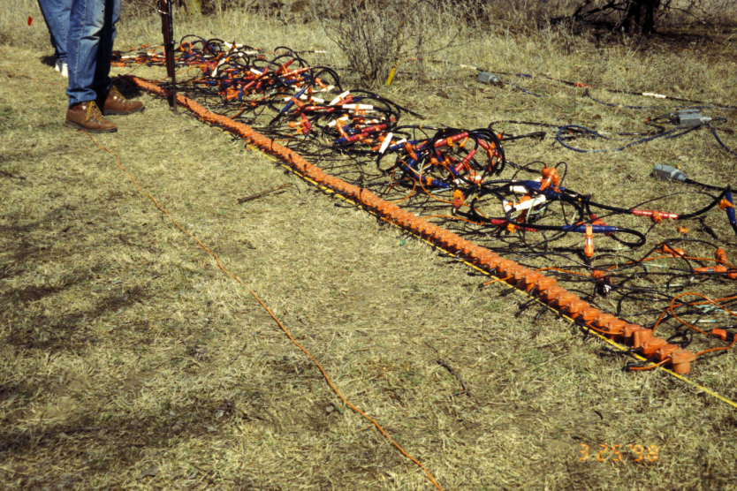

Slide 16
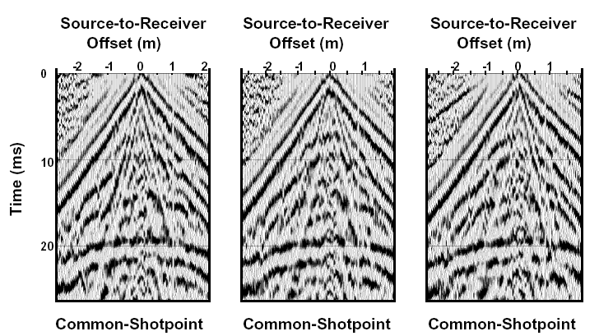
(From Baker et al., 1998)

Slide 17
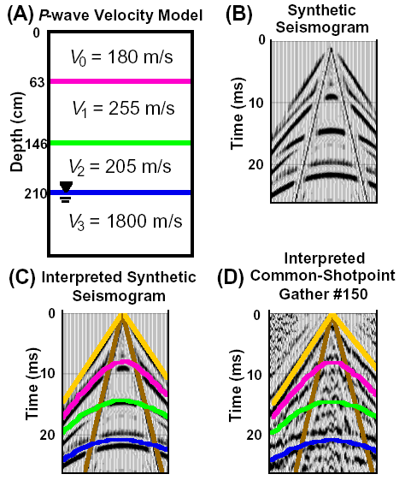
(From Baker et al., 1998)

Slide 18
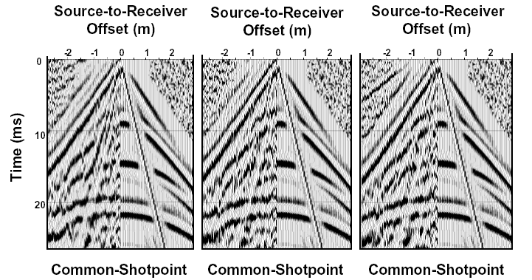
(From Baker et al., 1998)

Slide 19
Introduction (back on the topic of high frequencies!)
Qualitative experiments have indicated that the higher-energy near-surface seismic reflection projectile sources lack some of the high-frequency energy exhibited by smaller-energy sources.
In addition, soil moisture content has been shown to be an important variable in the frequency content of data even if the same source is used.
Again, again, why? (Quantitatively, not anecdotally!)

Slide 20
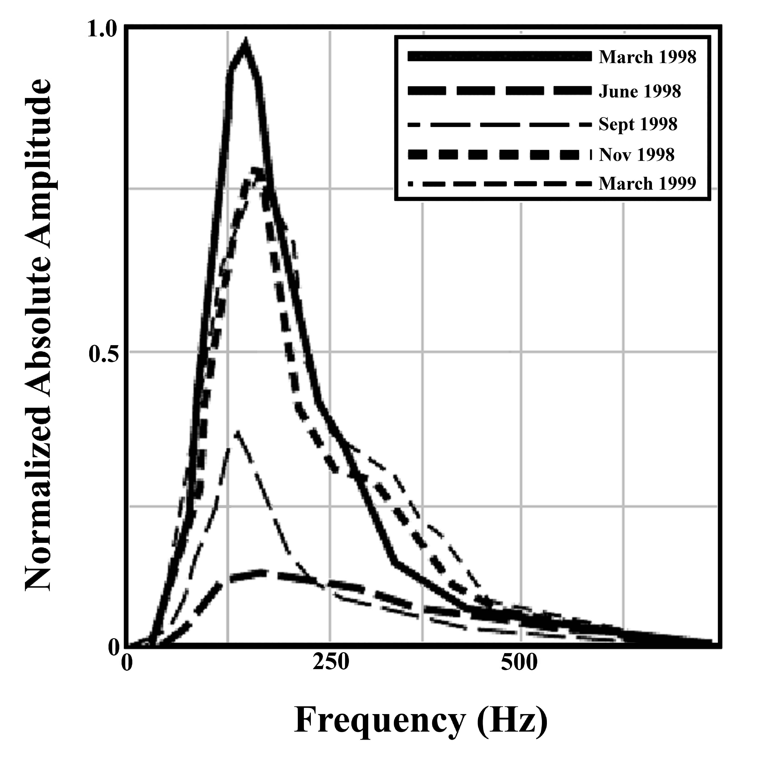
Soil-Moisture Effects on Reflection Amplitudes (same source)

Slide 21
Introduction
Why:
The reduction in the frequency content of the data has been hypothesized to correlate with greater amounts of near-source, nonlinear deformation (Malinowski et al., 2004).

Slide 22
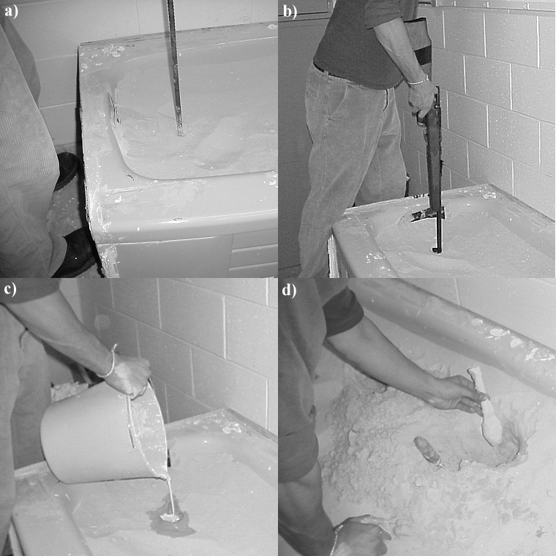
First Step:
Identify correlation among soil moisture, source energy, and near-source nonlinear deformation

Slide 23
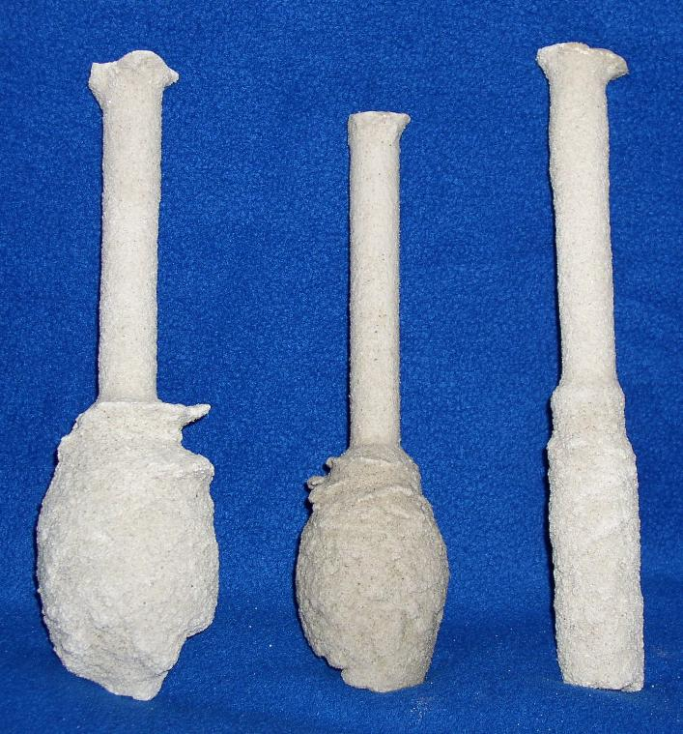
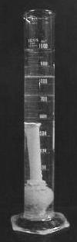

Slide 24
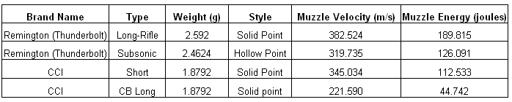

Slide 25
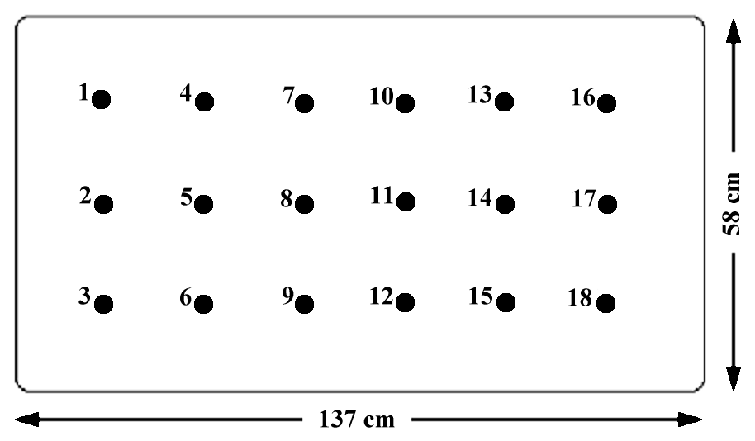

Slide 26
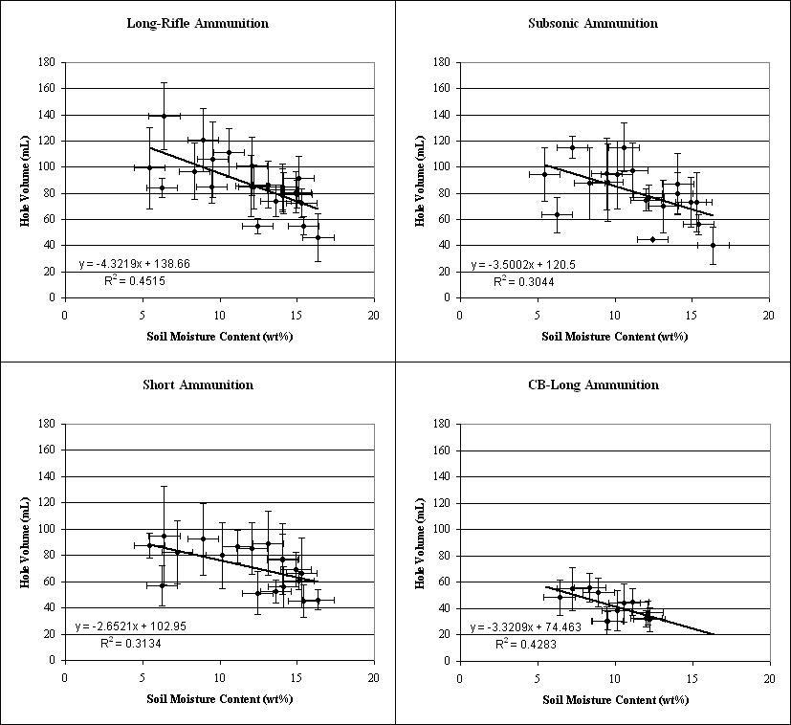

Slide 27
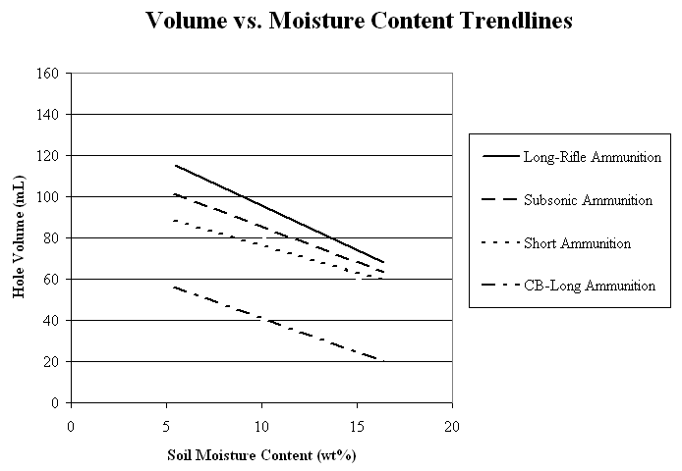

Slide 28
Second Step:
Identify correlation among soil moisture, source energy, and frequency content

Slide 29
Effects of soil moisture and source energy on the frequency spectra associated with near-surface seismic reflection sources
  Introduction
  Data Collection
  Results
  Discussion
  Future Work

Slide 31
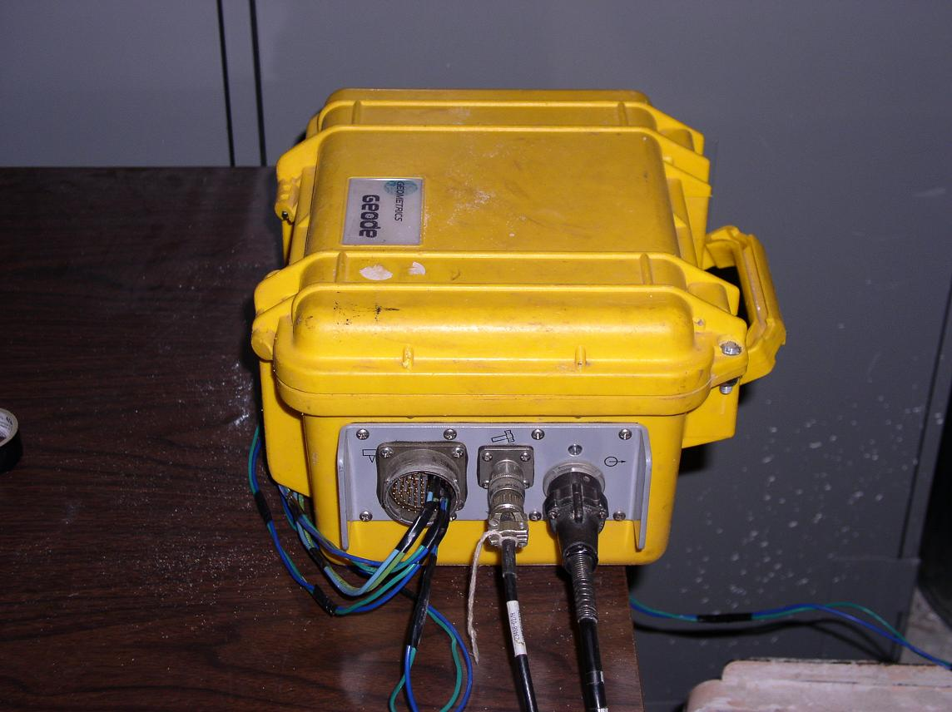

Slide 32
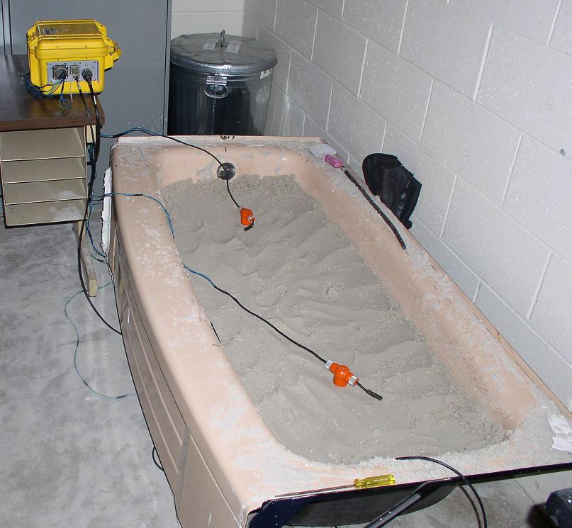

Slide 33
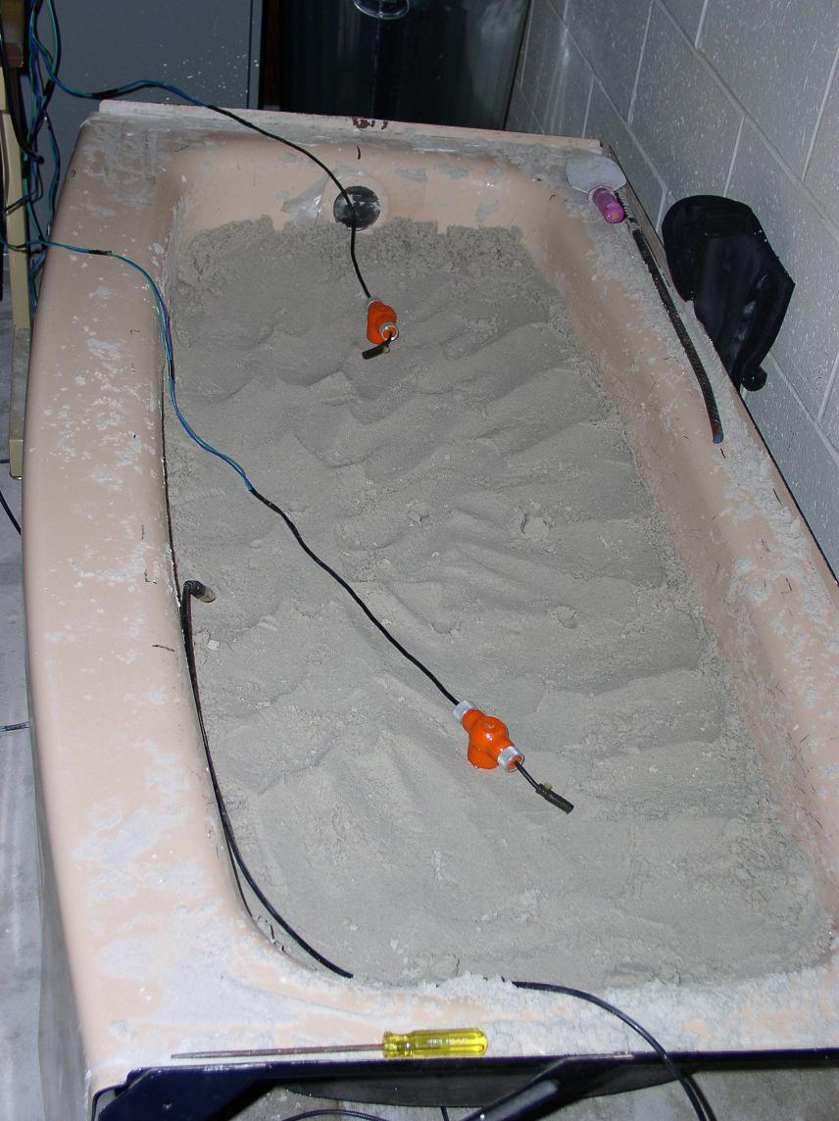
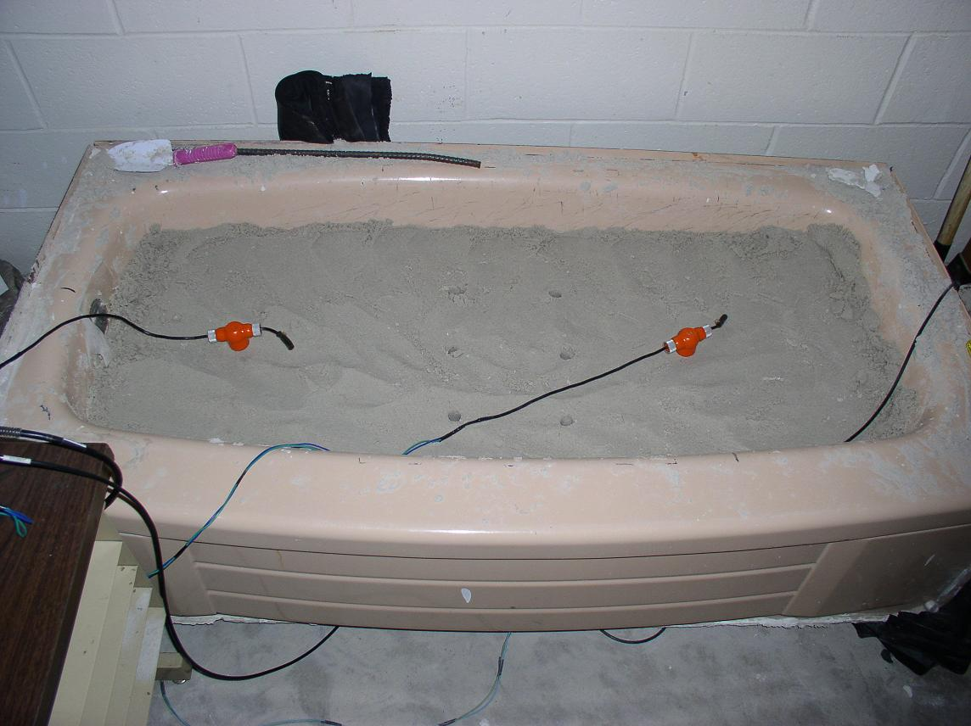

Slide 34
Effects of soil moisture and source energy on the frequency spectra associated with near-surface seismic reflection sources
  Introduction
  Data Collection
  Results
  Discussion
  Future Work

Slide 35
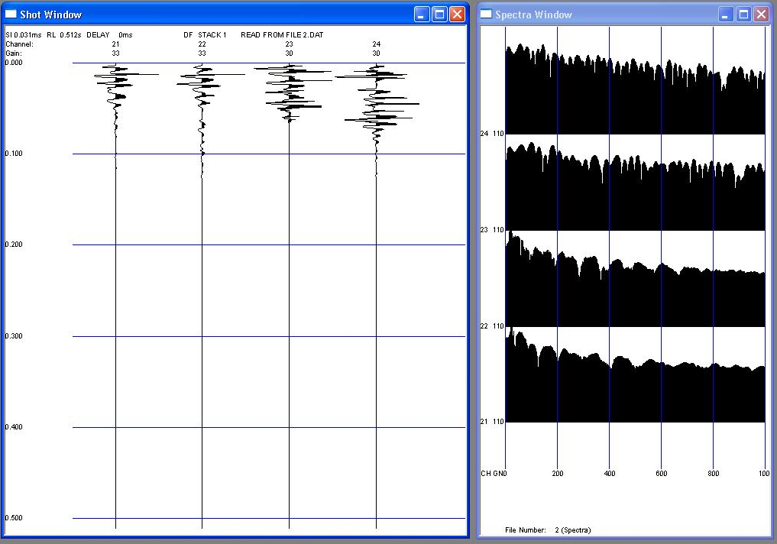

Slide 36
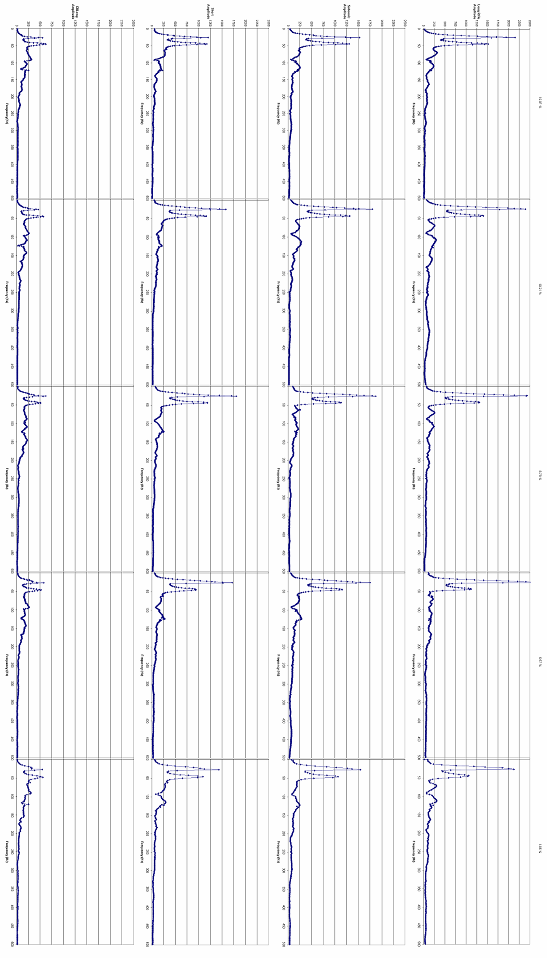
Increasing Source Energy
Increasing Soil Moisture

Slide 37
Bandwidth versus soil moisture and source energy

Slide 38
Effects of soil moisture and source energy on the frequency spectra associated with near-surface seismic reflection sources
  Introduction
  Data Collection
  Results
  Discussion
  Future Work

Slide 39
Discussion
Under the conditions imposed by our experiment, the frequency content of the data (as measured by bandwidth) correlates with greater amounts of near-source, nonlinear deformation:
frequency_{bandwidth} = f [source energy, soil moisture]

Slide 40
Effects of soil moisture and source energy on the frequency spectra associated with near-surface seismic reflection sources
  Introduction
  Data Collection
  Results
  Discussion
  Future Work

Slide 41
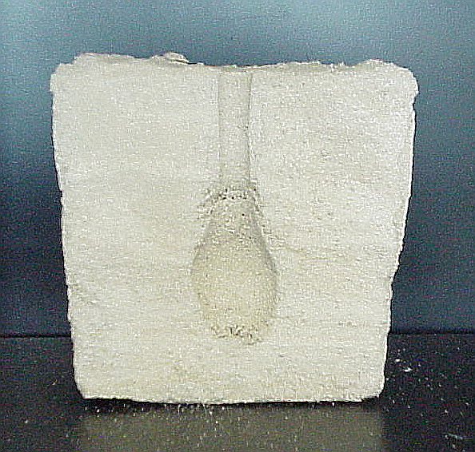
Question 1:
Is hole volume an accurate measure of volume of nonlinear deformation?

Slide 42
Question 2:
Do these findings hold true for other soil compositions?

Slide 43
Teaching via NSG Pitfalls
Concept #4
“REFRACTION” TOMOGRAPHY
Common Pitfall: “What you see is what you get” & “Ray paths dictate confidence”
Skills:
Basic tomography
Acquiring, processing, and interpreting seismic first-arrival tomography (SFT)
Learning Outcomes:
Understanding the shortcoming of tomography
Being aware of black-box software as well as black box hardware
Critical thinking about geophysics output

Slide 44
Teaching via NSG Pitfalls
“REFRACTION” TOMOGRAPHY (OR MORE ACCURATELY, SFT)
Common Pitfall: “What you see is what you get” & “Ray paths dictate confidence”
Taught in: Near-Surface Geophysics, Whole Earth Geophysics
Proceeded by: Lecture/reading, field work, and data analysis of seismic first-arrival tomography data
Type: In-Class lecture followed by an assignment…

Slide 45
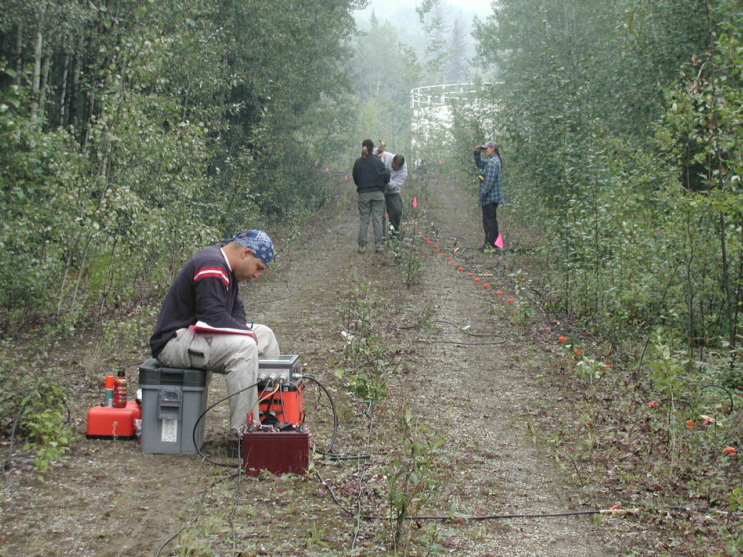
SFT Acquisition

Slide 46
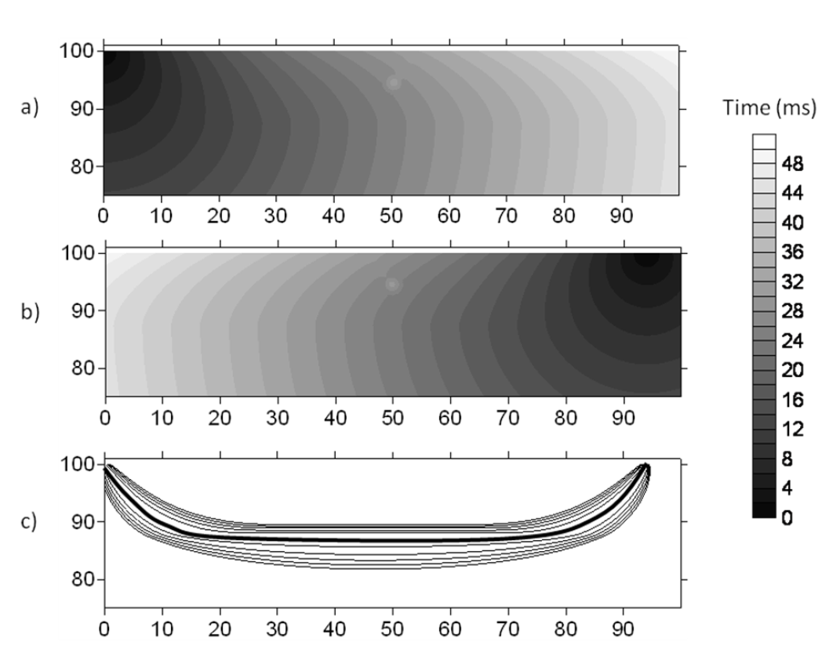
Raw Data

Slide 47
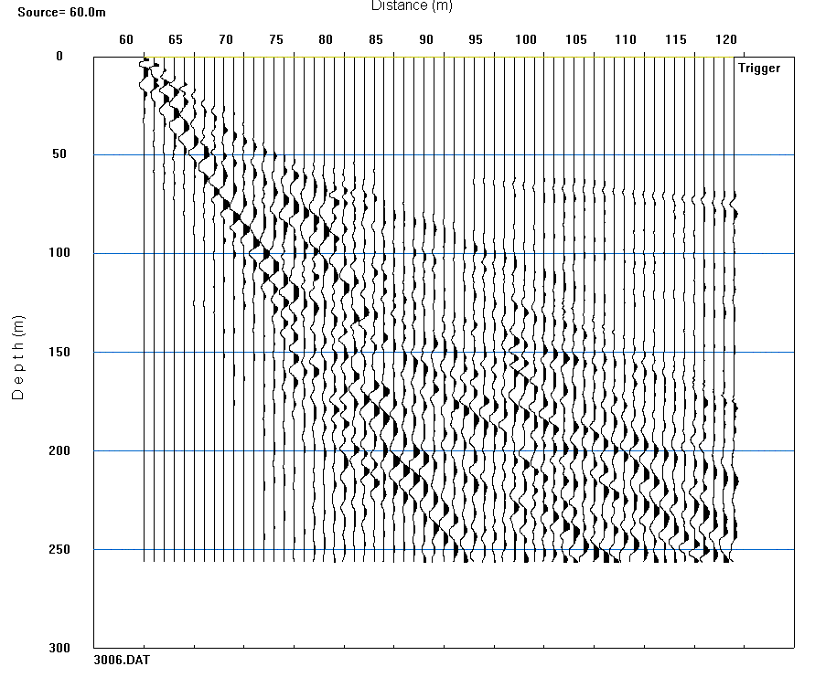
Raw Data

Slide 48
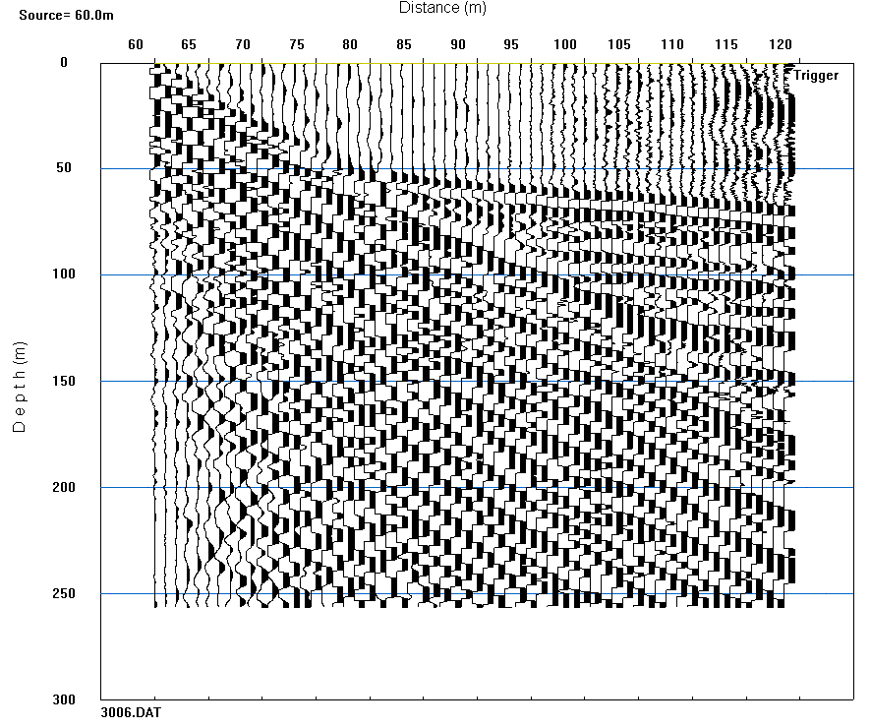
“Processed” Data

Slide 49
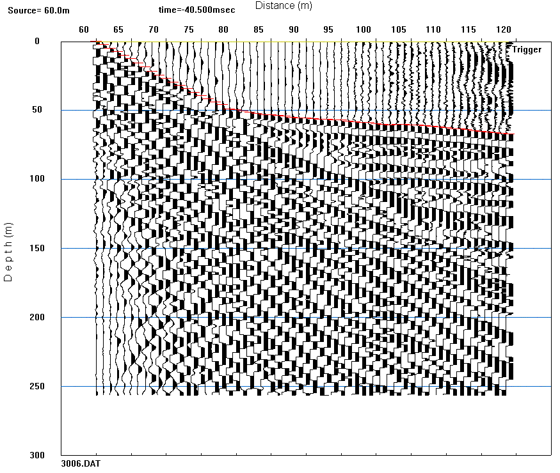
Picking First Arrivals

Slide 50
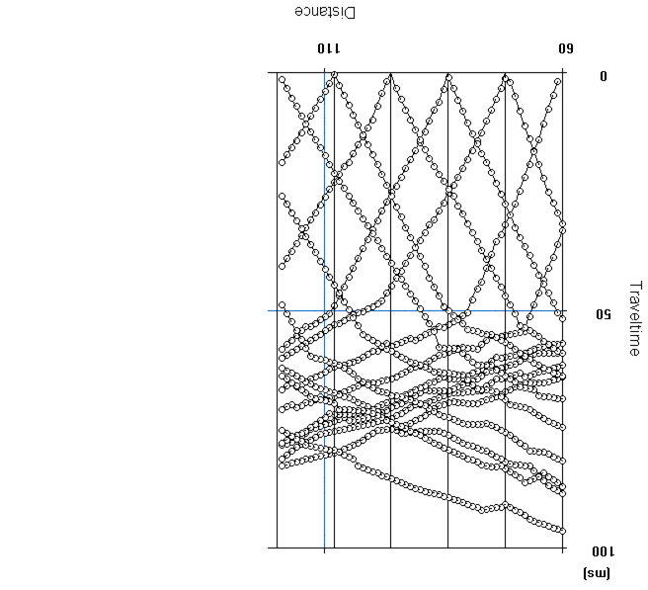
Collate Time Picks

Slide 51
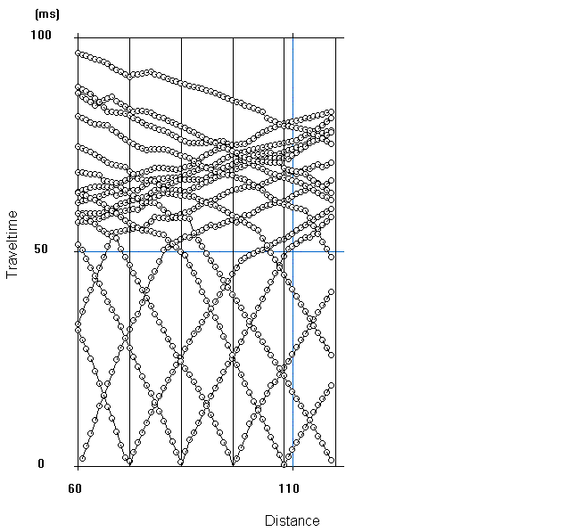
Collate Time Picks

Slide 52
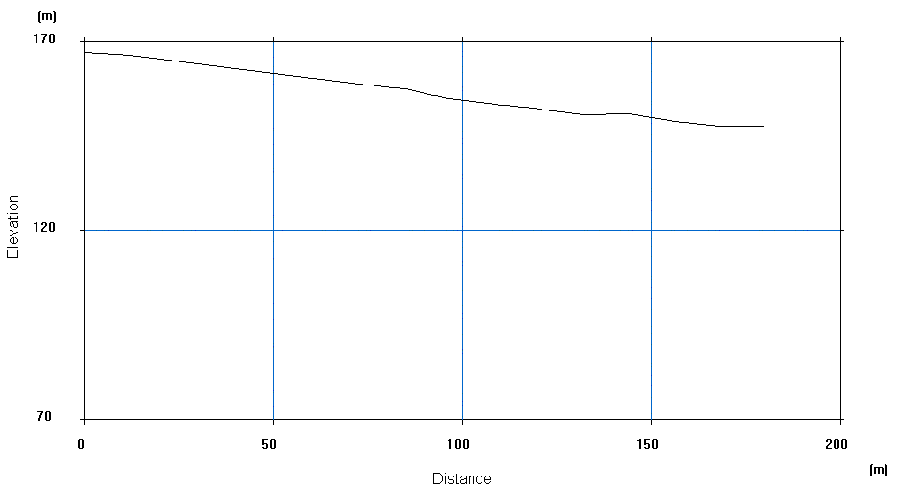
Import Elevation Data

Slide 53
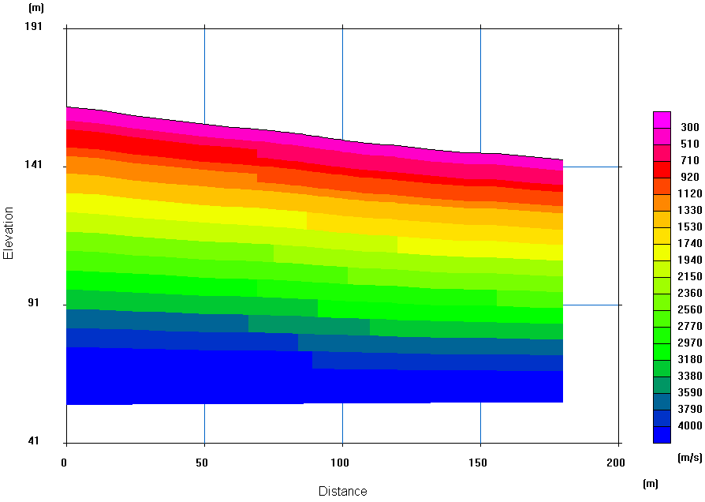
Initial Velocity Model

Slide 54
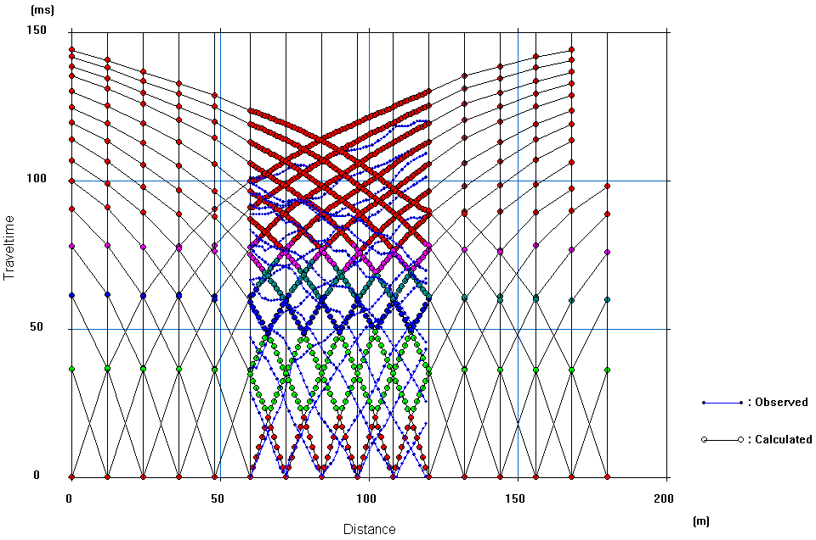
Iteration #1

Slide 55
Iteration #1

Slide 56
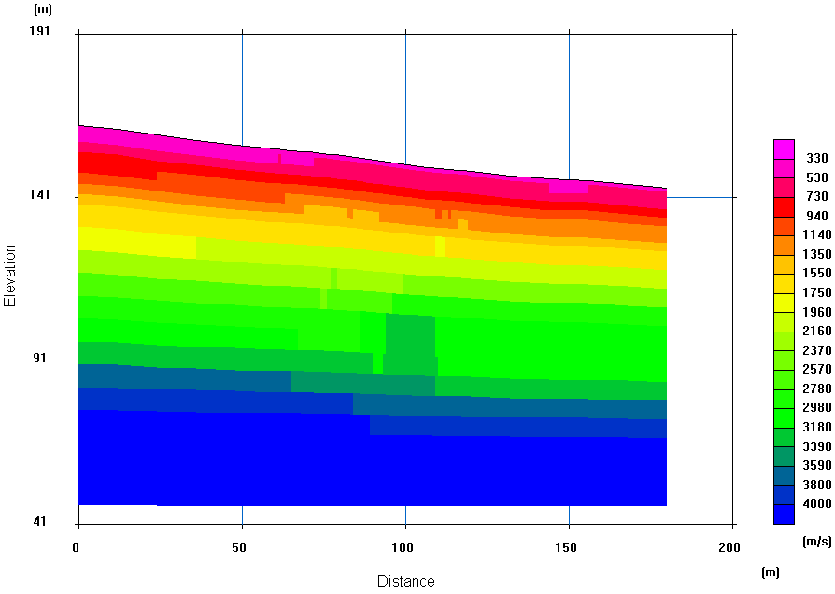
Iteration #2

Slide 57
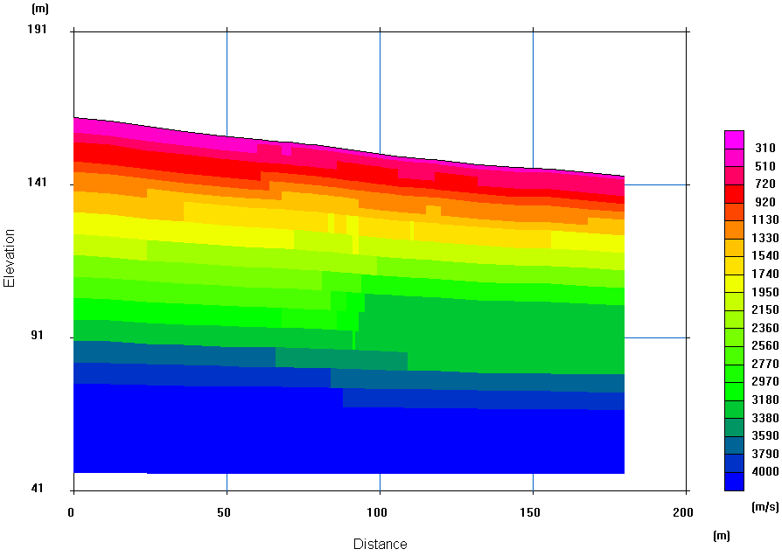
Iteration #3

Slide 58

Iteration #4

Slide 59
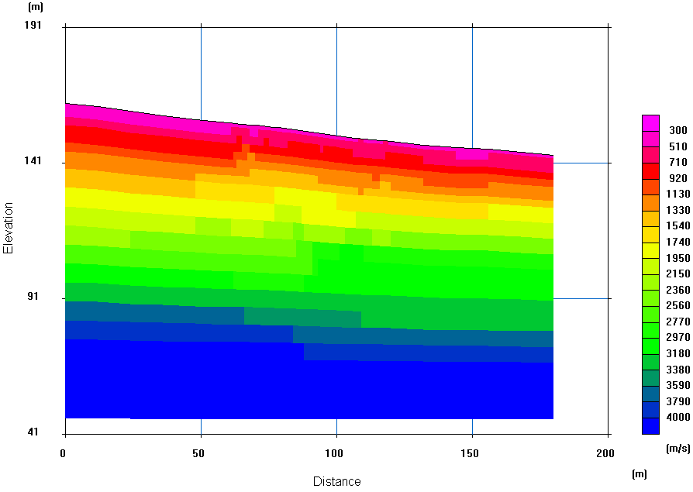
Iteration #5

Slide 60

Iteration #6

Slide 61

Iteration #7

Slide 62
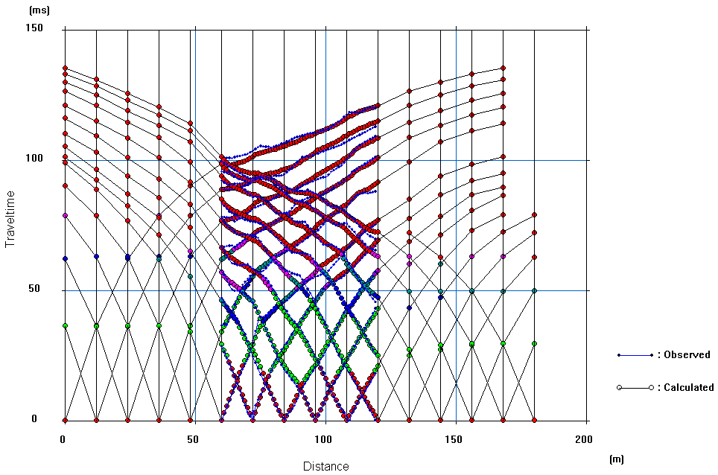
Iteration #7

Slide 63
Iteration #1

Slide 64
Iteration #7 – “Raw”

Slide 65
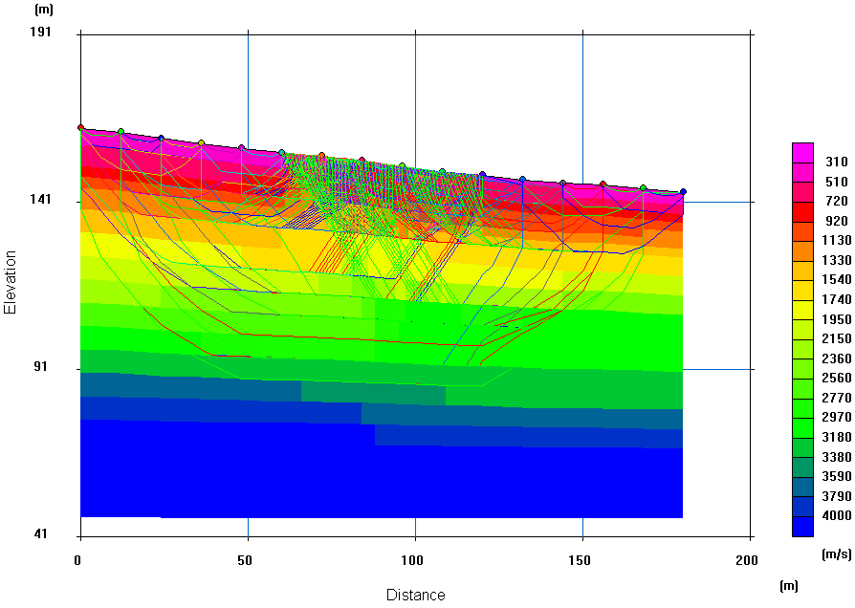
Iteration #7 – With Ray Tracing

Slide 66
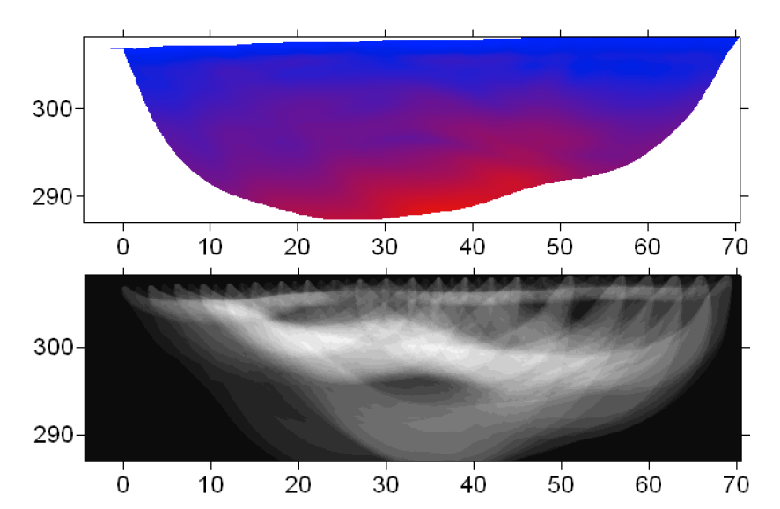
Ray Tracing: One of my pet peeves…

Slide 67
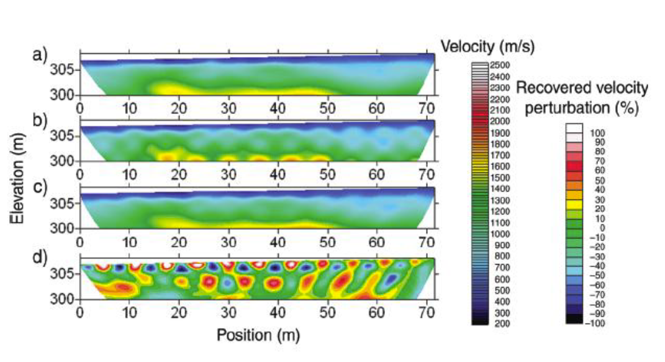
Checkerboarding: A better solution…

Slide 68
Iteration #7 – “Raw”

Slide 69

Iteration #7 – “Smoothed”

Slide 70

Iteration #7 – “Smoothed w/Contours”

Slide 71
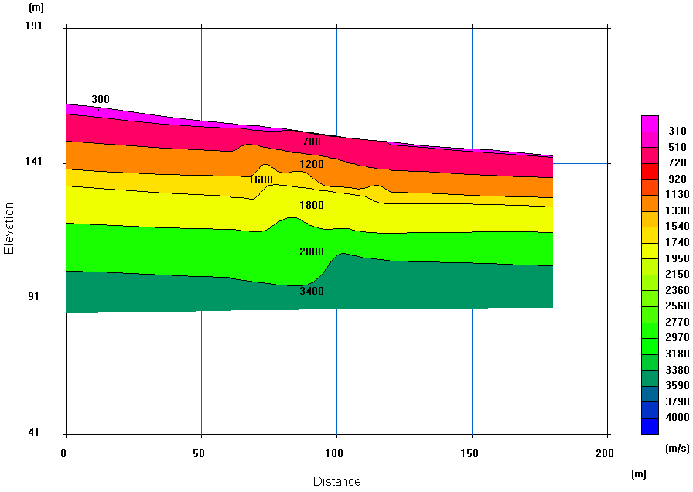
Iteration #7 – “Layer Interpolation”

Slide 72
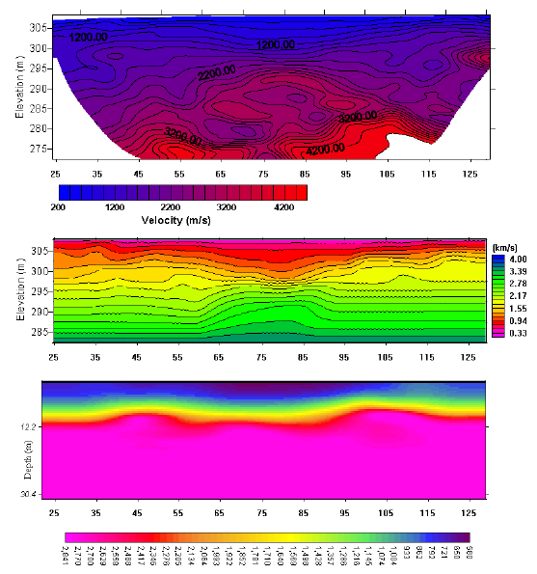
SFT
…Not all codes
are equal!
(From Doll, 2003)

Slide 73
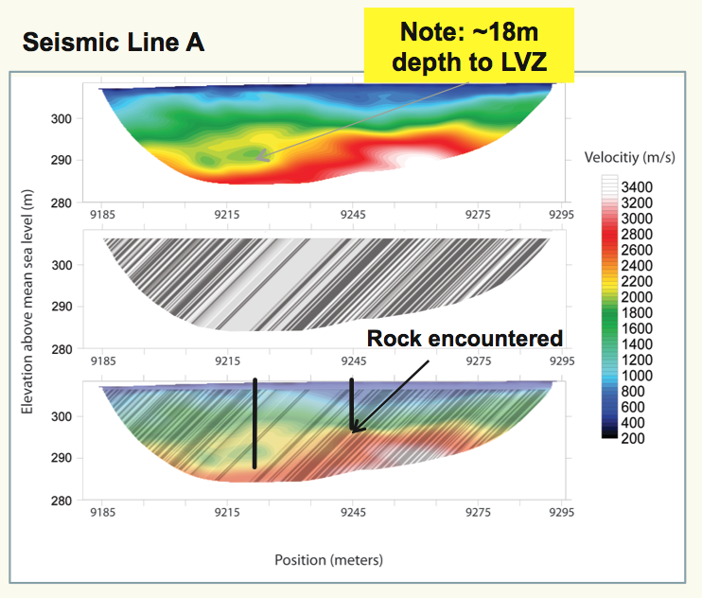
Assignment….INTERPRET THIS!
Sketch an interpretation of the upper 30 m of the subsurface based on this image…
Vertical and horizontal units in meters
LVZ denotes a seismic “low velocity zone”
<1m of soil, over 0-20m of saprolite BGS, over bedrock
The water table is 0.5-3m BGS
Bedrock is dominantly shale with some limestone interbeds
Bedrock may be faulted
Bedrock dips about 45 degrees from right to left, no folding at this scale
Think about boundaries, gradients

Slide 74
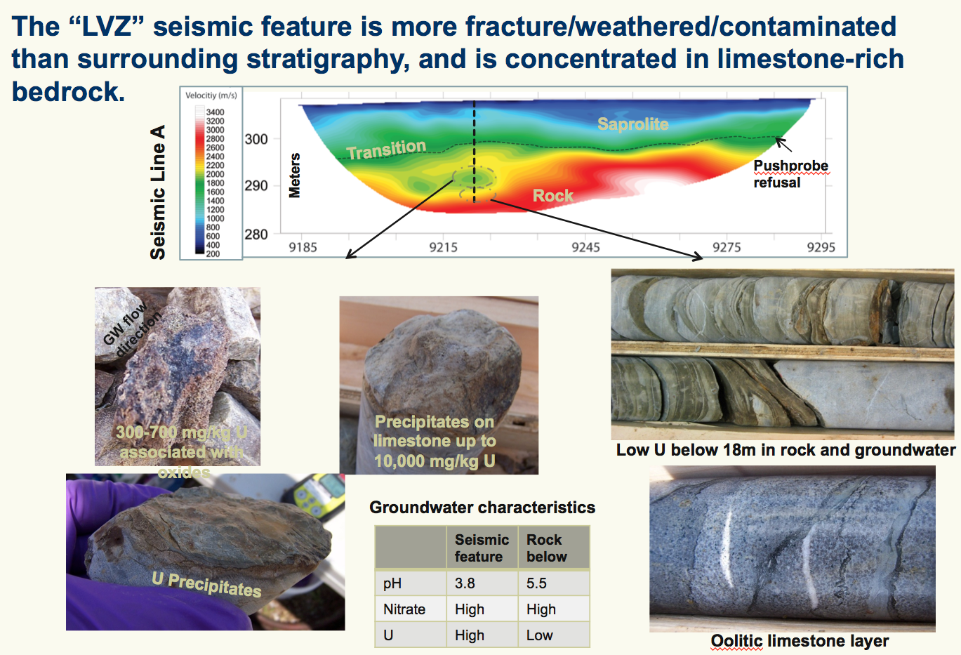
(From Doll, 2003)

Slide 75
(From Doll, 2003)

Slide 76
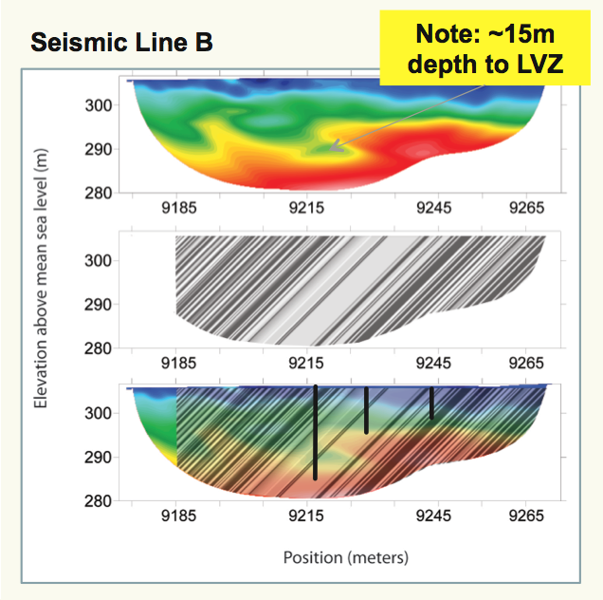
(From Doll, 2003)

Slide 77
Teaching via NSG Pitfalls
Objective of this talk: Present a few specific examples of critical thinking via common pitfalls in near-surface geophysical data analysis
Questions (more?) and continued discussion…

