Slide 1
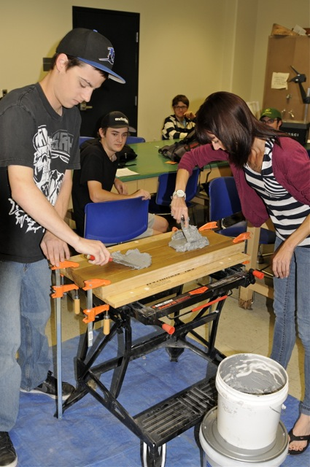
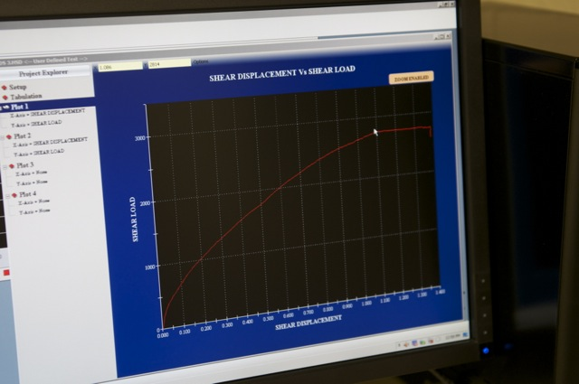
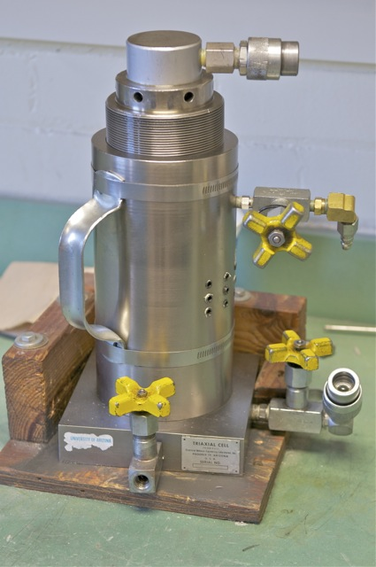
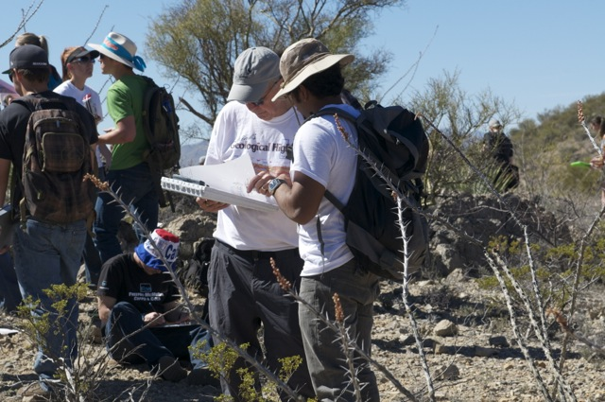
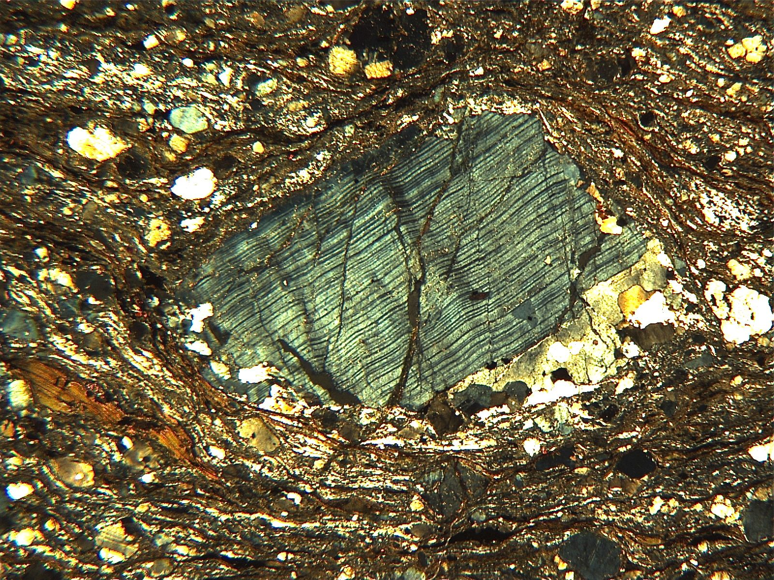
Future of Structural Geology in the next couple of decades

Slide 2
A ‘survey’ with an ‘n’ of 3:
Just a ‘dipping of a toe in the water’
Jan Tullis, Geological Sciences, Brown University
Alan Gibbs, Midland Valley Exploration, Ltd.
Bob Krantz, ConocoPhillips

Slide 3
The Survey Questions
What are your chief concerns about the future of structural geology?
What do you see as the opportunities/demand for structural geology?
What are the gaps in background/training of today’s undergraduate and graduate students?
What are the opportunities/possibilities in teaching structural geology in fresh ways?
What single change in teaching structural geology would make the most difference?

Slide 4
Jan Tullis’ Observations/Views
Concerns: Being perceived too narrowly as a ‘qualitative field descriptive’ science.
Demands: Need for integrative critical thinkers, people who think in 3D and 4D, across huge scales from micro to macro, who can integrate properties and processes, who are great a qualitatively rigorous physical reasoning.

Slide 5
Jan Tullis’ Views, con’t
Gaps: Insuffienct field experience. Little exposure to deformation mechanisms. Weak in ability to reason, and interpret process and history.
Opportunities: Less lecturing. More active learning. Discovery-and learner-centered education. Critical thinking and communication exercises.

Slide 6
Alan Gibb’s Views
Concerns: Not training enough structural geologists to meet society’s needs to ensure resources security and environmental protection.
Demands: Subsurface mapping and characterization essential in reducing commerical and environmental risk. Vital task is building valid subsurface models.

Slide 7
Alan Gibb’s Views, con’t
Gaps: Understanding map and section construction. Ability to draw sections from maps is woefully inadequate.
Opportunities: Re-focus on field-scale mapping and subsurface exploration, and preparing to improve utilization of time in field using 3D visualization, digital mapping, 3D modeling, etc.

Slide 8
Bob Krantz’ Views
Concerns: Not integrating across the full range of scales. Becoming too immersed in quantitative techniques at expense of context.
Demands: Any practitioner who can ‘integrate’ will always have a leadership role in deciphering geology. Companies regard structural geology as strategic skill, and there is a skill gap at present.

Slide 9
Bob Krantz’ Views, con’t
Gaps: Not enough appreciation of how structural geology gets applied beyond academics. Insufficient 3D digital tool experience.
Opportunities: Integrate digital tools with the conceptual learning. Don’t replace the need to learn to ‘do it by hand,’ but don’t stop there!

Slide 10
What single change in teaching would make the most difference?
Emphasize connections to all other fields, and to life. [Tullis]
Have students realize they have a critical role to play in our societies. [Gibbs]
Ensure that each topic/structure gets related to the system within which it functions. [Krantz]

Slide 11
First Rule of Engagement for
Brain-Storming the Future
For each of the 5 questions, we’ll go ‘round robin’, and each person will volunteer 1 idea (big or small), which will be recorded for all to see.
When an idea is presented, anyone can ask for clarification of the idea, but we won’t evaluate.
We’ll keep going round and round until we’re satisfied that the key ideas are on the table.

Slide 12
Second Rule of Engagement for
Brain-Storming the Future
For each of the 5 categories, we’ll quickly survey what we have and combine ideas that ‘go together’.
We’ll put a ‘name’ to each category of ideas, i.e., a shorthand identifier, just for ease of reference.

Slide 13
Third Rule of Engagement for
Brain-Storming the Future
We’ll pass out ballots for each of the question categories, and each of us will list, in order, our top three.
We’ll do a tally for each question category and conclude the top 3 observations/priorities for each.
We’ll find a way to summarize the results for ALL participants, so that everyone knows what was concluded.

Slide 14
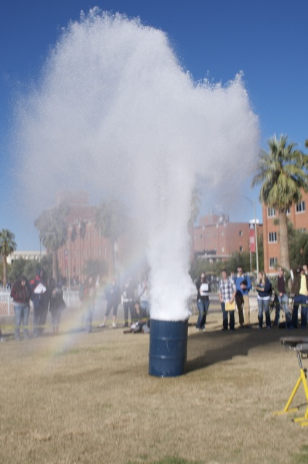
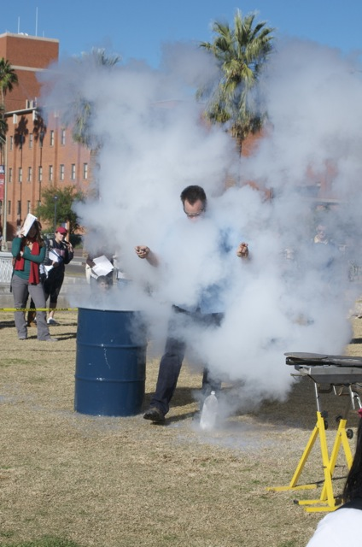
The Future Depends on What We Now Do, but Remember:
NO PRESSURE!!!!!!!!!!!

Slide 15
First Question
What are your chief concerns about the future of structural geology?

Slide 16
Second Question
What do you see as the opportunities/demand for structural geology?

Slide 17
Third Question
What are the gaps in background/training of today’s undergraduate and graduate students?

Slide 18
Fourth Question
What are the opportunities/possibilities in teaching structural geology in fresh ways?

Slide 19
Fifth Question
What single change in teaching structural geology would make the most difference?

